Slide 1
Food for thought…
What did you learn from your timeline?
What is an interesting fact?

Slide 2
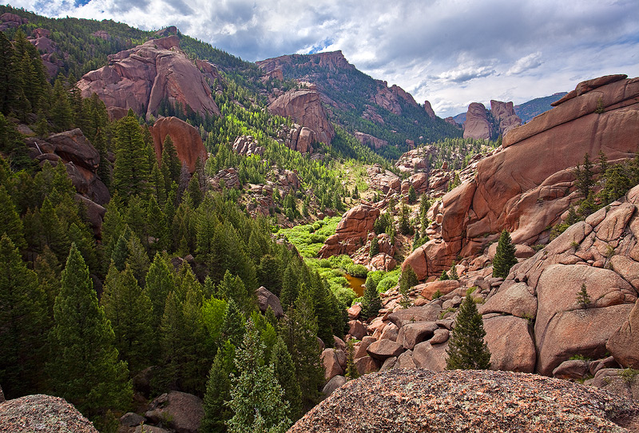
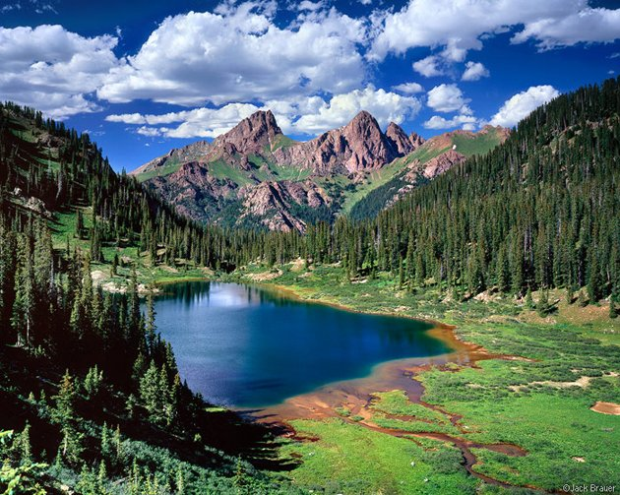
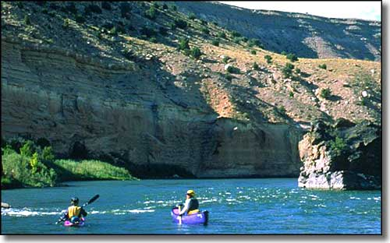
The Wilderness Act 1964
To establish a National Wilderness Preservation System for the permanent good of the whole people, and for other purposes.

Slide 3
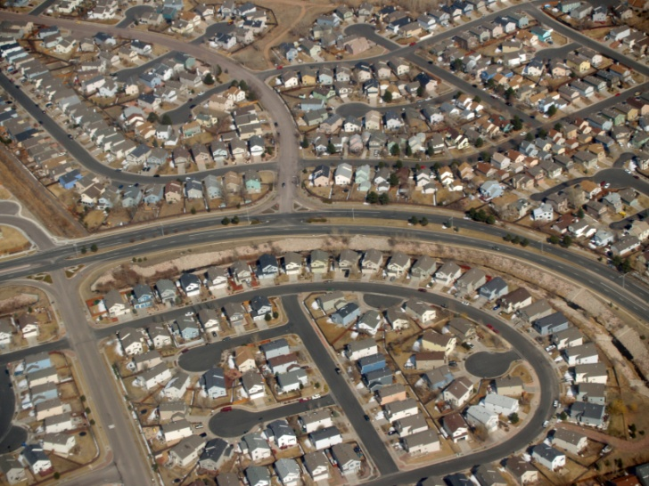
Events leading up to enactment
1964, post-war era
Development, dam construction, and road building is happening at a rate previously unseen
Several different agencies were managing “wild” lands but some people VALUED unfettered lands and wanted to ensure their existence into perpetuity

Slide 4
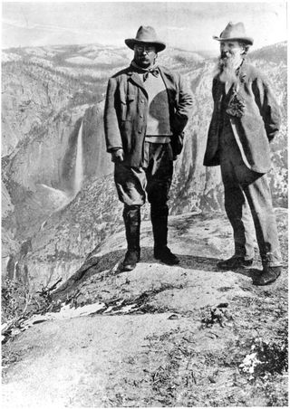
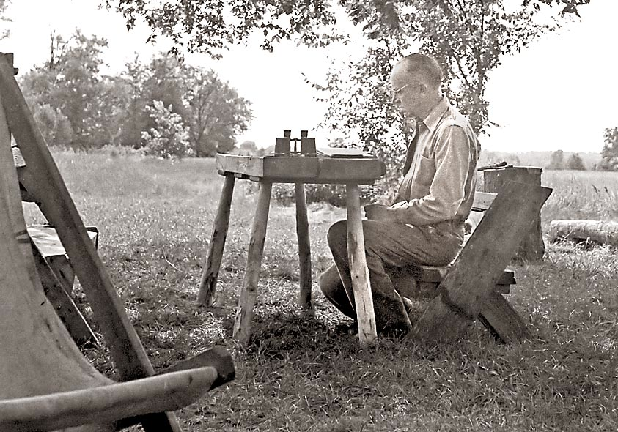
Key Players
Lyndon Johnson
Olas and Mardy Murie
Aldo Leopold
Theodore Roosevelt
John Muir

Slide 5
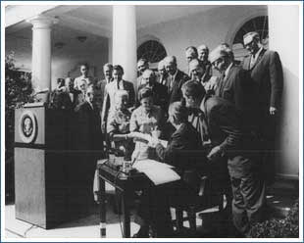
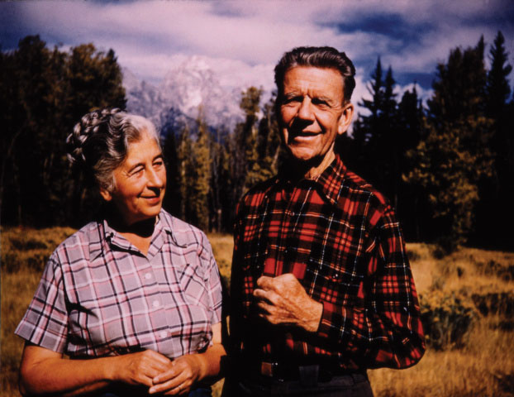
Key Players
Lyndon Johnson
Olas and Mardy Murie
Aldo Leopold
Theodore Roosevelt

Slide 6
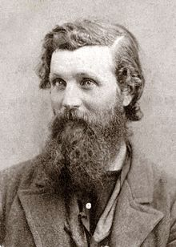
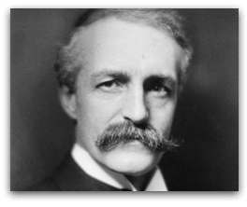
Controversy (then)
At that time the country is going through one of the biggest economic booms EVER.
Economics is defined by access to natural resources.
Why would the wilderness act be controversial?
Conservation vs. Preservation

Slide 7
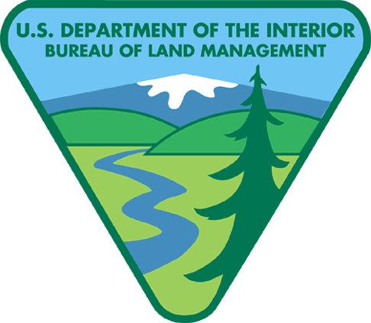
Wilderness is managed by:

Slide 8
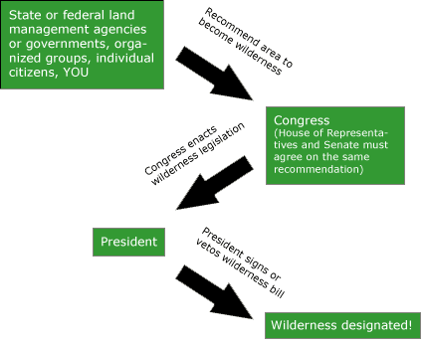
Path of a Wilderness designation

Slide 9
What qualifies as wilderness?
5,000 Acres or more. Roadless island
Is the area appear to be natural and is human presence relatively unnoticeable?
Does the area offer the opportunity for primitive camping, hiking, and skiing?
Does it provide opportunities for solitude?
Does the area contain unique features for non-economic purpose like science research, geological significance, scenic properties, ecological value, or historical value?

Slide 10
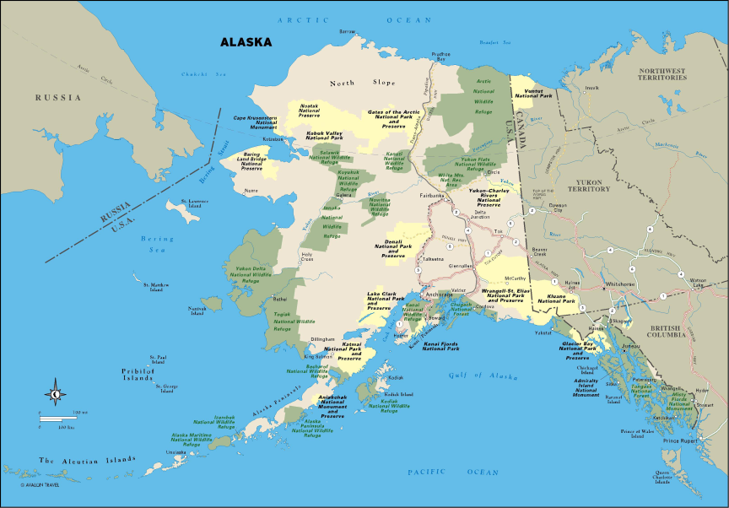
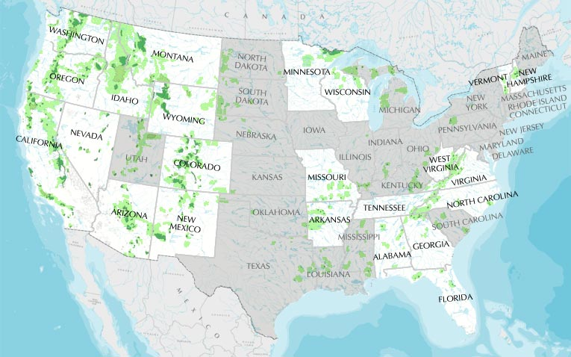
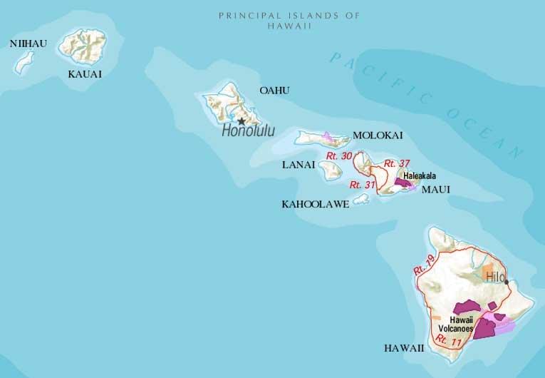
618 Million Acres of land

Slide 11
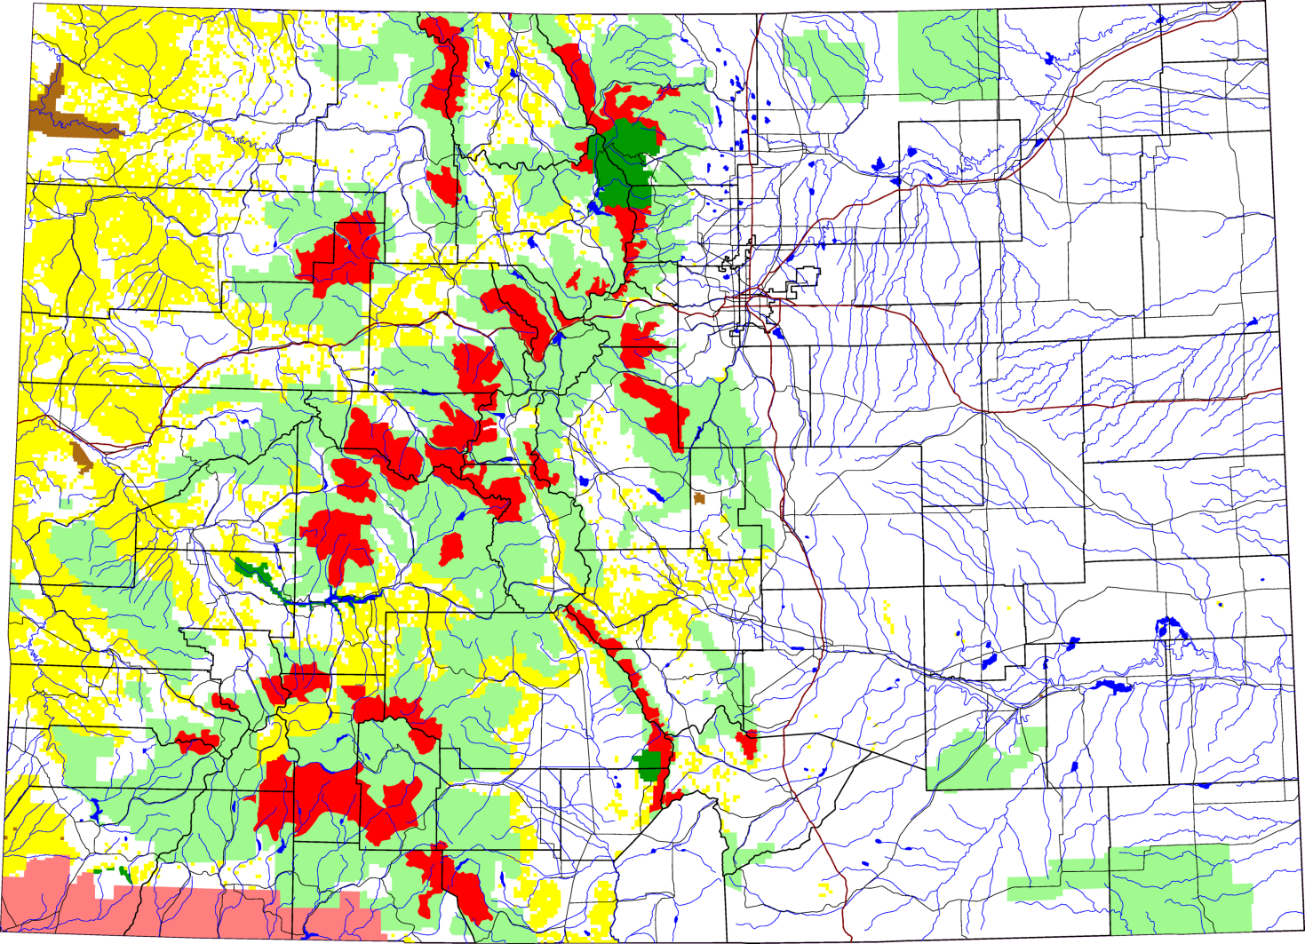
Colorado Wilderness

Slide 12
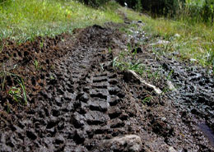
En vivo
Wilderness has conserved many lands for recreational use, scientific study, and continues to be a reservoir for biodiversity
Individuals don’t always obey signage

Slide 13
Controversy (now)
Bill to Release Wilderness Study Areas Creates Controversy
On July 26, the U.S. House of Representatives’ Committee on Natural Resources’ Subcommittee on National Parks, Forests and Public Lands held a hearing on a bill intended to release some U.S. Bureau of Land Management (BLM) and USDA Forest Service wilderness study areas and roadless areas from protection. H.R. 1581—the “Wilderness and Roadless Area Release Act of 2011”—is creating controversy within the conservation community, reports the Wildlife Management Institute.

Slide 14
Questions?

