Slide 1
PTT 09SEP2015
How do the predators of the Serengeti-Mara compete? OR not compete?
What are their preferred prey?
Logistics: OAJ Due Friday
“Celebration of Knowledge” Friday

Slide 2
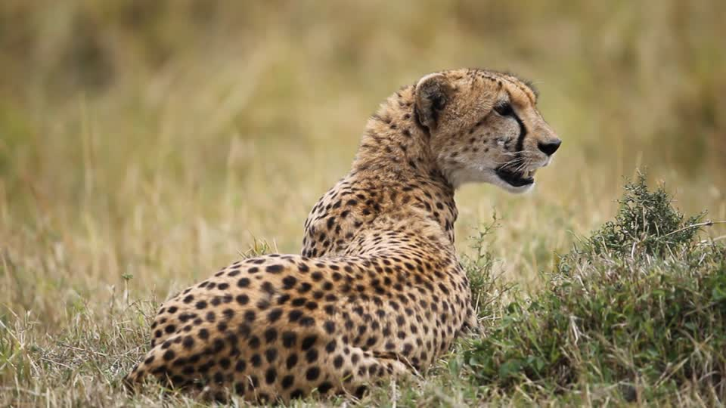
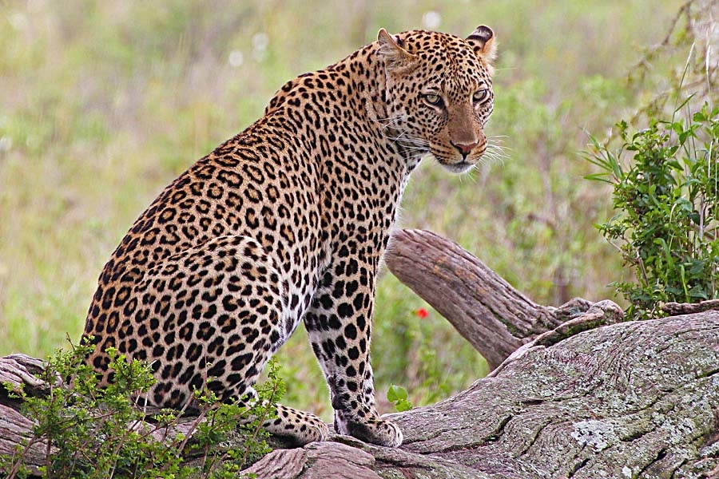
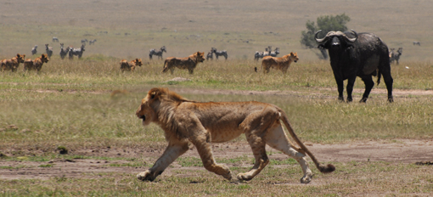

Slide 3
Niche: in Ecology, the position or function of an organism in a community of plant and animals.

Slide 4
Describe the animals niche.
What are the abiotic limitations and abundances?
What are the survival strategies the animal uses?
How does it interact with other species in the arctic?
COMPLETE SENTENCES PLEASE!

Slide 6
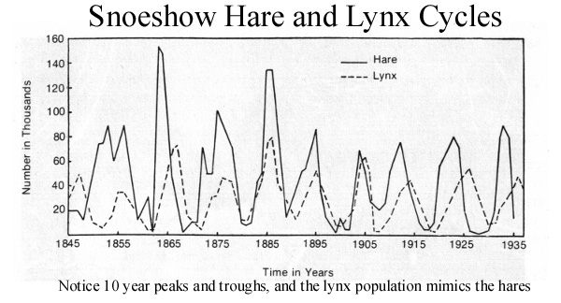
PTT 10SEP2015
What biological interaction is shown below?

Slide 7
