Slide 1
Economics ⬄ Ecology
Economic systems are rooted in AND limited by ecological systems
Biotic + Abiotic = Ecologic System

Slide 2
Economic System in a picture… (Capitalism)
Goods and
Services
Social Values
(laws)
Natural Resources

Slide 3
Economic System
social institution through which goods are produced, distributed and consumed to satisfy people’s needs and wants, EFFICIENTLY

Slide 4
Economic System in a picture…
Goods and
Services
Social Values
(laws)
Natural Resources

Slide 5
Types of capital
Natural capital: earth’s natural processes
Human capital: people’s physical and mental talents
Manufactured: machinery, equipment, factories

Slide 6
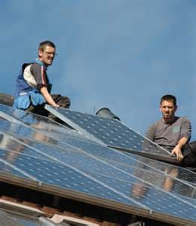
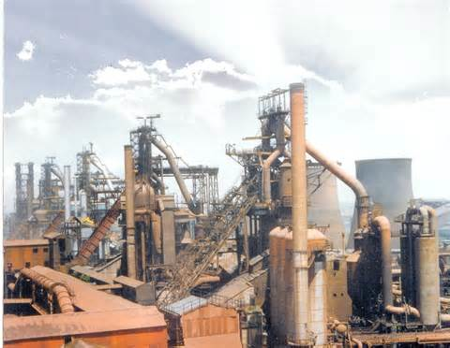
Think natural + human capital + manufactured capital = tradable goods and services

Slide 7
Think natural + human capital + manufactured = tradable goods and services

Slide 8
Economic system in a picture…
Social Values
(laws, trade systems, regulations)
Goods and
Services
Natural Resources

Slide 9
“Free Market” economy
interaction of DEMAND and SUPPLY and PRICE
economists believe that an economic system based on private ownership without government interference is the best way to solve problems
In this system companies that produce goods and services are driven by consumer choice.

Slide 10
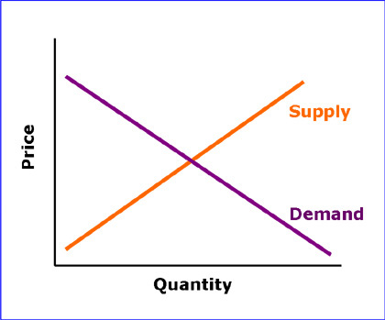
Supply and demand curves intersect at market price equilibrium point

Slide 12
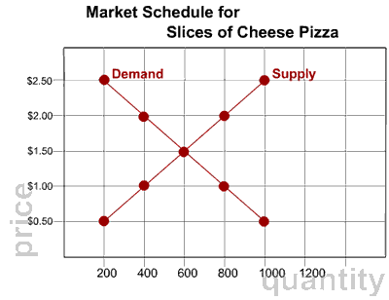

Slide 13
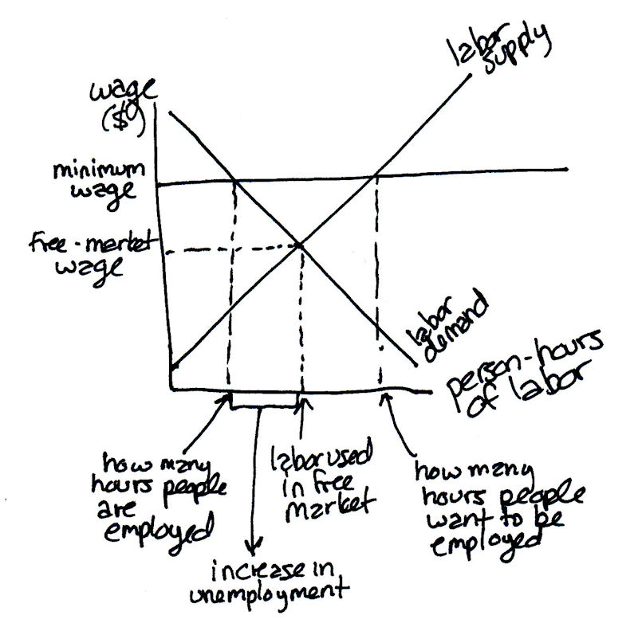

Slide 15
Warm-Up 10AUG2015
What is the difference between tropospheric ozone and stratospheric ozone?
Which can we scientifically measure?
(Don’t worry if you are un sure)
Turn in Lorax packet and Value Statement (if you haven’t emailed it to me already) to the basket

Slide 16
Logistics
Finish Economics reading by Wednesday 8/12
AP Summer Assignment Wednesday 8/19
Ozone lab from today will last all year long
We will do a “full value” lab report at the end of the year
We will collect Ozone data every month

Slide 18
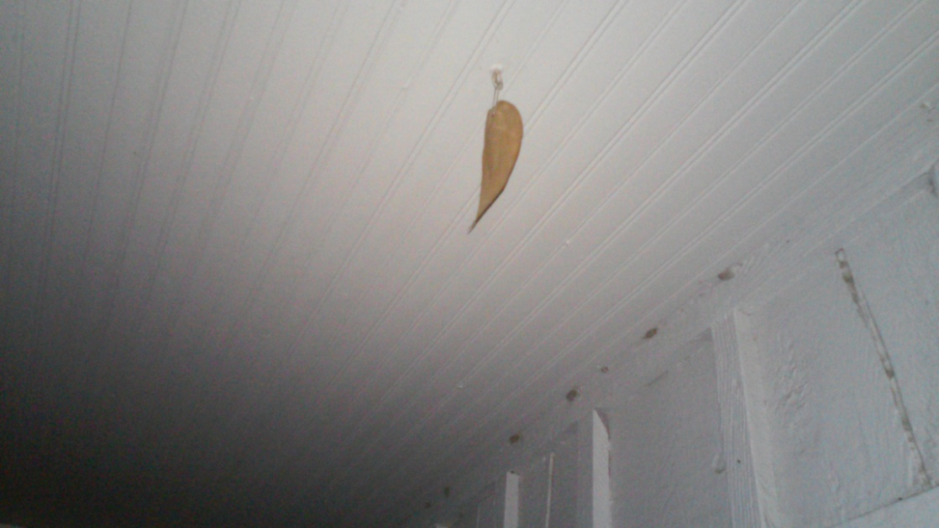
Warm-Up 11AUG2015
Define: natural capital, human capital, and manufactured capital.

Slide 19
Natural Capital + Human Capital + Manufactured capital = Goods and Services (tradable in a market)

Slide 20
Economic System in a picture… (Capitalism)
Goods and
Services
Social Values
(laws)
Natural Resources

Slide 21
Economic system in a picture…
Social Values
(laws, trade systems, regulations)
Goods and
Services
Natural Resources

Slide 22
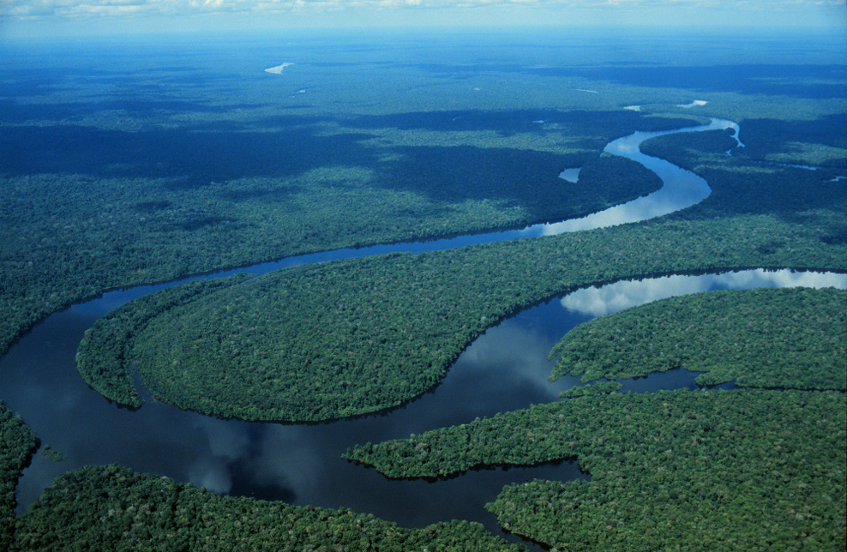
How many ways can this have “value”?

Slide 23
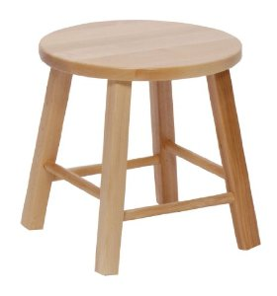
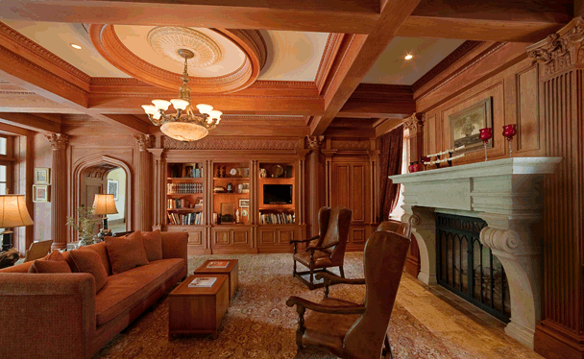
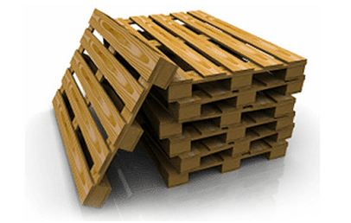

Slide 24
High throughput economics
Continued increase of flow of materials and resources is needed to continue economic growth
Waste ends up in planetary sinks (air, soil, water, organisms)

Slide 26
The worth of anything (natural, human, and manufactured goods) is based solely on its ability to be traded on a market.
Open-access resources, like air, the ocean, forests, freshwater, are available to all are not traded on the market.
These have NO value in any state of existence (good or bad) therefore there is no incentive besides government regulation to promote good behavior = MARKET FAILURE

Slide 27
Measuring Markets
GDP? Gross Domestic Product
Stock Markets?
GDP video

Slide 28
Governments intervene to correct market failures…………
national security
education
economic safety net
civil and property rights
worker health
protect natural capital
manage public land resources

Slide 29
Neoclassical Economics
Marshall and Friedman (Chicago school of Economics)
Assume that growth is unlimited and that growth is essential to maintain a growing economy
Natural capital can be replaced with substitutes
Issues with these assumptions?

Slide 31
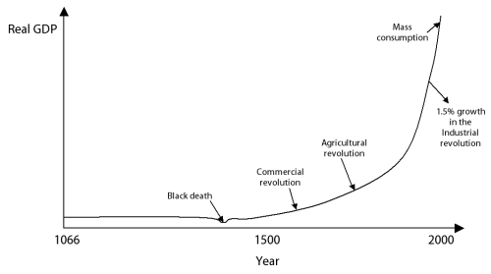
“Biggering, biggering, and biggering” (economic growth is unlimited)

Slide 32
NPR Story!

Slide 33
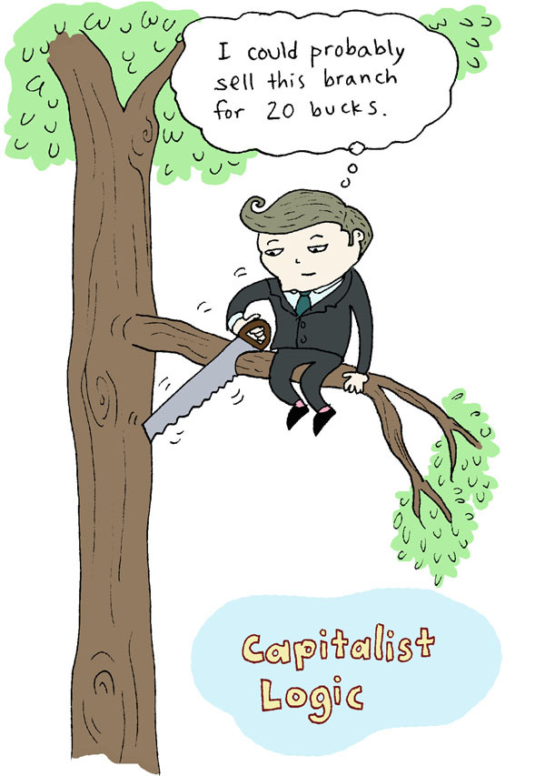

Slide 34
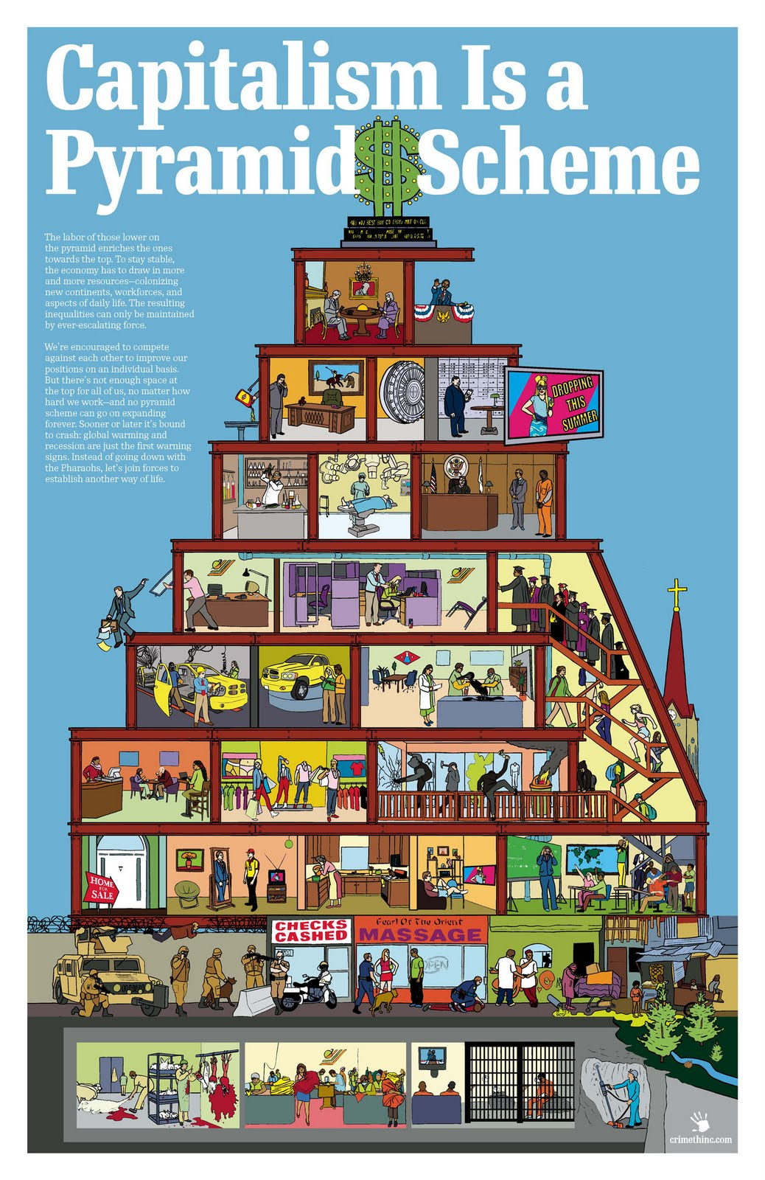
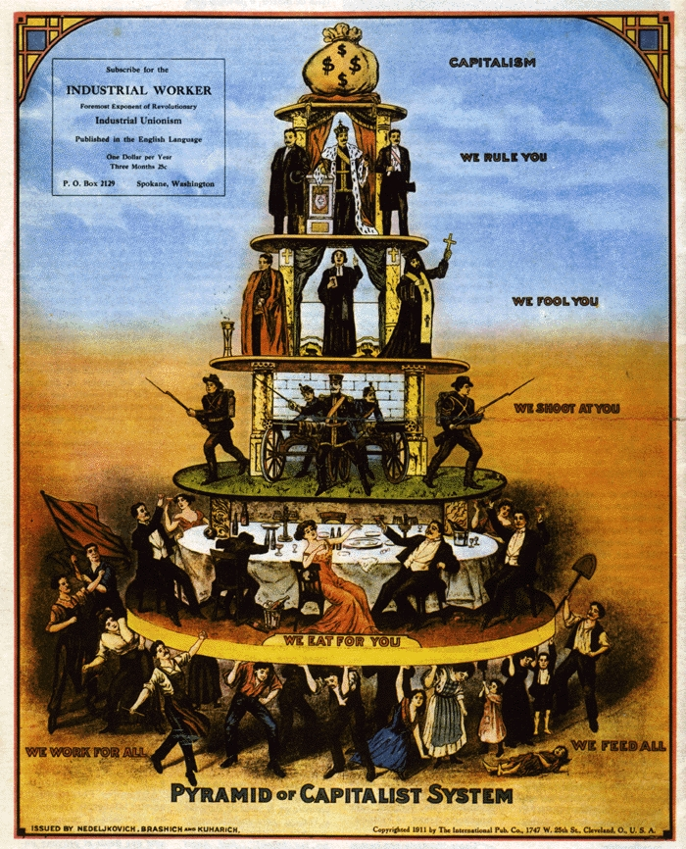

Slide 36
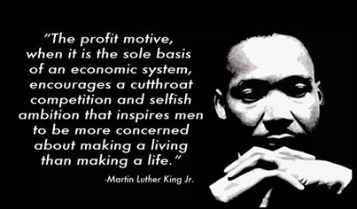
What does Dr. MLK Jr. mean?

Slide 38
Warm-Up 12AUG2015
What is GDP? How is it a good measurement? How is it a complete measurement?
Propose an alternative way to measure?

Slide 39
Ecological economists
Herman Daly and Robert Costanza
resources limited, no waste
encourage environmentally beneficial and sustainable forms of economic development
harmful environmental and health effects of production of goods should be included in price (full cost pricing
Issues with these assumptions?

Slide 40
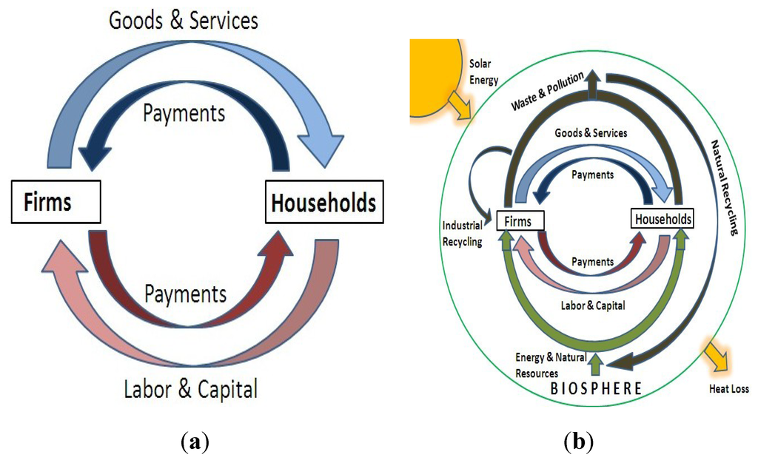

Slide 41
Non – use value of natural resources/ ecological services
Existence value
Aesthetic value
Bequest or opinion value

Slide 44
Strategies to fulfill goals…
Monitor economic and environmental health /enforce laws

Slide 45
Cost Benefit analysis
use uniform standards
clearly state all assumptions used
include estimates of ecological services
estimate long-term/short benefits and costs
summarize range of estimated costs and benefits

Slide 46
Strategies to fulfill goals…
Eco-labeling and certification
Phase in subsidies/tax breaks for environmentally beneficial goals
Tax shifting (pollution and waste
Instead of income taxes)

Slide 47
Full-Cost Pricing
Market Price/ Direct Price does not include the Indirect or External costs of harm to environment or human health (hidden cost)
Ex. failure to include climate change in the prices of fossil fuels

Slide 48
Reduction of poverty
GRAMEEN banks in Bangla Desh

