Slide 1
Warm-Up 24SEP2014
What are the three things that will contribute to the unequal heating of the Earth surface?
Logistics:
Finish reading chapter 4
Atmosphere activity is due today with Warm-Ups
Biome Presentations are next week Tues-Thursday (one Friday)

Slide 2
What are the three things that will contribute to the unequal heating of the Earth surface.
The angle of the sun’s rays as they strike the earth
The amount of surface area which the sun’s rays are distributed
The albedo effect (the amount of energy absorbed or reflected from the sun’s rays)

Slide 3
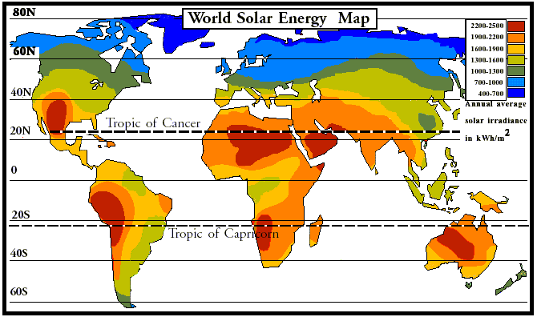

Slide 4
Climate Factors
TEMPERATURE
Latitude (distance from the equator)
Altitude (elevation above sea level)
Distance from the ocean
PRECIPITATION
Prevailing Winds (most common wind direction)
Topography (proximity to the mountains: windward or leeward side of the mountains)

Slide 5
How the convection currents move is caused by
properties of air
AND the Coriolis Effect

Slide 6
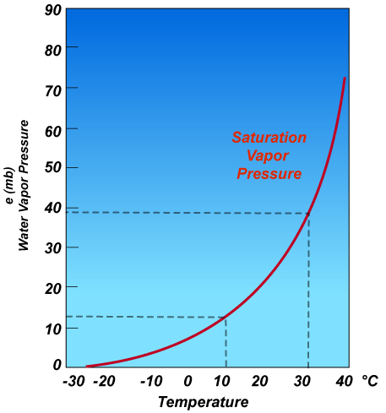
Atmospheric Convection Currents
Air has 4 properties that determines its movement here are 2:
Density- less dense air rises, denser air sinks.
Water vapor capacity- warm air has a higher capacity for water vapor than cold air.

Slide 7
Atmospheric Convection Currents
Air has 4 properties that determines its movement here are 2:
Adiabatic heating or cooling- as air rises in the atmosphere its pressure decreases and the air expands. Conversely, as air sinks, the pressure increases and the air decreases in volume.
Latent heat release- when water vapor in the atmosphere condenses into liquid water and energy is released.

Slide 8
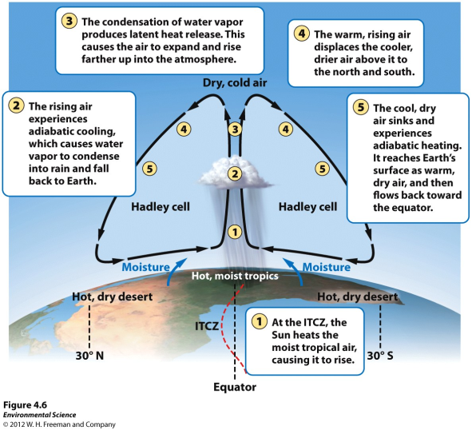
Formation of Convection Currents

Slide 9
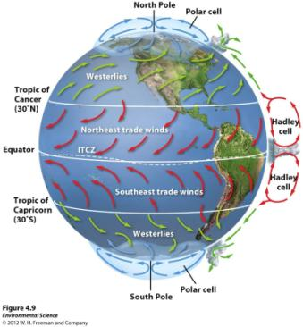
Formation of Convection Currents
Atmospheric convection currents are global patterns of air movement that are initiated by the unequal heating of Earth.
WIND DIRECTION

Slide 10
Formation of Convection Currents
Hadley cells- the convection currents that cycle between the equator and 30˚ north and south.

Slide 11
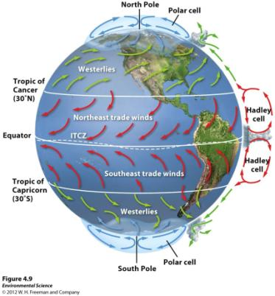
Formation of Convection Currents
Intertropical convergence- the area of Earth that receives the most intense sunlight and where the ascending branches of the two Hadley cells converge.

Slide 12
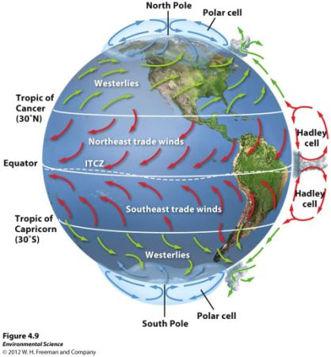
Formation of Convection Currents
Polar cells- the convection currents that are formed by air that rises at 60˚ north and south and sinks at the poles (90˚ north and south)

Slide 13
Earth's Rotation and the Coriolis Effect
As Earth rotates, its surface moves much faster at the equator than in mid-latitude and polar regions.
The faster rotation speeds closer to the equator cause a deflection of objects that are moving directly north or south.

Slide 14
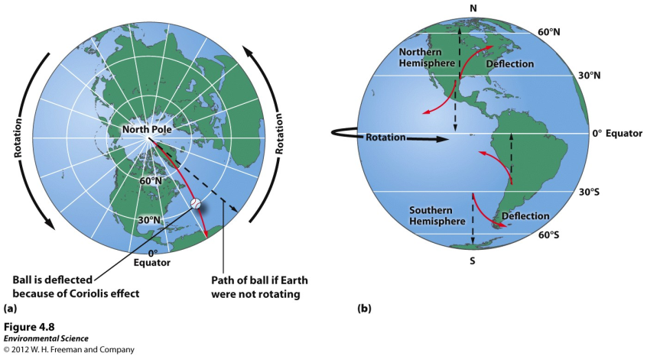

Slide 15
Earth's Rotation and the Coriolis Effect
Coriolis Effect- the deflection of an object's path due to Earth's rotation.
The prevailing winds of the world are produced by a combination of atmospheric convection currents and the Coriolis effect.

Slide 16
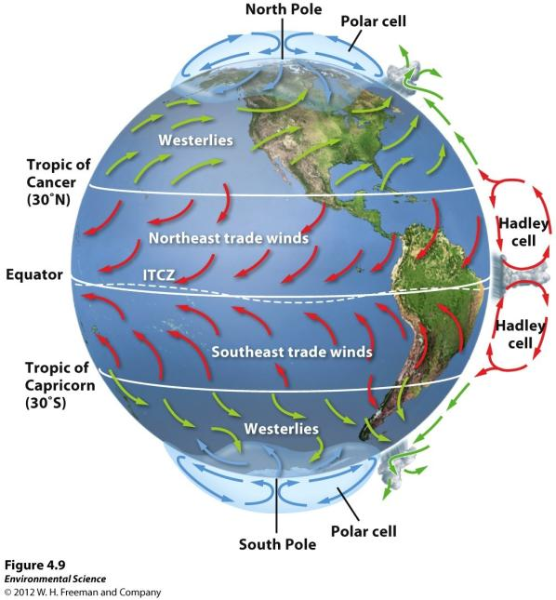

Slide 17
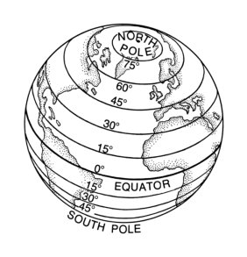
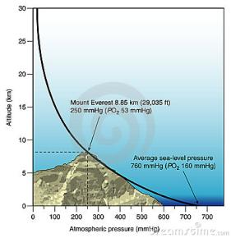
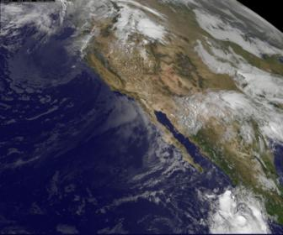
Climate Factors
TEMPERATURE
Latitude (distance from the equator)
Altitude (elevation above sea level)
Distance from the ocean

Slide 18
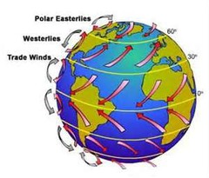
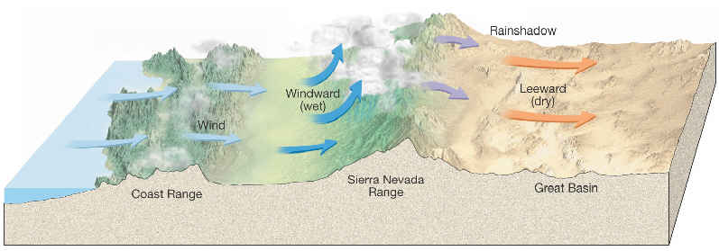
Climate Factors
PRECIPITATION
Prevailing Winds (most common wind direction)
Topography (proximity to the mountains: windward or leeward side of the mountains)

Slide 20
Variations in Climate Determine the Dominant Plant Growth Forms of Terrestrial Biomes
Climate affects the distribution of species around the globe.
Organisms possess distinct growth forms due to adaptations to local temperature and precipitin patterns.
Biomes- The presence of similar plant growth forms in areas possessing similar temperature and precipitation patterns.

Slide 21
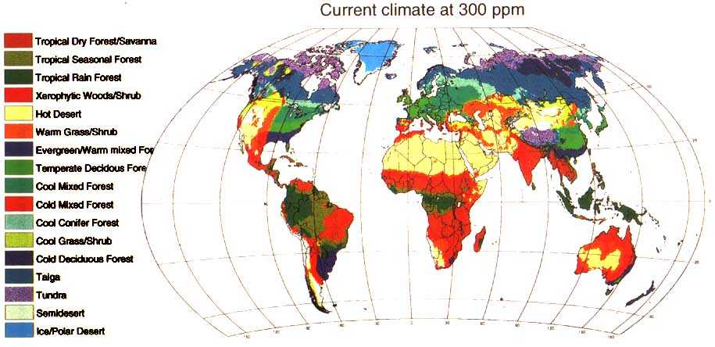

Slide 22
Ocean Currents
Ocean currents are driven by a combination of temperature, gravity, prevailing winds, the Coriolis effect, and the locations of continents.
Warm water, like warm air, expands and rises.

Slide 23
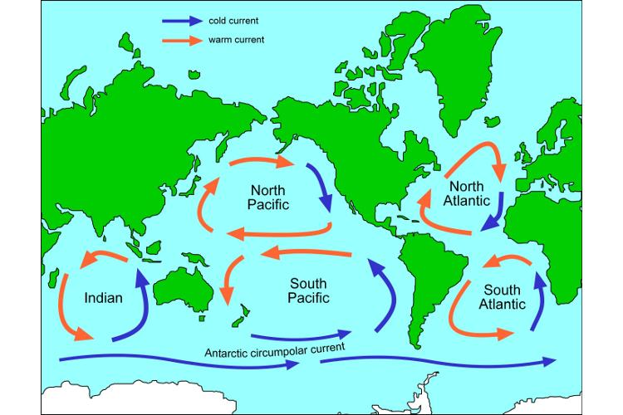
Gyres- the large-scale patterns of water circulation. The ocean surface currents rotate in a clockwise direction in the Northern Hemisphere and a counterclockwise direction in the Southern Hemisphere.

Slide 24
Upwelling
Upwelling- as the surface currents separate from one another, deeper waters rise and replace the water that has moved away.
This upward movement of water brings nutrients from the ocean bottom that supports the large populations of producers, which in turn support large populations of fish.

Slide 25
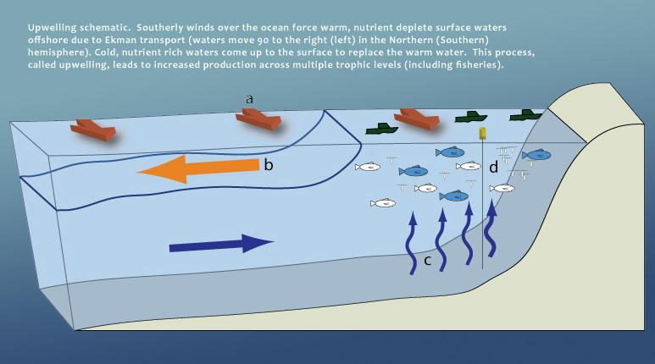
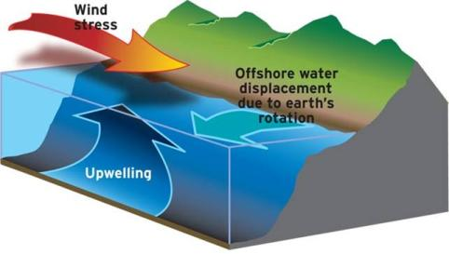

Slide 26
Thermohaline Circulation
Thermohaline circulation- another oceanic circulation that drives the mixing of surface water and deep water.
Scientists believe this process is crucial for moving heat and nutrients around the globe.
Thermohaline circulation appears to be driven by surface waters that contain unusually large amounts of salt.

Slide 27
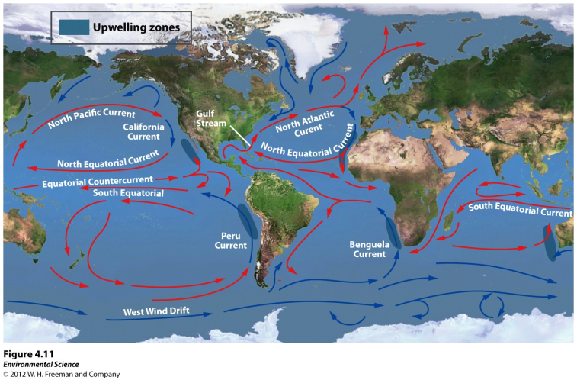
Thermohaline Circulation

Slide 28
Thermohaline Circulation
Some of the water that flows from the Gulf of Mexico to the North Atlantic freezes or evaporates, and the salt that remains behind increases the salt concentration of the water.
This cold, salty water is relatively dense, so it sinks to the bottom of the ocean, mixing with deeper ocean waters.
These two processes create the movement necessary to drive a deep, cold current that slowly moves past Antarctica and northward to the northern Pacific Ocean.

Slide 29
Climate Factors
TEMPERATURE
Latitude (distance from the equator)
Altitude (elevation above sea level)
Distance from the ocean
PRECIPITATION
Prevailing Winds (most common wind direction)
Topography (proximity to the mountains: windward or leeward side of the mountains)

Slide 30
Heat Transport
Ocean currents can affect the temperature of nearby landmasses.
For example, England's average winter temperature is approximately 20 ˚ C (36˚F) warmer than Newfoundland, Canada, which is located at a similar latitude.

Slide 31
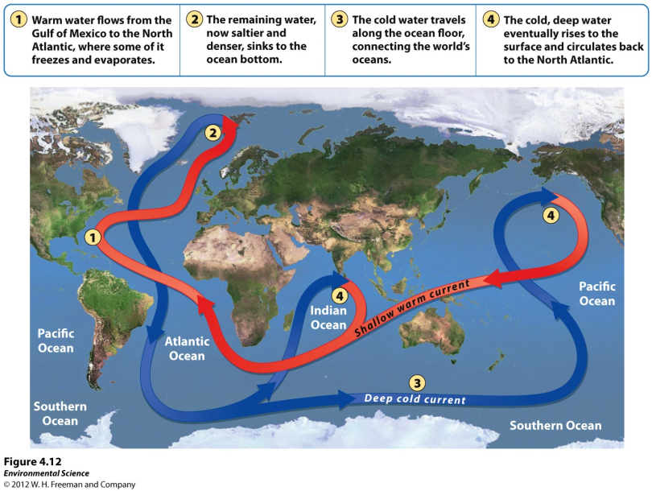

Slide 32
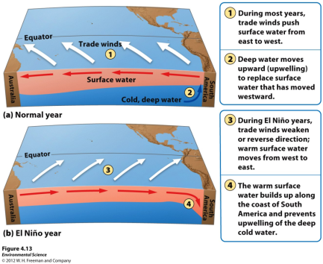
El Nino-Southern Oscillation
Every 3 to 7 years, the interaction of the Earth's atmosphere and ocean cause surface currents in the tropical Pacific Ocean to reverse direction.

Slide 33
El Nino-Southern Oscillation
First, the trade winds near South America weaken.
This weakening allows warm equatorial water from the western Pacific to move eastward toward the west coast of South America.
The movement of warm water and air toward South America suppresses upwelling off the coast of Peru and decreases productivity there, reducing fish populations near the coast.
These periodic changes in wind and ocean currents are collectively called the EL Nino-Southern Oscillation, or ENSO.

Slide 34
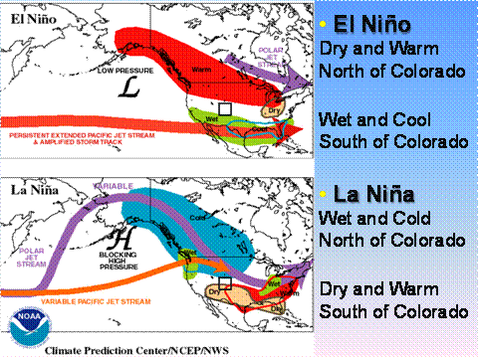

Slide 35
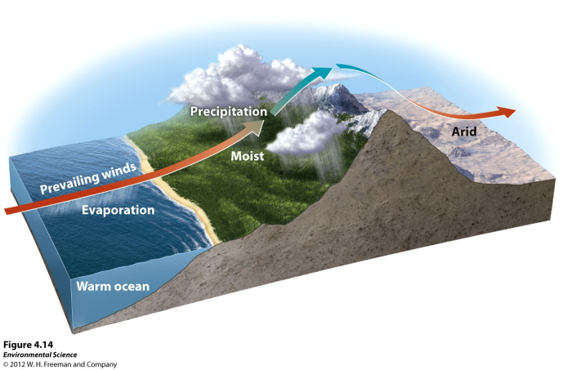
Rain Shadows

Slide 36
When air moving inland from the ocean that contains a large amount of water vapor meets the windward side of a mountain range (the side facing the wind), it rises and begins to experience adiabatic cooling.
Because water vapor condenses as air cools, clouds form and precipitation falls.
The presence of the mountain range causes large amounts of precipitin to fall on its windward side.

Slide 37
Rain Shadows
The cold, dry air then travels to the other side of the mountain range (the leeward side), where it descends and experiences higher pressures, which cause adiabatic heating.
This air is now war and dry and process arid conditions on the leeward side forming the region called a rain shadow.

Slide 38
Variations in Climate Determine the Dominant Plant Growth Forms of Terrestrial Biomes
Climate affects the distribution of species around the globe.
Organisms possess distinct growth forms due to adaptations to local temperature and precipitin patterns.
Biomes- The presence of similar plant growth forms in areas possessing similar temperature and precipitation patterns.

Slide 39
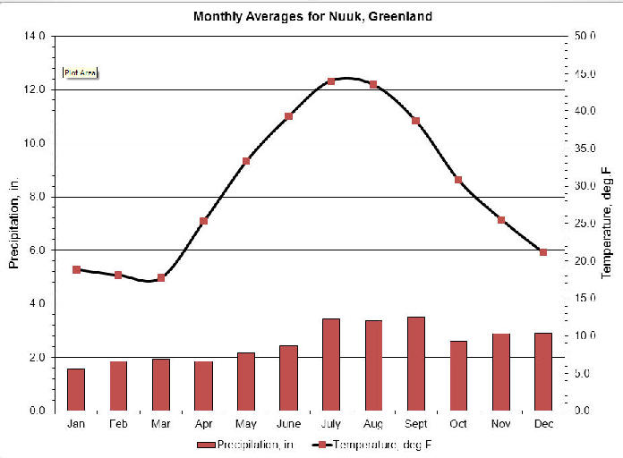
Climatograms

Slide 40
