Slide 1
Warm-up 22SEP2014
How are weather and climate similar and different?
Which is happening outside right now?
Logistics:
Biome Presentations T/W/Th next week.
Atmosphere Map DUE Thursday.
Warm-Ups (for the last 2 weeks) due Thursday.

Slide 2
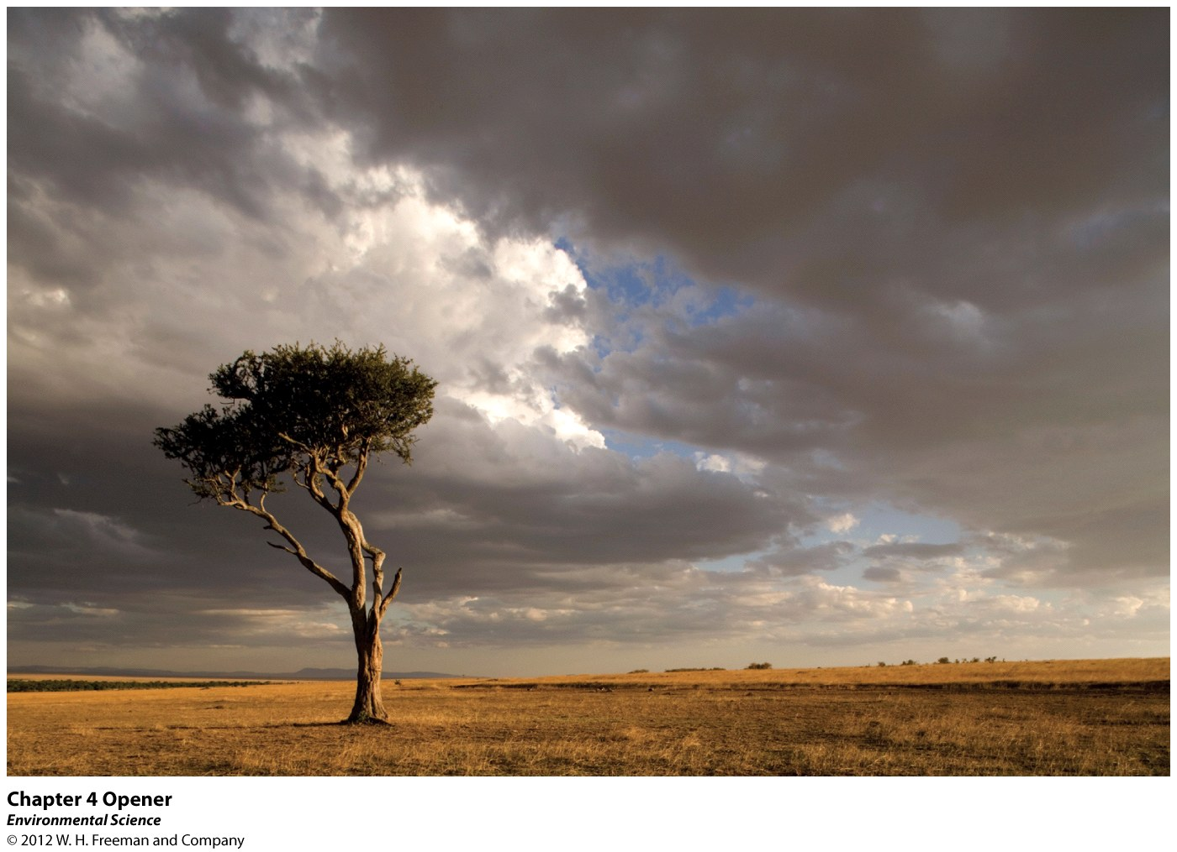
Chapter 4
Global Climates and Biomes

Slide 3
Global Processes determine Weather and Climate
At the end of this Chapter you should be able to answer the following:
What are the forces that drive global circulation patterns?
How do those patterns determine weather and climate?
What are the major terrestrial biomes?
What are the major aquatic biomes?
What is unique about the different biomes?

Slide 4
Global Processes Determine Weather and Climate
Weather- the short term conditions of the atmosphere in a local area. These include temperature, humidity, clouds, precipitation, wind speed and atmospheric pressure.
WEATHER is NOW

Slide 5
Global Processes Determine Weather and Climate
Climate- The average weather that occurs in a given region over a long period- typically several decades.
CLIMATE is over DECADES

Slide 6
Climate Factors
TEMPERATURE
Latitude (distance from the equator)
Altitude (elevation above sea level)
Distance from the ocean
PRECIPITATION
Prevailing Winds (most common wind direction)
Topography (proximity to the mountains: windward or leeward side of the mountains)

Slide 7
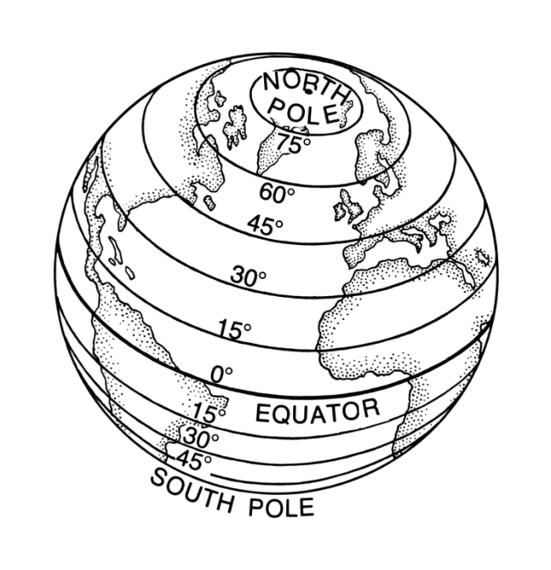
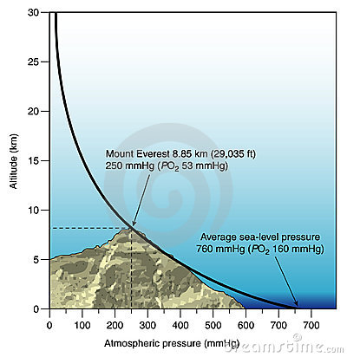
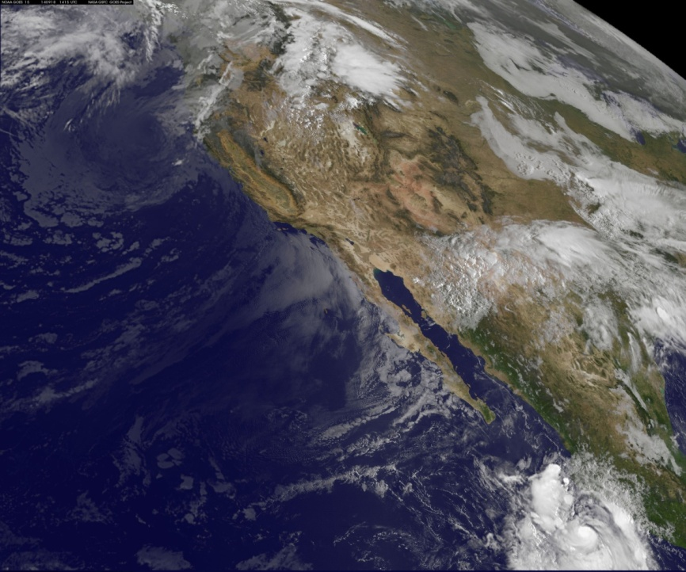
Climate Factors
TEMPERATURE
Latitude (distance from the equator)
Altitude (elevation above sea level)
Distance from the ocean

Slide 8
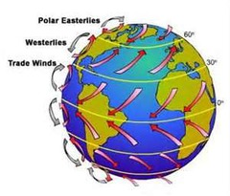
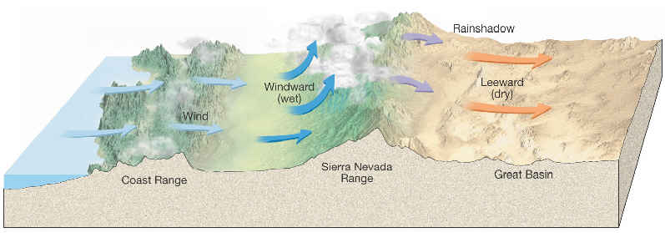
Climate Factors
PRECIPITATION
Prevailing Winds (most common wind direction)
Topography (proximity to the mountains: windward or leeward side of the mountains)

Slide 9
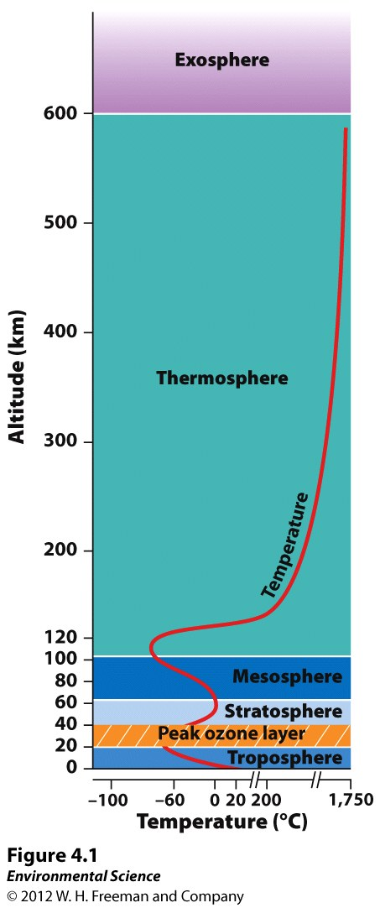
Earth's Atmosphere

Slide 10
Troposphere- the layer closest to Earth's surface extending roughly 16 km (10 miles) above Earth.

Slide 11
Stratosphere- above the troposphere, this extends from roughly 16 to 50 km (10-31 miles).

Slide 12
The thermosphere is important to Earth organisms because it blocks X-ray and UV radiation
Also it is the location that Northern Lights are created

Slide 13
As distance from the surface of the Earth increases, density decreases dramatically.

