Slide 1
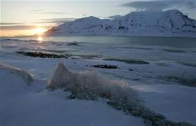
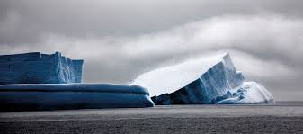
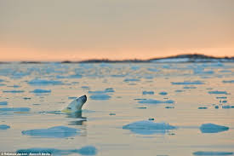
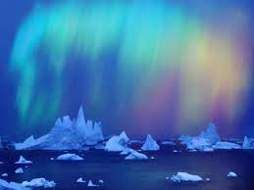
Polar Ice-Caps
By: Presquila and Sena

Slide 2
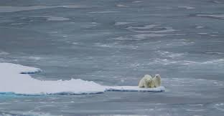
Polar Ice Biome
The Polar ice biome refers to the large amount of ice that surrounds the Polar Ice-caps. The Polar ice biome could be found in the Arctic and Antarctica. The Polar ice biome is the coldest Climate on Earth. The sun could shine on the land for 24 hours and the temperature still would not change. During winter there is no sunshine, therefor the temperature is lower than usual. Since the land is mostly made up of ice no plants can grow besides microscopic algae. Most animals live below the ice (in the ocean) and get their vegetation from the ocean.

Slide 3
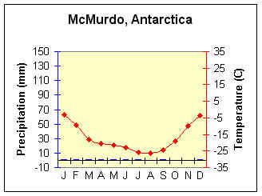
Average Monthly Precipitation and Temperature
The temperature in the Polar Ice-caps is always below 0 degrees celsius. The annual temperature is -17 degrees celsius.The humidity levels are so low that the precipitation is very similar to most deserts. Only 7.8mm precipitation falls on the Polar ice caps.

Slide 4
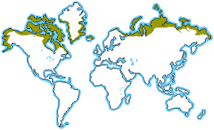
The Polar Ice Caps
The Arctic is located on the North region on 60 degrees latitude. Antarctica is located on the South region on 60 degrees latitude.

Slide 5
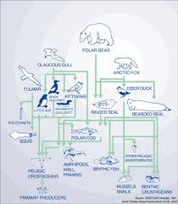
Food web
The common animals found in the Polar ice caps are; polar bears, seals, penguins, fish, whale, and many more. But fish are a big part of the Polar ice caps food web. Most animals depend on it, since there are no plants around. They need the fish to get energy and other nutrients.

Slide 6
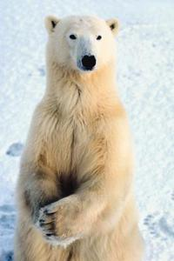
A typical Animal (Polar Bear)
Scientific name: Ursus maritimus
Description: They roam the arctic ice caps and ice sheets searching for their favorite prey known as (seals). They’re large and slightly Webbed meaning (having the toes connected by a membrane), their white thick fur helps them adapt to the cold environment as well as helping them camouflage in the ice by making them the queen of the Arctic.
Survival Strategy: Since polar Bear are fast swimmers they’re able to swim from a melting ice cap to an unmelting ice caps.

Slide 7
A Typical plant
Scientific name: Microscopic Algae
Description: Are simple aquatic plants, which do not have roots, stems or leaves and have primitive methods of reproduction. They are carbon fixing and oxygenating organisms.
Survival Strategy:N/A

Slide 8
Environmental Damage
Global Warming is a big part of the polar ice cap environmental damage, the Average temperatures in the Arctic region are rising twice as fast as they are elsewhere in the world. The Arctic ice is getting thinner and melting which is affecting the wildlife animals and plants to stay alive. This dramatic ice melt is not only affecting the arctic ,but in a way affecting us human as well because it decreases the number of ice animals that get to live.

Slide 9
Solution
In order to keep the polar ice cap from melting, we need to decrease the amount of fossil fuels, oils, coal and gas.

Slide 10
Fun Facts
If all the Ice was to melt in the Polar ice caps then the sea level would rise by 210ft.
Antarctica is the only continent with no native species of ants.
Snow falling on South Pole takes 100,000 years to flow to the coast of Antarctica.
The Dry air in the Polar ice caps is very similar to the climate in Mars.

Slide 11
Sources MLA format
National Geographic, Ice cap. National Geographic Society. September 30, 2015. 1996-2015. http://education.nationalgeographic.com/encyclopedia/ice-cap/
Science Biome World, Polar Ice. Weebly. September 30, 2015. 2015. http://scienceworldbiomes.weebly.com/polar-ice.html
The Physical Environment, Ice Cap Climate. Courtesy NOAA. September 30, 2015. 2003-2012. http://www.earthonlinemedia.com/ebooks/tpe_3e/climate_systems/icecap.html
National Wildlife Federation, Polar Bear. National Wildlife Federation. September 30, 2015. 1996-2015. https://www.nwf.org/Wildlife/Wildlife-Library/Mammals/Polar-Bear.aspx

