Slide 1
Warm-Up 23OCT2015
List 2 interactions we discussed yesterday and give an example of each.
What is a keystone species?

Slide 2
In community ecology we have talked about various organisms influence and interact with each other
There are some organisms that have more of an impact on the ecosystem as a whole than others

Slide 3
Keystone Species:
A species that has a disproportionately large effect on the community
Loss of this species has a large impact on the community as a whole

Slide 4
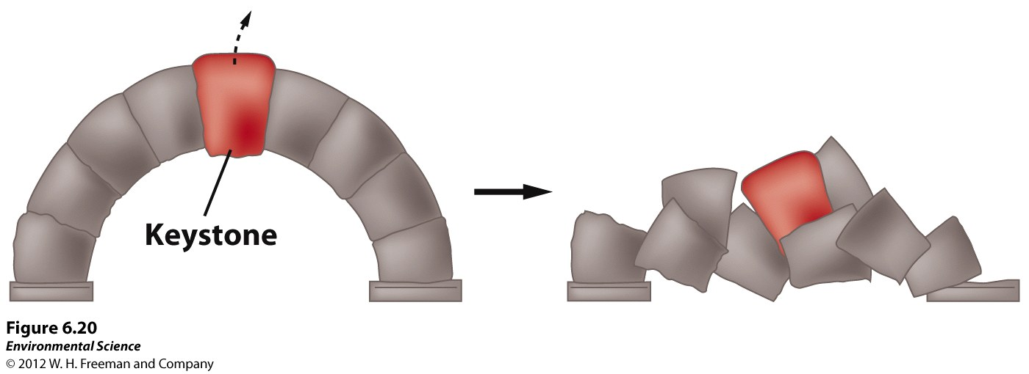
We use the keystone analogy because…

Slide 5
Often these species exist in relatively low numbers
We can also use the knowledge of the keystone species and manage ecosystems to ensure their survival into perpituity

Slide 6
Keystone Species role can be…
Physical Disturbances
Predator-mediated Competition
Ecosystem engineers

Slide 7
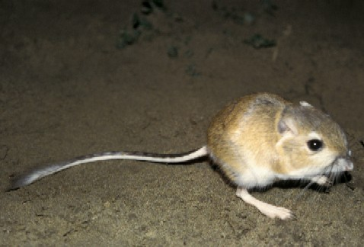
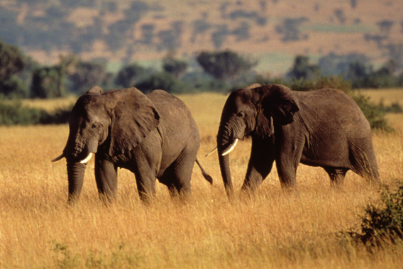
Physical Disturbance
Natural behaviors alter the abiotic part of the landscape and this impacts the biotic community

Slide 8
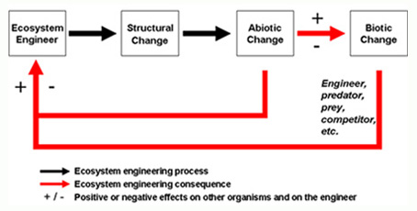
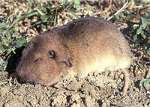
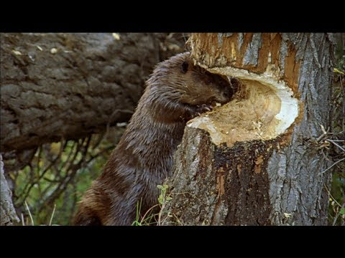
Ecosystem engineers

Slide 9
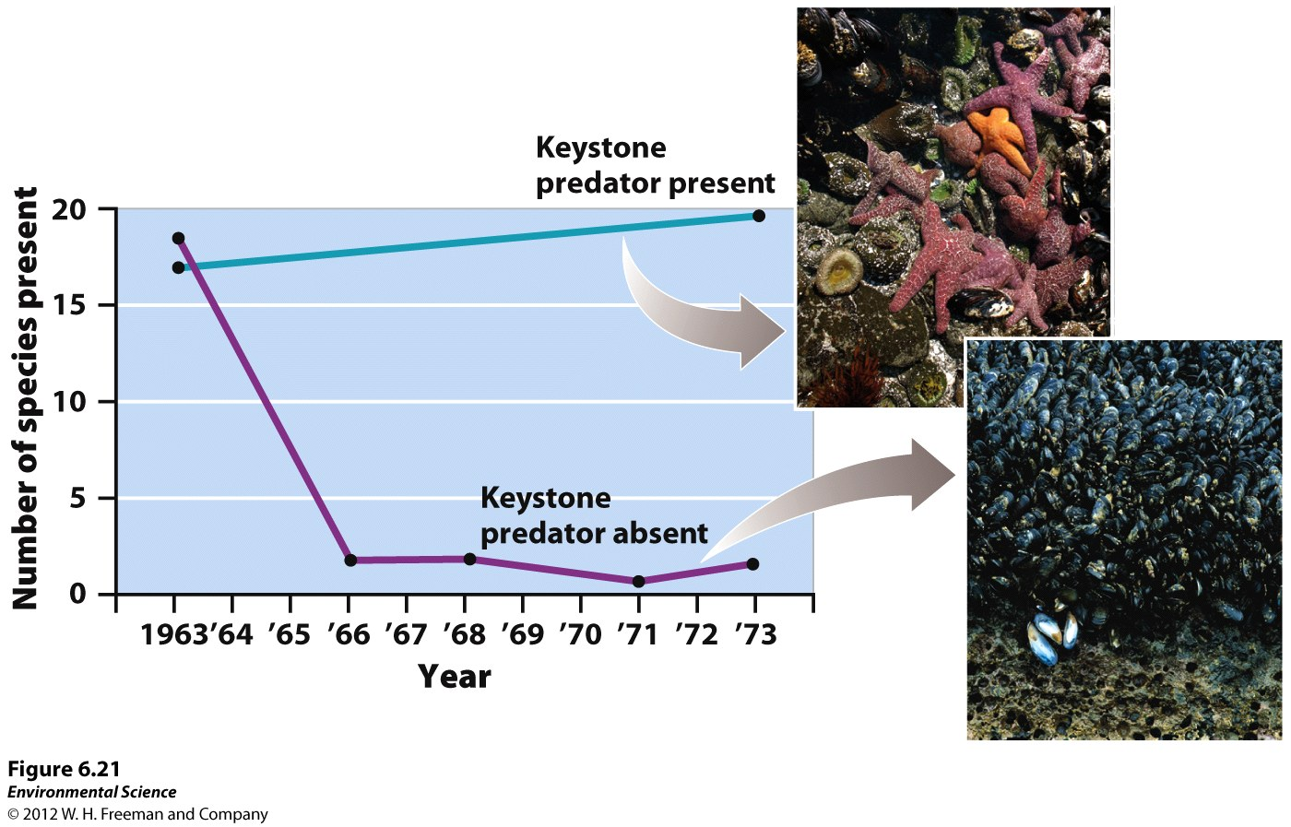
Predator mediated-competition

Slide 10
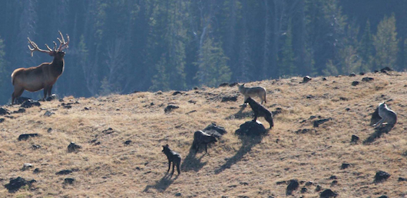
Predator-mediated Competition
Predators are often keystone species in ecosystems

Slide 11
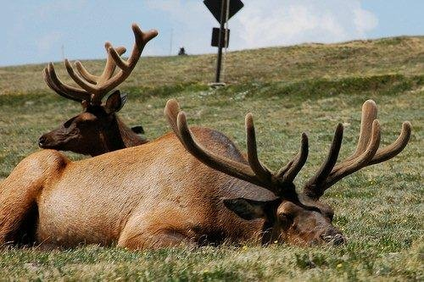
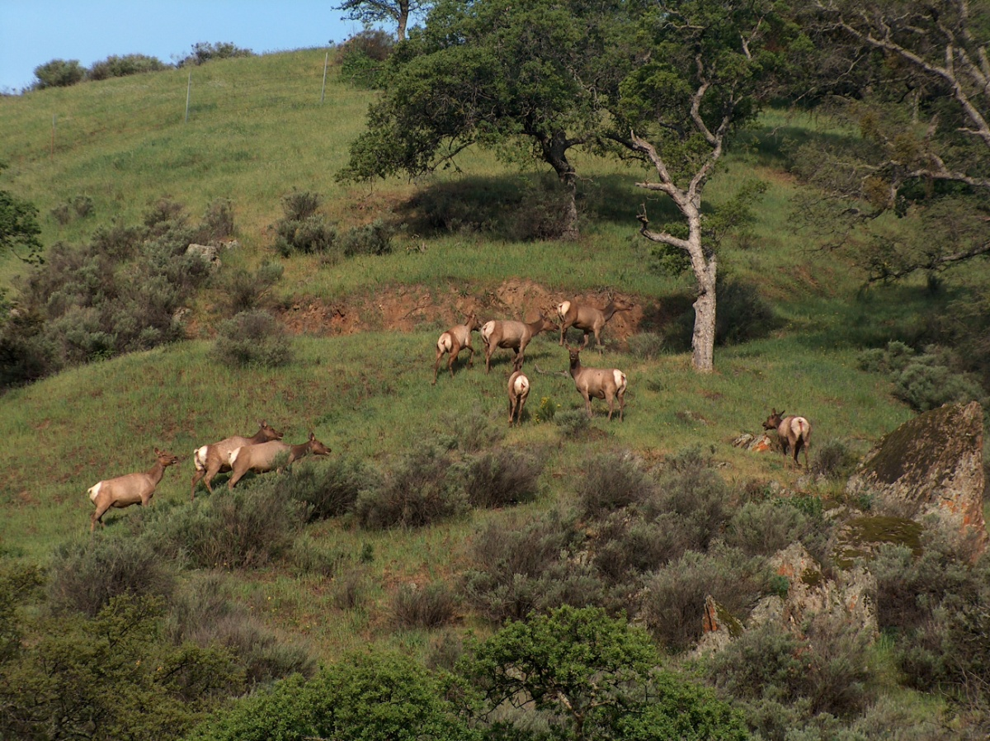
The Ecology of FEAR

Slide 12
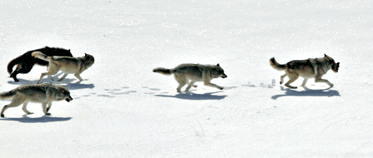
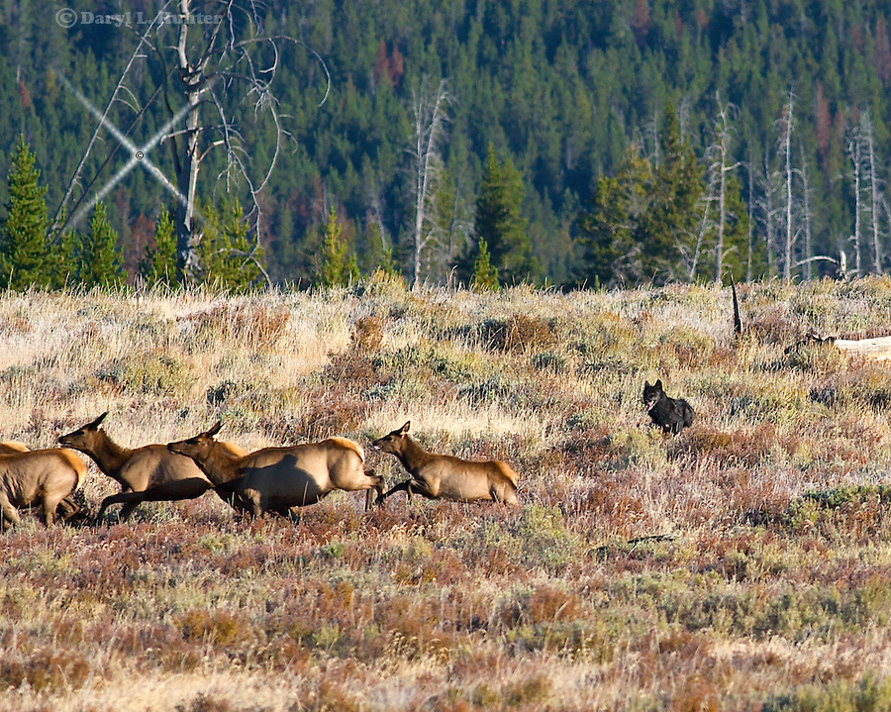
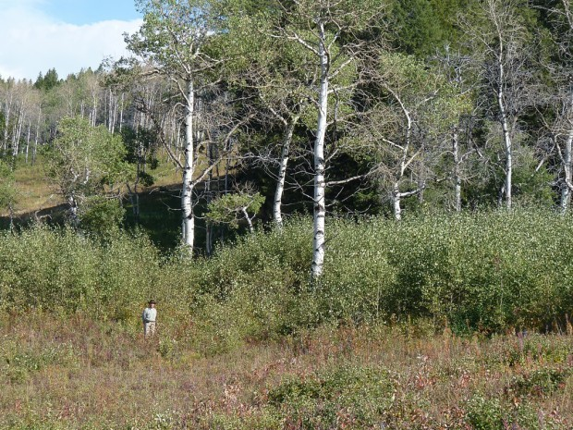

Slide 13
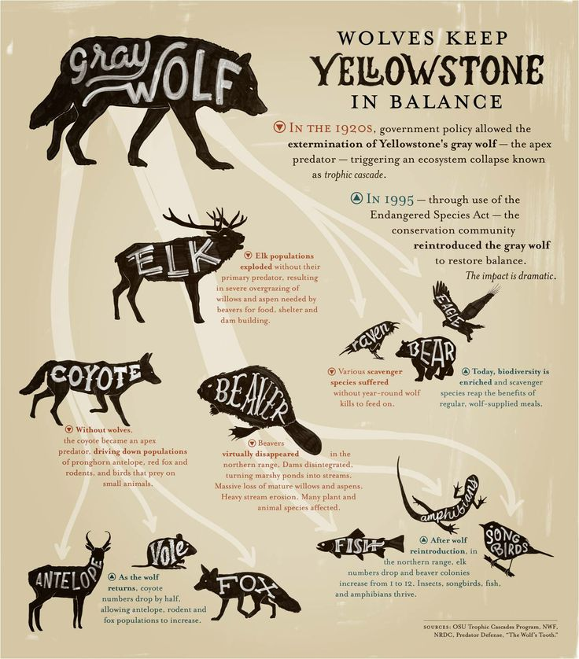

Slide 14
Like all things wolves have economic, environmental, and social impacts
$ tourism, cattle impacts, hunting
Keystone species, their existane is essential to the functioning of the ecosystem (charismatic mega-fauna)
People celebrate them or fear them

Slide 15
Keystone Species role can be…
Physical Disturbances
Predator-mediated Competition
Ecosystem engineers

Slide 16
What roles might a keystone species play?
Thinking about managing or protecting ecosystems and/or specific species does it make sense to use a keystone species as an example?
Why?

Slide 17
Things to do…
Finish Symbiosis WS from yesterday
Take out your Ozone data so I can check it
Measure your sprouts
Qualitative measurement (observations)
Quantitative measurement: measure the # sprouted AND the height of each sprouted plant

Slide 19
Warm-Up 26OCT2015
How can the knowledge of a Keystone species help us manage (or protect) habitats?

Slide 20
To Do…
Symbiosis WS due today!
Measure ALL you plants
Create data tables
Begin background research for the final lab report

Slide 22
Warm-up 29OCT2015
What is ecological succession?
Logistics:
Warm-ups due tomorrow
Mark and Recapture Questions!

Slide 23
Change Happens
Without human influence ecosystems change over time
Change in species composition of communities over time is a perpetual process in nature

Slide 24
Destruction = Creation

Slide 25
Ecological Succession
The predictable replacement of one group of species by another group of species over time
All ecosystems undergo this change in some form or another

Slide 26
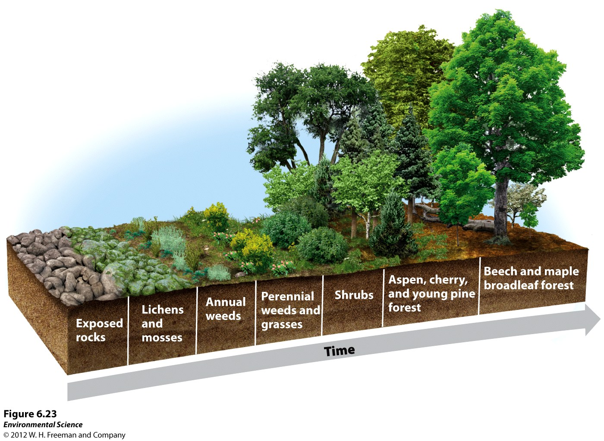
Primary Succession

Slide 27
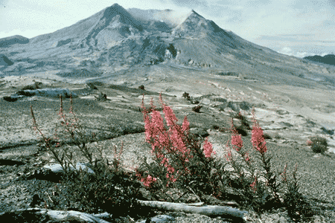
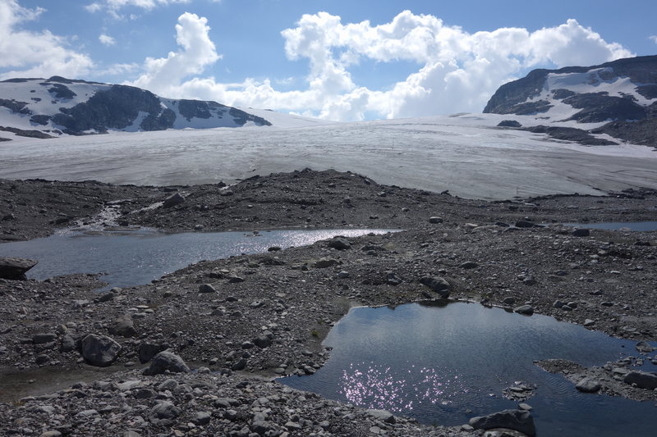
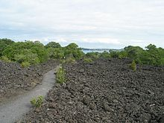

Slide 28
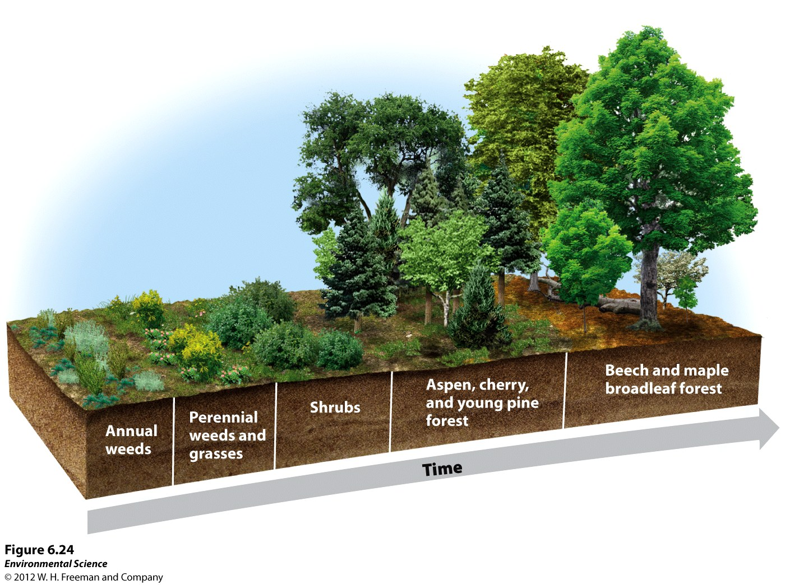
Secondary Succession

Slide 29
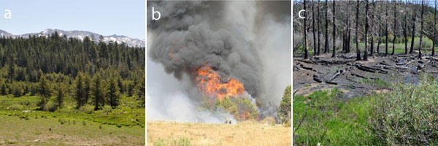
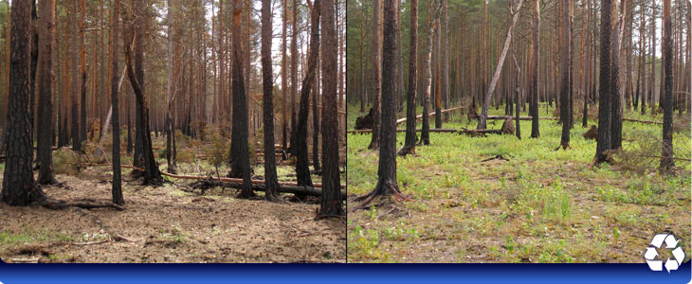

Slide 30
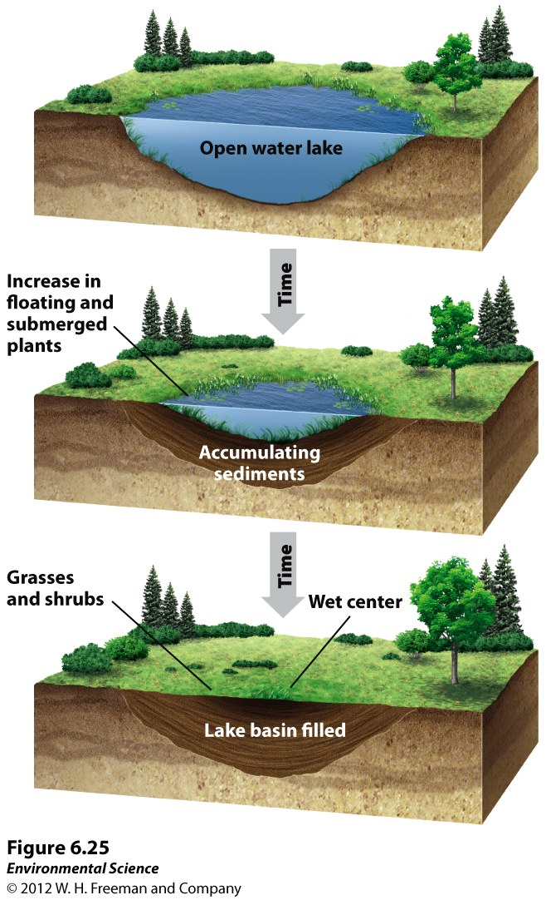
Lake Succession

Slide 31
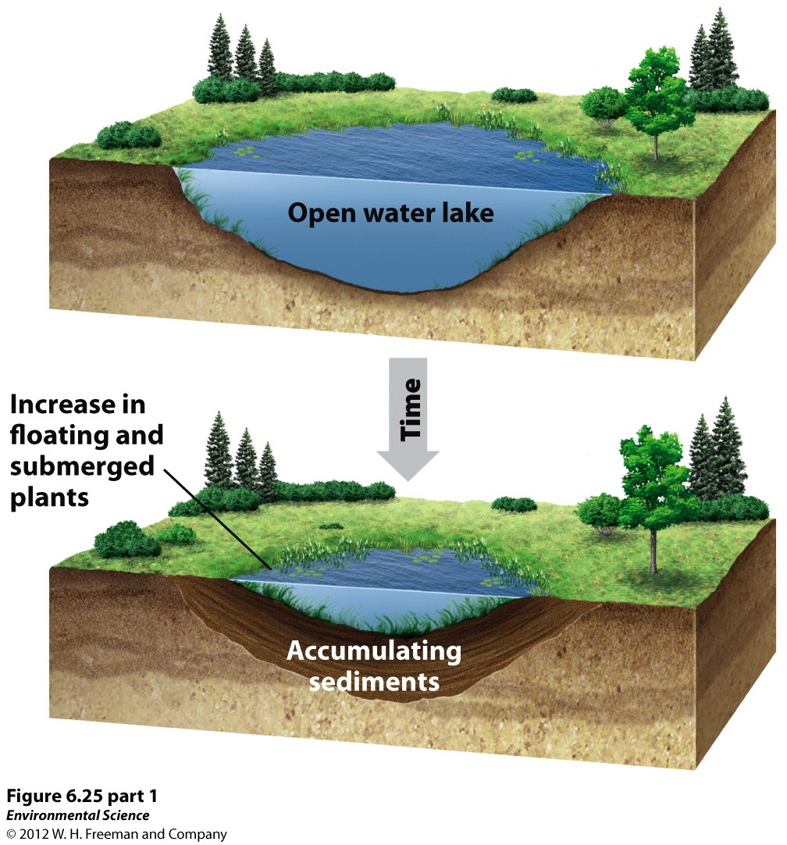

Slide 32
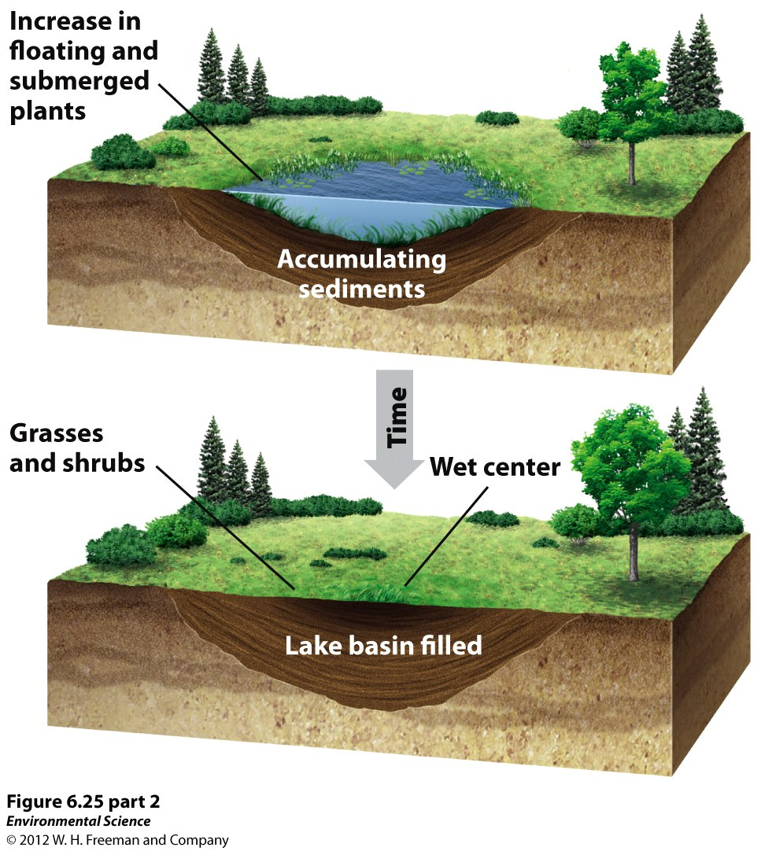

Slide 33
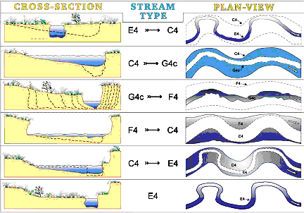
River succession

Slide 34
To do…
Measure your plants!
Each individual (calculate averages for each 2, 4, 8, 16, 32)
Remember our study question: how does density effect growth in plants?
Measuring height and wet biomass to answer the question

Slide 35
Anthropogenic change
This is a natural process
Humans are altering ecosystems all over the world, we are also an element of ecological succession
The scale that we are changing ecosystems is huge, and unprecedented

Slide 36
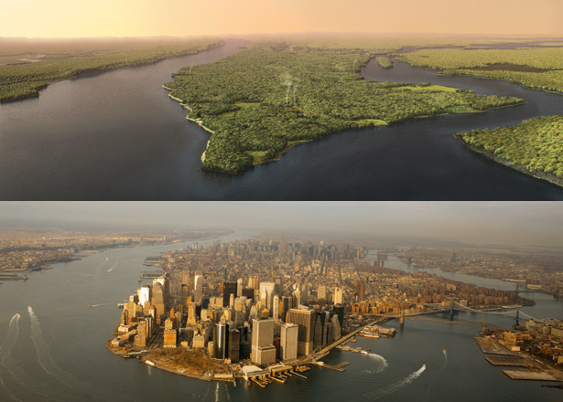
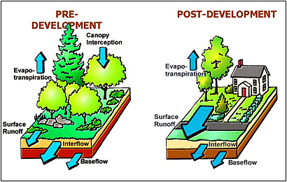

Slide 38
Warm-up 27OCT2015
What trends do you observe in your plants so far?
Mark and Recapture Lab Questions (Due Thursday)

Slide 39
We take samples to make inferences about populations

Slide 40
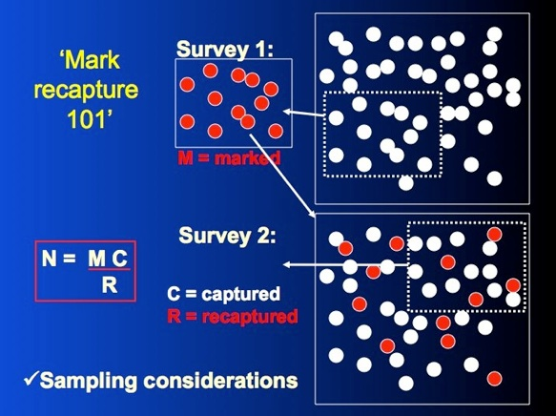
Mark n Recapture
A method of sampling that involves a series of samples that we can estimate the total population

Slide 41
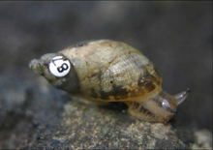
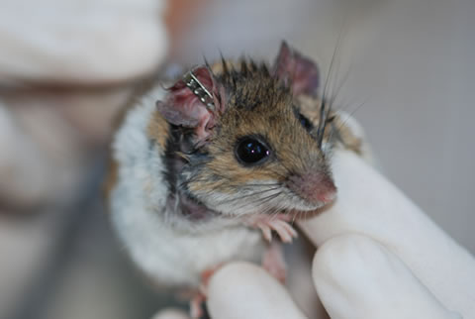
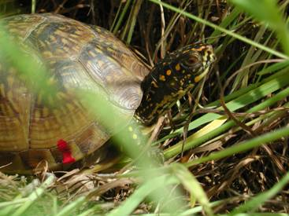
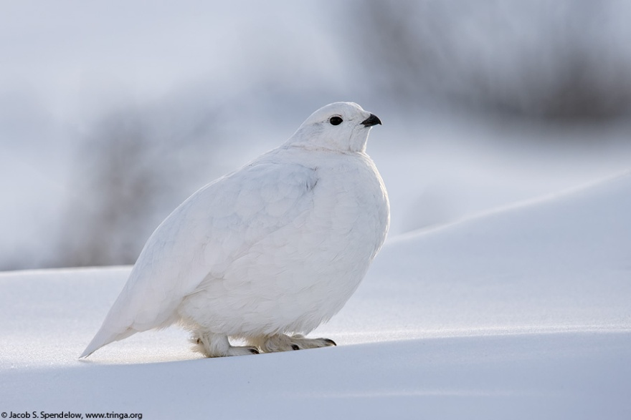
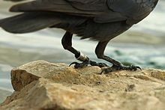
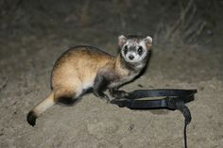
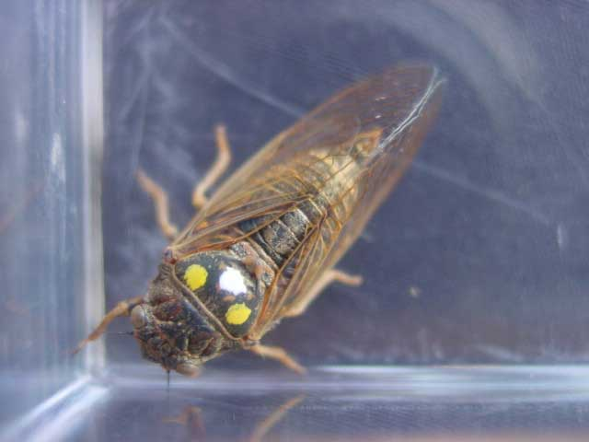
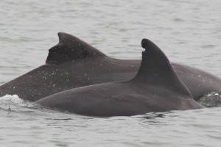
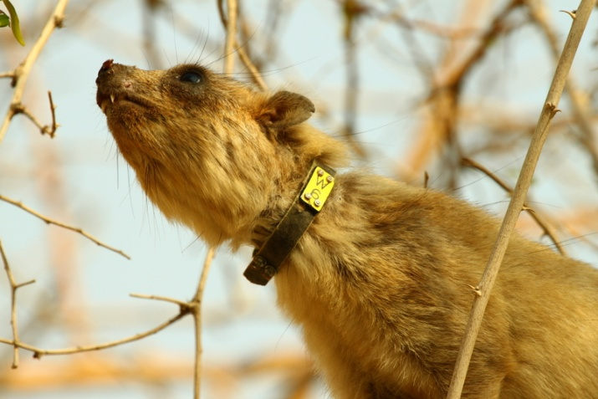
Examples of marks

Slide 43
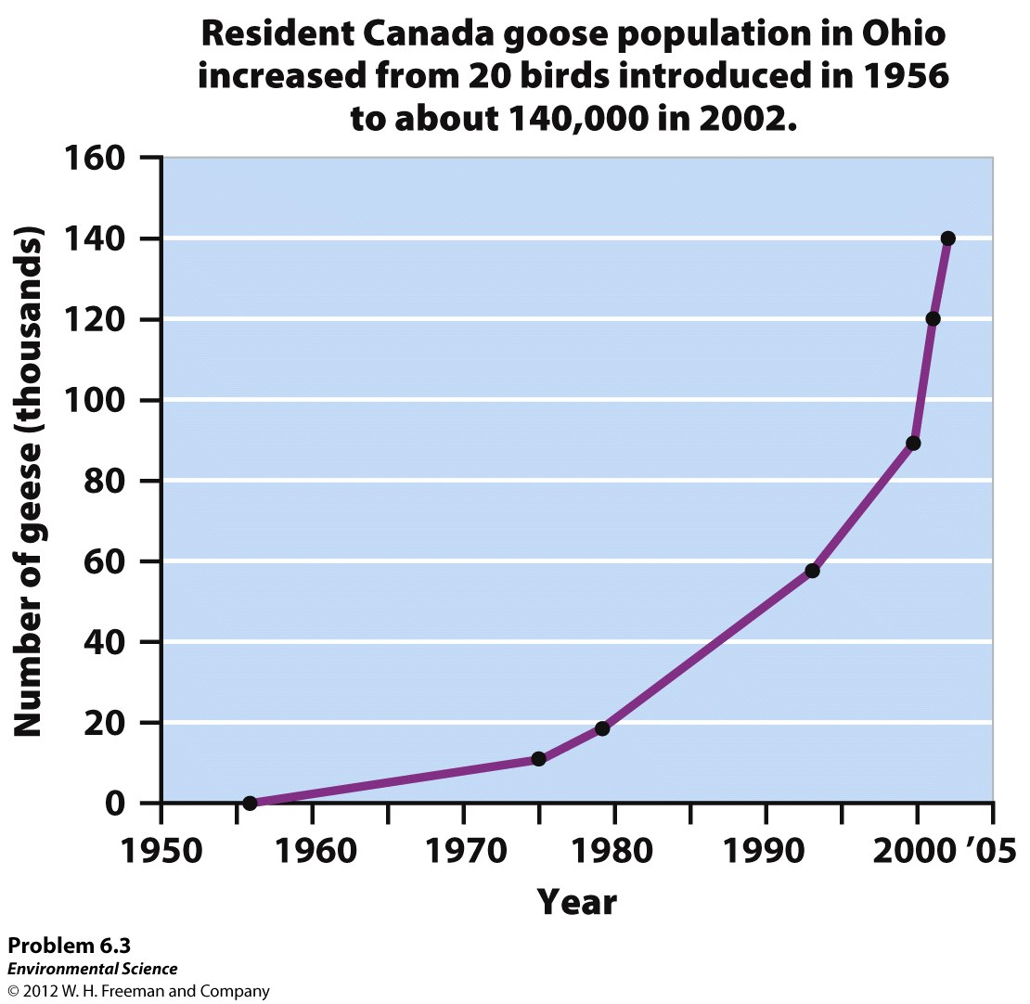

Slide 44
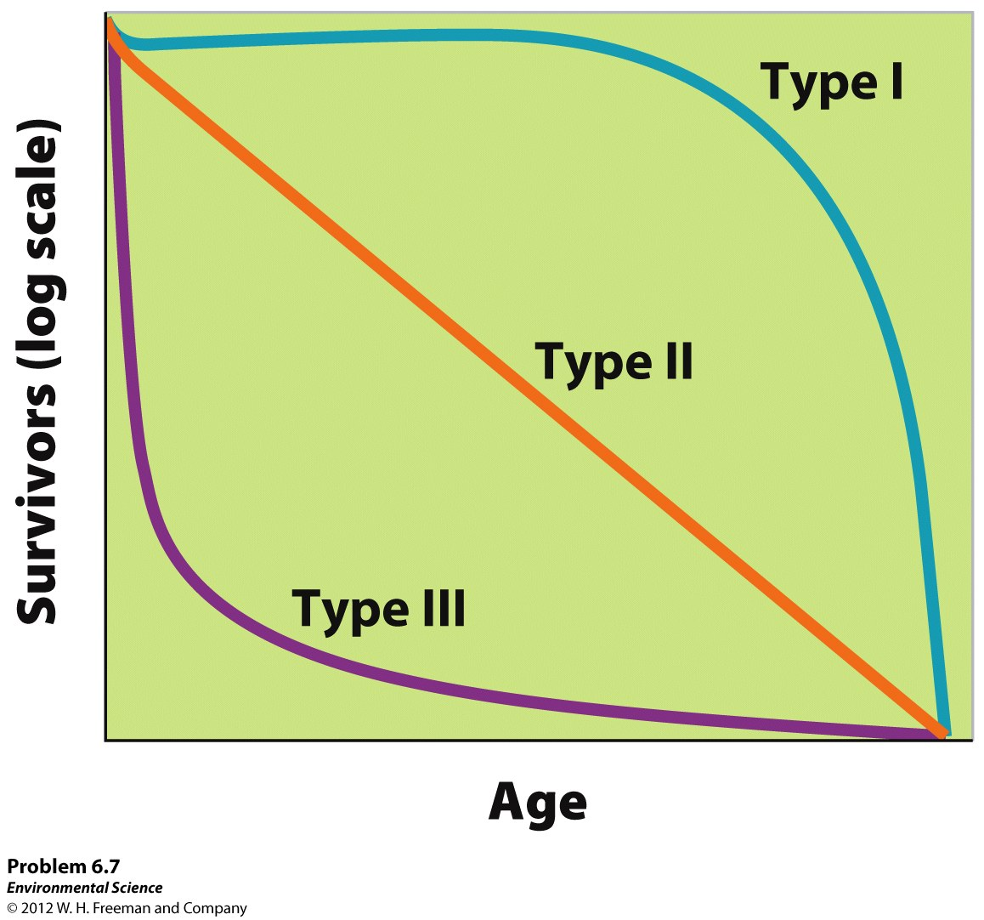

Slide 45
