Slide 1
Warm-Up 20OCT2014
Draw a graph of exponential growth.
What is carrying capacity?

Slide 2
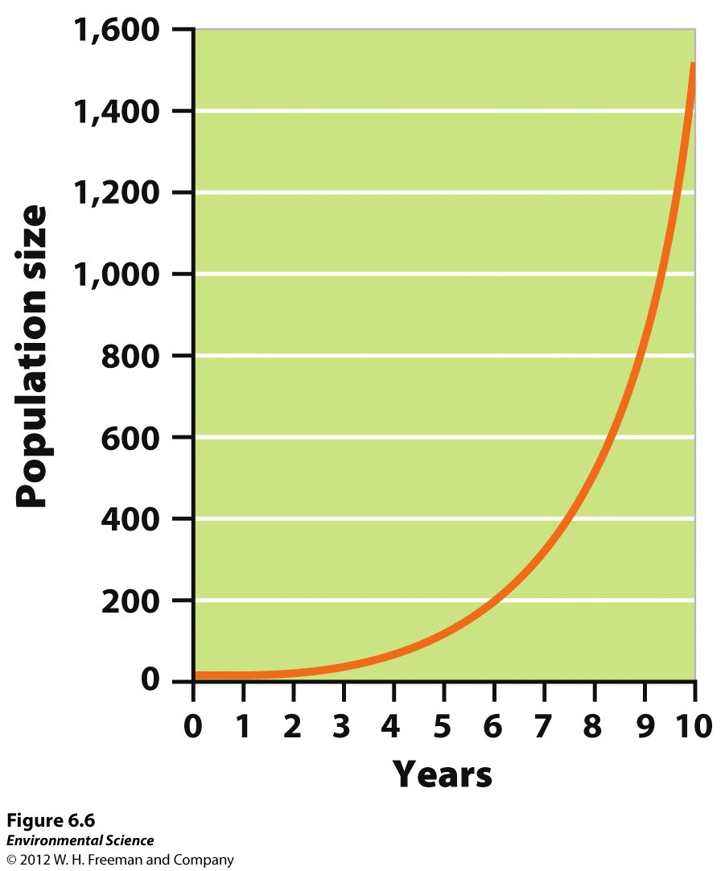

Slide 3
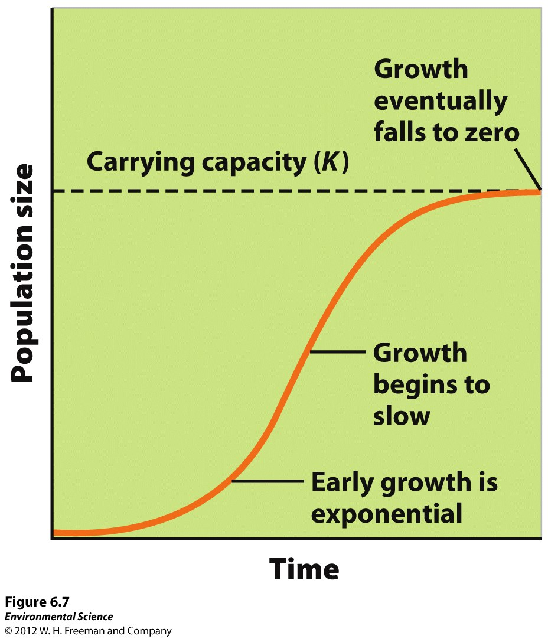

Slide 4
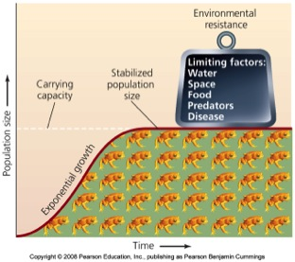
Limiting Factors
Food
Water
Space
Mates
Predators
Disease

Slide 5
Logistics
Ozone Lab check on Friday: Aug, Sept, Oct data in a safe place for all year data collecting.
10 Vocabulary due Friday
The Exponential Growth/Rule of 70 is DUE tomorrow (10/21)
I am making an assumption that you are reading chapter 6!

Slide 6
Population Patters
Exponential
Logistic
Oscillations

Slide 7
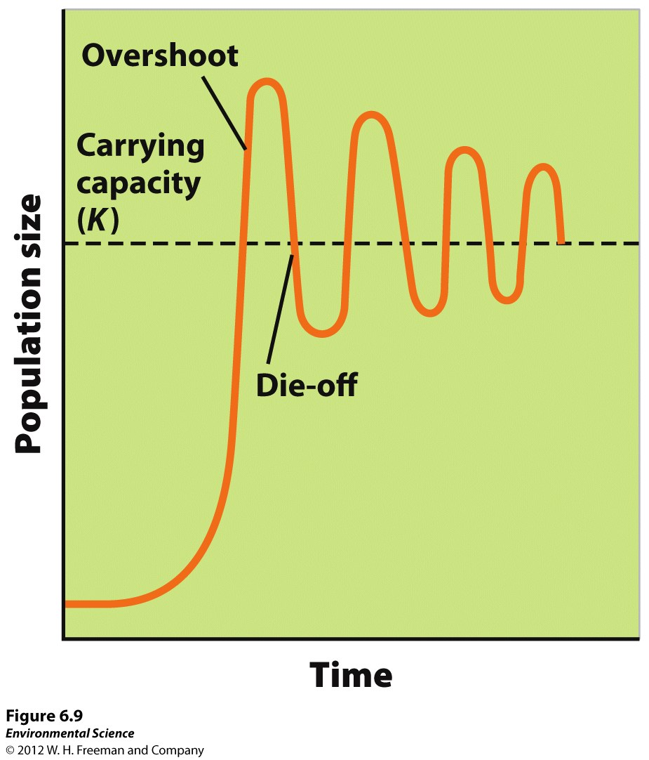

Slide 8
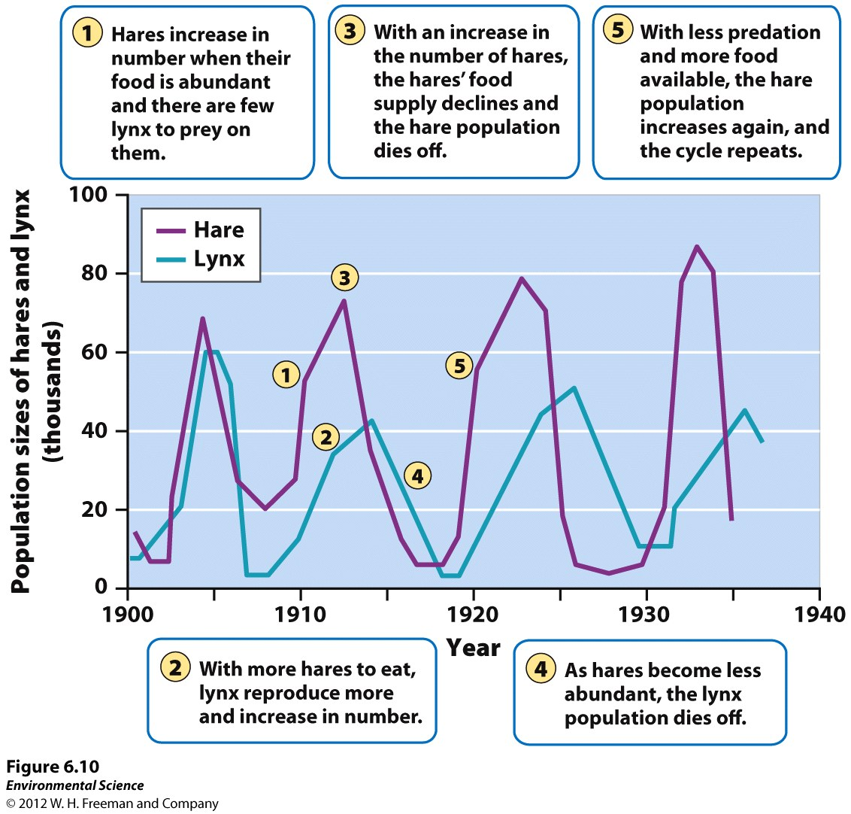

Slide 9
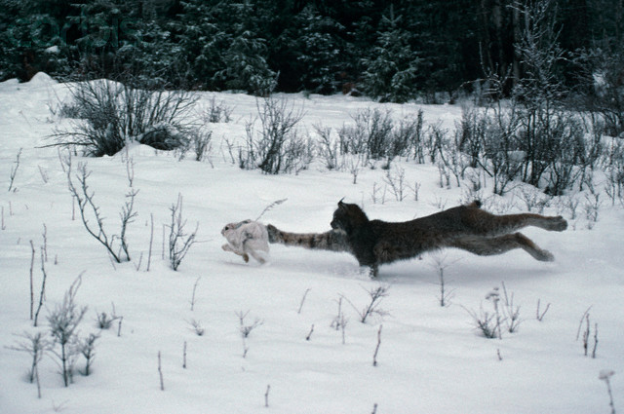
Predators as Population Regulators
Oscillations of prey species and/or predator species are often very connected.
As we saw with the lynx and showshoe hare
Hudson Bay Company data from fur trapping

Slide 10
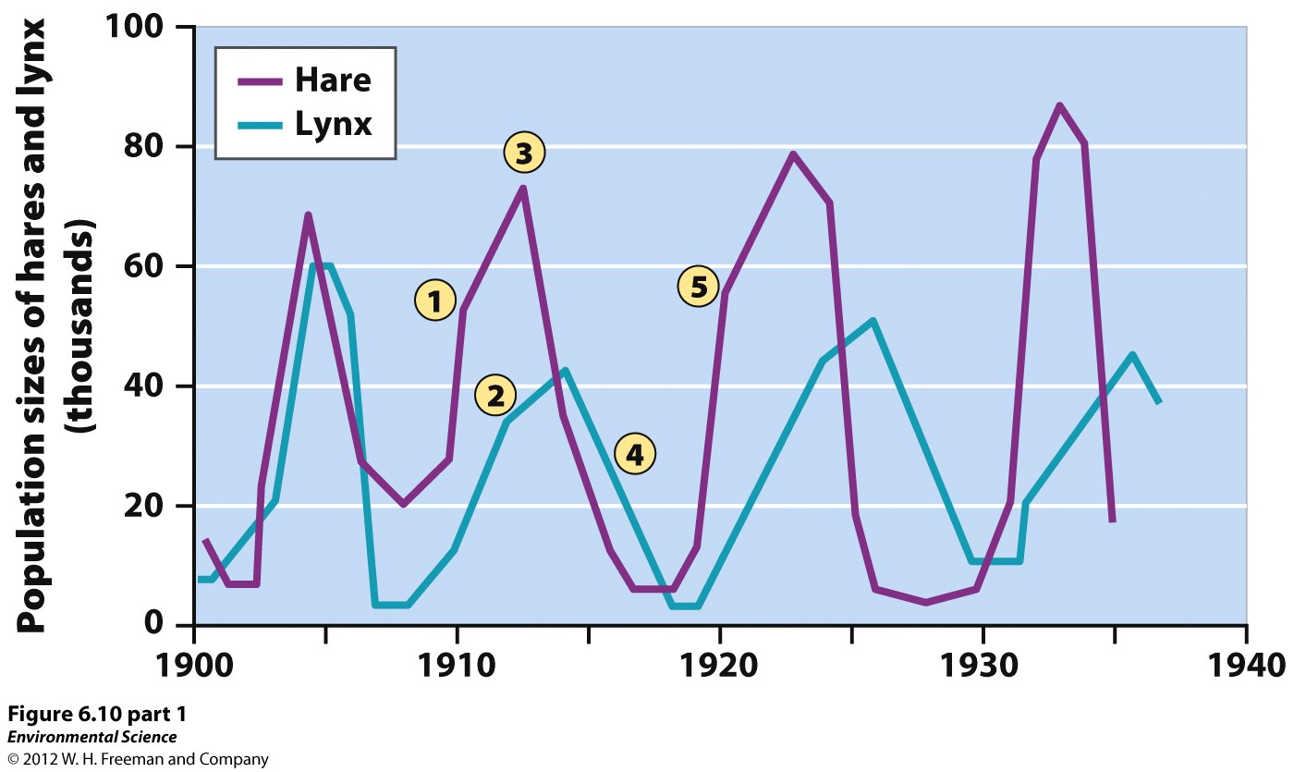

Slide 11
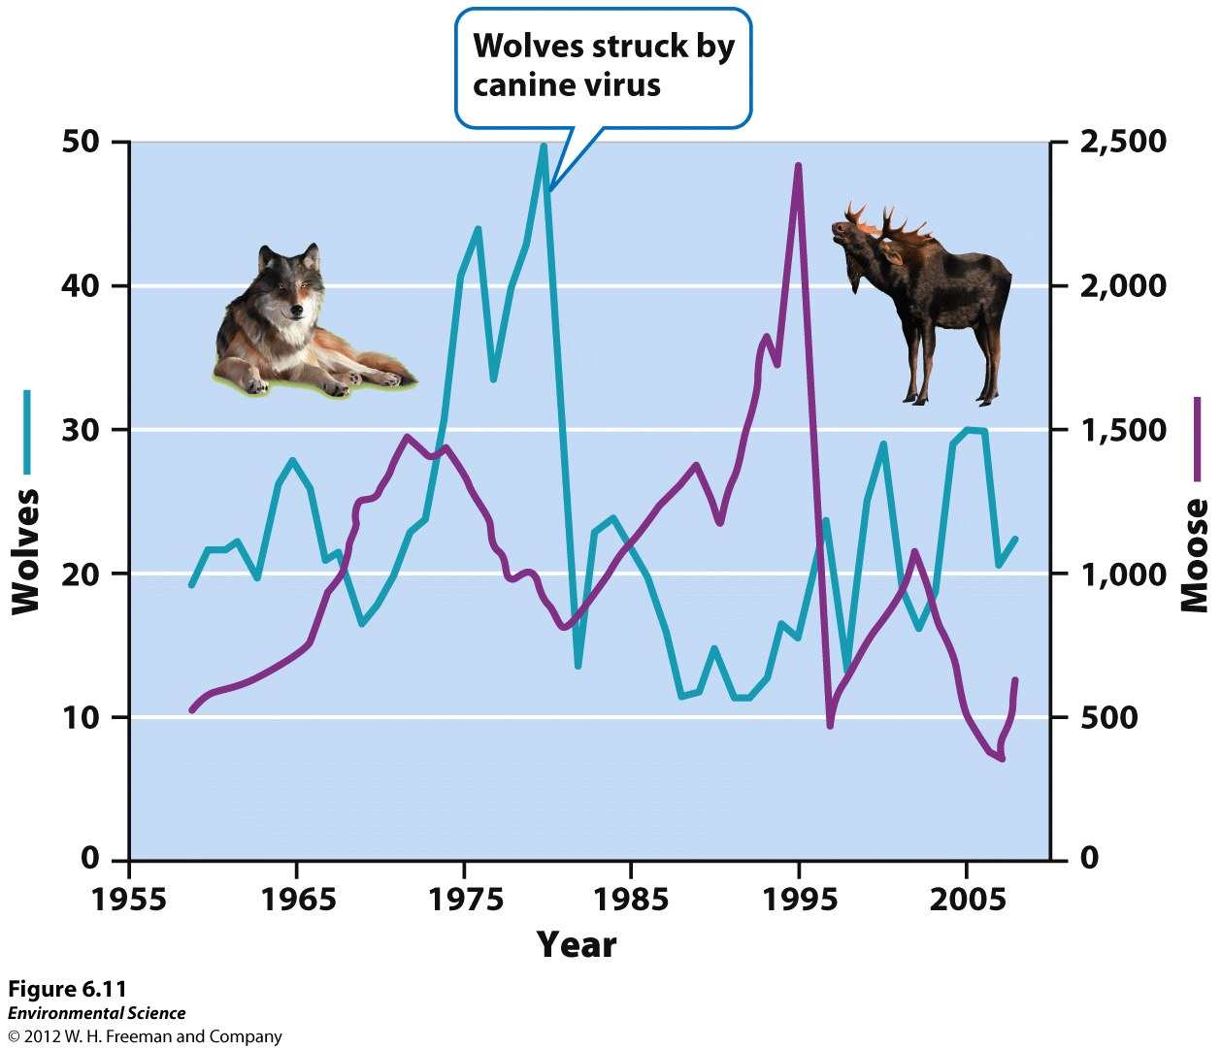

Slide 12
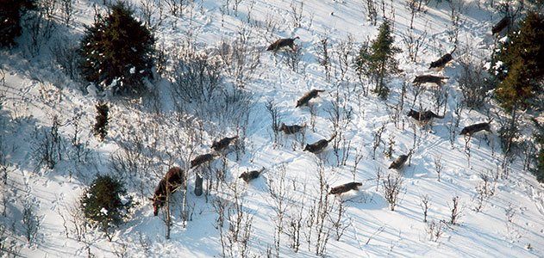
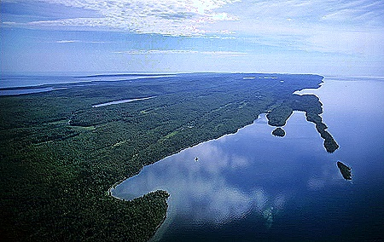
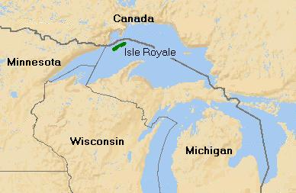
Wolves and Moose of Isle Royale

Slide 13
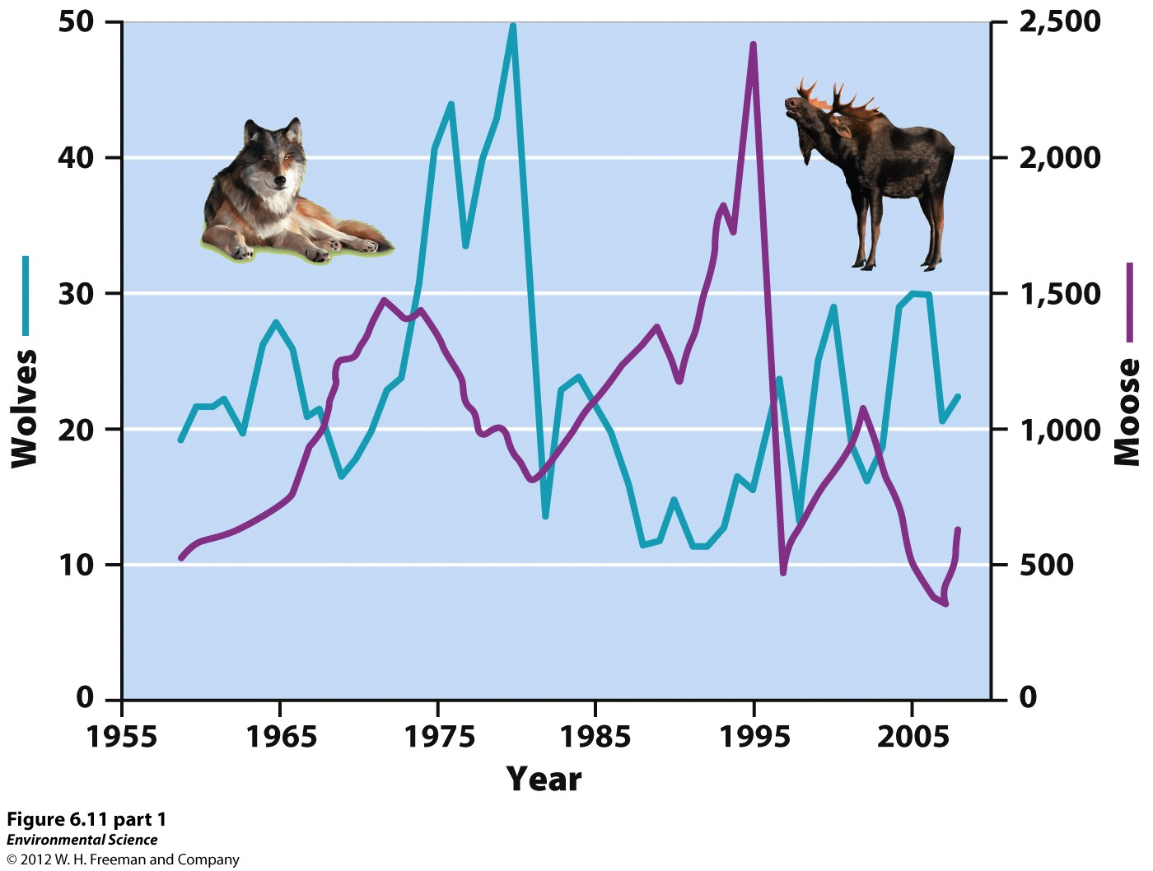

Slide 14
Reproductive strategies and survivorship curves

Slide 15
K and r Selected Species
Represent the range of reproductive strategies in nature
K selected are low growth rate, the pop’n grows slowly until the carrying capacity is reached
r selected have high growth rates, they produce large numbers of offspring

Slide 16
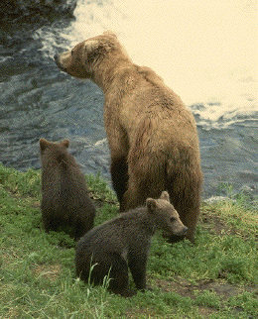
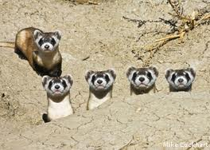
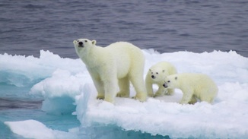
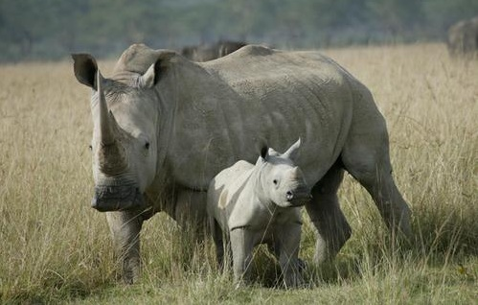
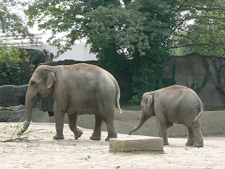
K selected examples

Slide 17
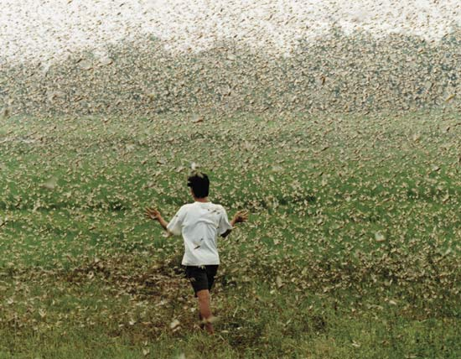
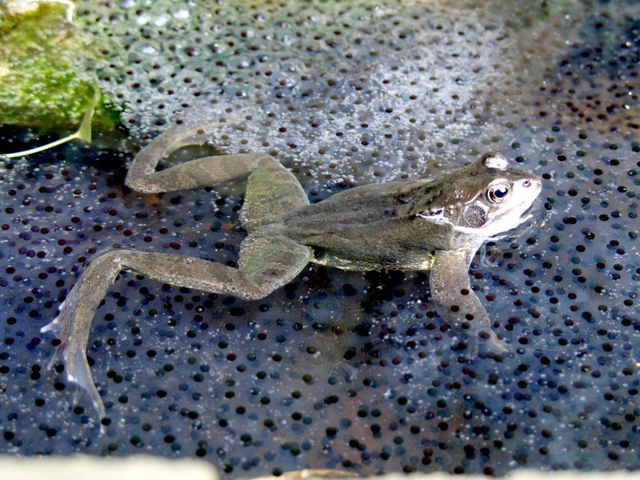
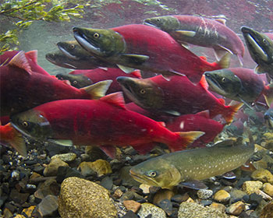
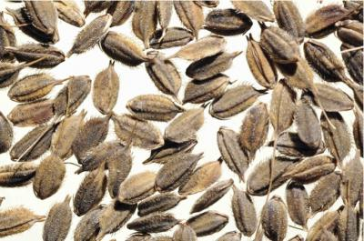
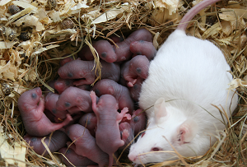
r selected examples

Slide 18
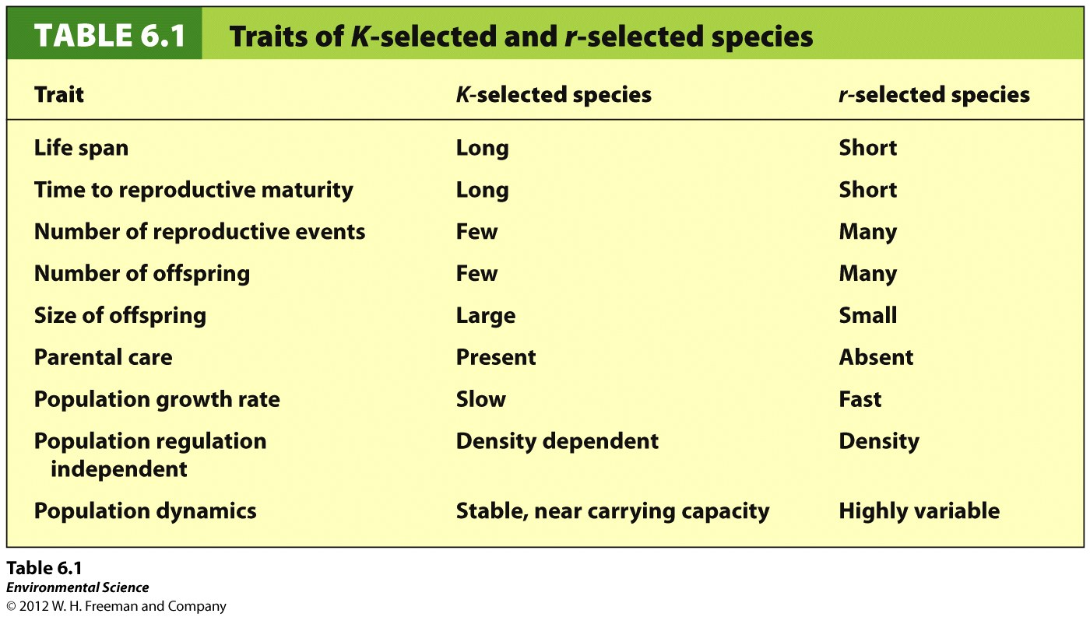

Slide 19
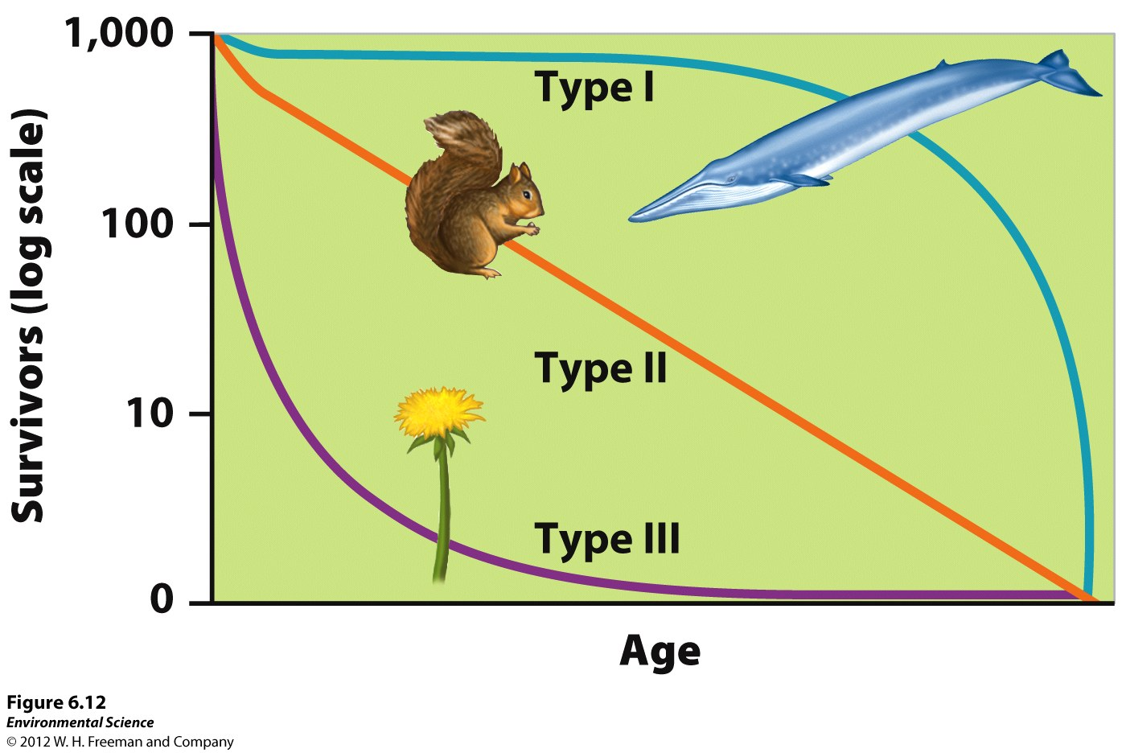
Survivorship Curves

Slide 20
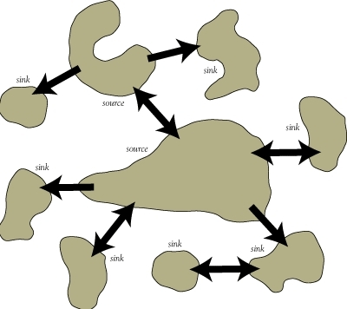
Metapopulations
A group of spatially distinct populations that connect by occasional movements of individuals between the metapopulations

Slide 21
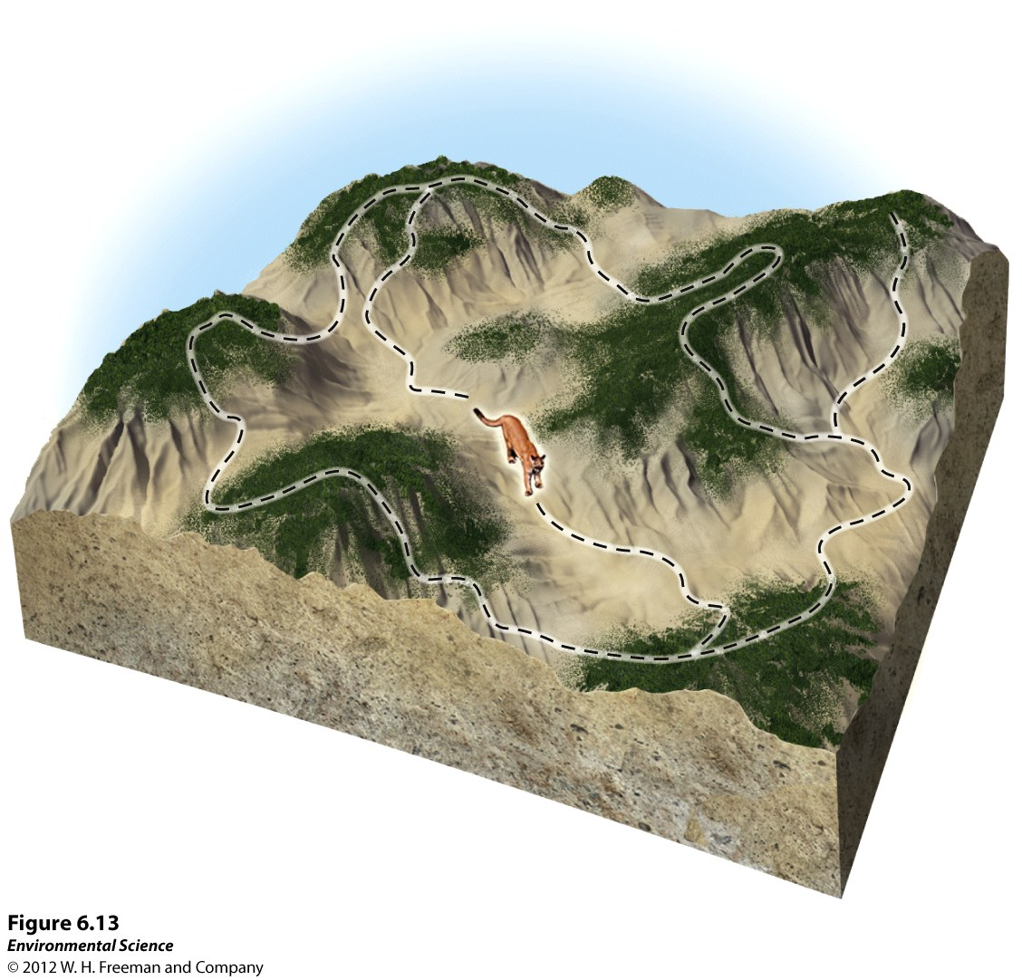

Slide 22
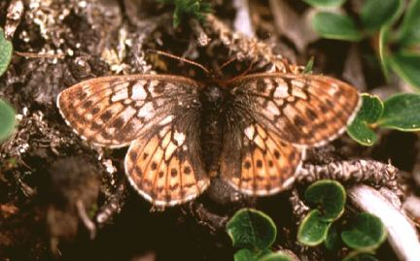
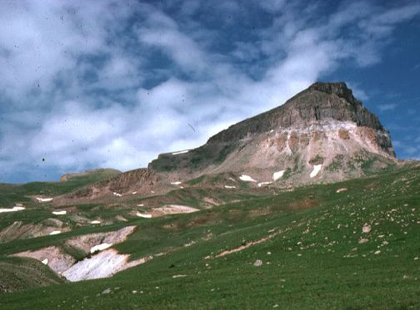
Metapopulation example

Slide 23
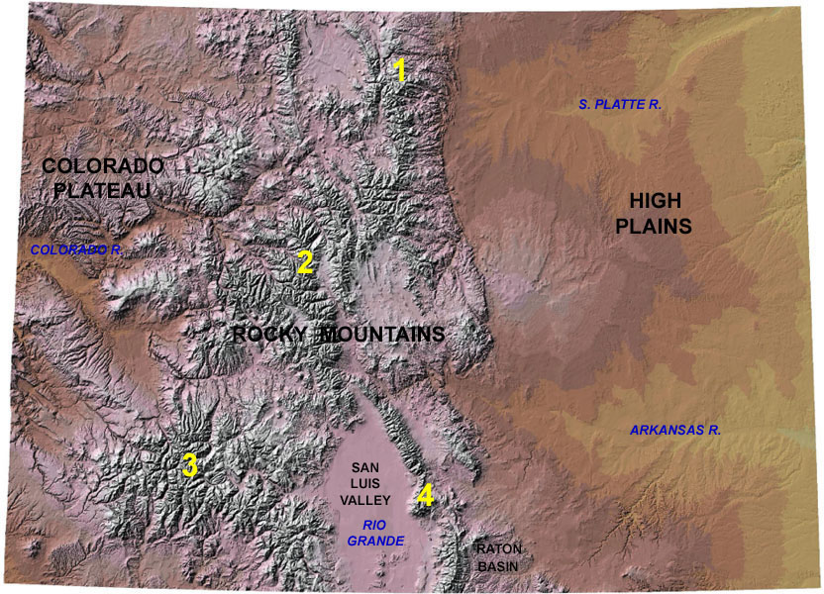

Slide 24
What happens if you alter the r and K terms in the logistic growth model?
What did the scientists learn from the records of the Hudson Bay Company?
What is a meta-population? How do meta-population contribute to the preservation of biodiversity?

