Slide 1
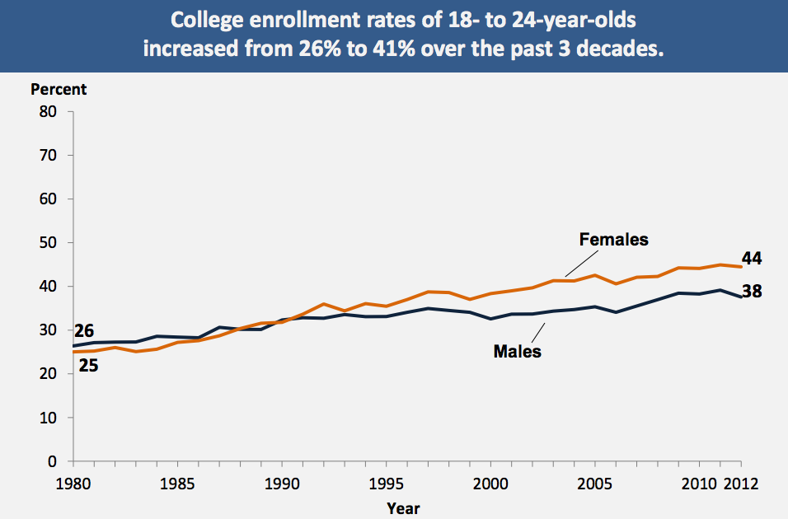
PTT 20OCT2015
Write a summary statement for the following graph.

Slide 2
Pencil Check out Sheet
If you need to borrow a pencil…
Add your name to the sign-out sheet BEFORE CLASS STARTS!
Return your pencil after class. Failure to return your pencil will result in -5 BTS.

Slide 3
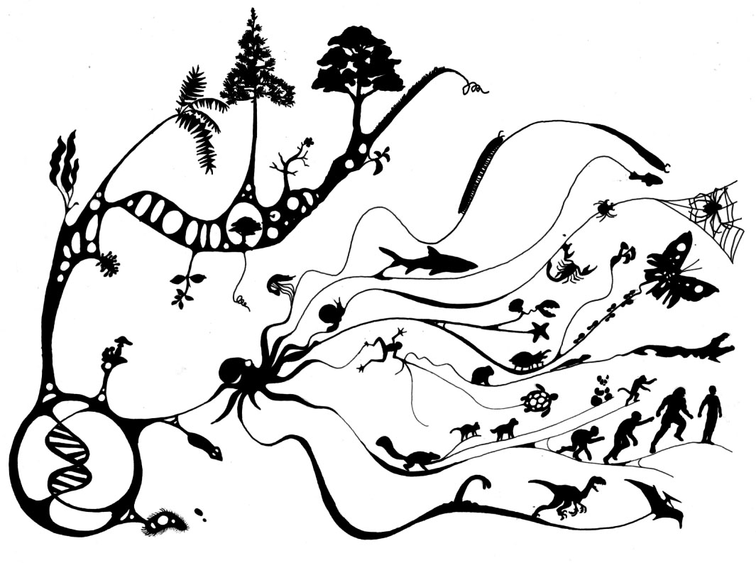
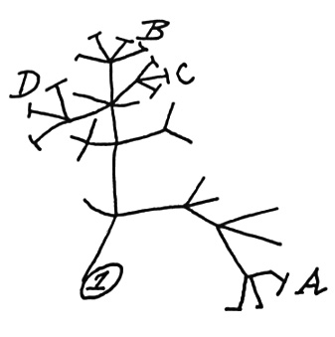
Evolution
Over the next few weeks we will discuss the Theory of Evolution

Slide 4
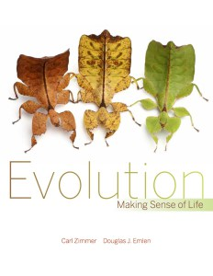
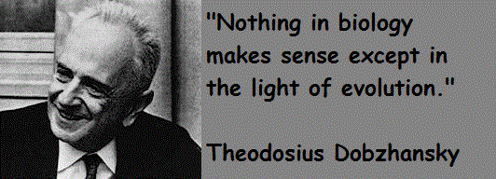

Slide 5
Evolution is the change in the frequency of alleles over time.
Evolution is the change in traits over time.

Slide 6
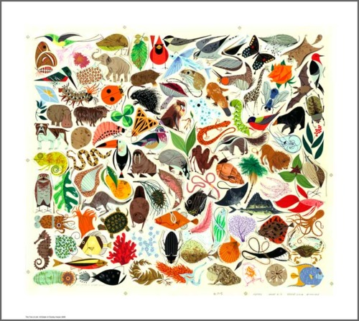
There exist 8.7 billion species on Earth
How did all these species come to exist?

Slide 7
Natural Selection
Explains how species come into existence and go extinct over time
Definition: the organisms with traits best suited for their environment are more likely to survive and reproduce.

Slide 8
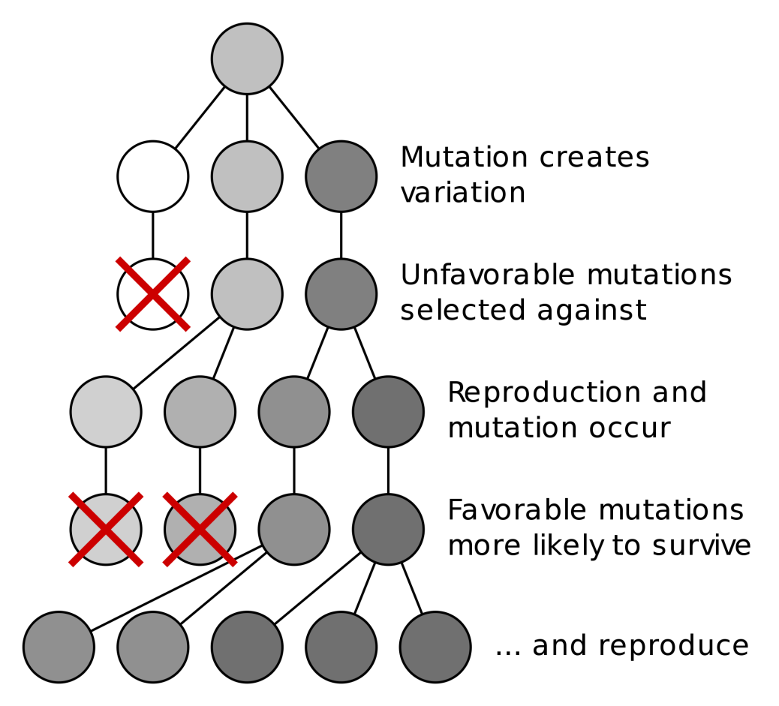
5 Principles
Organisms produce more offspring than survive
Variations in traits occur among individuals of a species
Some traits are passed to the offspring

Slide 9
5 Principles
4. Some traits are helpful. Individuals with helpful traits survive and reproduce better than those without these traits.

Slide 10
5 Principles
5. Over time, the offspring of individuals with helpful traits make up more of the population and eventually may become separate species

Slide 11
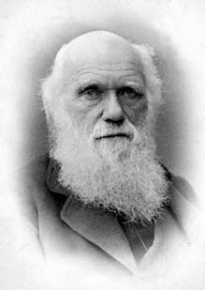
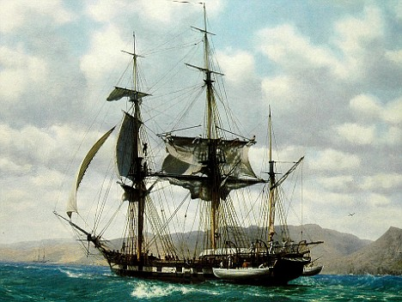
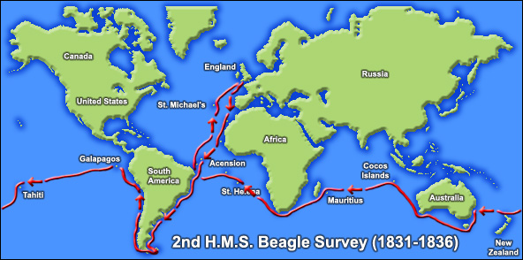

Slide 12
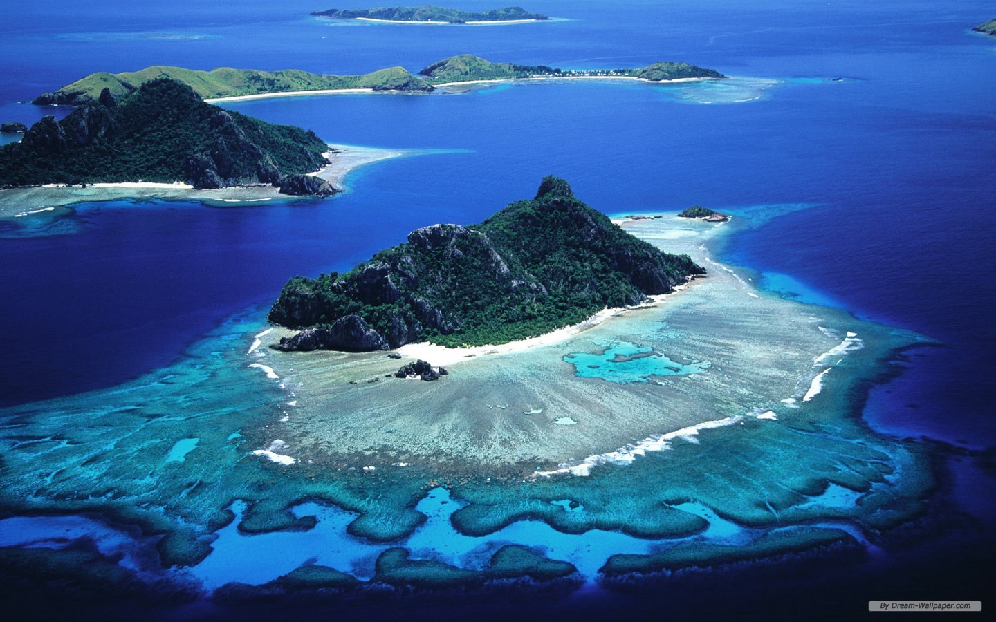
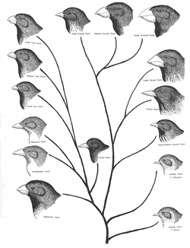

Slide 13
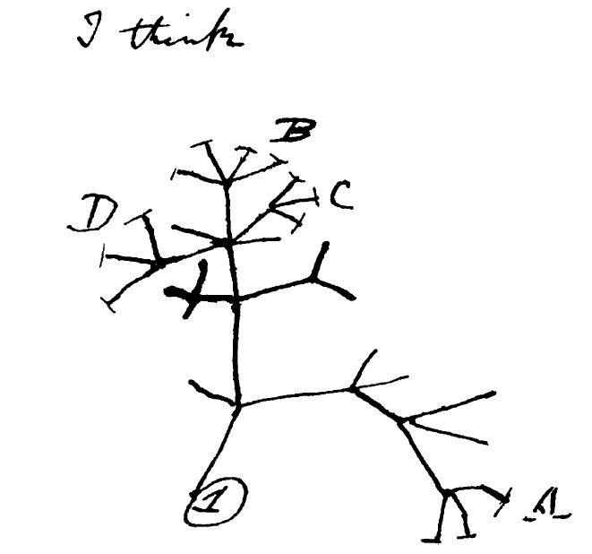

Slide 15
Please continue your notes by using the text book to complete the note guide you picked up on the way in the door.
Open to page 154.

Slide 17
PTT 21OCT2015
What is evolution?
What is a theory in science?

Slide 18
Evolution is the change in the frequency of alleles over time OR the change in traits over time

Slide 19
5 Principles of Natural Selection
Organisms produce more offspring than survive
Variations occur among individuals of a species
Some variations are passed to the offspring
Some variations are helpful. Individuals with helpful variations survive and reproduce better than those without these variations.
Over time, the offspring of individuals with helpful traits make up more of the population and eventually may become separate species

Slide 20
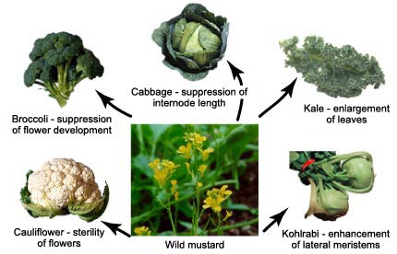
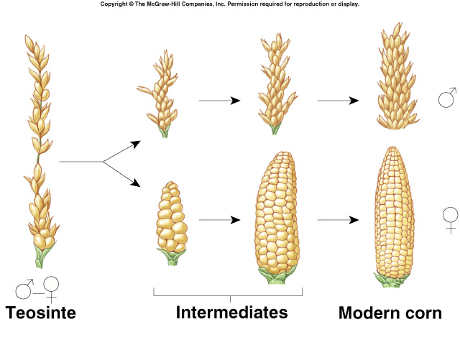
Artificial Selection
Human driven selection process where humans choose the traits they want

Slide 21
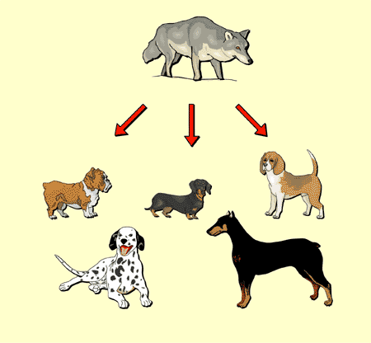
Artificial Selection
Human driven selection process where humans choose the traits they want

Slide 22
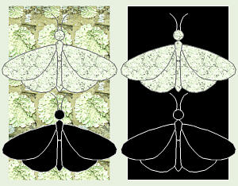
Natural Selection
Natural Processes (biotic or abiotic) are the selective force.
Nature favors certain traits over others

Slide 23
Selective Forces
Anything that make one certain traits more common in the population
Competition
Abiotic changes
Mate choice
Climate or Weather

Slide 24
Evolution is the change in the frequency of alleles over time OR the change in traits over time

Slide 25
Sometimes natural selection can be called the “survival of the fittest”
Let’s define our terms.

Slide 26
Adaptations
Adaptations can be a genetic mutation or change in alleles (a trait) that helps or harms an organism.
Adaptations can make organisms more or less fit for their environment

Slide 27
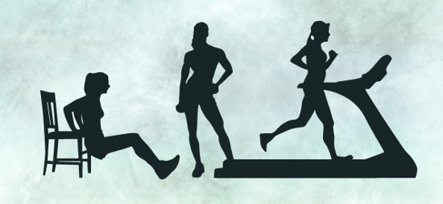
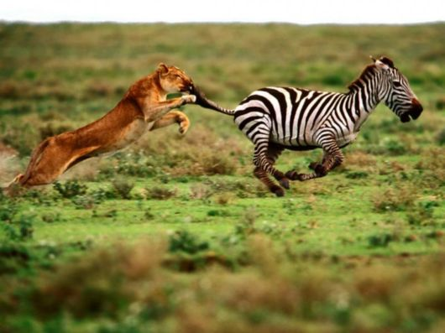
fitness

Slide 28
fitness

Slide 29
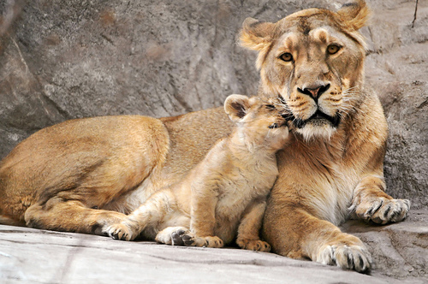
fitness
The ability to survive AND reproduce in a given environment

Slide 30
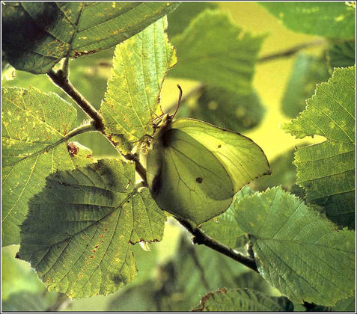
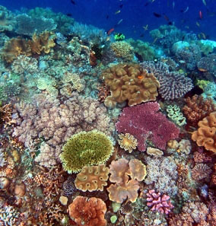
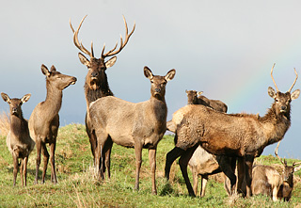
Do these organisms have the traits (alleles) to be considered fit?

Slide 31
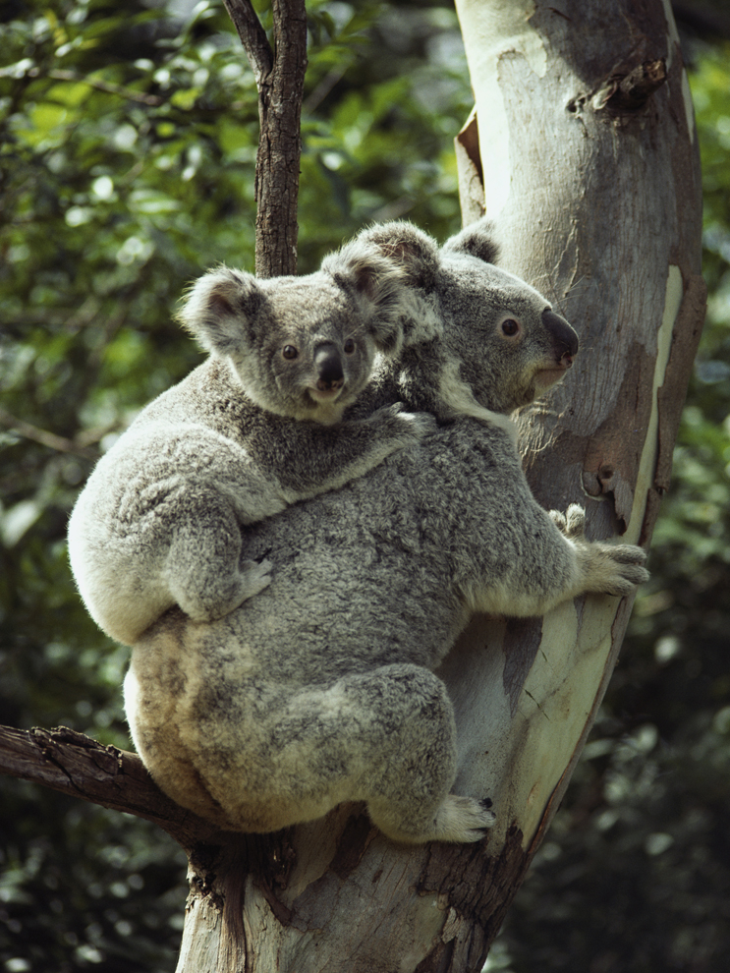
What adaptations make this organism fit for its environment?

Slide 32
Each table has an organism with it’s environment.
Make a list of 5 things that make the organism fit for their environment.

Slide 34
PTT 22OCT2015
How are Natural Selection and Artificial selection the same?
How are they different?

Slide 35
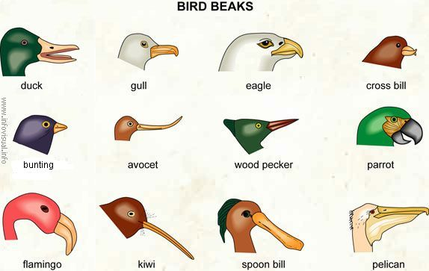
Beans and Beaks
To model natural selection using different beak “traits”

Slide 36
Using one hand and the other behind your back, take one bean to your nest at a time
This birds that are the most successful will reproduce and the unsuccessful birds will “die” and be reborn as the successful birds
Un-sportsman-like behavior will earn you –BTS and a 0 on the lab

Slide 37
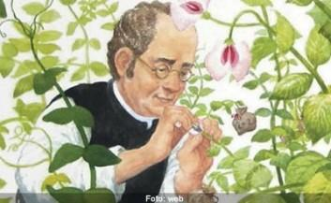
Gregor Mendel “the Father of Genetics”
Used the Science Circle to study how pea flower color was determined

Slide 38
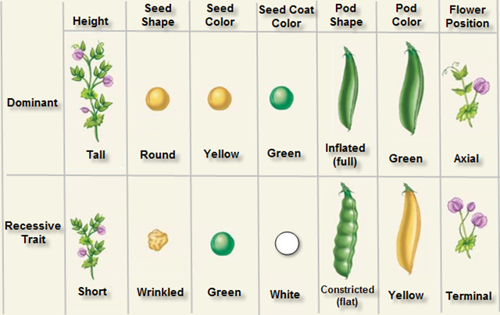
Observed all these traits in pea plants
(page 129

Slide 39
Question: how is heredity connected to pea plant traits.
Hypothesis: If I create hybrids of homozygous plants, then there will be a predictable traits observed in the next generation of pea plants
Design: 1. Predict the traits possible in a homozygous cross 2. Cross homozygous pea plants 3. Observe the next generation of pea plants

Slide 40
Collect Data: Mendel observed countless peas
Analyze Data: He looked at his data and realized he could predict will good accuracy the next generation traits, but not 100%
Conclude: that pea plant traits can be dominant and reccessive
Share

Slide 41
Question: How many different combinations are possible in hybridizing pea plants?

Slide 42
Starting on page 126-132 please read the text and fill-in the blanks on your paper
If you finish the front, start on the back

Slide 44
PTT 03FEB2015
What is an adaptation?
What is fitness?
What does abiotic and biotic mean?
Deadline for late work is Wednesday.
7A – Turn in your science notebooks by leaving them on your desks

Slide 45
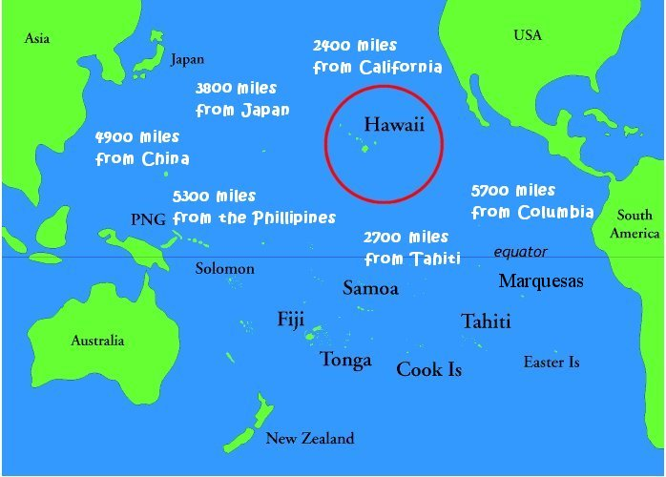
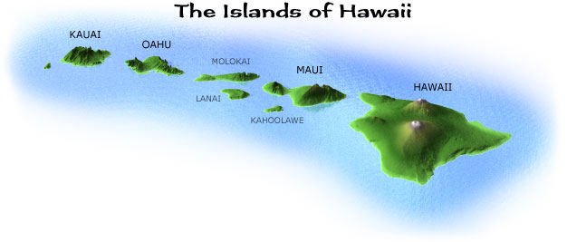
Story of Hawaii Birds

Slide 46
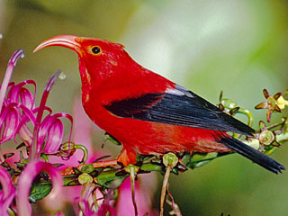
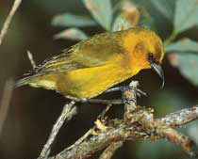
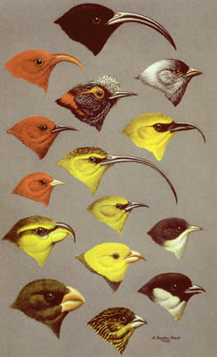
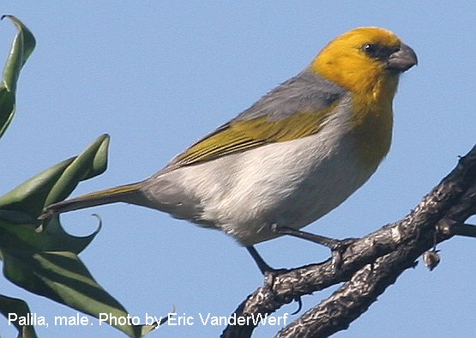
Story of Hawaii Birds

Slide 47
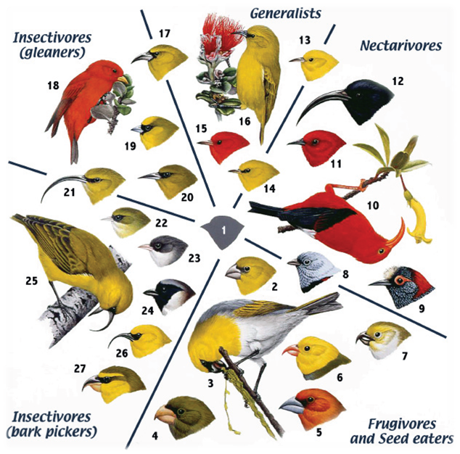
Adaptive Radiation

Slide 48
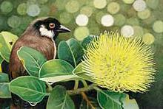
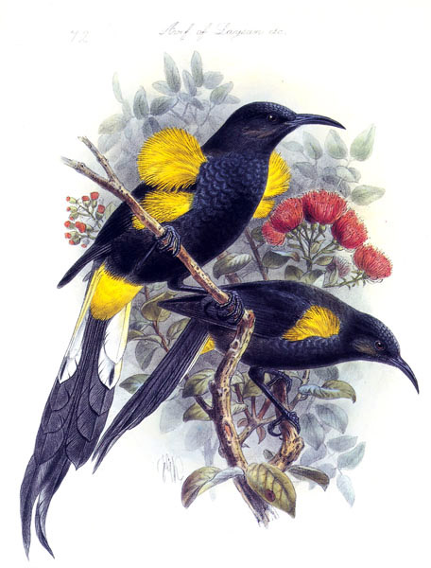
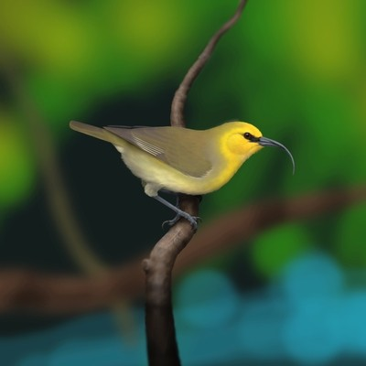
Extinct birds

Slide 51
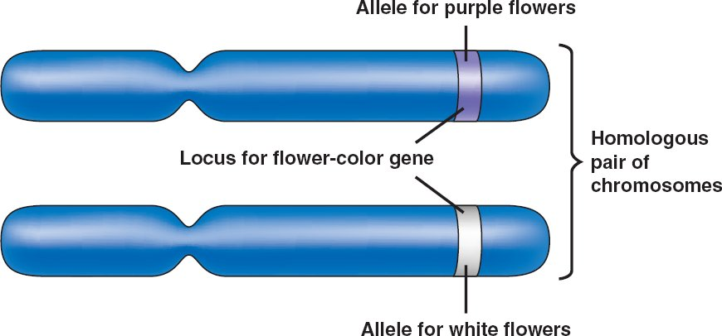
PTT 13JAN2015
What is an allele?
What is evolution?

Slide 52
Evolution is the change in the frequency of alleles over time

Slide 53
Starting on page 126-132 please read the text and fill-in the blanks on your paper
If you finish the front, start on the back

Slide 54
Mendel used simple probability to predict what traits would be present in the next generation of pea plants.
He called these Punnett squares

Slide 55
Genes have two or more alleles that will determine the phenotype (trait expressed) of an organism

Slide 56
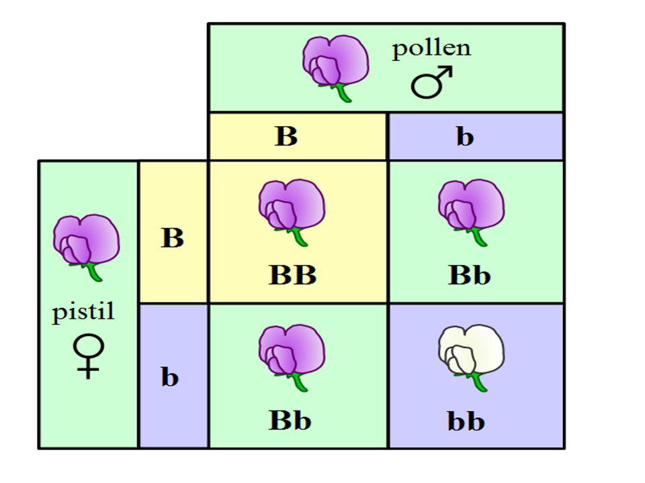
Alleles can be dominant or recessive.

Slide 57
An organism will be homozygous or heterozygous
Homozygous: has the same alleles
Heterozygous: has different alleles

Slide 58
The only way that an organism will express a recessive allele is if is homozygous.
A dominant allele will be expressed as a trait in both heterozygous and homozygous plants

Slide 59
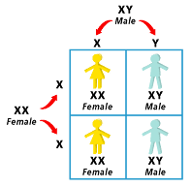
Human gender is determined the same way.

Slide 61
PTT 14JAN2015
Which of these are heterozygous and which is homozygous? HOW DO YOU KNOW?
What is evolution?

Slide 62
Evolution is the change in the frequency of alleles over time OR the change in traits over time

Slide 63
Terms for you notebook
Purebred: the organism is homozygous dominant or homozygous recessive (TT or tt)
Hybrid: the organism has one of each allele (Tt)

Slide 64
Y = Yellow body
y= blue body
Which is the dominant trait?
What combinations will make a Yellow body?
What combinations will make a blue body?

Slide 65
B: represents an allele that codes for Brown eyes, is this allele dominant?
b: represents an allele that codes for blue eyes, is this allele dominant?
Lets do a Punnett square.

Slide 66
What percentage of the offspring will have brown eyes?
What percentage will have blue eyes?

Slide 67
What percentage are homozygous recessive?
What percentage are homozygous dominant?
What percentage are heterozygous?

Slide 68
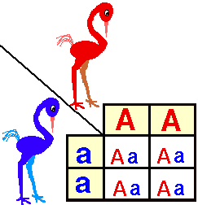

Slide 69
What percentage of the birds will express the red phenotype?
What percentage of the birds will express the purple phenotype?
What percentage are heterozygous?
What percentage are homozygous?

Slide 70
Are any of the birds hybrids?
Are any of the birds purebred?

Slide 71
Bikini Bottom Genetics (Due Tomorrow)
Let’s do #4 together
This is due tomorrow (15 points!)

Slide 72
Bikini Bottom Genetics (Due Tomorrow)
You have time in class. PLEASE use it wisely. I am here to help.
This is due tomorrow (15 points!)

Slide 74
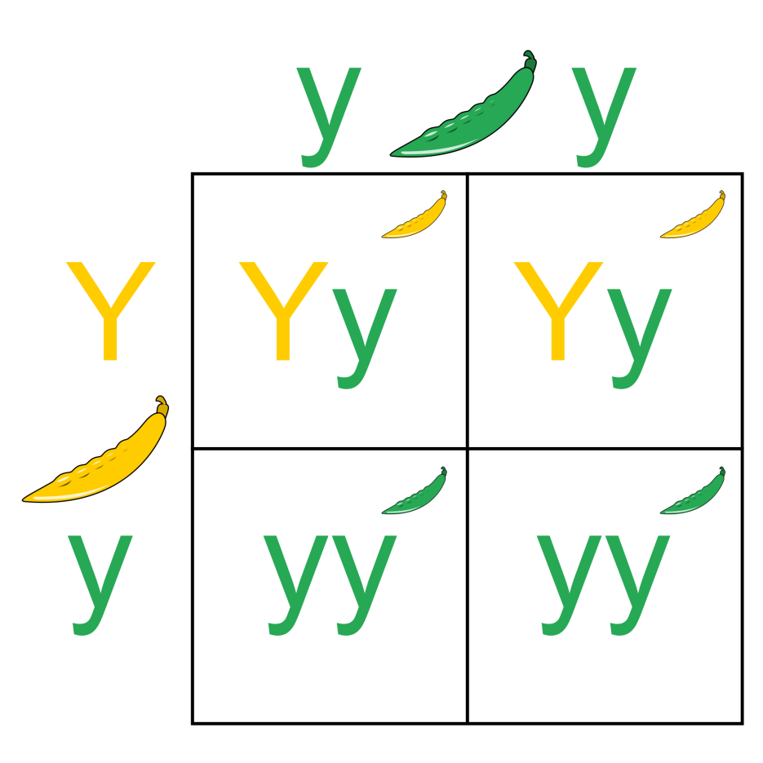
PTT 15JAN2015
What percentage is homozygous?
What percentage is heterozygous?
What percentage is green?
What percentage is yellow?

Slide 75
Any questions from bikini bottom?

Slide 76
Evolution is the change in the frequency of alleles over time OR the change in traits over time

Slide 77
Practicing Punnett Squares makes us Perfect!
I will check on your progress throughout the day, you will get credit if you finish in class.

Slide 79
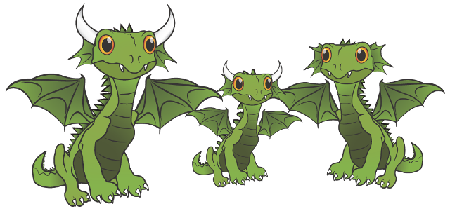
PTT 16JAN2015
Looking at this dragon family, what is the only possible genotype for the offspring?
Hint: you may need to do a Punnett square

Slide 80
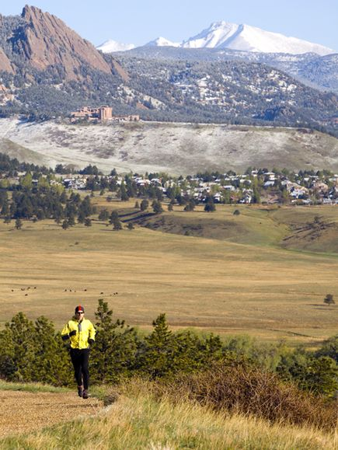
Outdoor Adventure Journal #2 is due on Tuesday!

