Slide 1
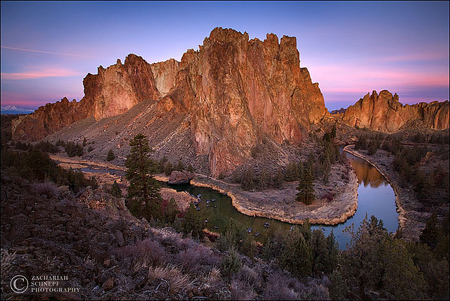
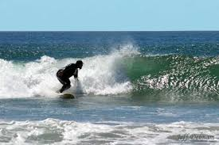
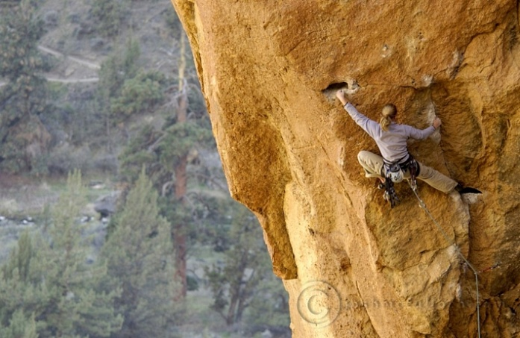
PTT 19OCT2015
How did you use the science circle over Fall Break?

Slide 2
Logistics
OAJ #6 is due on Friday 10/23
Classroom Expectation Review

Slide 3
Graphing Review
What is the TAG method?

Slide 4
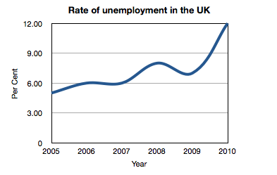
What general trend is this graph showing?\
How do you know?

Slide 5
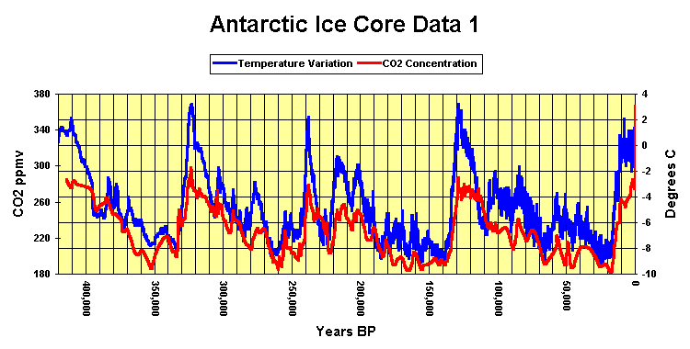
What is this graph showing us?
Let’s write a summary statement about this graph?

Slide 6
We will use short packet to review graph interpretation…

