Slide 1
Warm-Up 19OCT2015
How would you define a population?
Nature exists in several levels of complexity, what are these levels?

Slide 2
Warm-Up
How would define a population?
All the individuals of the same species that live in a given area at a particular time.
Nature exists in several levels of complexity, what are these levels?
Individual, Population, Community, Ecosystem, and Biosphere

Slide 3
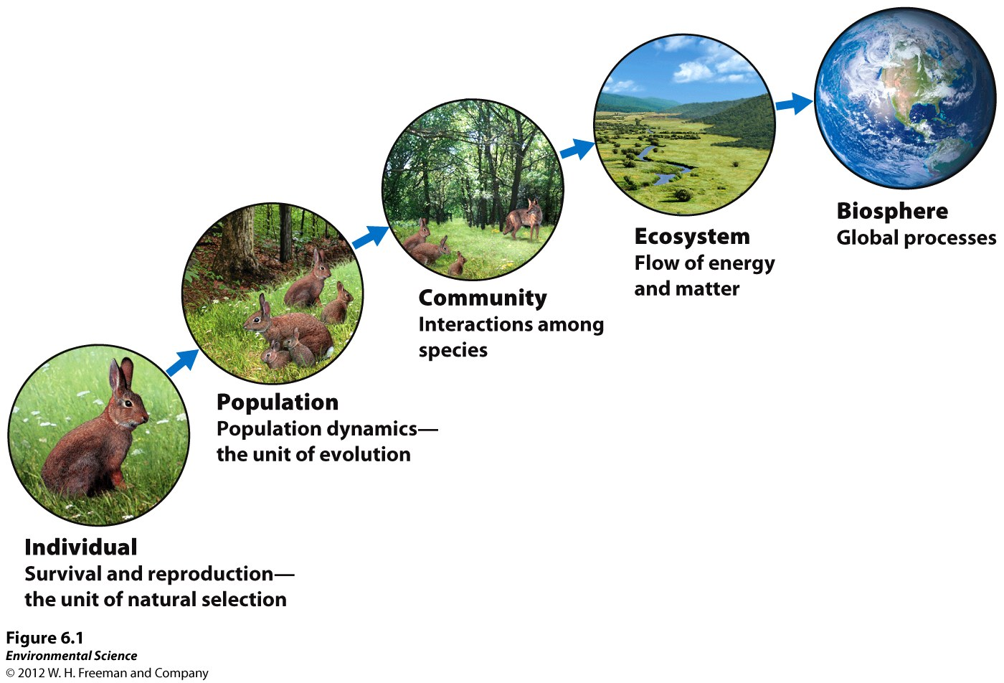

Slide 4
Logistics…
10 Vocabulary are due on Friday
READ Chapter 6 over the next week (please ask questions!!)
Density Dependent Lab (3 week lab) starts tomorrow…

Slide 5
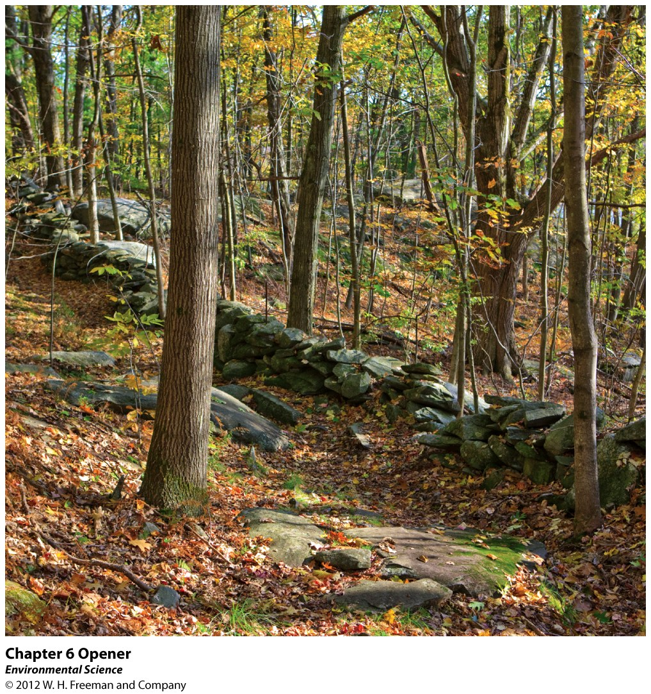

Slide 6
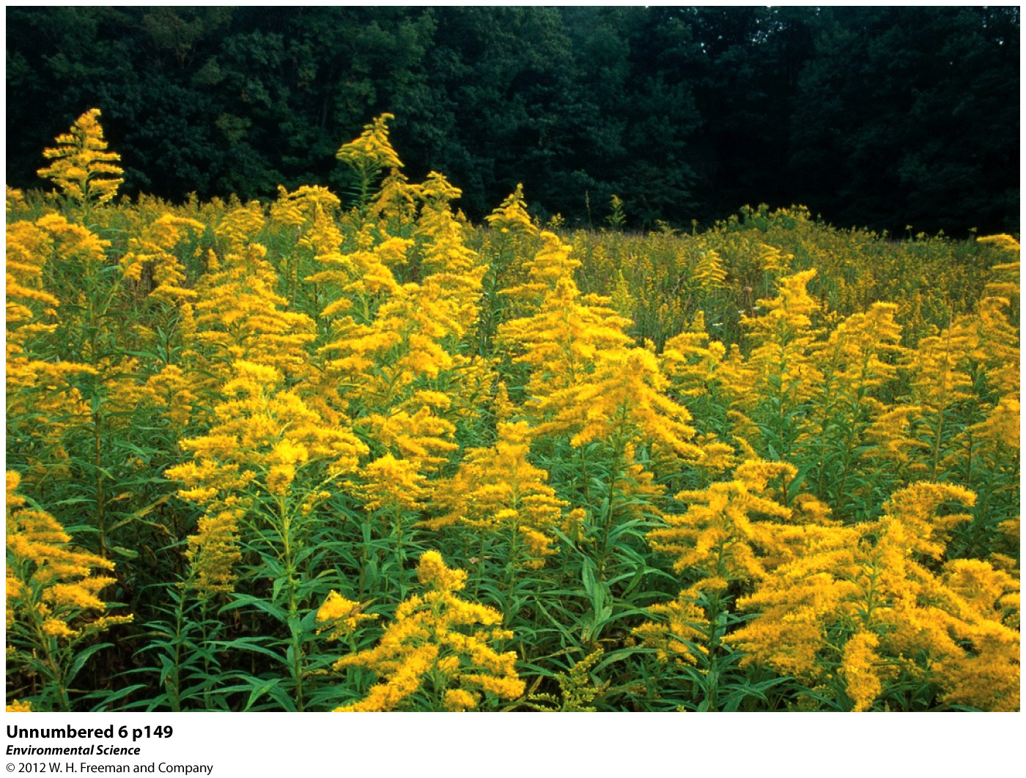

Slide 7
Key Ideas for Chapter 6
What are the levels of complexity in Nature
Compare and Contrast the ways that density dependent and density independent factors effect population size
Explain growth models, reproductive strategies, survivorship curves, and metapopulations

Slide 8
Key Ideas for Chapter 6
Describe species interactions and the importance of keystone species
Discuss ecological succession
Explain how latitude, time, area, and distance affect the species richness of a community

Slide 10
Population ecologists study the factors that regulate population abundance and distribution

Slide 12
(B + I) – (D + E) = Pop’n
(Births + Immigration) – (Deaths + Emigration)

Slide 13
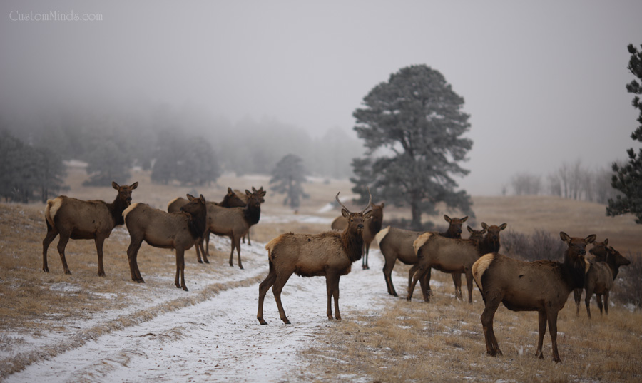
Elk are a highly studied and managed species in Colorado

Slide 14
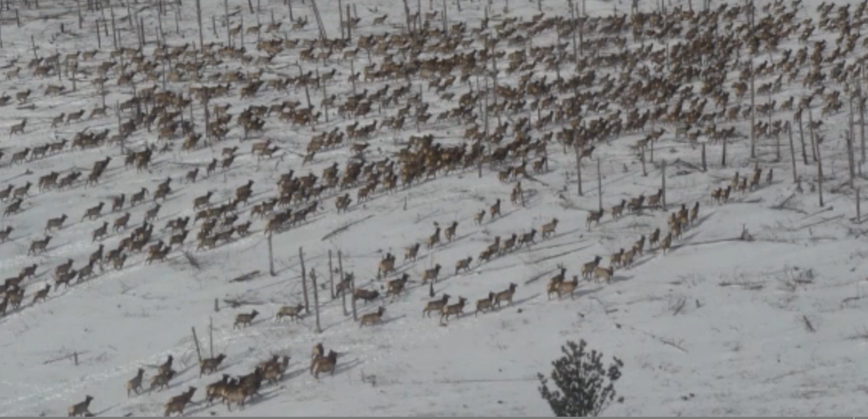
The factors Parks and Wildlife are studying:
Population Size
Population Density
Population Distribution
Population Sex Ratio
Population Age Structure

Slide 15
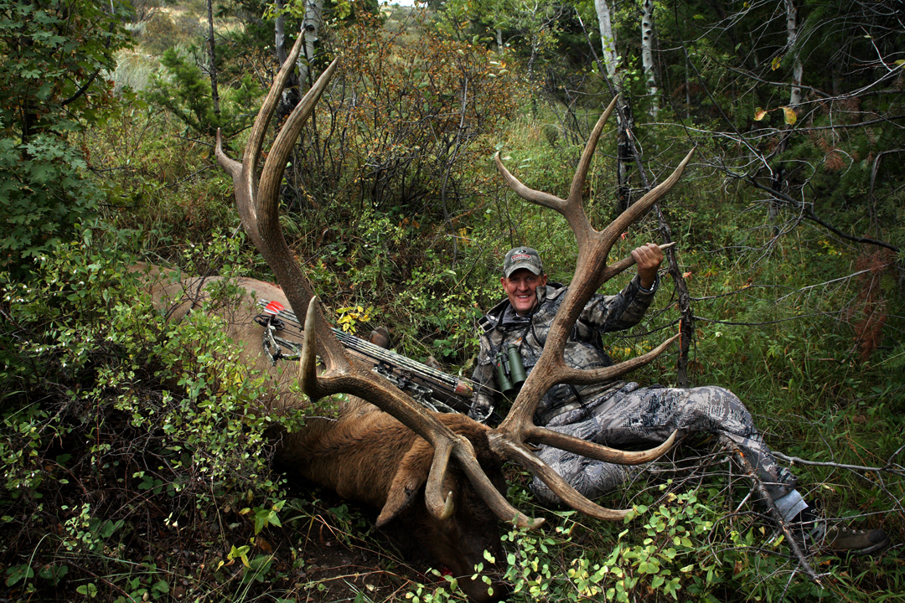
Elk are a highly studied and managed species in Colorado
Economic
Social
Environmental

Slide 16
Population Ecology
(B + I) – (D + E) = Pop’n
(Births + Immigration) – (Deaths + Emigration)

Slide 17
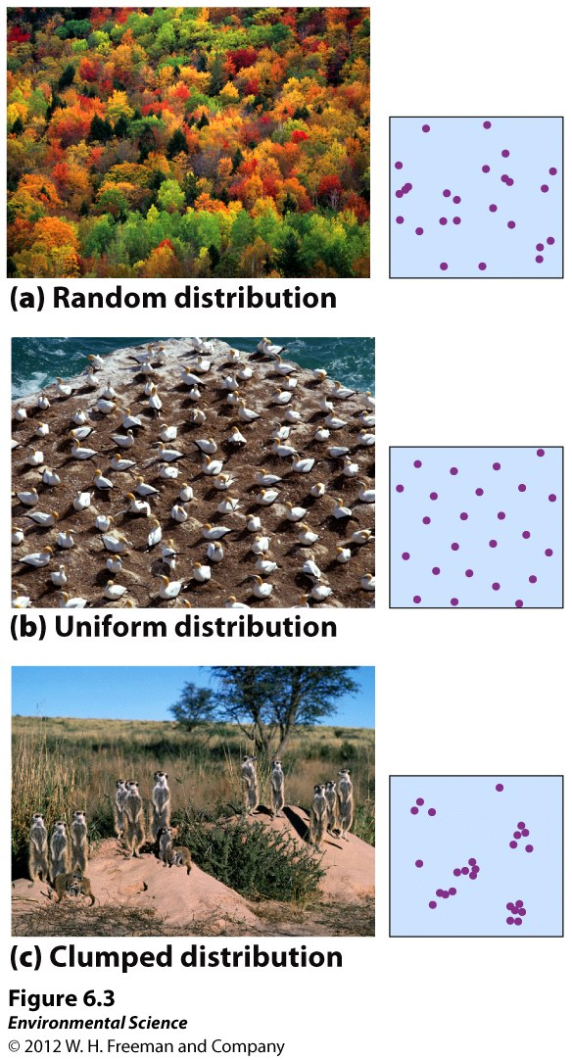

Slide 18
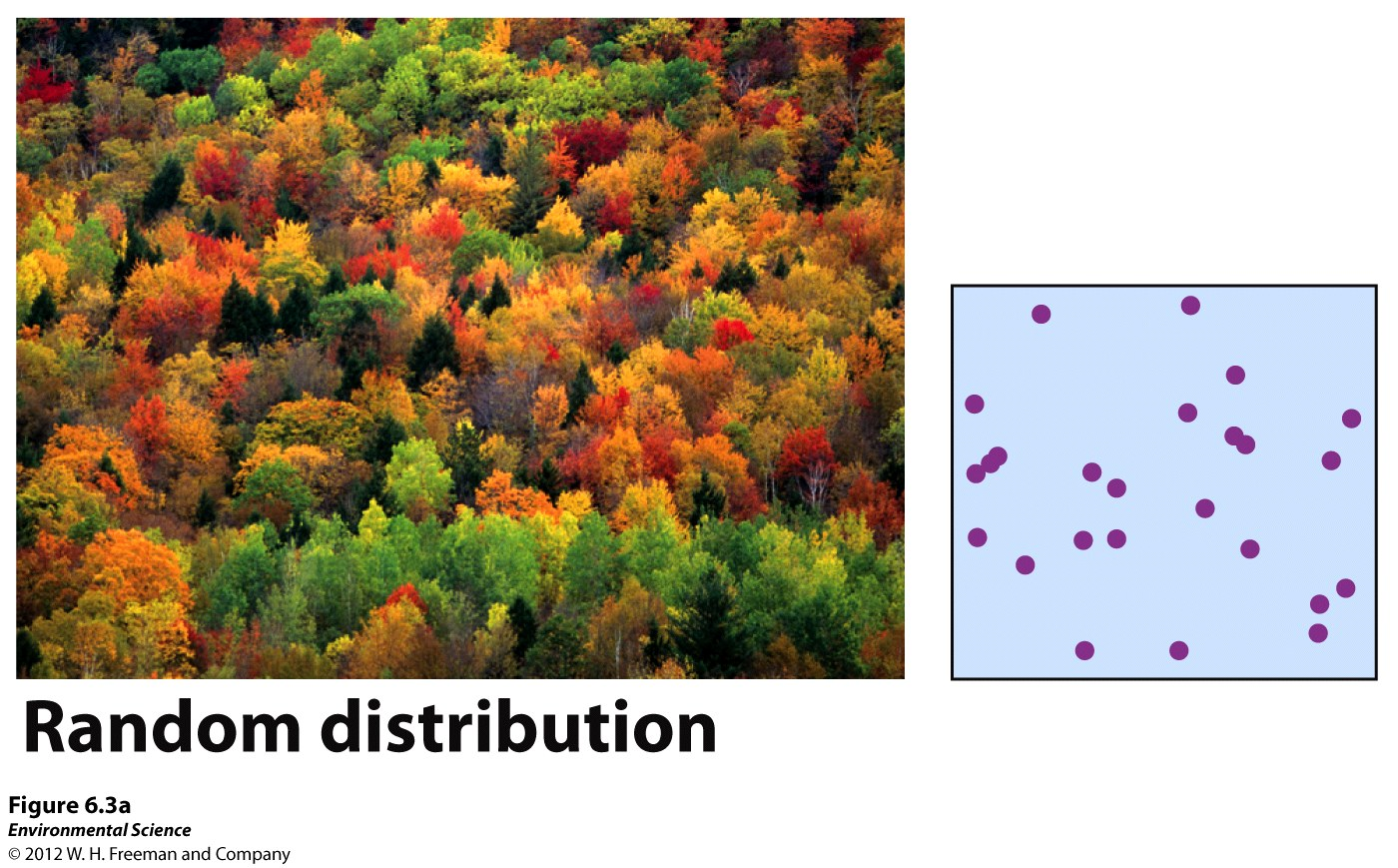

Slide 19
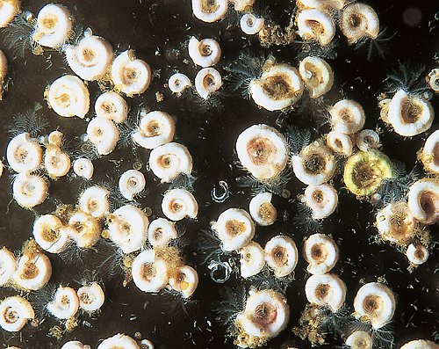
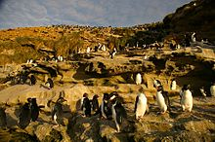
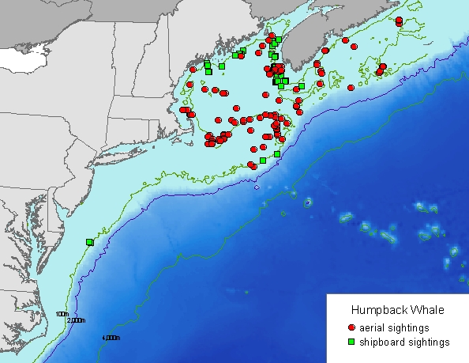

Slide 21
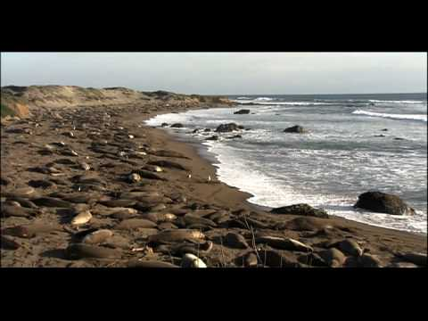
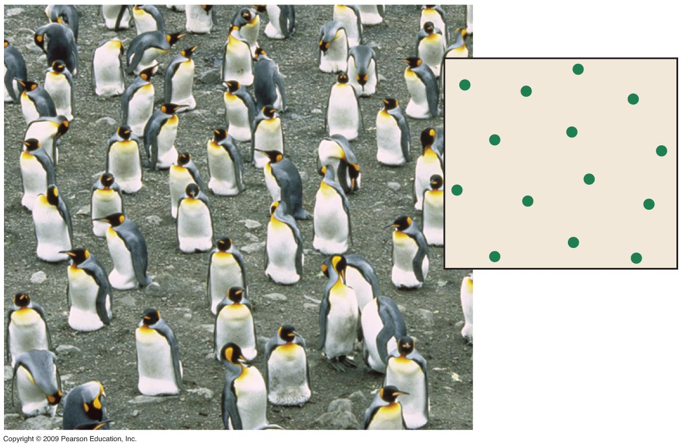
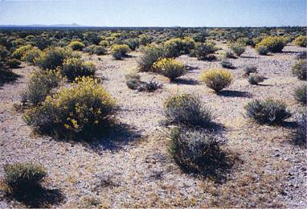

Slide 22
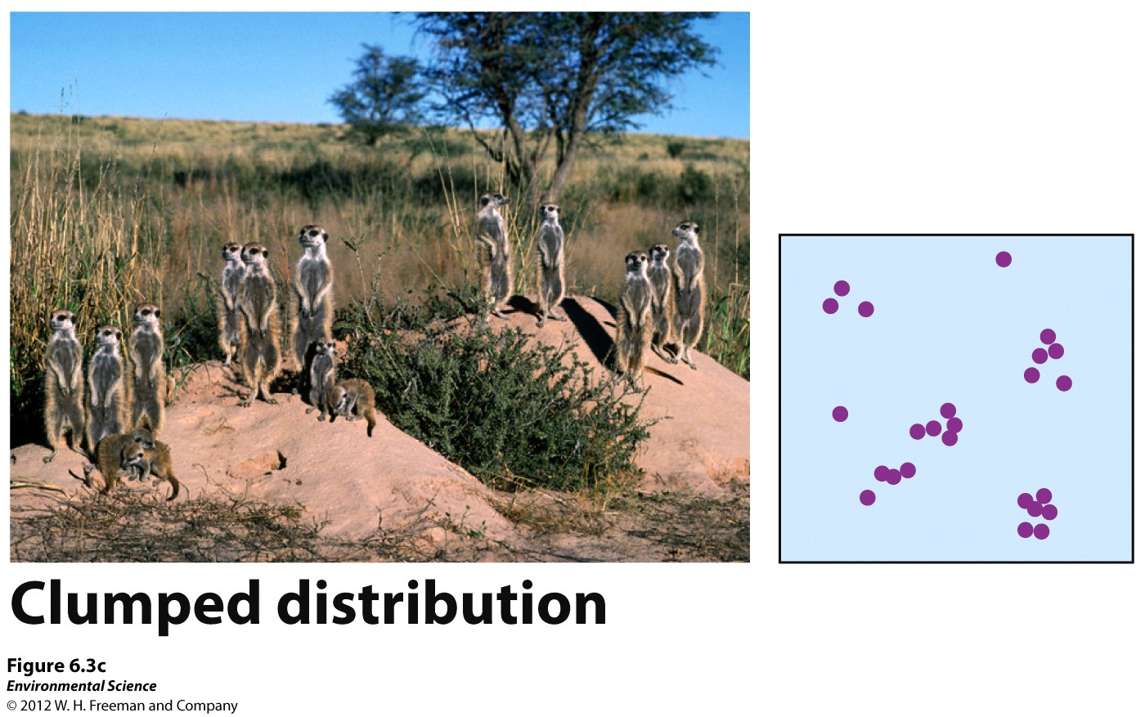

Slide 23
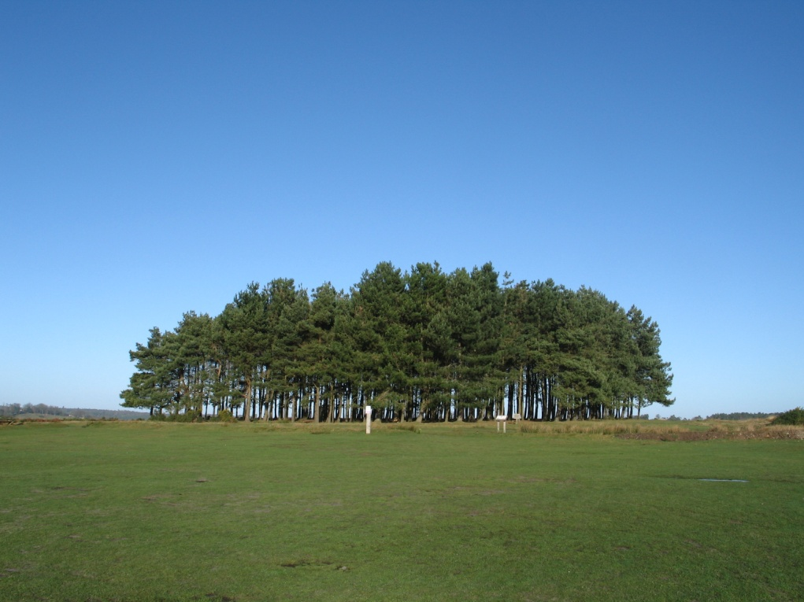
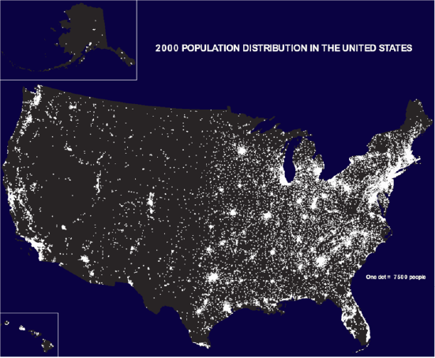

Slide 24
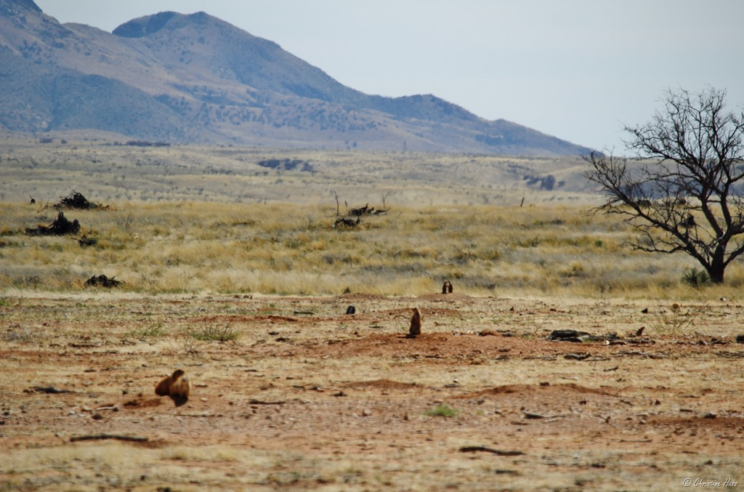

Slide 25
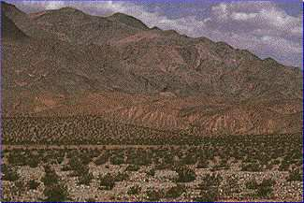

Slide 26
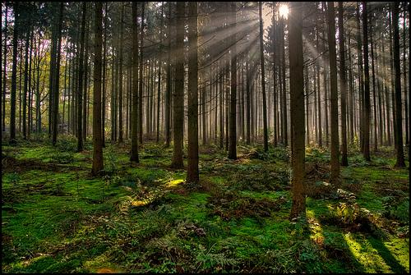

Slide 27
Density-Dependent: A factor that influences an individual’s ability to survive.
Survival and reproduction depends on the size of the population.
Density-Independent: A factor that has the same effect on an individual’s survival and reproduction at any size.
Does not depend on the population size

Slide 28
Density-Dependent: A factor that influences an individual’s ability to survive.
Survival and reproduction depends on the size of the population.
A limiting factor exists in all ecosystems

Slide 29
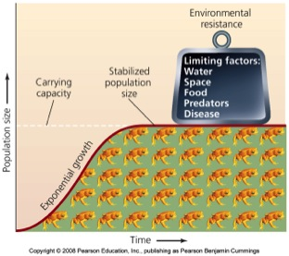
Limiting Factors
Food
Water
Space
Mates
Predators
Disease

Slide 30
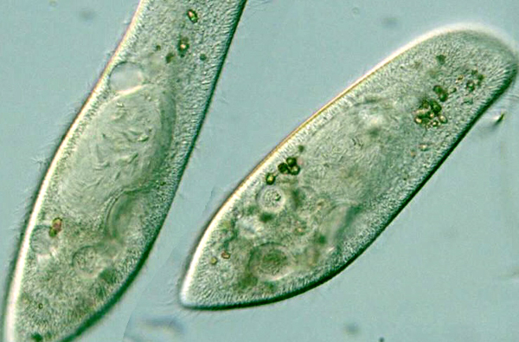
The Classic Example…

Slide 31
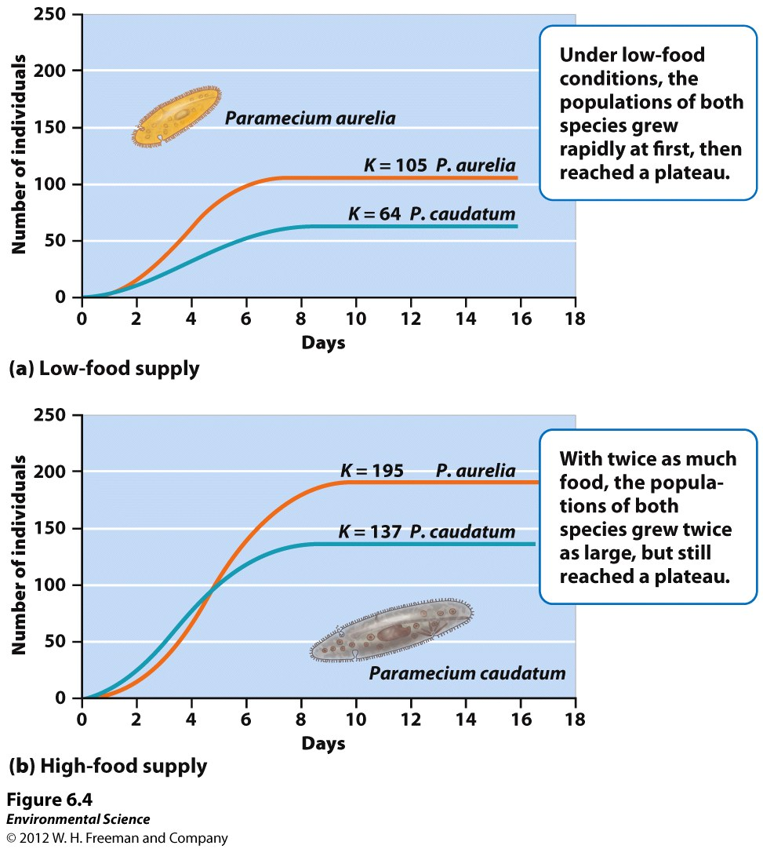

Slide 32
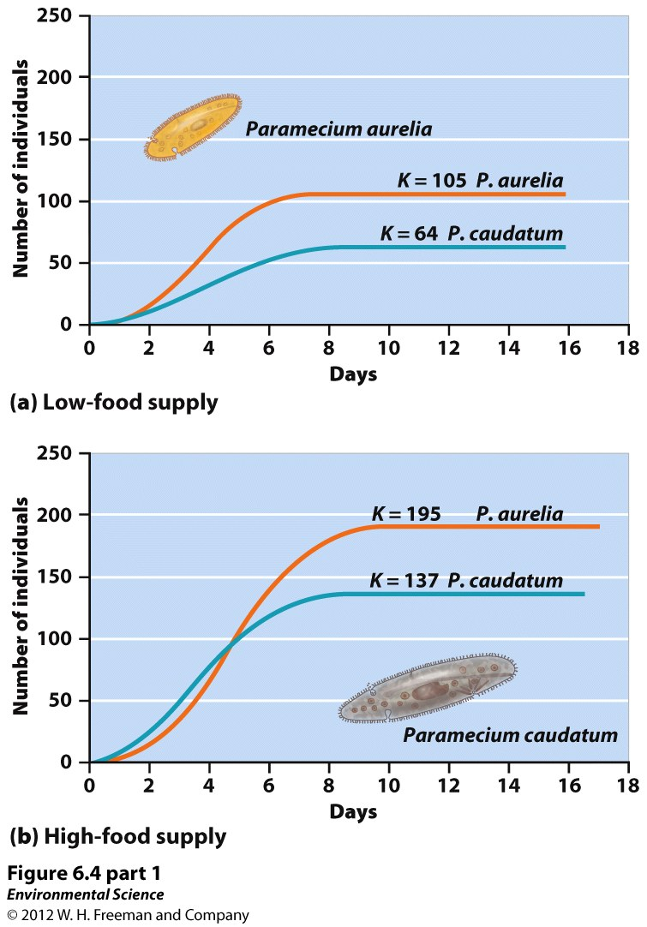

Slide 33
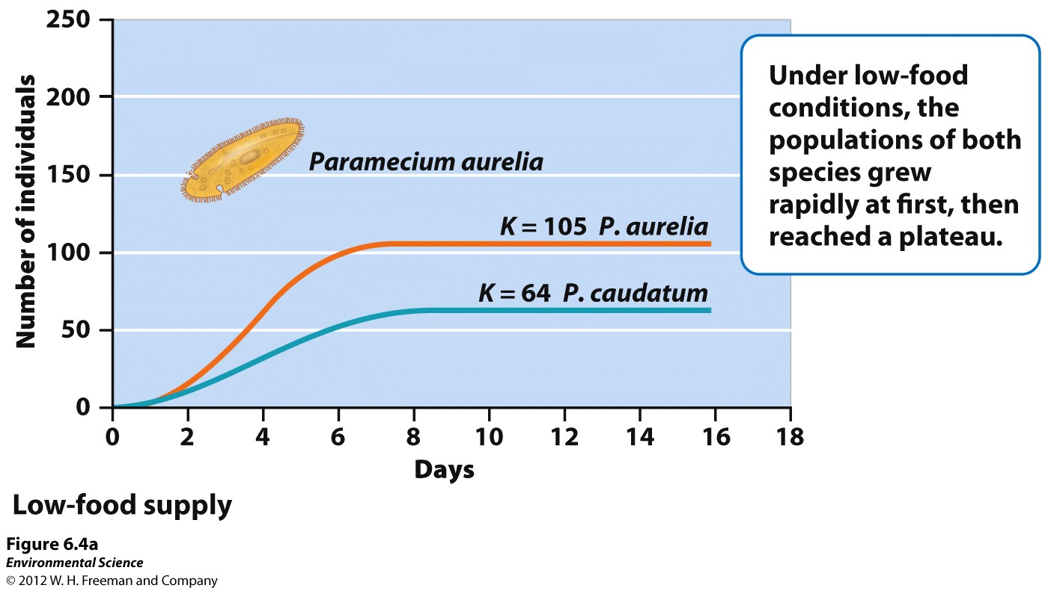

Slide 34
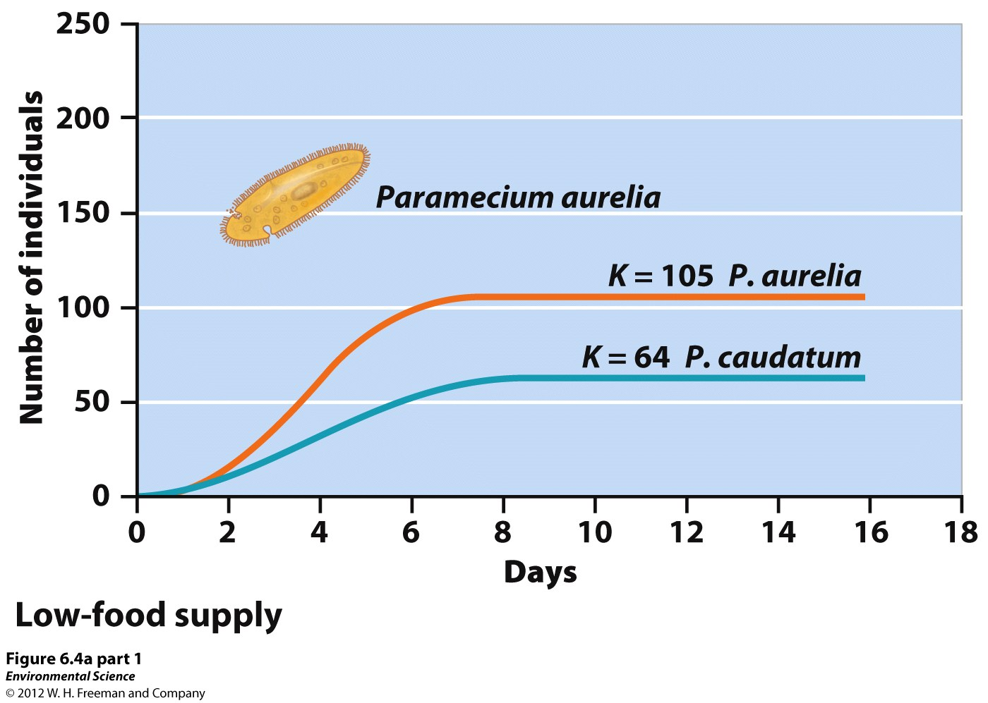

Slide 35
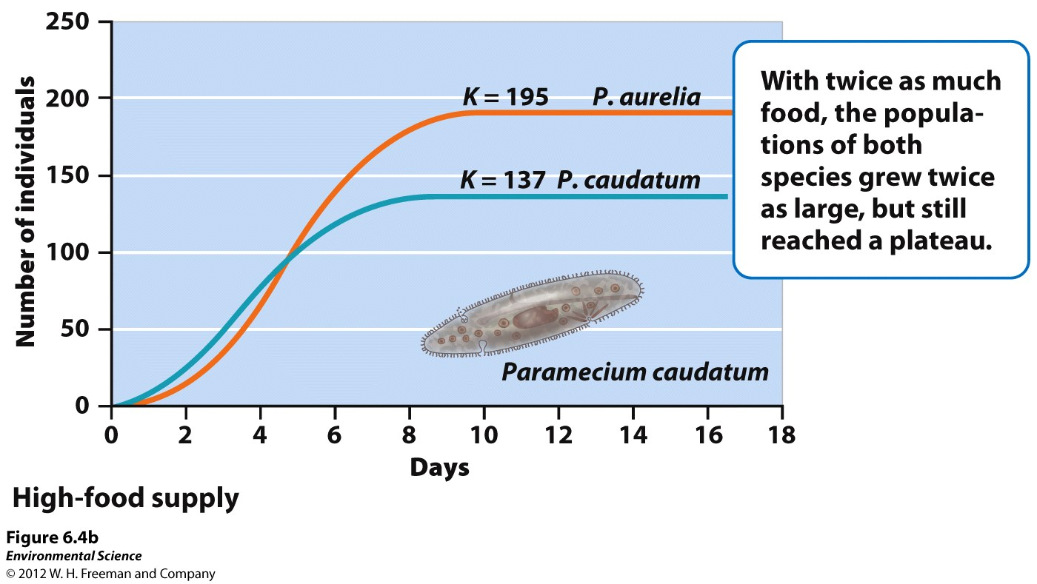

Slide 36
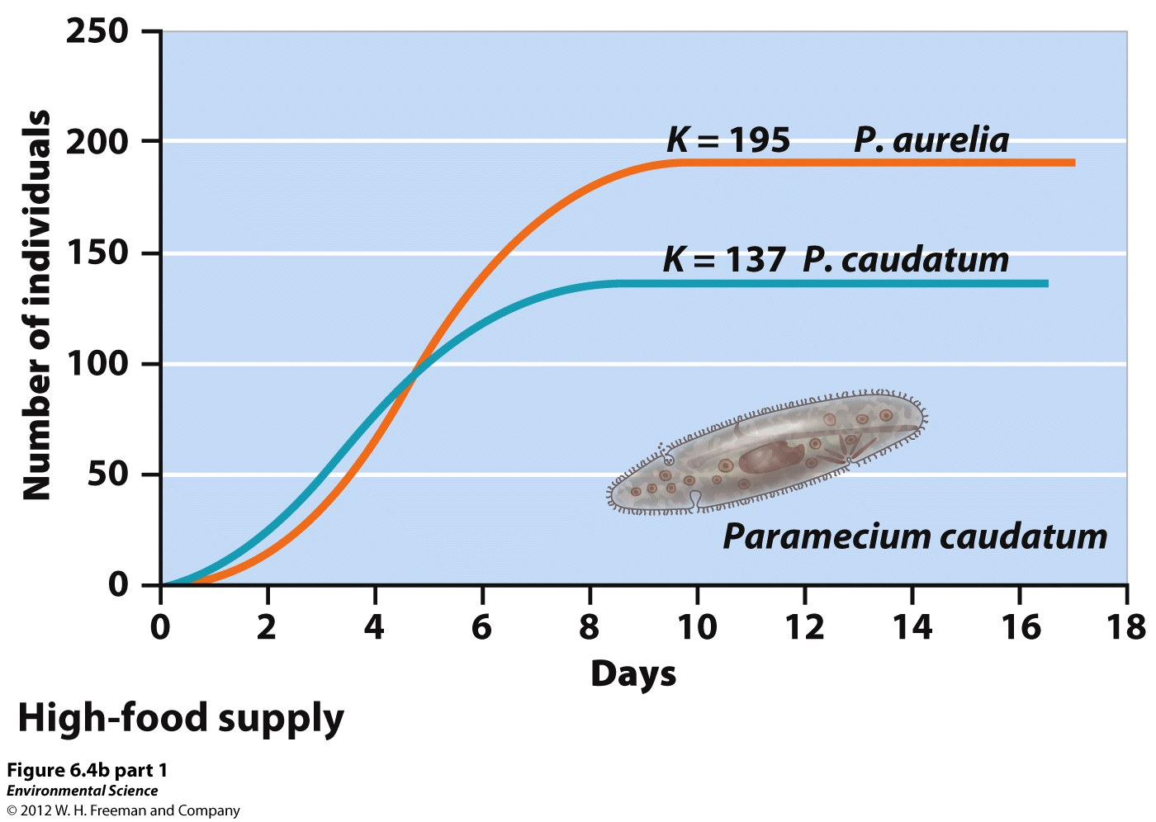

Slide 37
Limiting Factors
Food
Water
Space
Mates
Predators
Disease

Slide 38
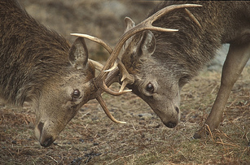
Colorado fall is the time for Mule Deer and Elk “rut”
Males compete for mates

Slide 39
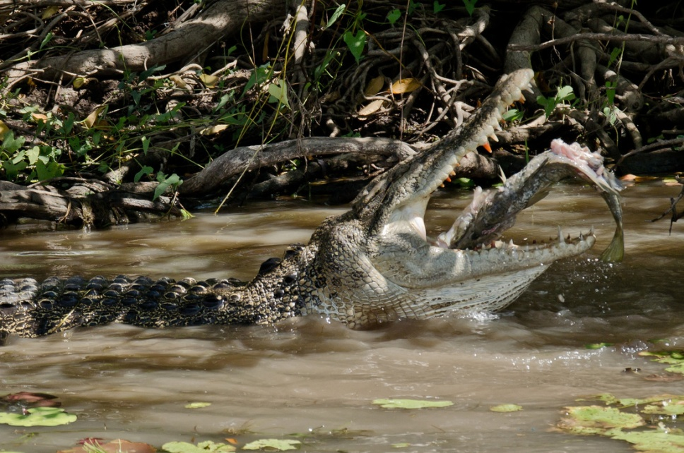
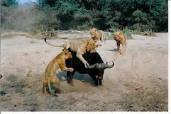
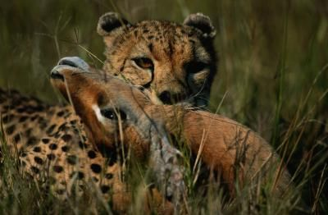
Predation

Slide 40
Space

Slide 41
Carrying Capacity
When the limit of the population is reached.
The largest number of individuals a given area can SUSTAINABLY support.

Slide 42
Limiting Factors
Food
Water
Space
Mates
Predators
Disease

Slide 43
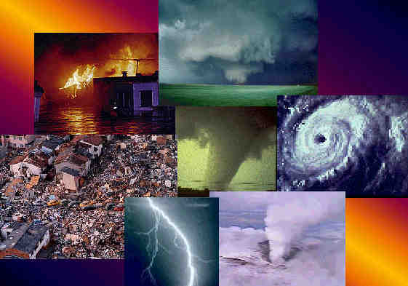
Density-Independent: A factor that has the same effect on an individual’s survival and reproduction at any size.
Does not depend on the population size

Slide 44
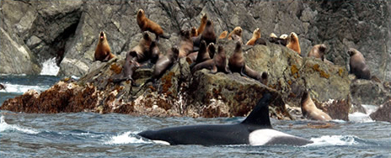
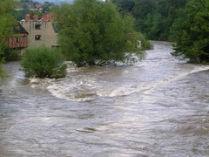
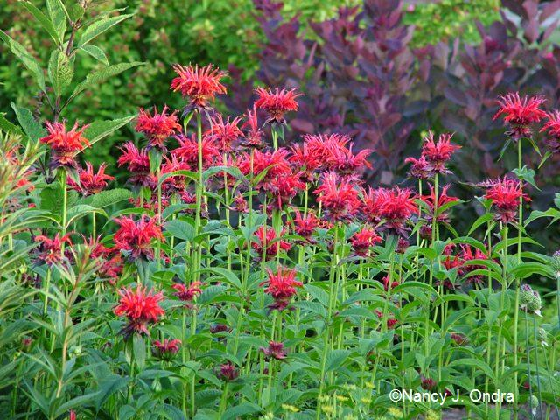
Density Independent or
Density Dependent?

Slide 45
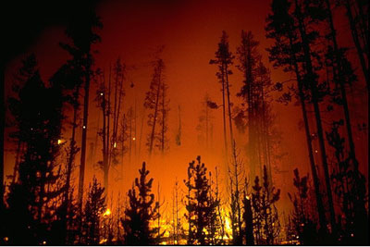
Density Independent or
Density Dependent?

Slide 46
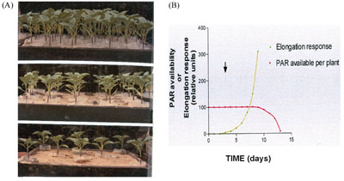
Density Independent or
Density Dependent?
How does density affect plant growth?

Slide 48
Carrying Capacity
When the limit of the population is reached.
The largest number of individuals a given area can SUSTAINABLY support.

Slide 49
What factors regulate the size of the population?
What did Gause discover in his classic experiment?
What is the difference between density-dependent and density-independent factors that influence population size?
Give an example of each.

Slide 51
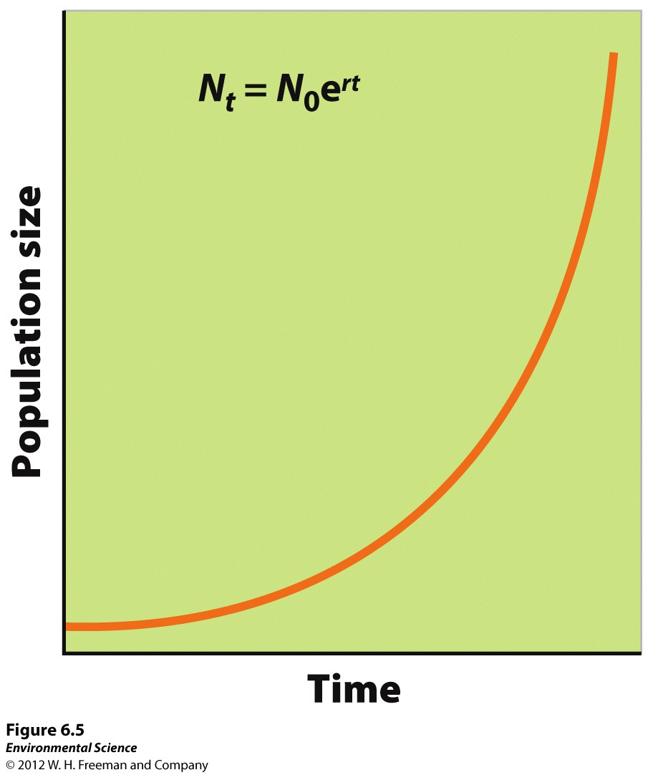

Slide 52
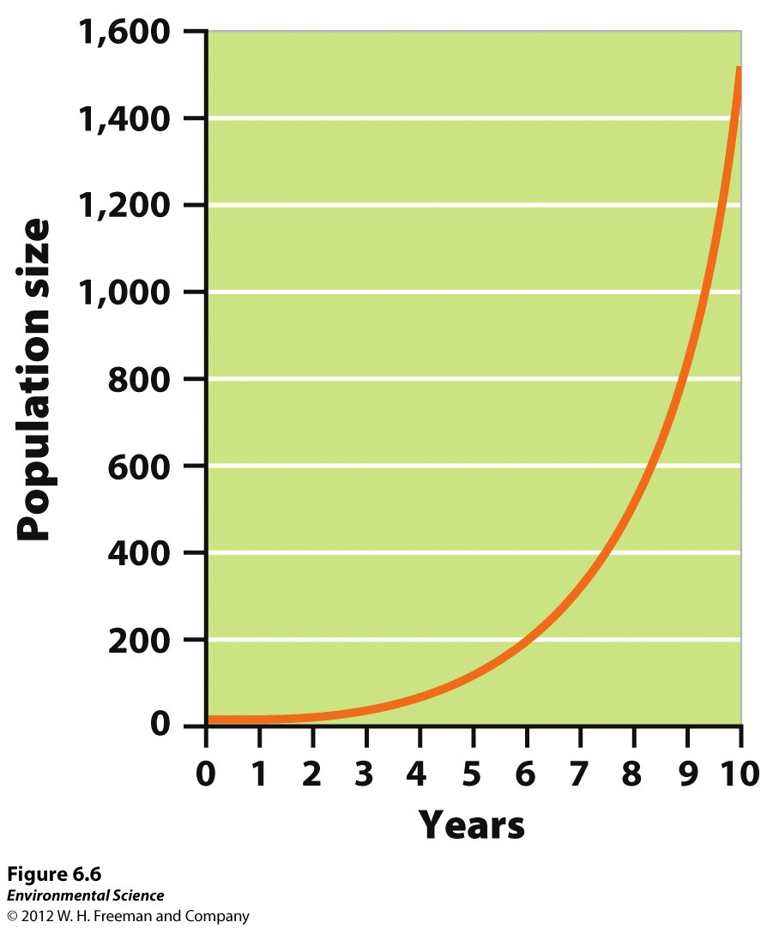

Slide 53
