Slide 1
Warm-Up 05OCT2015
What are the 5 Global Environmental Health Indicators?

Slide 2

Five global Environmental Indicators
Biological Diversity
Food Production
Average surface temperature and CO2 concentrations
Human Population
Resource Depletion

Slide 3
Logistics
Classroom stuff:
NO MORE FOOD! ONLY WATER BOTTLES!
Cell phones are not allowed unless given specific permission to use for academic reasons only.
Galapagos is due today.
At this point you should have started reading chapter 5, Please finish by Wednesday to allow study time for your…
Chapter 4/5 Celebration: Friday (10/9)

Slide 4
Climate Factors
TEMPERATURE
Latitude (distance from the equator)
Altitude (elevation above sea level)
Distance from the ocean
PRECIPITATION
Prevailing Winds (most common wind direction)
Topography (proximity to the mountains: windward or leeward side of the mountains)

Slide 5
Earth is characterized by patterns of temperature and precipitation.
In the end, this is driven by the unequal heating of the Earth by the sun, Earth rotation, and geographic features.

Slide 6
On a global scale these variations in climate (temperature and precipitation) have given rise to the distinct biomes around the world.

Slide 7
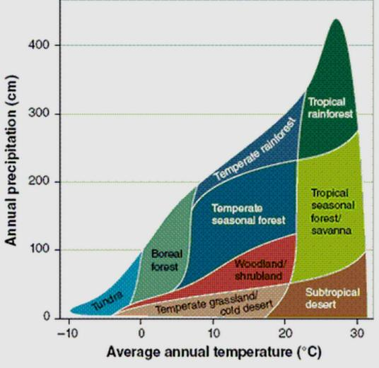
Terrestrial biomes are defined by their unique plant communities.

Slide 8
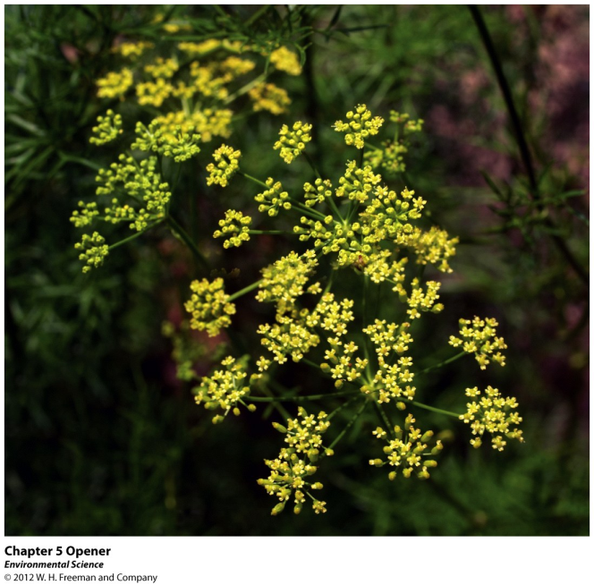
Chapter 5
Evolution of Biodiversity

Slide 9
Five global Environmental Indicators
Biological Diversity
Food Production
Average surface temperature and CO2 concentrations
Human Population
Resource Depletion

Slide 10
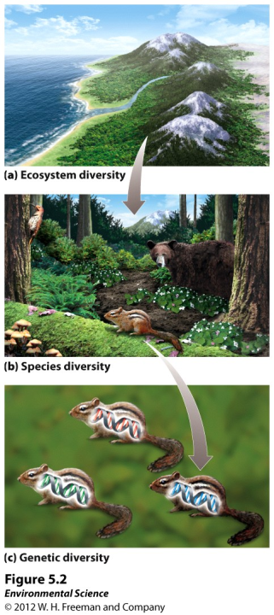
Earth is home to a tremendous diversity of species
Ecosystem diversity- the variety of ecosystems within a given region.

Slide 11
Earth is home to a tremendous diversity of species
Species diversity- the variety of species in a given ecosystem.

Slide 12
Earth is home to a tremendous diversity of species
Genetic diversity- the variety of genes within a given species.

Slide 14
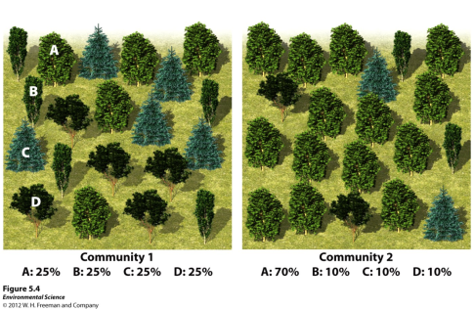
Species richness- the number of species in a given area.
Species evenness- the measure of whether a particular ecosystem is numerically dominated by one species or are all represented by similar numbers of individuals.

Slide 15
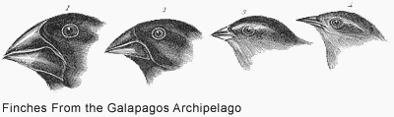

Evolution is the mechanism underlying biodiversity
Evolution- a change in the genetic composition of a population over time.

Slide 16
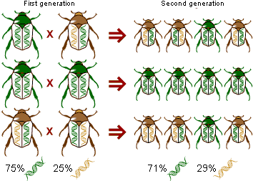
Evolution is the mechanism underlying biodiversity
Microevolution- evolution below the species level.

Slide 17
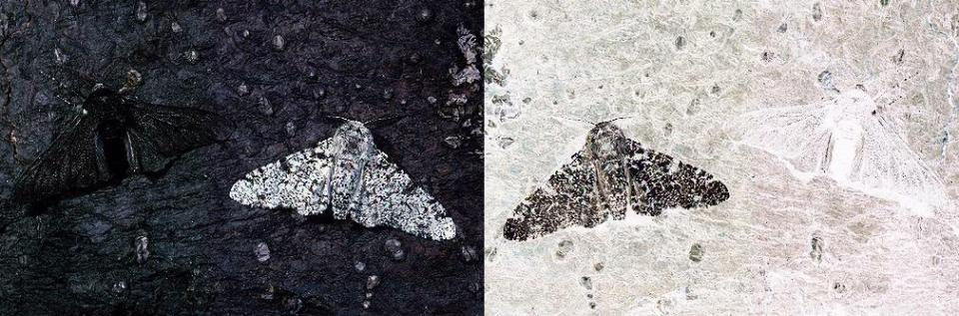

Slide 18
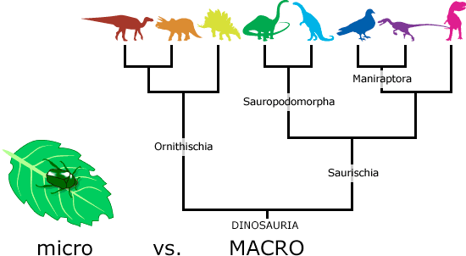
Evolution is the mechanism underlying biodiversity
Macroevolution- Evolution which gives rise to new species or new genera, family, class or phyla.

Slide 19
Creating Genetic Diversity
Genes- physical locations on chromosomes within each cell of an organism.
Genotype- the complete set of genes in an individual.
Mutation- a random change in the genetic code.
Phenotype- the actual set of traits expressed in an individual.

Slide 21
Warm-up 06OCT2015
Compare and contrast species richness and species evenness.
Compare and contrast macro and micro evolution.

Slide 22
Macroevolution- Evolution which gives rise to new species or new genera, family, class or phyla.

Slide 23
Species richness- the number of species in a given area.
Species evenness- the measure of whether a particular ecosystem is numerically dominated by one species or are all represented by similar numbers of individuals.

Slide 24
Evolution is the mechanism underlying biodiversity
“Nothing in Biology makes sense except in the light of evolution.” Theodosius Dobzhansky

Slide 25
Evolution by artificial and natural selection
Evolution by artificial selection- when humans determine which individuals breed.
Evolution by natural selection- the environment determines which individuals are most likely to survive and reproduce.

Slide 26
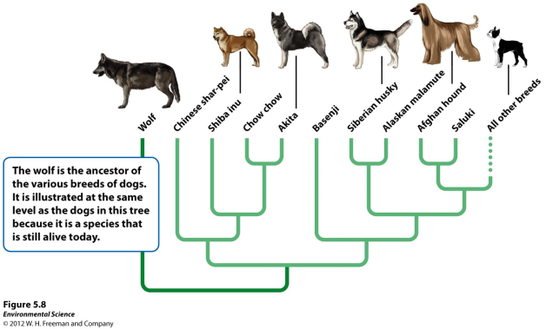
Evolution by artificial and natural selection
Evolution by artificial selection- when humans determine which individuals breed.

Slide 27
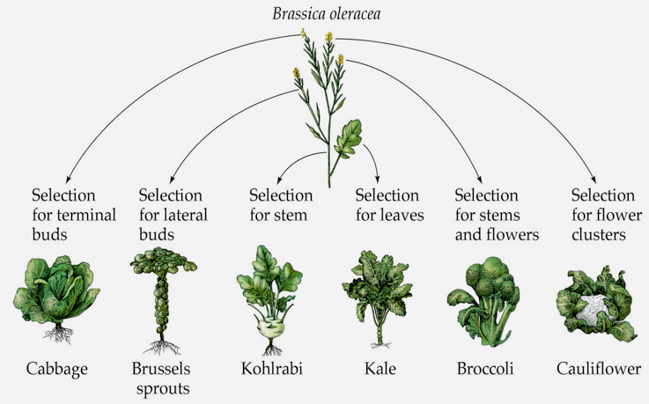
Natural or Artificial?

Slide 28
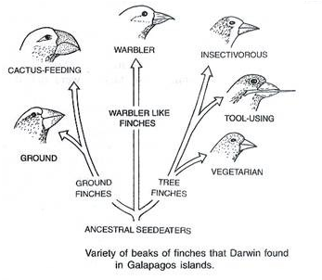
Natural or Artificial?

Slide 29
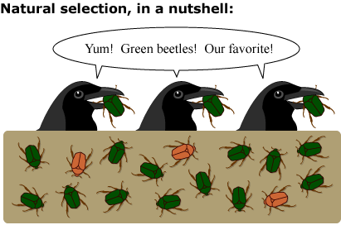
Evolution by artificial and natural selection
Evolution by natural selection- the environment determines which individuals are most likely to survive and reproduce.

Slide 30
Darwin’s theory of evolution by natural selection
Individuals produce an excess of offspring.
Not all offspring can survive.

Slide 31
Darwin’s theory of evolution by natural selection
Individuals produce an excess of offspring.
Not all offspring can survive.
Individuals differ in their traits.
Differences in traits can be passed on from parents to offspring.

Slide 32
Darwin’s theory of evolution by natural selection
Individuals produce an excess of offspring.
Not all offspring can survive.
Individuals differ in their traits.
Differences in traits can be passed on from parents to offspring.
Differences in traits are associated with differences in the ability to survive and reproduce.

Slide 33
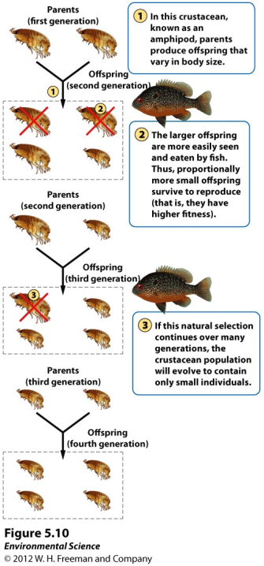

Slide 34
Evolution by Random Processes
Mutation- occur randomly and can add to the genetic variation of a population.
Genetic drift- change in the genetic composition of a population over time as a result of random mating.
Bottleneck effect- a reduction in the genetic diversity of a population caused by a reduction in its size.
Founder effect- a change in a population descended from a small number of colonizing individuals.

Slide 36
Mutation- occur randomly and can add to the genetic variation of a population.

Slide 37
Genetic drift- change in the genetic composition of a population over time as a result of random mating.
Think moth example

Slide 38
Bottleneck effect- a reduction in the genetic diversity of a population caused by a reduction in its size.

Slide 39
Founder effect- a change in a population descended from a small number of colonizing individuals.

Slide 40
What are the four ways to randomly evolve?
How does evolution lead to biodiversity?

Slide 41
The pace of evolution

Slide 42
The pace of evolution

Slide 43
The pace of evolution

Slide 44
The pace of evolution

Slide 45
The pace of evolution

Slide 46
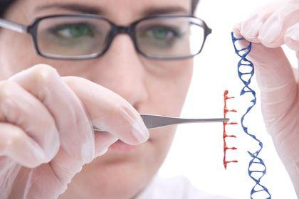
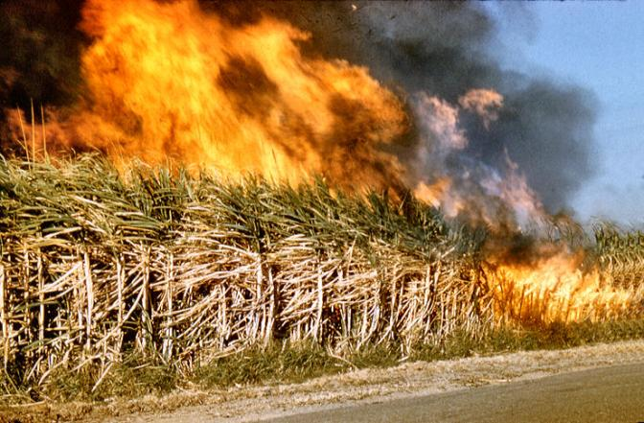
Genetic Engineering

Slide 47
How does geographic isolation lead to reproductive isolation?
What factors influence a species chances of adapting successfully to a change in its environment?
Why is the pace of human-driven evolution faster than that of natural evolutionary processes?

Slide 48
Something to ponder…
Humans are altering the Abiotic factors of the global environment. For example: the burning of fossil fuels that contributes to global warming.
What will happen to species around the world?

Slide 49
How do fundamental niches and realized niches differ?

Slide 50
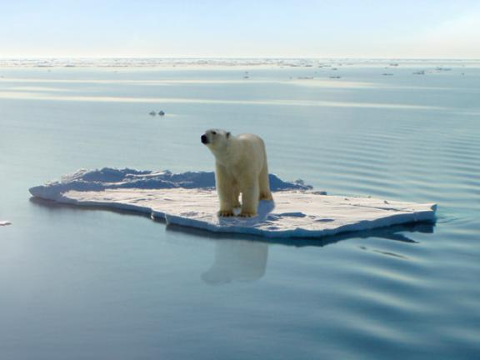
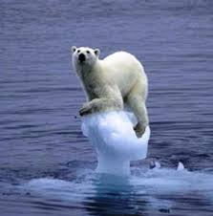
Environmental changes
Abiotic or Biotic

Slide 51
Environmental Changes
Habitat Loss or degradation
Overharvesting
Invasive species
Climate change
Emerging diseases
Measurable through time

Slide 52
Extinction Ecology (yikes!)

Slide 53
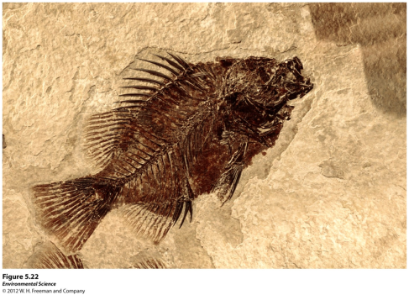
The Fossil Record
Fossils- remains of organisms that have been preserved in rock. Much of what we know about evolution comes from the fossil record.

Slide 54
Extinction Causes
Species cannot adapt to the environmental changes fast enough
  The species cannot physically access habitat (can not migrate)
  If they can move the species can not out compete the residents already in the area

Slide 55
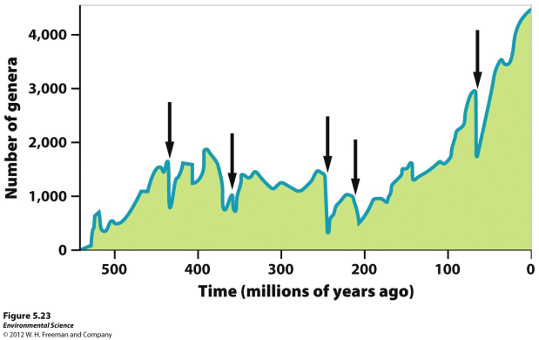
The Five Global Mass Extinctions
Mass extinction- when large numbers of species went extinct over a relatively short period of time.

Slide 56
The Sixth Mass Extinction
Scientists feel that we are in our sixth mass extinction, occurring in the last two decades.
Estimates of extinction rates vary widely, from 2 % to 25% by 2020.
In contrast to previous mass extinctions, scientists agree that this one is caused by humans.

Slide 57
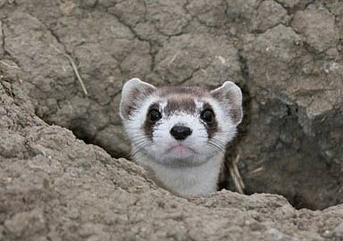
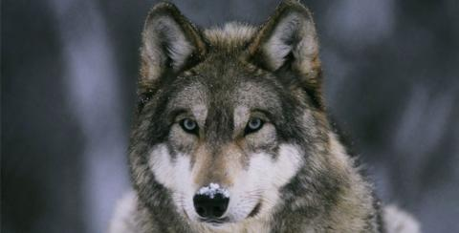
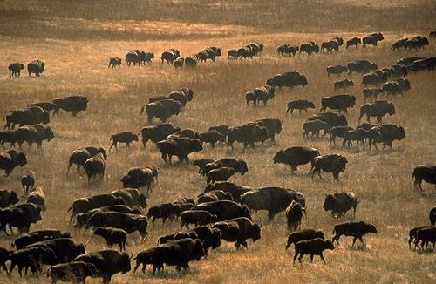
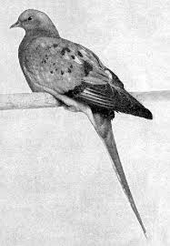

Slide 58
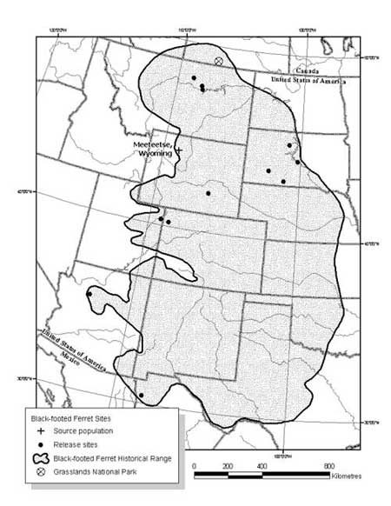

Slide 59
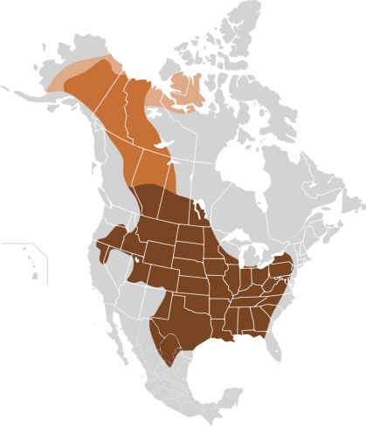
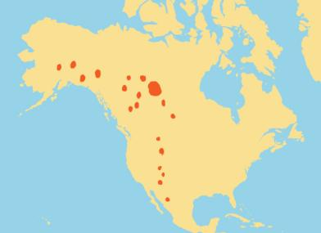

Slide 60
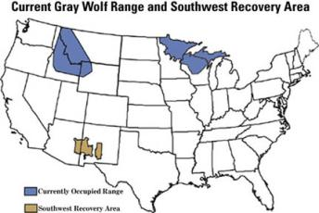
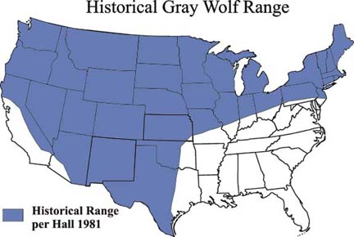

Slide 61
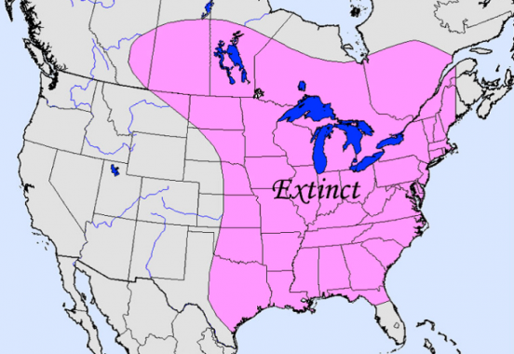

Slide 62
How does environmental change determine species distribution? Why does it lead to extinction?
How are human activities affecting extinction rates, and why is their impact a particular concern?

Slide 64
Warm-up 07OCT2015
What is so special about the 6th great extinction?
What are the factors that effect the pace of evolution?

Slide 65
Warm-up 07OCT2015
What is so special about the 6th great extinction?
    Human Driven
What are the factors that effect the pace of evolution?
  Environmental change
  Genetic variation
  Population Size
  Generation Time

Slide 66
Environmental Changes
Habitat Loss or degradation
Overharvesting
Invasive species
Climate change
Emerging diseases

Slide 67
Biodiversity
Speciation and Extinction combine to determine present day biodiversity.

Slide 68
Evolution shapes ecological niches and determines species distributions
Range of tolerance- all species have an optimal environment in which it performs well. The limit to the abiotic conditions they can tolerate is known as the range of tolerance.
Fundamental niche- the ideal conditions for a species.

Slide 69
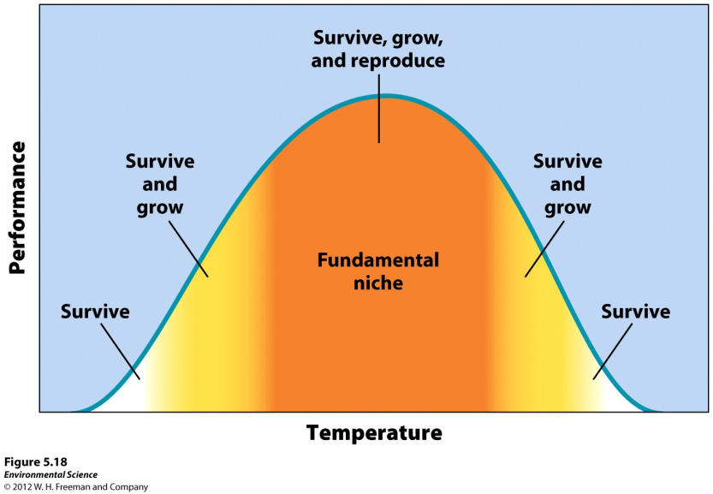

Slide 70
Niches
Realized niche- the range of abiotic and biotic conditions under which a species lives. This determines the species distribution, or areas of the world where it lives.
Niche generalist- species that live under a wide range of conditions.
Niche specialist- species that live only in specific habitats.

Slide 71
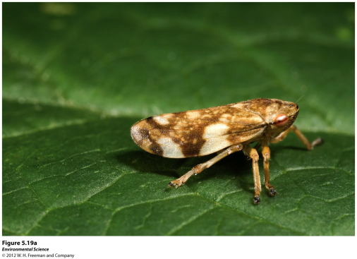
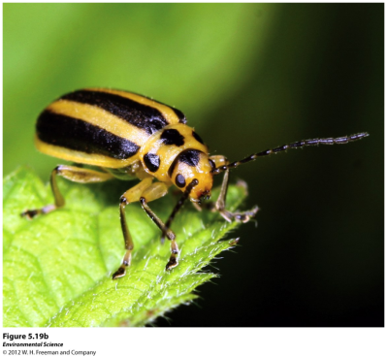
Meadow Spittlebug, generalist Skeletonizing leaf beetle, specialist

Slide 72
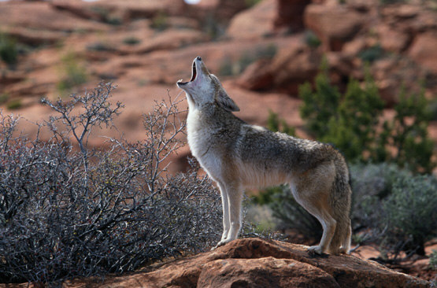
Coyote, generalist Black Footed Ferret, specialist
(BFFs)

Slide 73
Niche determines species distributions
(Abiotic + Biotic = Ecosystem)

Slide 74
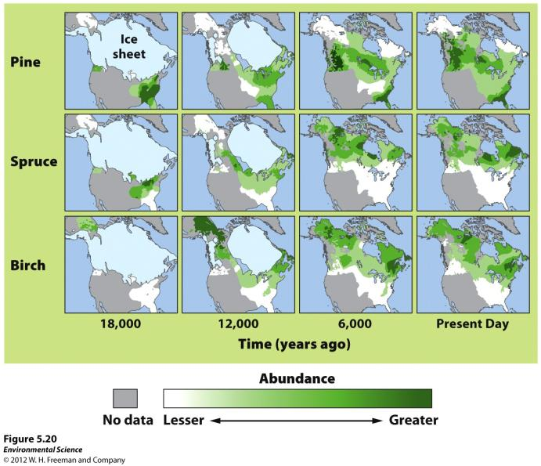

Slide 75
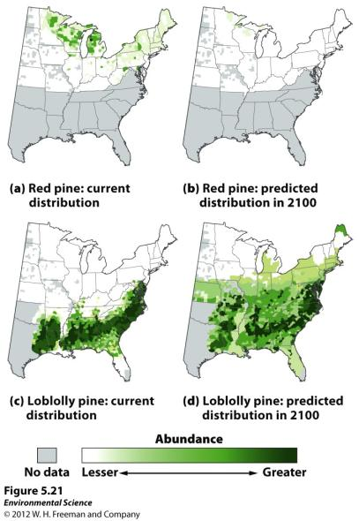

Slide 76
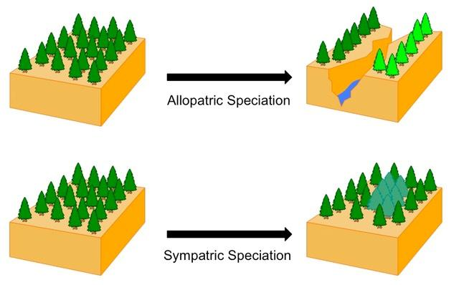
Biodiversity
Allopatric and sympatric speciation are common ways new species arise

Slide 77
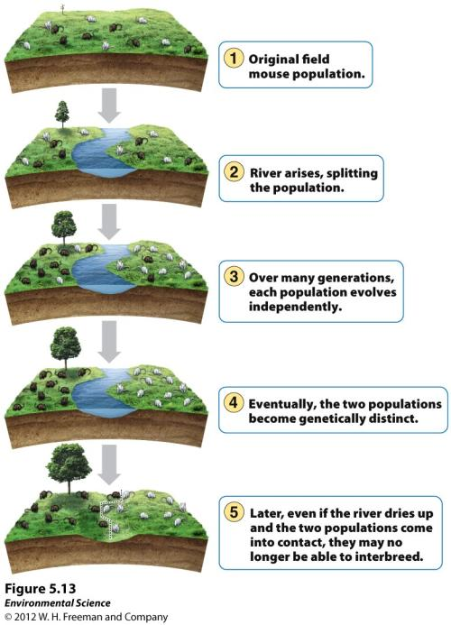
Allopatric Speciation

Slide 78
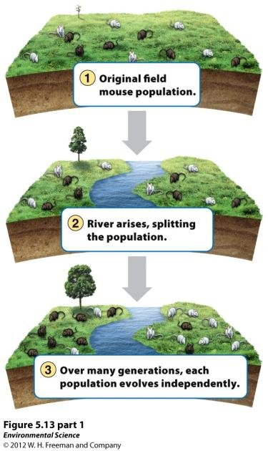

Slide 79
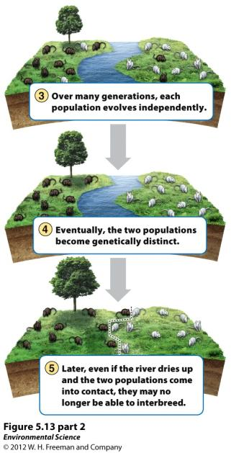

Slide 80
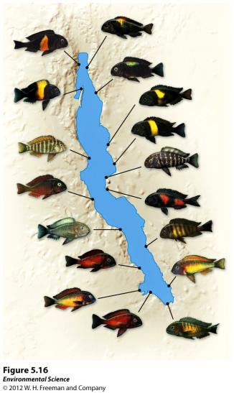
Sympatric Speciation
Species evolve from the random ways we discussed yesterday
  Mutation
  Bottleneck
  Founder effect
  Genetic Drift

Slide 81
Compare and contrast sympatric and allopatric speciation.

Slide 82
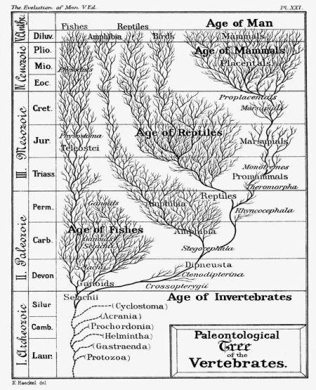
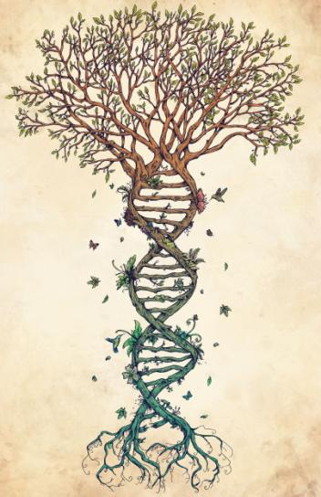
Phylogentic Trees

Slide 83
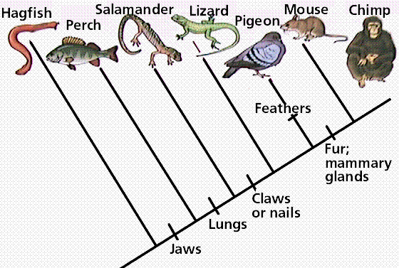
Phylogentic Trees
Groups organisms by shared traits

Slide 84
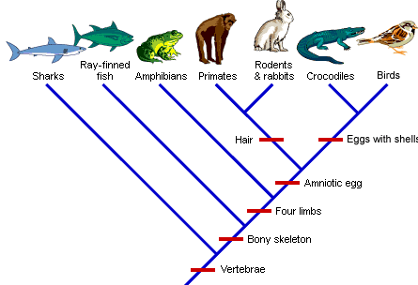

Slide 85
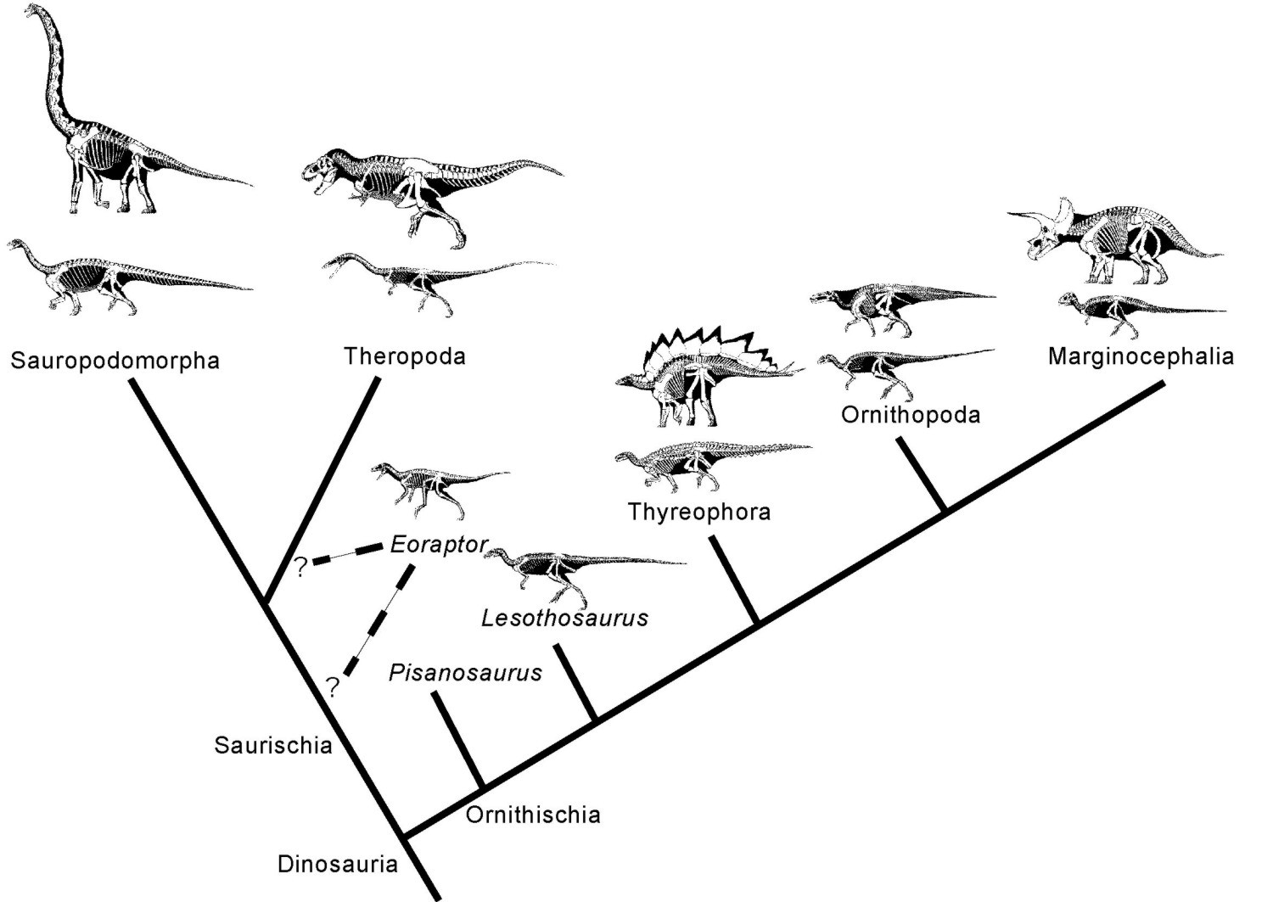

Slide 86
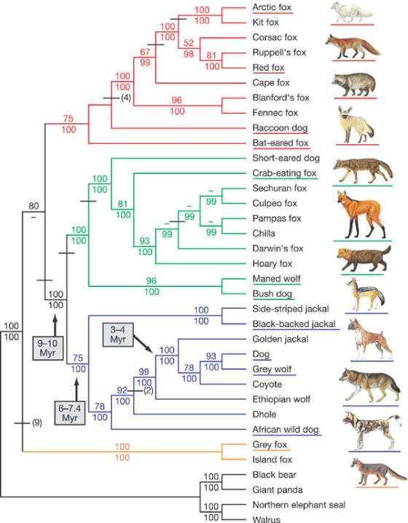

Slide 87
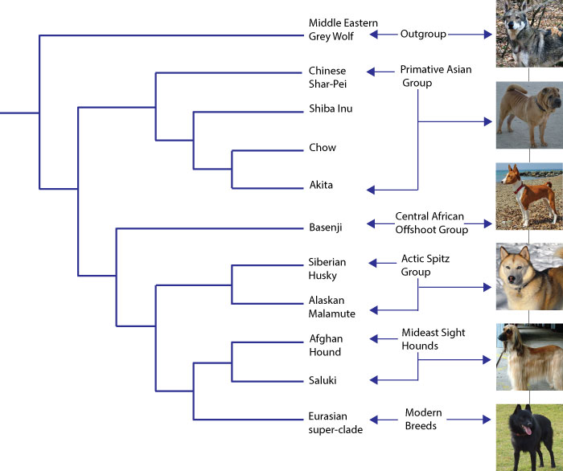

Slide 88
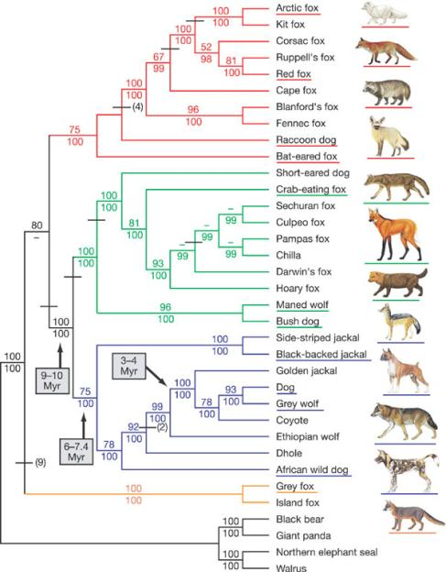

What is another way we can compare these phylogenetic trees?

Slide 89
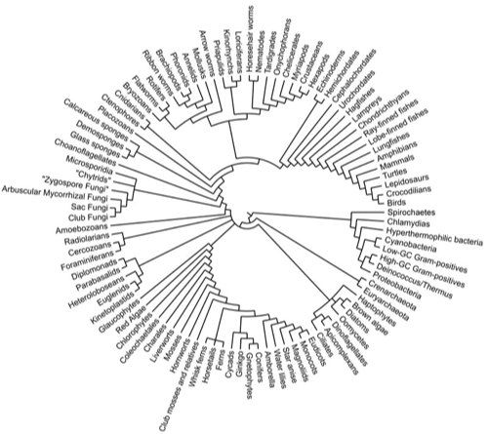
Phylogenetic Tree based on Genetics

