Slide 1
Ocean
Kalynn & Walter

Slide 2
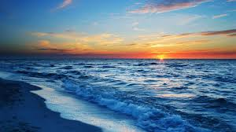
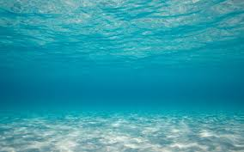
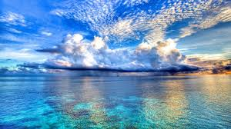
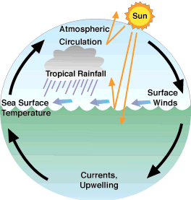
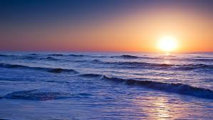
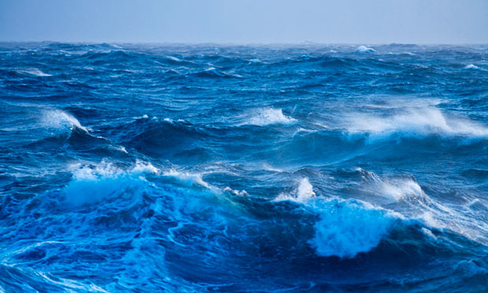
Physical
Chemical; salinity, dissolved gases Physical; temperature, density, buoyancy, waves, tides, and currents.
Are properties of ocean water that delicately cross each other to produce one of the most self-sustaining life support systems on earth.

Slide 3
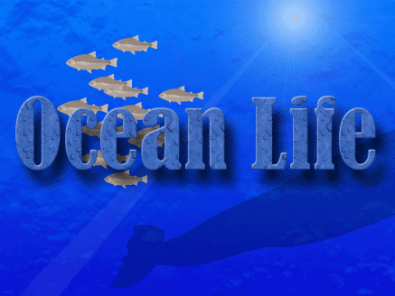
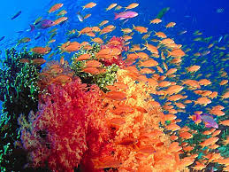
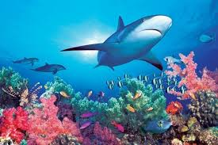
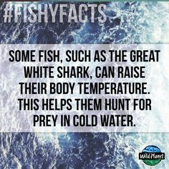
The Ocean life
Earth is totally different from what it would be if it had no ocean. The ocean, and life in the ocean, have "constructed the planet." The ocean is an important part of the Earth System. It influences the transformation of energy and materials important to the climate system. On the most basic level, the ocean has shaped our atmosphere. Over millions of years, the concentration of gases in the atmosphere is determined by life. If life did not exist, especially life in the ocean, earth would be very different. On a deeper level, oceanic microbes irreversibly changed the geochemistry of earth and the biogeochemical cycles.

Slide 4
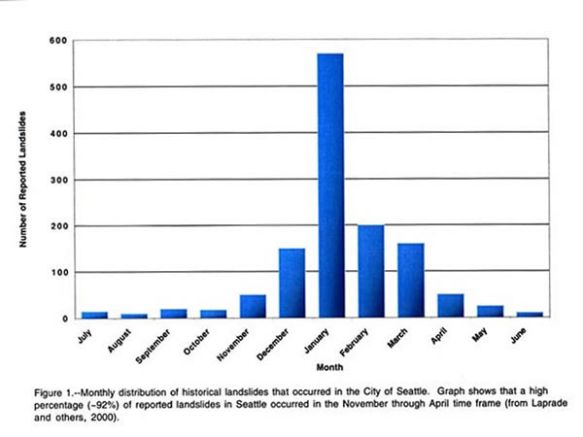
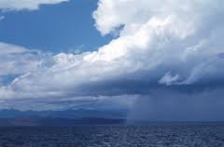
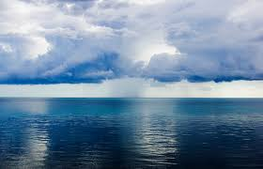
Precipitation
Since it is the largest biome in the world, the climate varies from -40 degrees fahrenheit to over 100 degrees. The average temperature is 39 degrees fahrenheit, but it is warmer near the equator because direct rays of sun can warm the water. The coldest is in the north and south poles, where the water is close to freezing, if not frozen (Glaciers). Also, the deeper the ocean is, the colder the water will be because the sunlight isn't directly piercing it.

Slide 5
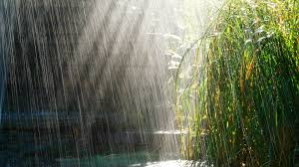
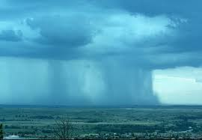
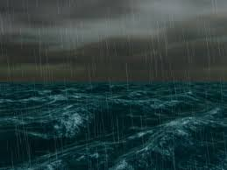
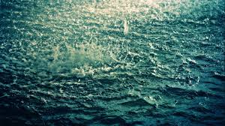
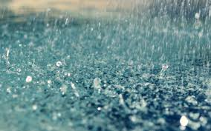
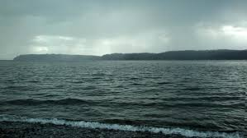
Rainfall
More than half of the world's rainfall is over the ocean for two reasons: One, it's so large two, the water cycle runs faster. This is because the biome is made of water. The average yearly precipitation can add up to over 100 inches.

Slide 6
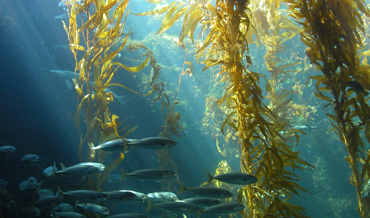
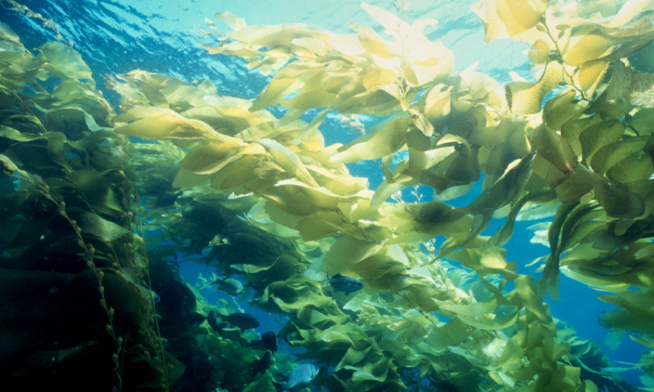
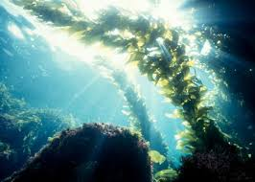
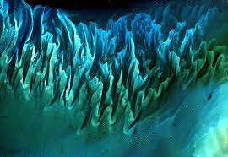
Typical Plant
Seaweed
Some seaweeds are microscopic, such as the phytoplankton that live suspended in the water column and provide the base for most marine food chains. Some are enormous, like the giant kelp that grow in abundant “forests” and tower like underwater redwoods from their roots at the bottom of the sea. Most are medium-sized, and come in colors of red, green, brown, and black. They randomly wash up on beaches and shorelines just about everywhere.

Slide 7
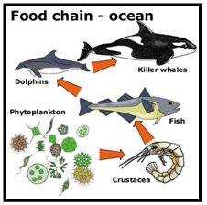
Food Web
Organisms in a community are linked through what they eat and what eats them. A food chain is a single pathway connecting a producer with several levels of consumers. In a typical marine food chain, dinoflagellates convert energy from sunlight into food through photosynthesis and store it in their tissues. Copepods feed on dinoflagellates and incorporate this energy into their own tissues. The energy is transferred to sunfish when they feed on copepods, to small sharks that feed on sunfish, and to large sharks that feed on small sharks. The feeding relationships in an ecosystem consist of many food chains interconnected into a network called a food web.

Slide 8
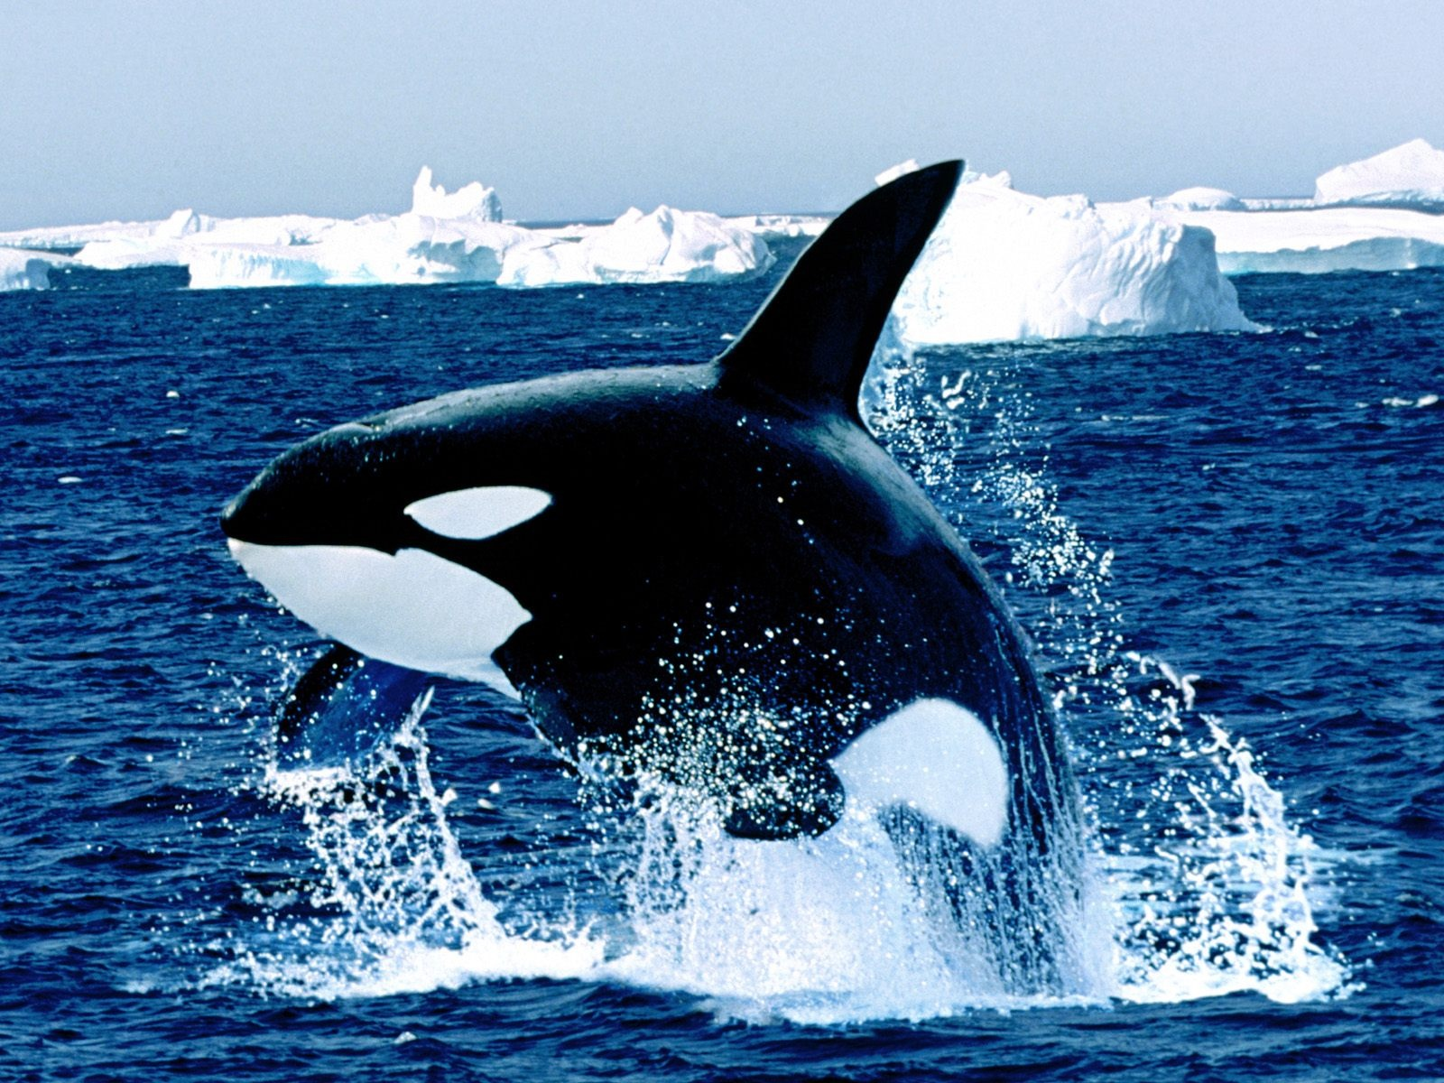
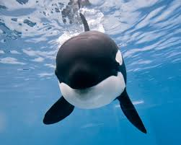
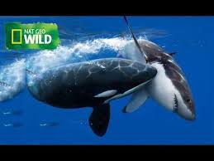
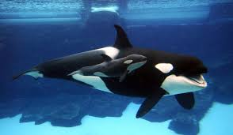
Typical Animal
Killer Whales
The killer whale (scientifically known as orcinus orca) is a large oceanic marine mammal that is part of the toothed whale (odontoceti) suborder. Killer whales are really considered a dolphin. Killer whales are one of the most well-recognized animals in the world and are easily spotted by their large size and distinct black and white color pattern killer whales are such social animals, they are almost always found in pods. They hunt together and use very unique methods to round food.

Slide 9
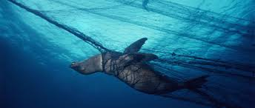
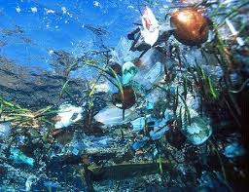
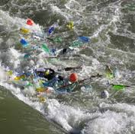
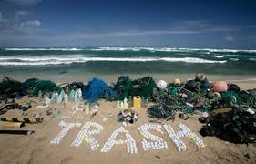
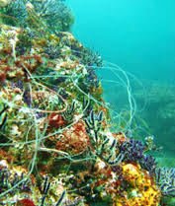
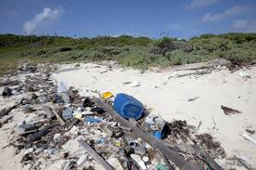
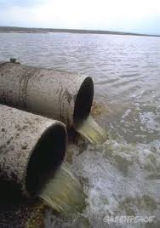
Threat to the Ocean
1. Overfishing Is Draining the Life From the Water
Overfishing is having some serious impacts on our oceans. Not only does it work towards wiping out a species, but also the other species of marine animals that are dependent upon those fish for survival. It's been shown that overfishing can cause marine animals to starve, since we're taking food from their mouths in too large of numbers for them to be able to get their fill. It is also estimated that most seas already need long term fishing bans if certain species are to recover at all.
2. Ocean's Most Important Predators Being Killed...But Just for the Fins
Overfishing is an issue that extends beyond familiar species like bluefin tuna and orange roughy. It's also a serious issue with sharks. Sharks are killed in the tOns of millions each year, mainly for their fins. It is a common practice to catch sharks, cut off their fins, and toss them back into the ocean where they are left to die. The fins are sold as an ingredient for soup. And the waste is extraordinary.

Slide 10
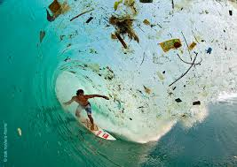
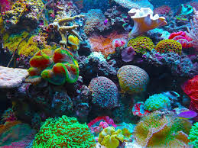
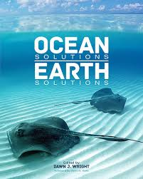
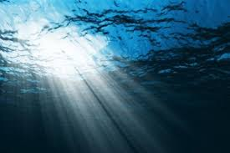
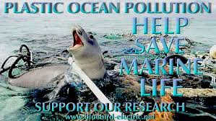
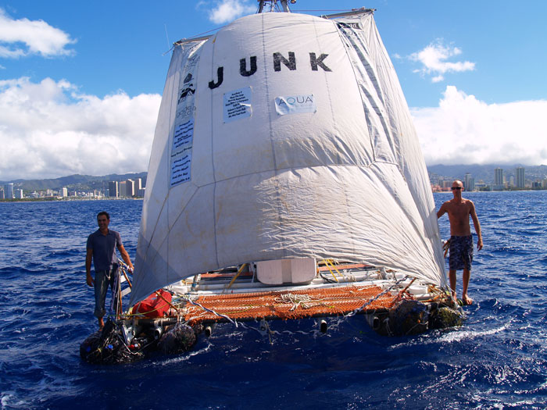
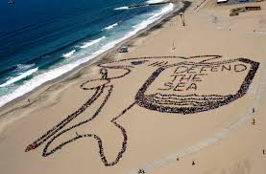
Solutions
1.. Mind Your Carbon Footprint and Reduce Energy Consumption
Reduce the effects of climate change on the ocean by leaving the car at home when you can and being conscious of your energy use at home and work. A few things you can do to get started today: Switch to compact fluorescent light bulbs, take the stairs, and bundle up or use a fan to avoid oversetting your thermostat.
2. Cut Carbon Emissions
When we burn fossil fuels (like oil, gas, or coal) to power our homes, businesses, and cars, we are adding the gas carbon dioxide to the air. The blanket of carbon dioxide we've been building for over a hundred years acts like a greenhouse
3.Use Fewer Plastic Products
Plastics that end up as ocean debris contribute to habitat destruction and entangle and kill tOns of thousands of marine animals each year. To limit your impact, carry a reusable water bottle, store food in non disposable containers, bring your own cloth tote or other reusable bag when shopping, and recycle whenever possible
.

Slide 11
Bibliography
Google images
Ocean Conservancy - oceanconservancy.org‎
Ocean - Wikipedia, the free encyclopedia
The Ocean -- National Geographic
Forests of the Sea: Phytoplankton and Marine plants ...
www.phschool.com/atschool/phsciexp/active_art/ocean_food_web
THATS OUR PRESENTATION!!!!!!!

