Slide 1
Warm-Up 03NOV2015
What is the major difference between primary and secondary succession?
How might conservation biologists use succession to manage lands?

Slide 3
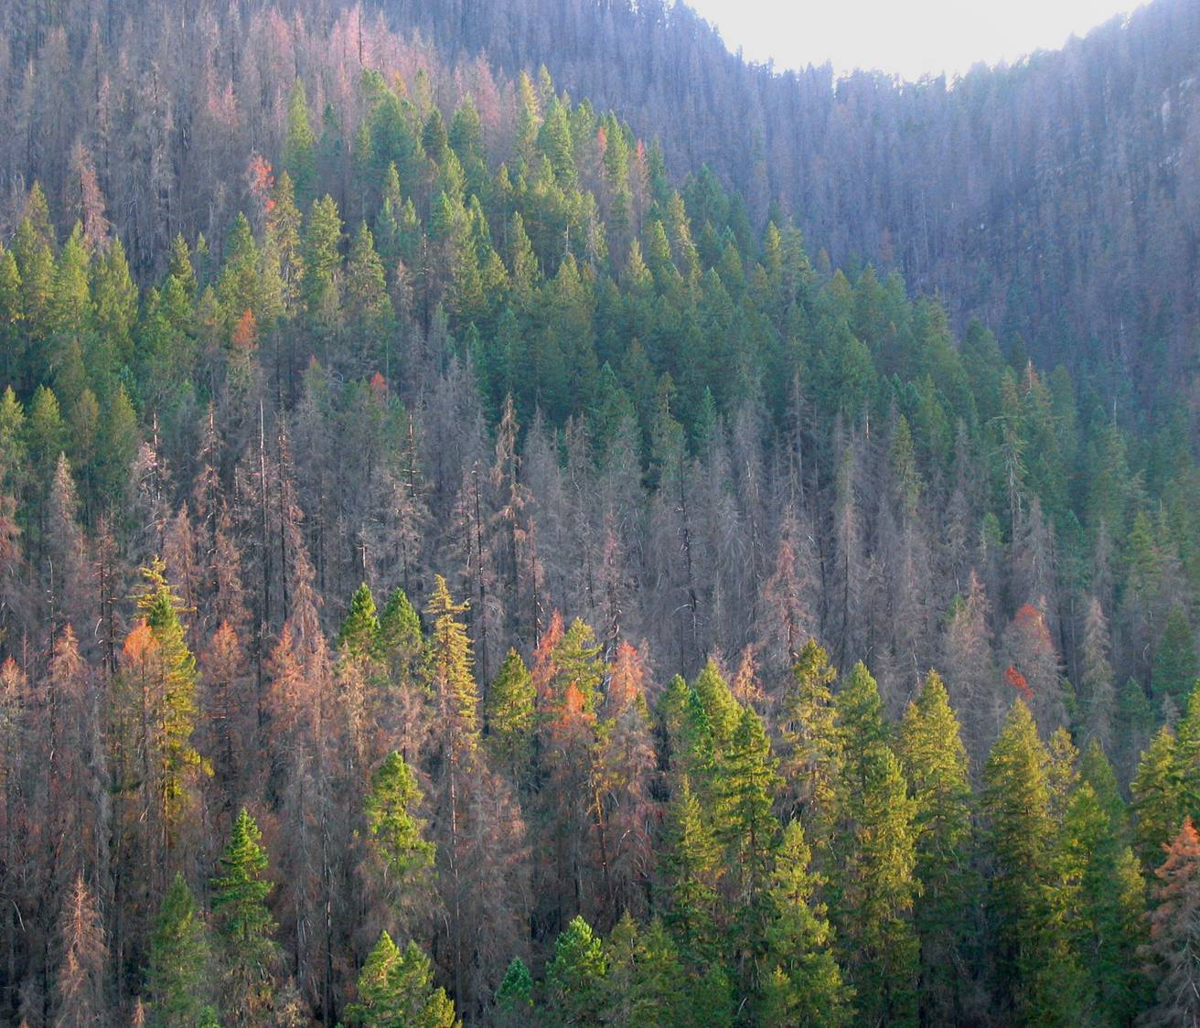
Can create a “mosiac”

Slide 4
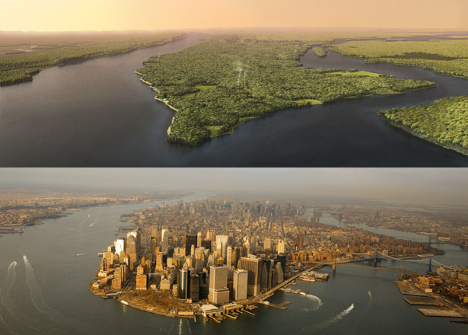
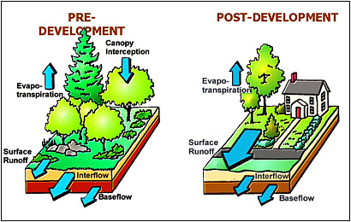

Slide 5
Species richness in a community is influences by many factors
Latitude
Time
Habitat size
Distance from other communities

Slide 6
Conservation and Island Biogeography
Combines all the previously listed factors
Explains the dual importance of habitat size and distance in determining species richness

Slide 7
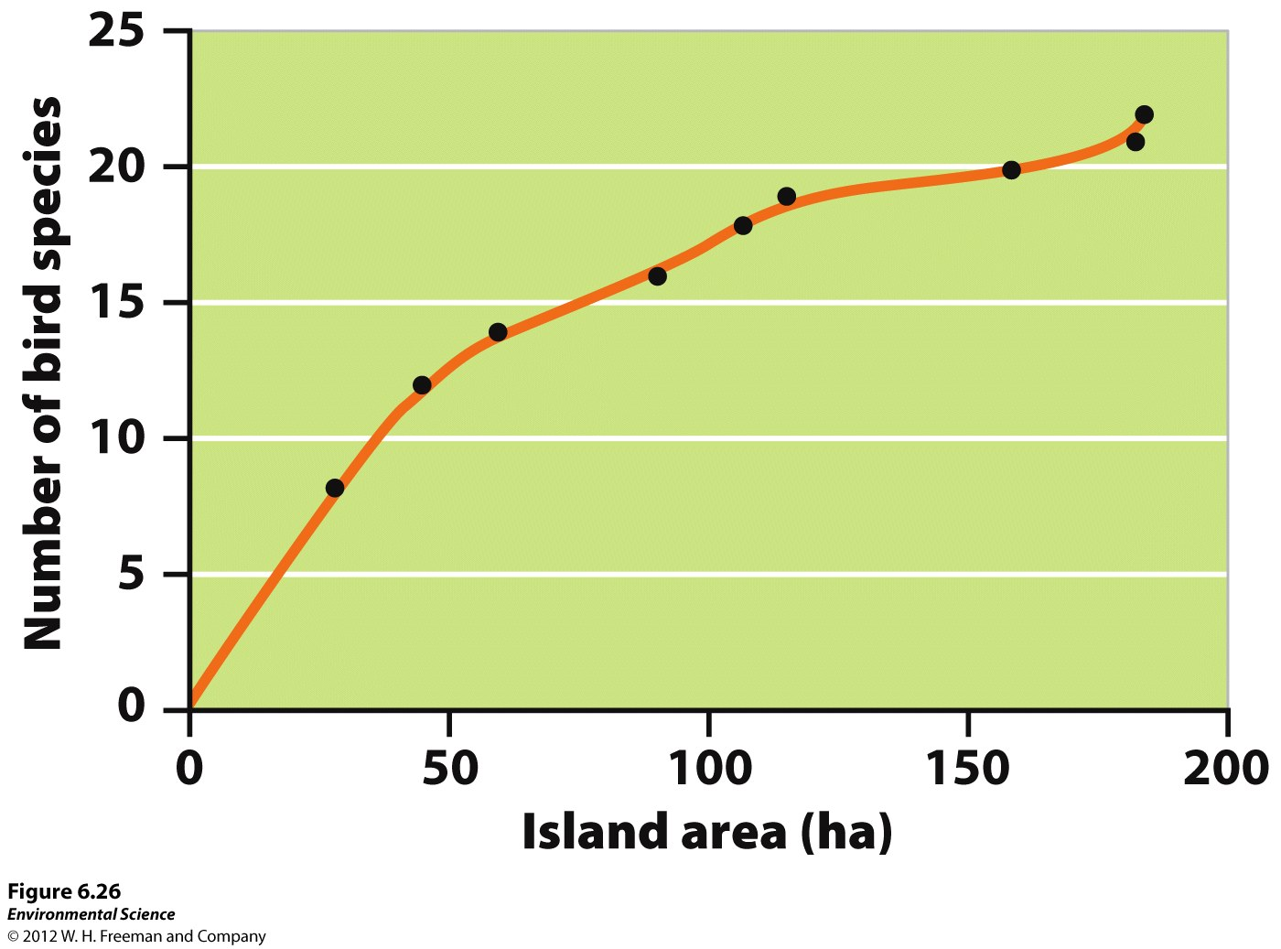

Slide 8
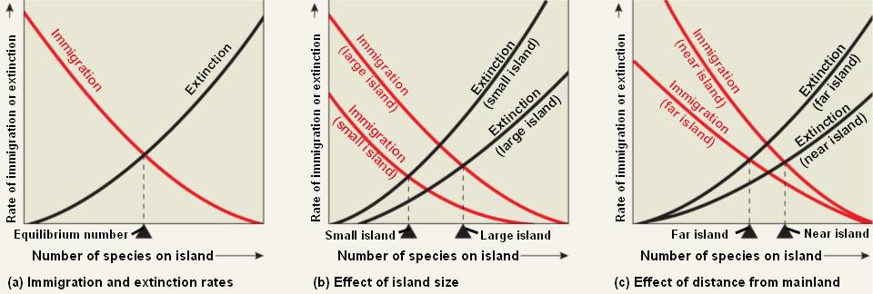

Slide 9
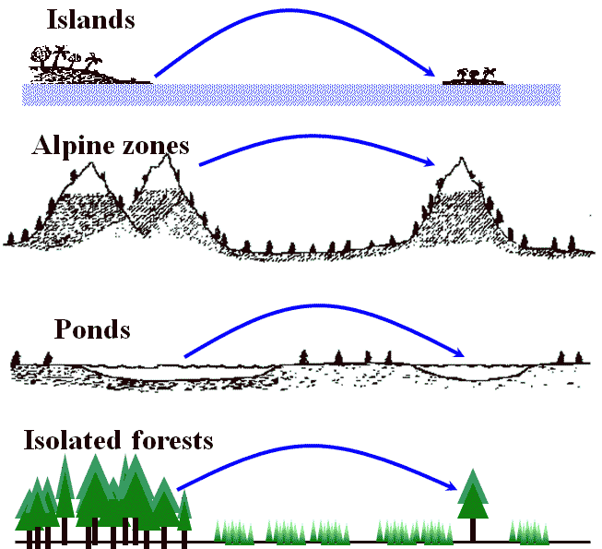
Virtual Islands

Slide 10
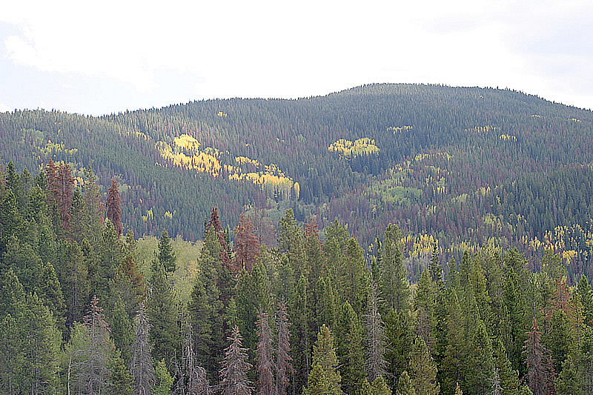
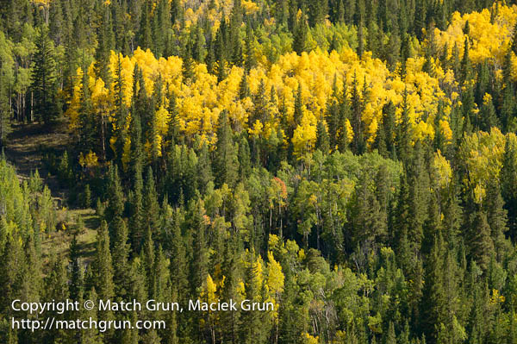
Virtual Islands

Slide 11
Anthropogenic change
Humans are altering ecosystems all over the world, we are also an element of ecological succession
The scale that we are changing ecosystems is huge, and unprecedented
What can we do conserve habitats?

Slide 12
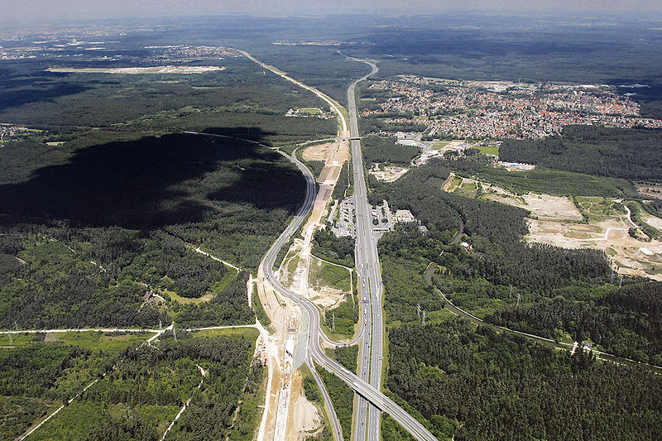

Slide 13
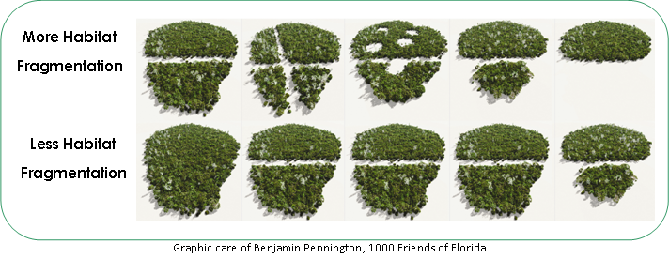
Island biogeography applied to conservation

Slide 14
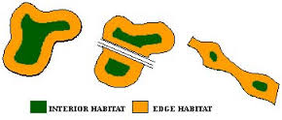
Interior and edge species are very different
Ideally you have both in the conserved land

Slide 15
Connected > Disconnected

Slide 16
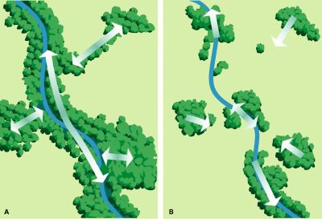
Corridors are thought to increase connectivity (thus wildlife movement)

Slide 17
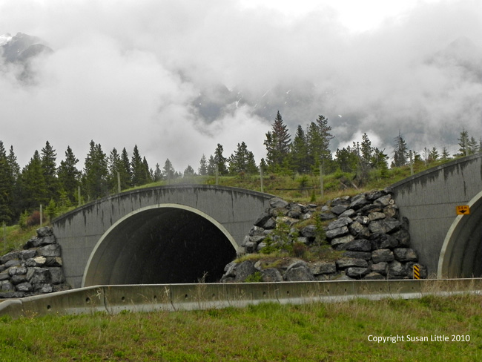
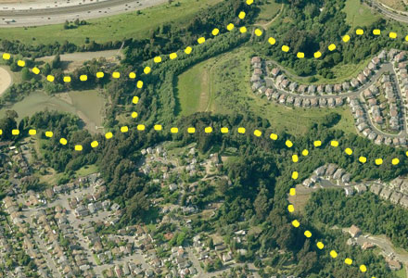

Slide 18
Key ideas from Ch 6
Levels of complexity
Contrast the way in which density-dependent and density-independent factors affect population size
Explain growth models, reproduction strategies, survivorship curves, and meta-populations
Describe species interactions and the roles of keystone species
Discuss the process of ecological succession
Explain how latitude, time, area, and distance affect the species richness of a community

Slide 19
