Slide 1
Warm-up 18NOV2014
What is fertility?
How is fertility connected to a country being classified as developing or developed?
Today: Turn in World Population Lab
Friday: Celebration of Knowledge
10 Vocabulary words
Movie Permission Slips
Monday (11/23): FRQ

Slide 2
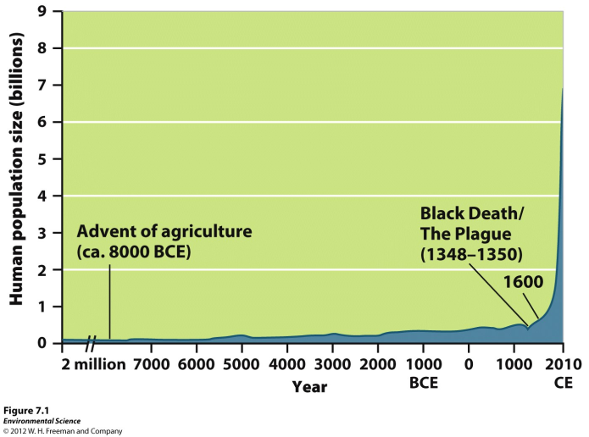
Scientists Disagree on Earth’s Carrying Capacity
Figure
7.1

Slide 3
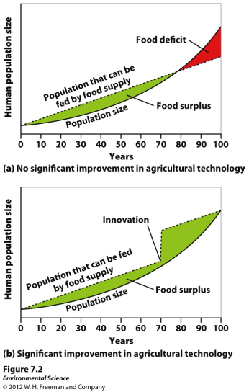
Scientists Disagree on Earth’s Carrying Capacity
The following graphs show theoretical models of food supply and population size.

Slide 4
Carrying capacity of Earth is constant
Human ingenuity will find a way to exceed the carrying capacity of Earth

Slide 5
What determines carrying capacity of a habitat?
How might humans differ from other organisms in terms of carrying capacity?
Will humans exceed Earth’s carrying capacity? What evidence can you use to justify your argument?

Slide 6
We better change or DIE!
Technology will SAVE us!

Slide 7
Changes in Population Size
Crude birth rate (CBR)= the number of births per 1,000 individuals per year.
Crude death rate (CDR)= the number of deaths per 1,000 individuals per year.
Global population growth rate =
(CBR- CDR)/ 10
National population growth rate =
(CBR+ immigration) - (CDR + emigration)/ 10
Doubling time (in years)- 70/growth rate

Slide 8
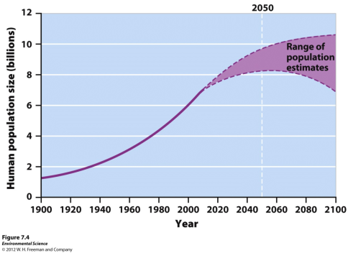
Fertility
Total fertility rate- an estimate of the average number of children that each woman in a population will bear.

Slide 9
Fertility
Replacement level fertility- the total fertility rate required to offset the average number of deaths in a population and for the current population size to remain stable.

Slide 10
Fertility
Un-Developed countries- little on no industrial development, low income, low life expectancy, and education
Developed countries- countries with relatively high levels of industrialization and income.
TFR 2.1 or less
Developing countries- countries with relatively low levels of industrialization and income of less that $3 per person per day.
TFR greater than 2.1

Slide 11
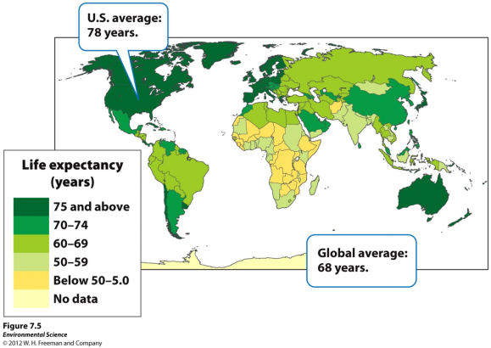
Life Expectancy
Life expectancy- the average number of years that an infant born in a particular year in a particular country can be expected to live, given the current average life span and death rate of that country.

Slide 13
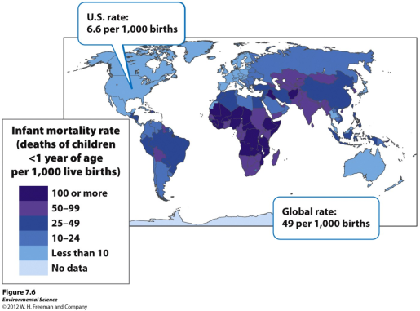
Life Expectancy
Infant mortality rate- the number of deaths of children under 1 year of age per 1,000 live births.
Child mortality rate- the number of deaths of children under age 5 per 1,000 live births.

Slide 15
Age Structure
Age structure diagrams (population pyramids)- visual representations of age structure within a country for males and females.
As shown in figure 7.8

Slide 16
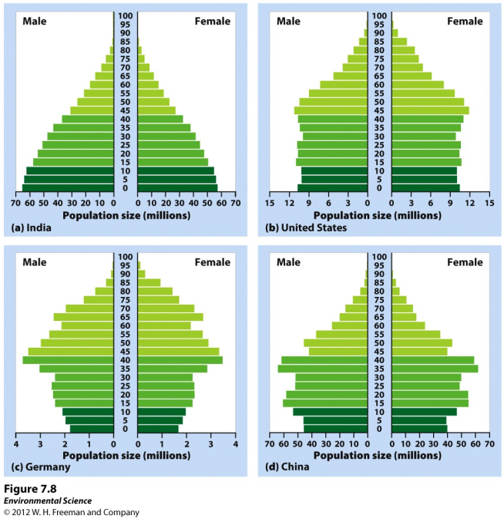

Slide 17
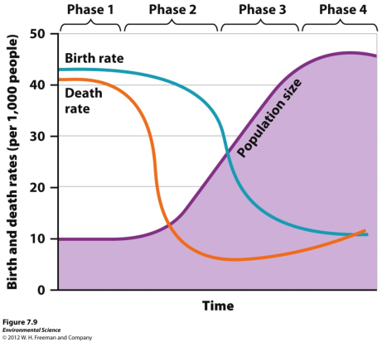
The Demographic Transition
The theory of the demographic transition is the theory that as a country moves from a subsistence economy to industrialization and increased affluence, it undergoes a predictable shift in population growth.

Slide 18
The Stages of the Demographic Transition
Phase 1: Slow population growth because there are high birth rates and high death rates which offset each other.

Slide 19
The Stages of the Demographic Transition
Phase 2: Rapid population growth because birth rates remain high but death rates decline due to better sanitation, clean drinking water, increased access to food and goods, and access to health care.

Slide 20
The Stages of the Demographic Transition
Phase 3: Stable population growth as the economy and educational system improves and people have fewer children.

Slide 21
The Stages of the Demographic Transition
Phase 4: Declining population growth because the relatively high level of affluence and economic develop encourage women to delay having children.

Slide 22
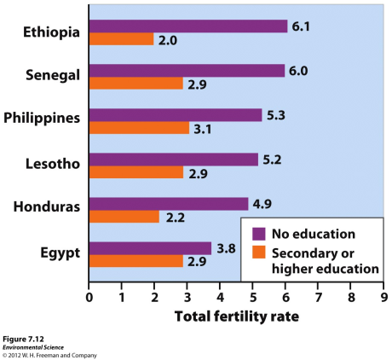
Family Planning
Family planning- the regulation of the number or spacing of offspring through the use of birth control.
Education plays a role

Slide 23
What is demographic transition?
How do education and demographic transitions relate to each other?
In what ways are phase 1 and phase 3 similar?

Slide 24
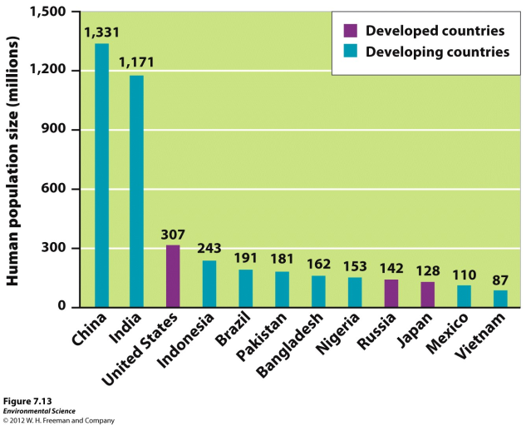
The 12 Most Populous Countries in the World

Slide 25
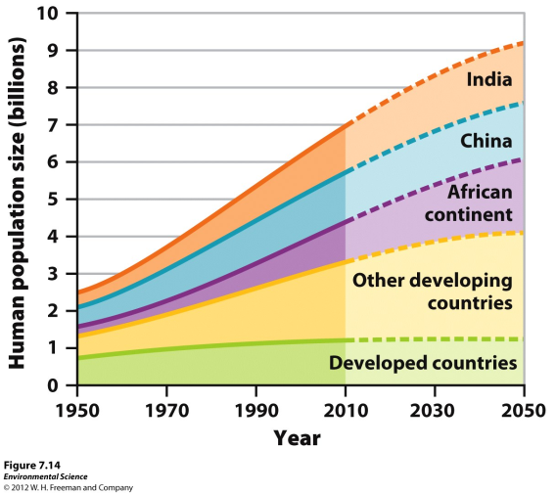
The relationship between economic development and population growth rate for developing nations.

Slide 26
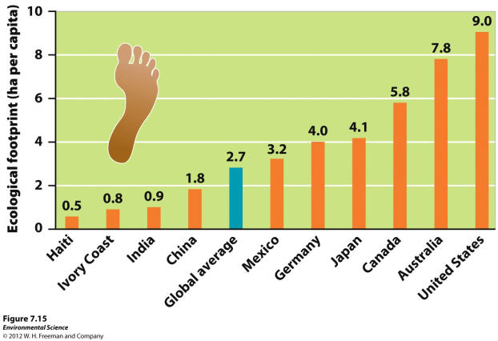
Ecological Footprints
Affluence - having a lot of wealth such as money, goods, or property.

Slide 27
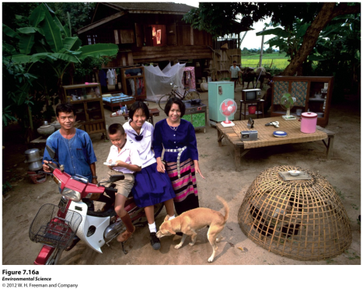
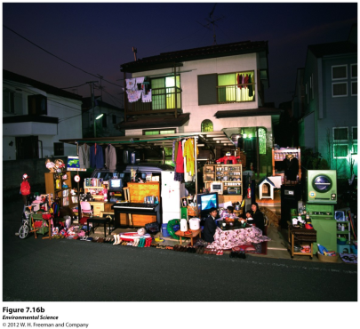
The IPAT Equation
To estimate the impact of human lifestyles on Earth we can use the IPAT equation:
Impact= Population X Affluence X Technology

Slide 28
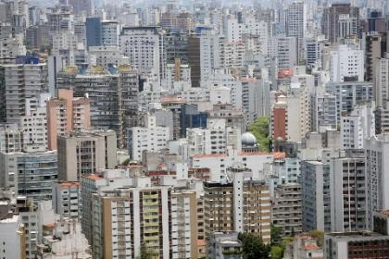
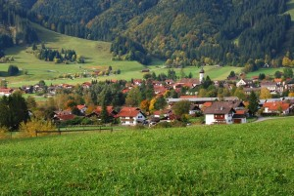
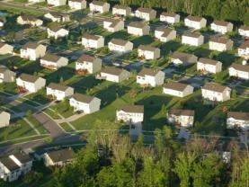
A country’s affluence also influences WHERE people live.
Urban Suburban Rural

Slide 30
Warm-Up 19NOV2015
How does affluence impact the amount of resources an individual consumes?
Thursday:
Celebration of Knowledge (Due on Monday)
10 Vocabulary words
Movie Permission Slips
Monday (11/23): FRQ

Slide 31
Ecological Footprints
Affluence - having a lot of wealth such as money, goods, or property.

Slide 32
The IPAT Equation
To estimate the impact of human lifestyles on Earth we can use the IPAT equation:
Impact= Population X Affluence X Technology

Slide 33
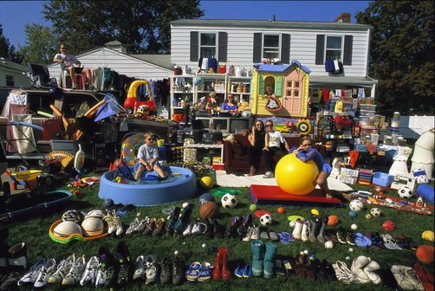
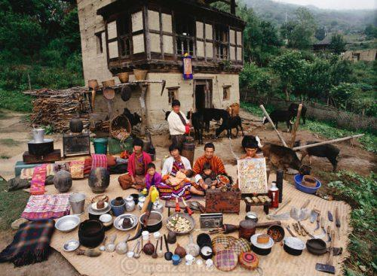

Slide 34
A country’s affluence also influences WHERE people live.
Urban Suburban Rural

Slide 35
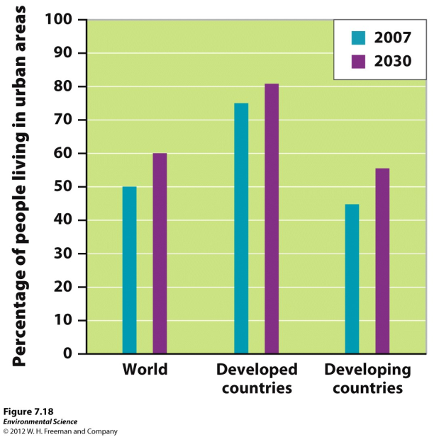

Slide 36
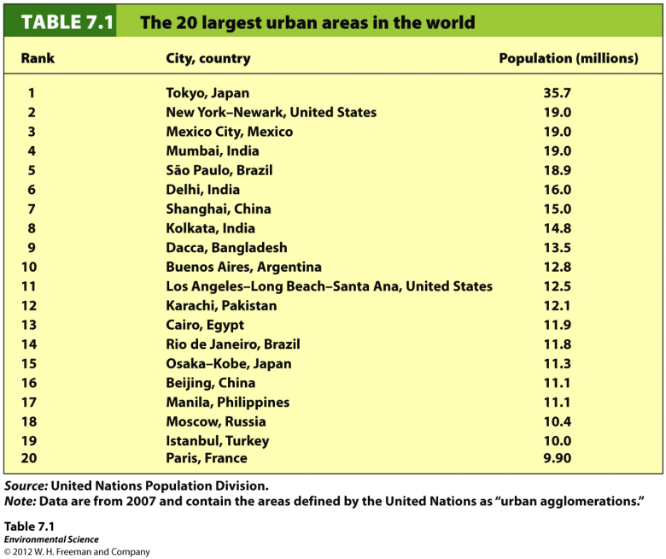

Slide 37
The Impact of Affluence
Gross domestic product (GDP)- the value of all products and services produced in a year in that country.
GDP is made up of consumer spending, investments, government spending, and exports minus imports.
A countries GDP often correlates with its pollution levels.

Slide 38
Local vs Global impacts
Local: developing countries tend to use local items, timber, land to grow food
Global: Affluent countries tend to use more non-local goods and spread impacts to other places
Urban: cities represent 50% of the population and 75% resources consumed

Slide 39
What does the IPAT equation describe?
How do local and global environmental impacts differ? Where do we tend to see more versus the other?
How does a country’s degree of development influence its environmental impact?

Slide 40
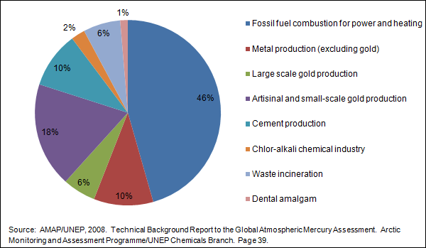

Slide 41
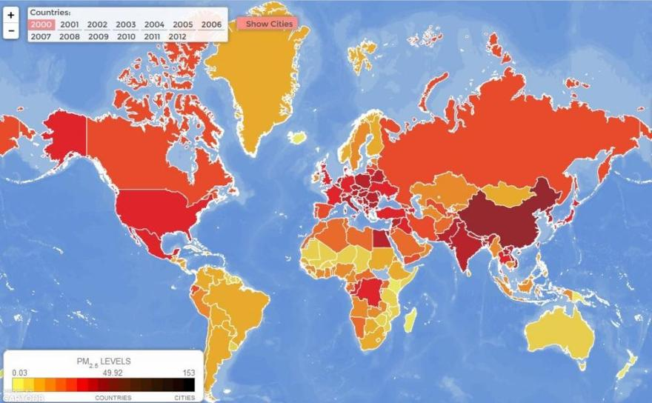
Air Pollution (general) by country

Slide 42
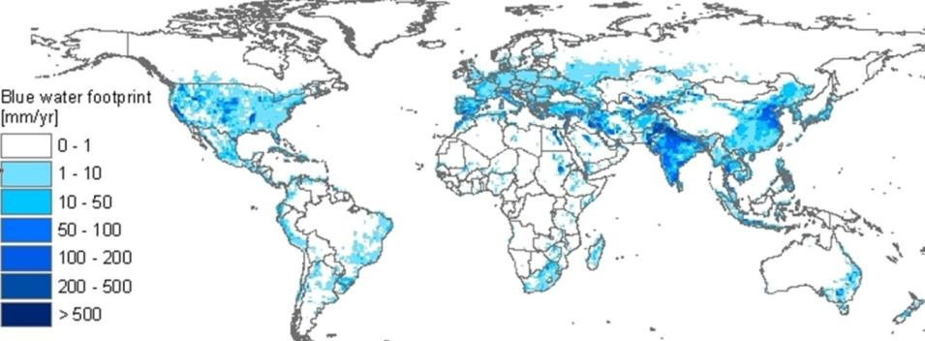
Water Use per person

Slide 43
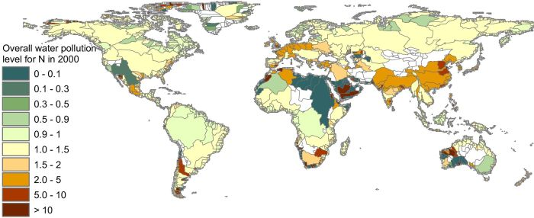
Water Pollution

Slide 44
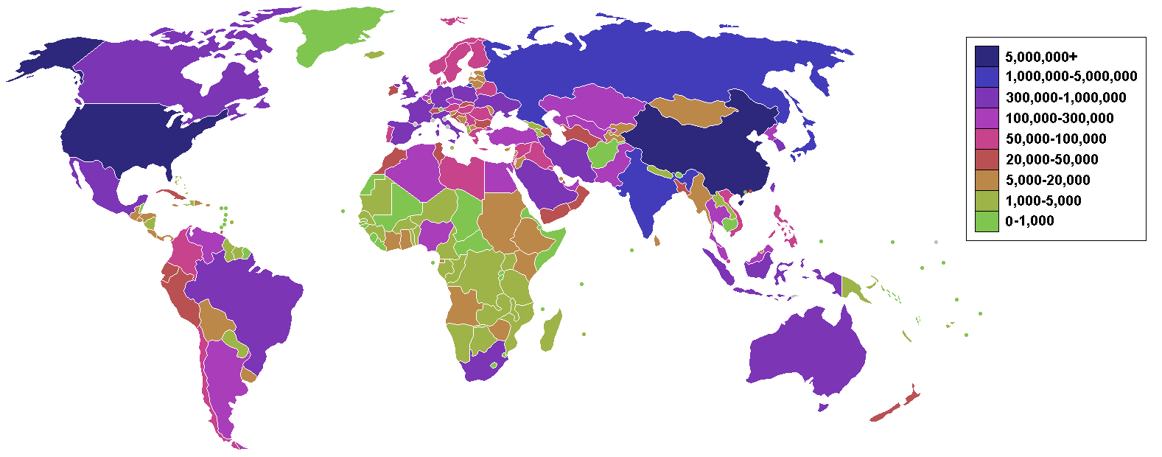
Carbon Dioxide Emissions

Slide 45
What is our responsibility in pollution
What is our role in relating to developing countries?
Can we ethically tell them how to develop?

