Slide 1
PTT 18NOV2015
Fill in the blank on the board.
Where is the code found for the traits we observe in living things?
Reminders:
7B: Progress reports DUE TODAY
OAJ #10 due on Friday
Honors Project (December 14th)

Slide 2
Genetics!
The study of how organisms inherit the traits

Slide 3
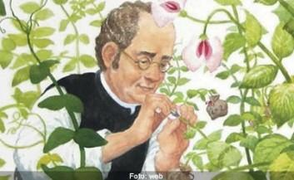
Gregor Mendel “the Father of Genetics”
Used the Science Circle to study how pea flower color was determined

Slide 4
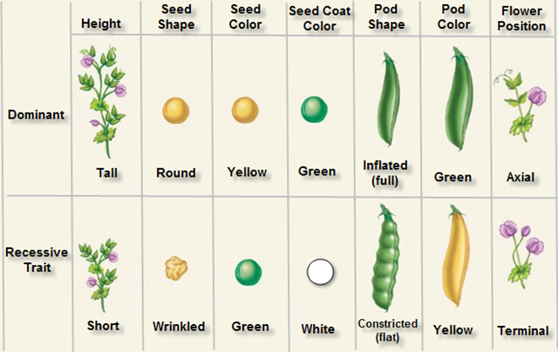
Observed all these traits in pea plants

Slide 5
Question: how is heredity connected to pea plant traits.
Hypothesis: If I create hybrids of homozygous plants, then there will be a predictable traits observed in the next generation of pea plants
Design: 1. Predict the traits possible in a homozygous cross 2. Cross homozygous pea plants 3. Observe the next generation of pea plants

Slide 6
Collect Data: Mendel observed countless peas
Analyze Data: He looked at his data and realized he could predict will good accuracy the next generation traits, but not 100%
Conclude: that pea plant traits can be dominant and recessive
Share

Slide 7
Question: How many different combinations are possible in hybridizing pea plants?

Slide 8
Mendel used simple probability to predict what traits would be present in the next generation of pea plants.
He called these Punnett squares

Slide 9
Phenotype: the trait we see
Genotype: the genetic make up

Slide 10
Genes have two or more alleles that will determine the phenotype (trait expressed) of an organism
Genes have 2 alleles for each trait

Slide 11
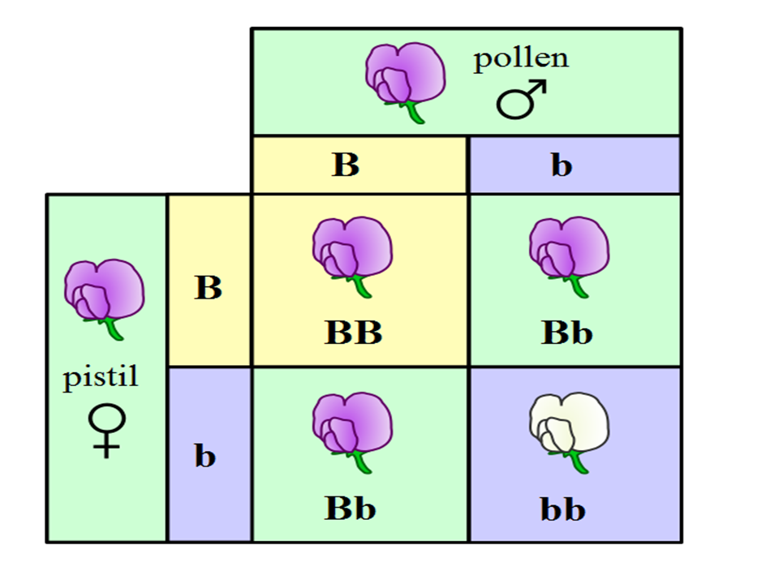
Alleles can be dominant or recessive.

Slide 12
Dominant Allele: DOMINATES (capital letters)
Recessive: gets dominated (lower case letters)

Slide 13
An organism can be homozygous or heterozygous
Homozygous: has the same alleles (TT or tt)
Heterozygous: has different alleles (Tt)

Slide 14
Using the terms describe the following genotypes
Bb
bb
BB

Slide 15
Write the letters for the following
Homozygous recessive
Heterozygous
Homozygous dominant

Slide 16
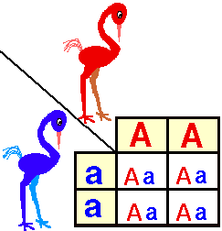
Describe these birds using the terms we just learned

Slide 17
The only way that an organism will express a recessive allele is if is homozygous.
A dominant allele will be expressed as a trait in both heterozygous and homozygous plants

Slide 18
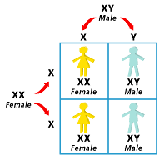
Human gender is determined the same way.

Slide 20
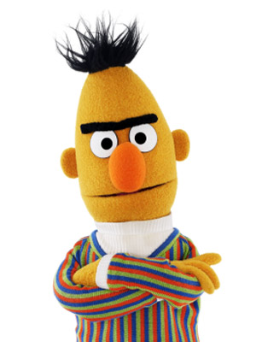
PTT 19NOV2015
U is the dominant allele to have separate eyebrows. u is the recessive allele for a uni-brow.
What is the phenotype for these genotypes:
UU
uu
Uu

Slide 21
Using the terms learned yesterday, describe the following:
TT
Tt
tt

Slide 22
What are the alleles for the following:
Heterozygous
Homozygous recessive
Homozygous dominant

Slide 23
Punnett Square Practice
Due at the end of class!
I am going to check your planners

