Slide 1
Warm-up 05NOV2014
Hypothesize what will happen when all people are given equal access to a resource
Ms. Leigh is no longer accepting Late assignments, if you want credit for it. Turn it in on time.
Due today is the Effects of Density on Plant Growth

Slide 3
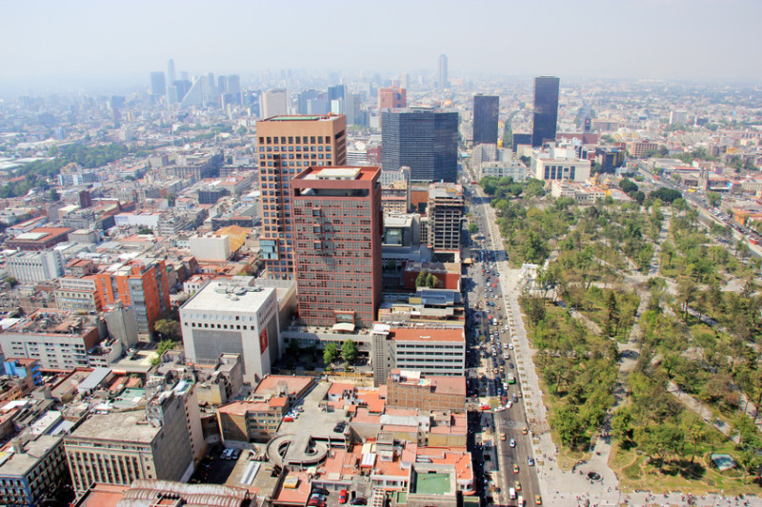
Warm-up 10NOV2014
From Hardin, define the following terms:
Freedom
Invisible Hand
Tragedy
Commons
Temperance
NO MORE LATE WORK!

Slide 4
Logistics
NO MORE LATE WORK!
You should be reading/read Chapter 7
Warm-Ups due Friday
World Population research due Friday
Permission Slips are due by 11/20

Slide 5
In your groups discuss and develop a response to your question (be prepared to share)
AND create a follow-up question to ask the class
Your participation is worth 20 points today, please be thoughtful and respectful

Slide 7
Warm-Up 13NOV2015
What is the human population on Earth?
What is the US population?

Slide 8
Warm-Up 13NOV2015
What is the human population on Earth?
7,273,868,578
What is the US population?
373,578,752
Turn in Warm-Ups today
World Population Graphs is due on TUESDAY

Slide 9
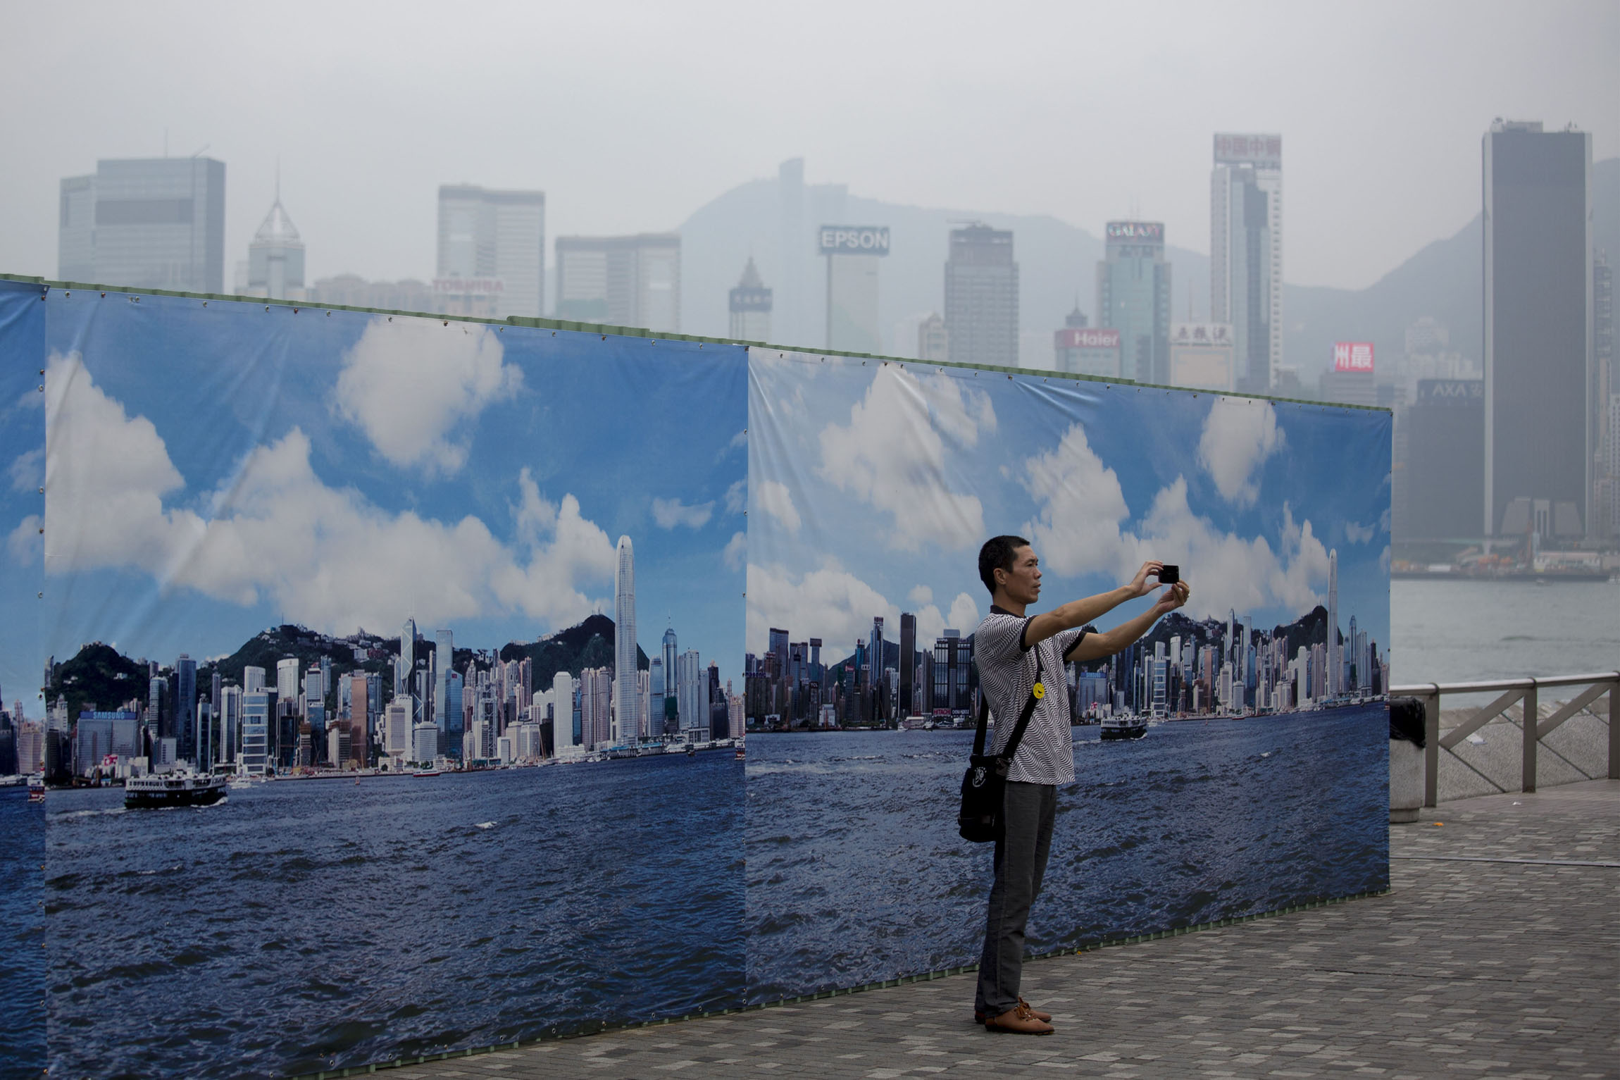
Human Population

Slide 10
Un-Developed countries- little on no industrial development, low income, low life expectancy, and education
Developed countries- countries with relatively high levels of industrialization and income
Developing countries- countries with relatively low levels of industrialization and income of less that $3 per person per day.

Slide 11
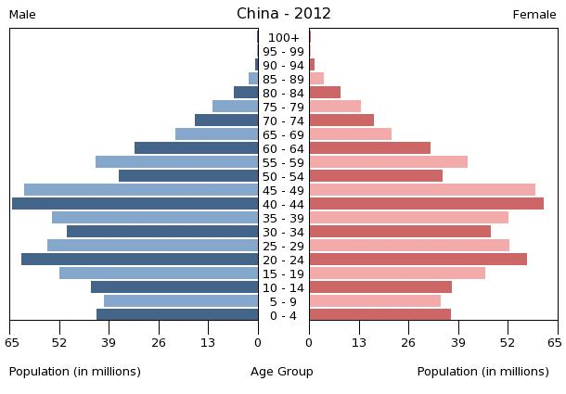
Age Structure Pyramids

Slide 12
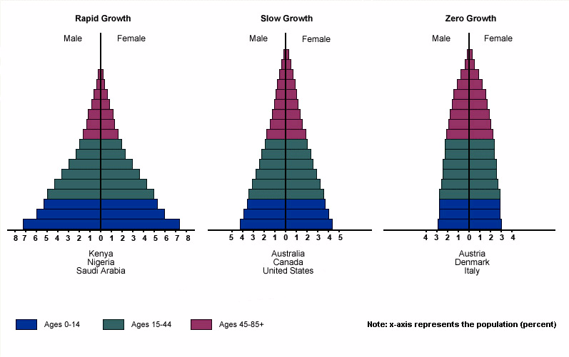

Slide 13
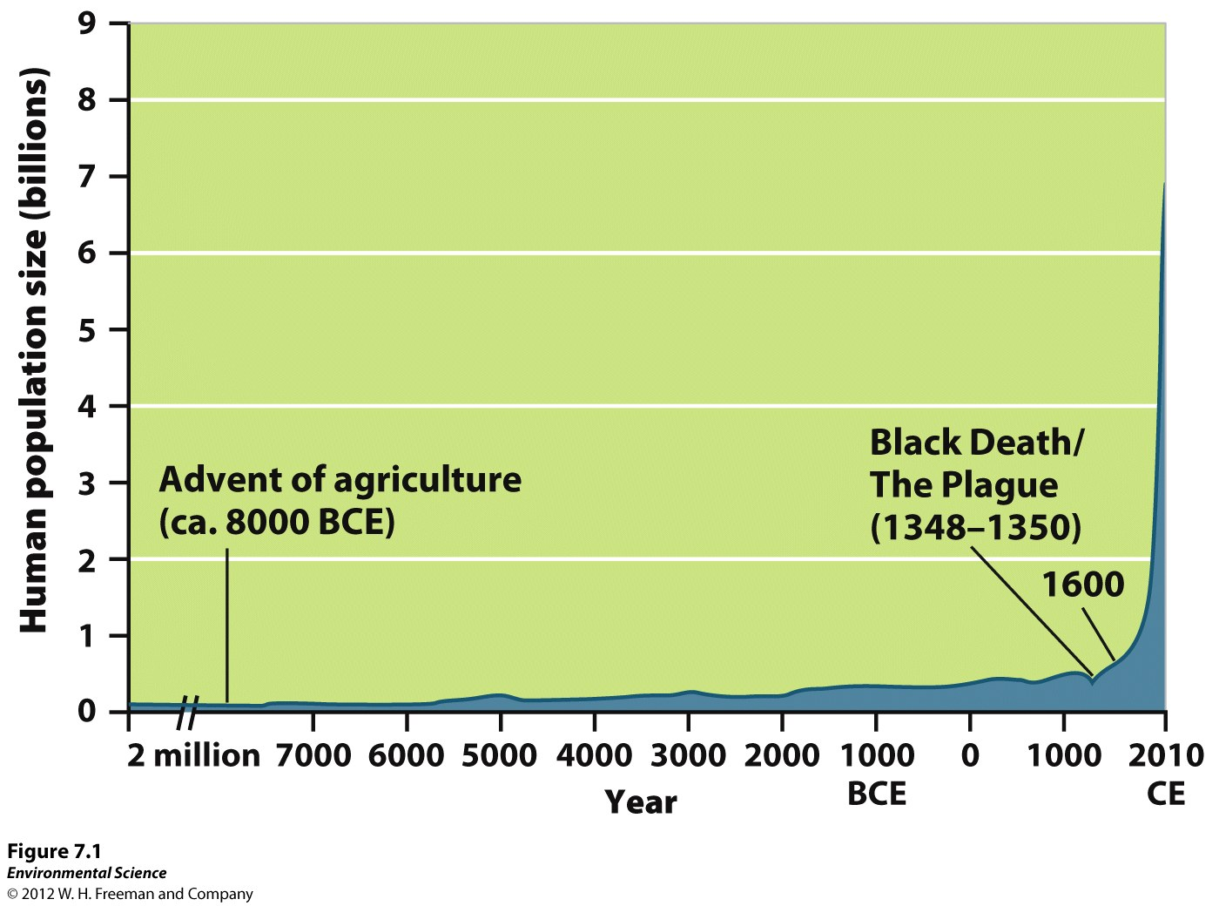
Scientists Disagree on Earth’s Carrying Capacity
Figure
7.1

Slide 14
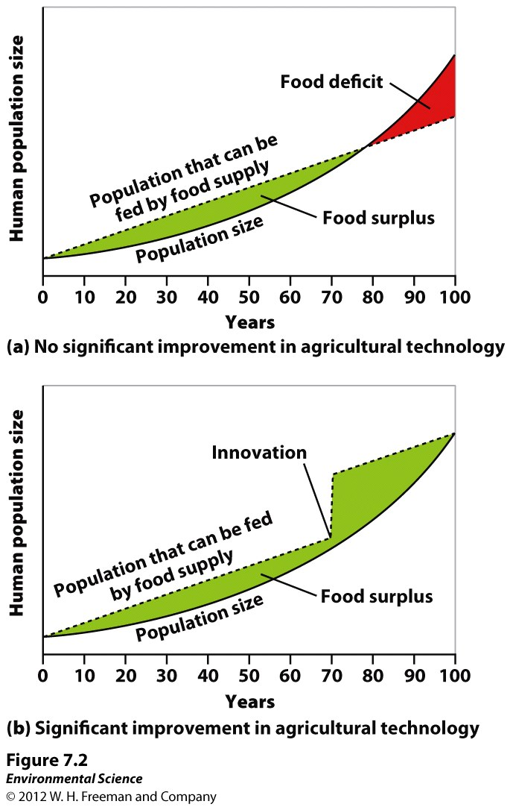
Scientists Disagree on Earth’s Carrying Capacity
The following graphs show theoretical models of food supply and population size.

Slide 15
Carrying capacity of Earth is constant
Human ingenuity will find a way to exceed the carrying capacity of Earth

Slide 16
What determines carrying capacity of a habitat?
How might humans differ from other organisms in terms of carrying capacity?
Will humans exceed Earth’s carrying capacity? What evidence can you use to justify your argument?

Slide 17
We better change or DIE!
Technology will SAVE us!

Slide 18
Factors that Drive Human Population Growth
Population = (B + I) – (D + E)
Same applies to humans

Slide 19
Factors that Drive Human Population Growth
Demography- the study of human populations and population trends.
Changes in Population Size
Fertility
Life Expectancy
Age Structure
Migration

Slide 20
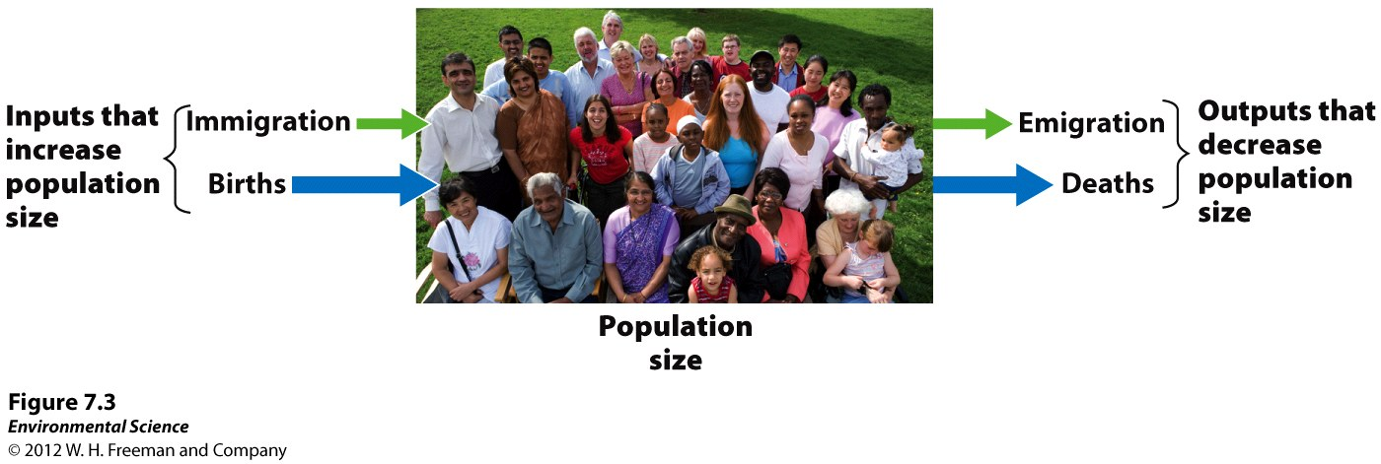
Changes in Population Size
Immigration- the movement of people into a country
Emigration- the movement of people out of a country.
Net migration rate- the difference between immigration and emigration in a give year per 1,000 people in the country.

Slide 21
Changes in Population Size
Crude birth rate (CBR)= the number of births per 1,000 individuals per year.
Crude death rate (CDR)= the number of deaths per 1,000 individuals per year.
Global population growth rate =
(CBR- CDR)/ 10
National population growth rate =
(CBR+ immigration) - (CDR + emigration)/ 10
Doubling time (in years)- 70/growth rate

Slide 22
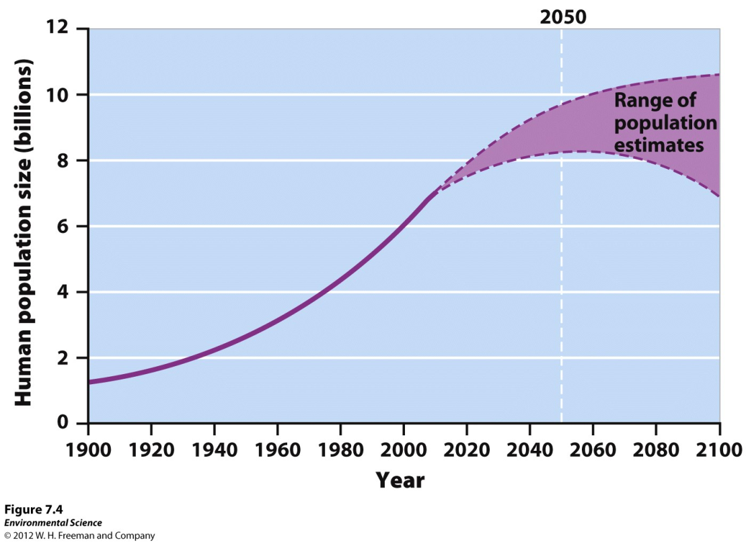
Fertility
Total fertility rate- an estimate of the average number of children that each woman in a population will bear.

Slide 23
Fertility
Replacement level fertility- the total fertility rate required to offset the average number of deaths in a population and for the current population size to remain stable.

Slide 24
Fertility
Un-Developed countries- little on no industrial development, low income, low life expectancy, and education
Developed countries- countries with relatively high levels of industrialization and income.
TFR 2.1 or less
Developing countries- countries with relatively low levels of industrialization and income of less that $3 per person per day.
TFR greater than 2.1

Slide 27
Warm-up 13NOV2014
Define carrying capacity.
What is the carrying capacity for humans on Earth?

Slide 28
Warm-up 13NOV2014
Define carrying capacity.
The maximum population a given area can sustainably support.
What is the carrying capacity for humans on Earth?
9-10 billion humans on Earth

Slide 29
How is the information in the video and the introduction similar?

Slide 31
Warm-Up 13NOV2014
What are the 2 schools of thought about human population growth?

Slide 33
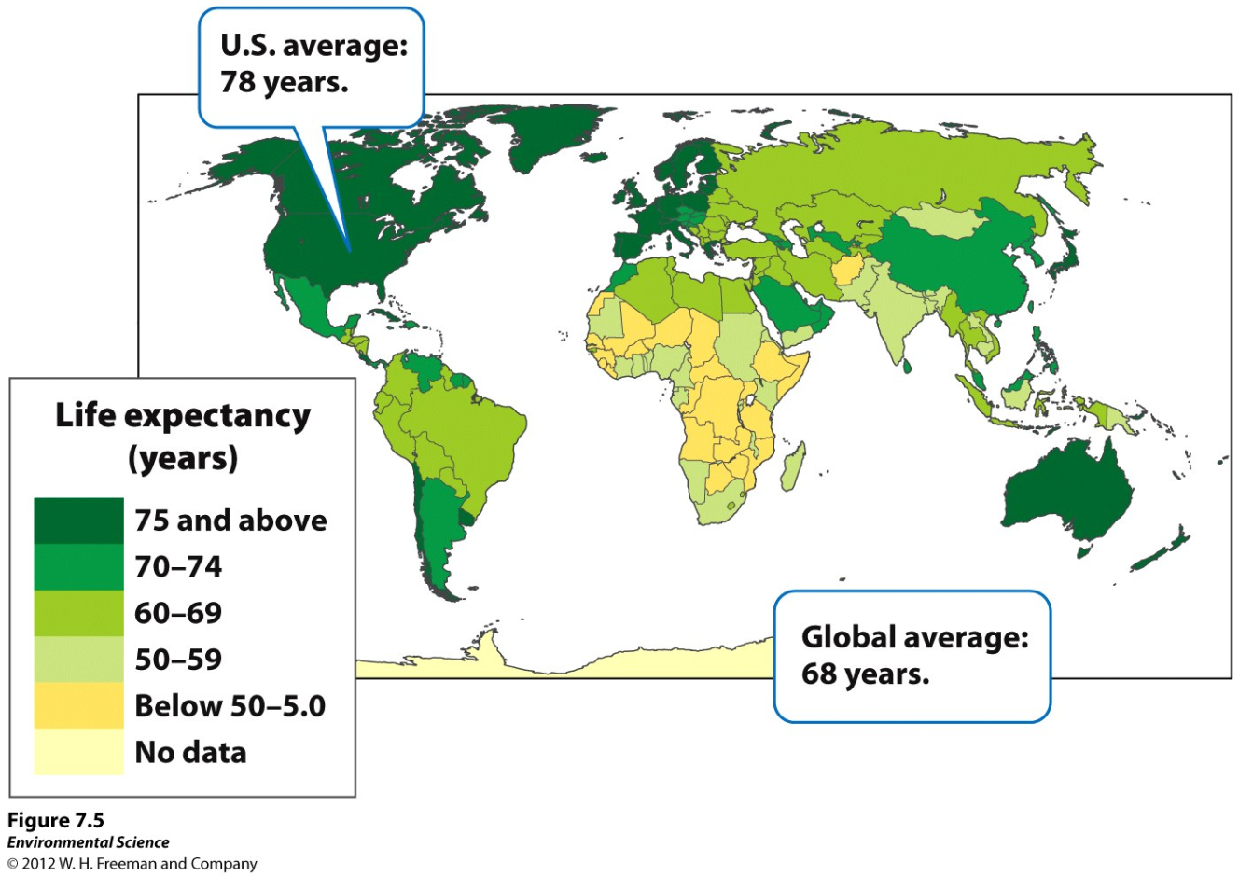
Life Expectancy
Life expectancy- the average number of years that an infant born in a particular year in a particular country can be expected to live, given the current average life span and death rate of that country.

Slide 34
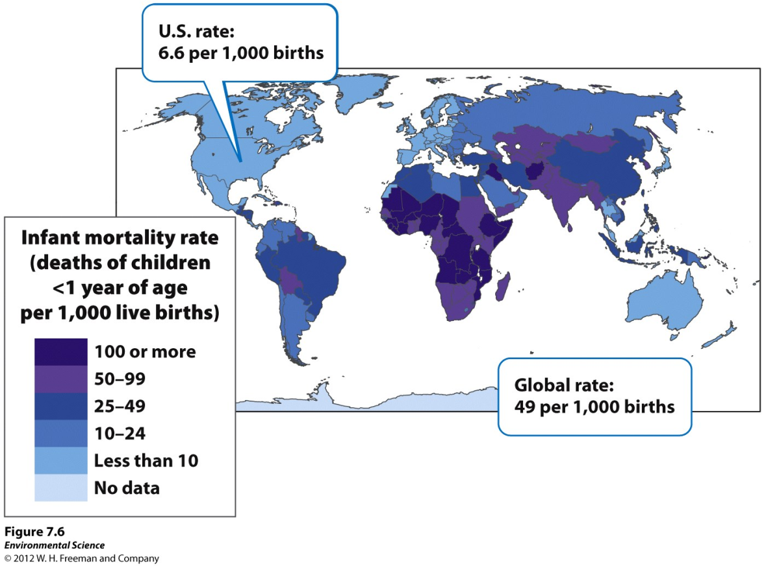
Life Expectancy
Infant mortality rate- the number of deaths of children under 1 year of age per 1,000 live births.
Child mortality rate- the number of deaths of children under age 5 per 1,000 live births.

Slide 35
Age Structure
Age structure diagrams (population pyramids)- visual representations of age structure within a country for males and females.
As shown in figure 7.8

Slide 36
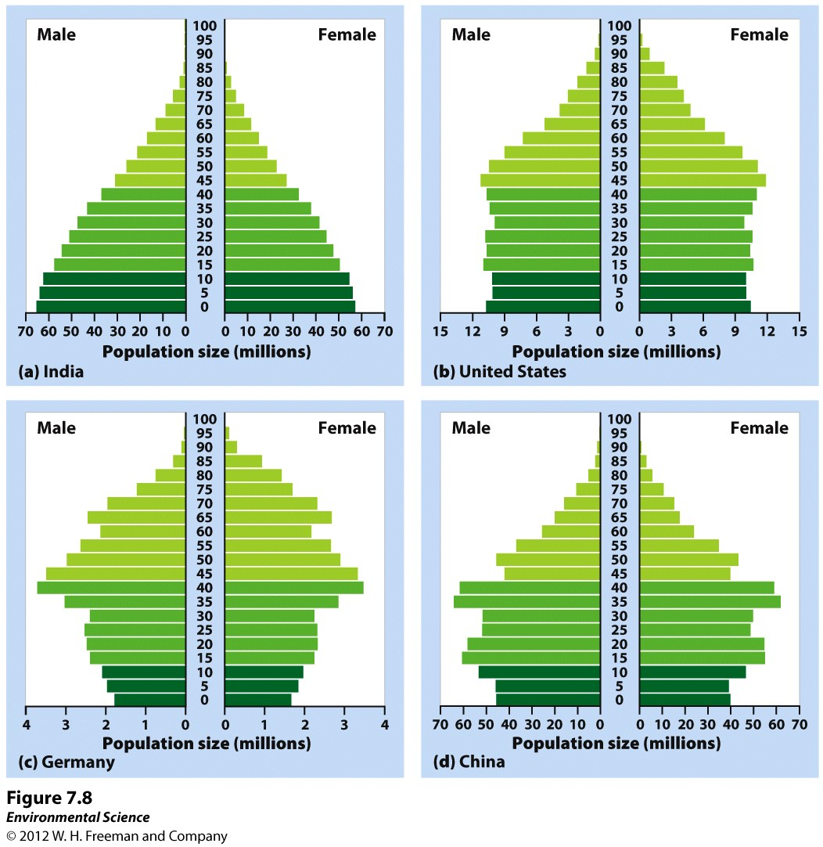

Slide 38
People Paradox
Responses to these questions will be due on Monday (11/17)
Please write a one page typed response to the last question. State and defend your opinion with information from class and research if needed.
Cite in MLA if you use any sources.

