Slide 1
PTT 02NOV2015
How many extinctions have happened on Earth so far?
Do scientists think we are in an extinction event now? What evidence did you study on Friday to support this claim?
Extra Credit to students who participate in the STEAM festival doing a science demonstration see Ms. Leigh after school for information

Slide 2
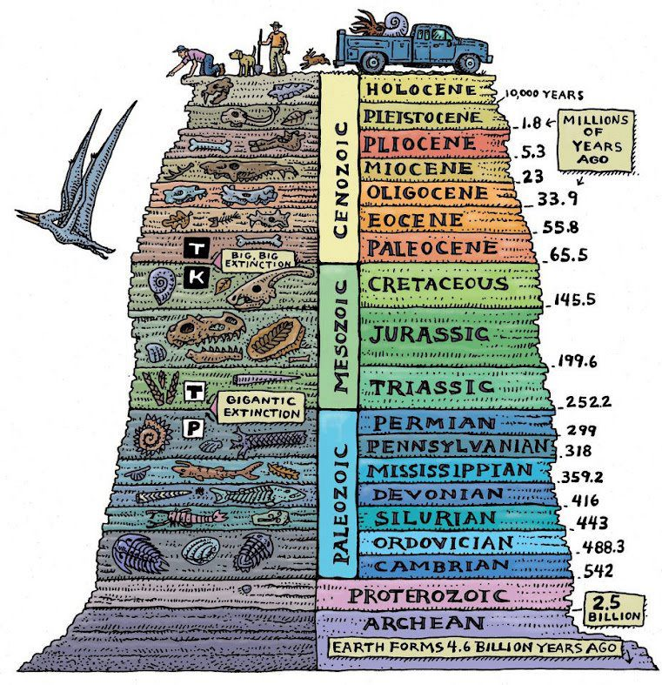
The life present on Earth at the time define the eras and periods.
There is much more time on Earth without life than with.
Human existence is minute compared to the Earth’s existence

Slide 3
Extinctions are caused by environmental changes!

Slide 4
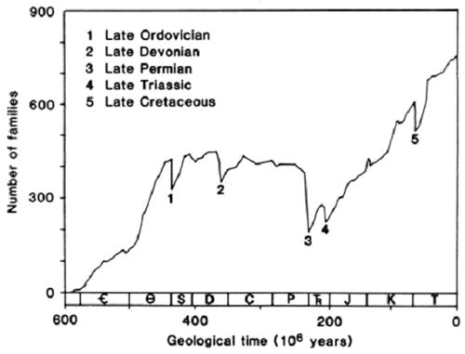

Slide 5
In your table group:
Read the article as a group and answer the following questions:
When was your extinction?
What life was common before the extinction?
What went extinct? What percentage of all species went extinct?
What caused the extinction?
What else was interesting about your extinction?

Slide 7
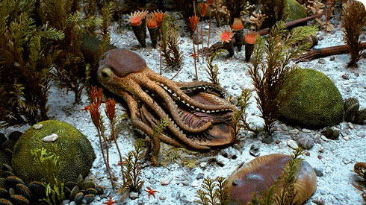
End-Ordovician Extinction

Slide 8
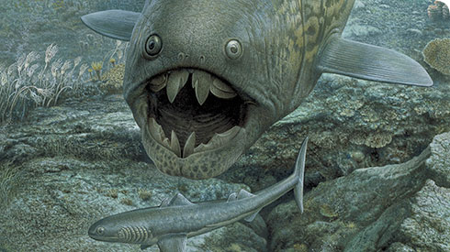
Late Devonian Extinction

Slide 9
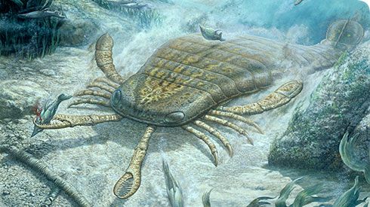
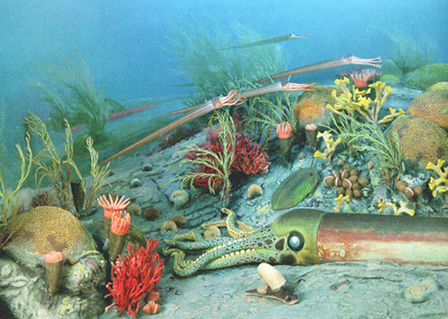
End-Permian Extinction

Slide 10
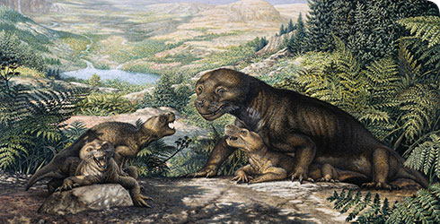
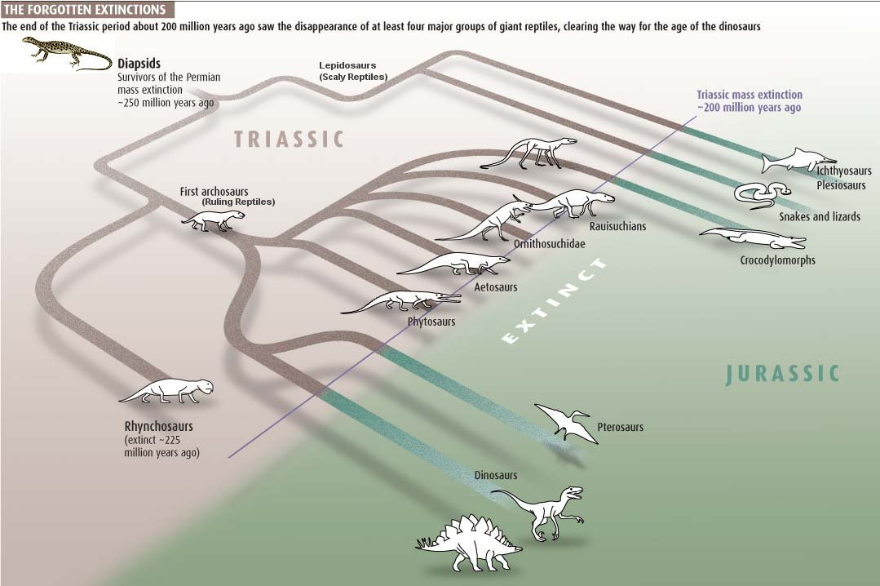
End-Triassic Extinction

Slide 11
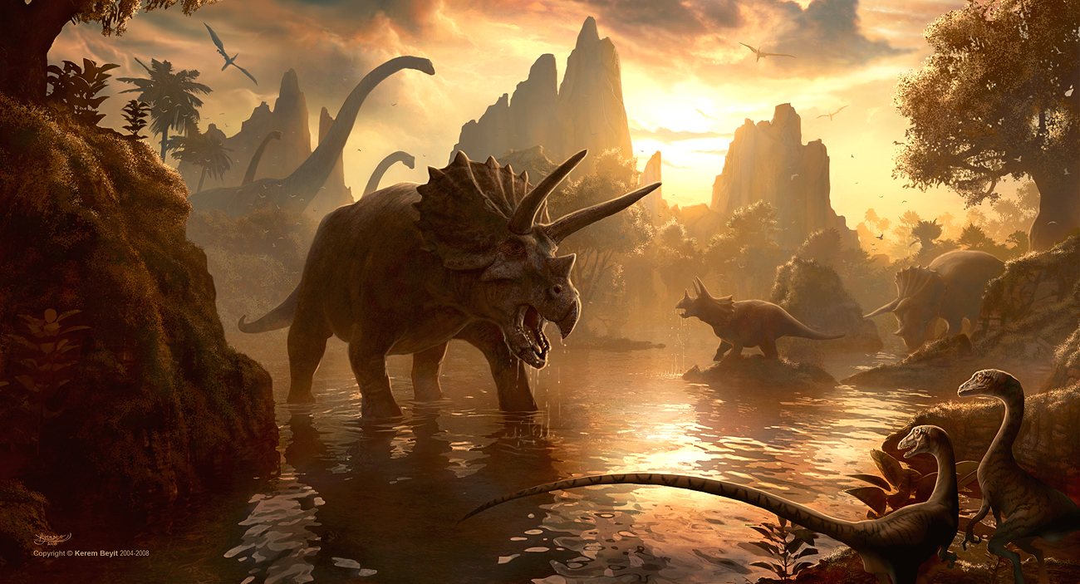
End-Cretaceous (KT) Extinction

Slide 12
Surviving Mass Extinctions?
What causes mass extinctions?
What is life like after the extinction?
Are some species more likely to survive than others? WHY?

Slide 13
Extinctions are caused by environmental changes
Fitness:
The ability to survive and reproduce in a given environment

Slide 15
PTT 03NOV2015
What causes mass extinctions?
What specific environmental (abiotic) change cause the extinction you researched?

Slide 18
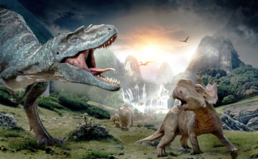
Mesozoic Extinction
Today you will morph into archeologists and research fossils from the mesozoic extinction

Slide 20
PTT 04NOV2015
How did an asteroid hitting Earth cause the extinction of the forams and the dinosaurs?
What evidence did scientists use to support this hypothesis?

Slide 23
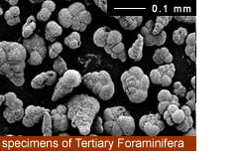
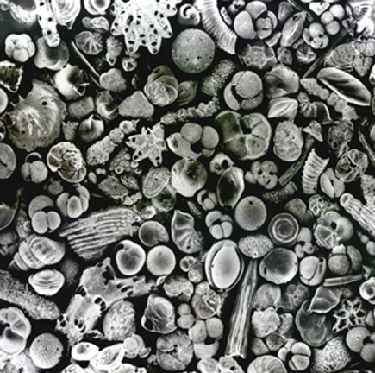
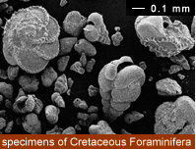
Forams!

Slide 24
Extinctions are caused by environmental (abiotic changes)
Scientists use fossil evidence to study evolution and extinctions on Earth.
Today: Finish the study of Forams TURN IT IN!

Slide 25
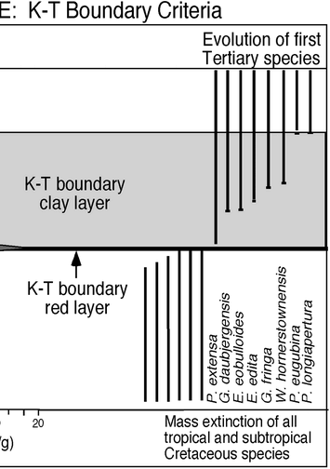

Slide 27
PTT 05NOV2015
What evidence did you use to study the Mesozoic extinction?
What did you observe in the foram diversity after the KT boundary?

Slide 28
Cenozoic:
Age of Mammals
Mesozoic:
Age of Dinosaurs (reptiles)
Paleozoic:
Age of Marine organisms
Precambrian

Slide 30
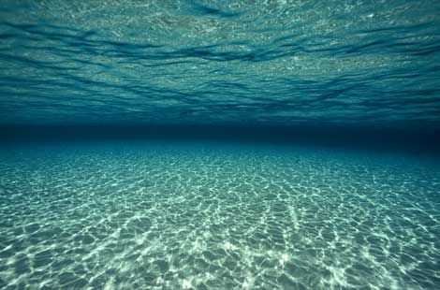
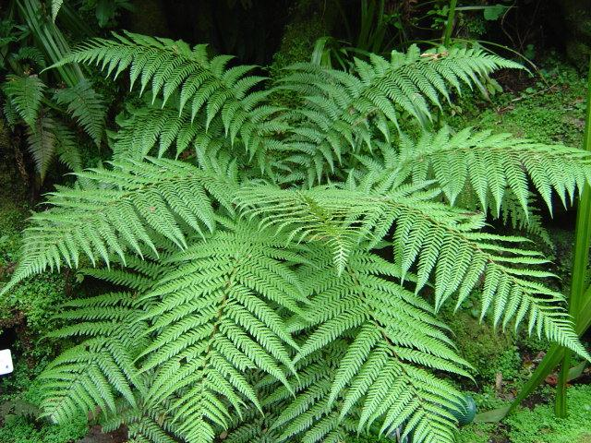
Yesterday we studied the extinction in ocean fossils
Today we will study evidence from the KT extinction on land:
Ferns!

Slide 31
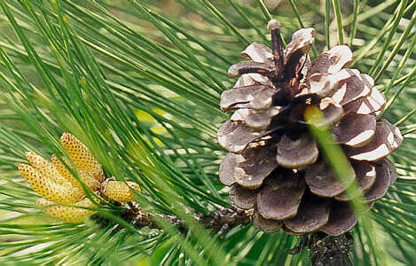
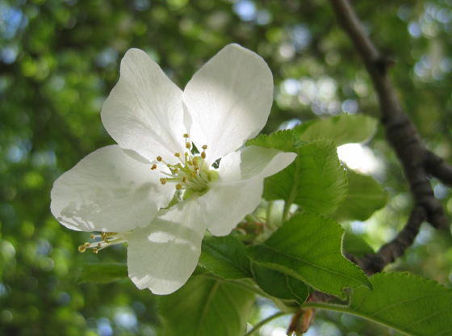
Angiosperm and Gymnosperm
Angiosperm: Flowers
Gymnosperm: spores/cones

Slide 34
PTT 06NOV2015
What did you observe in the kinds of plants before and after the KT boundary?
What animals survived the KT extinction?
TURN IN YOUR OAJ!
“biotic and abiotic things” is not a good enough connection to science – give me more details

Slide 35
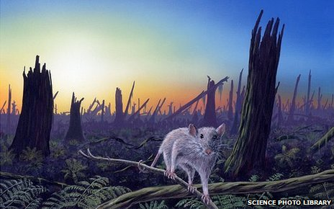
Survivors of the KT extinction

Slide 36
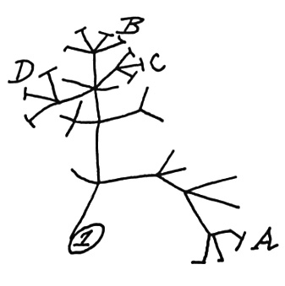
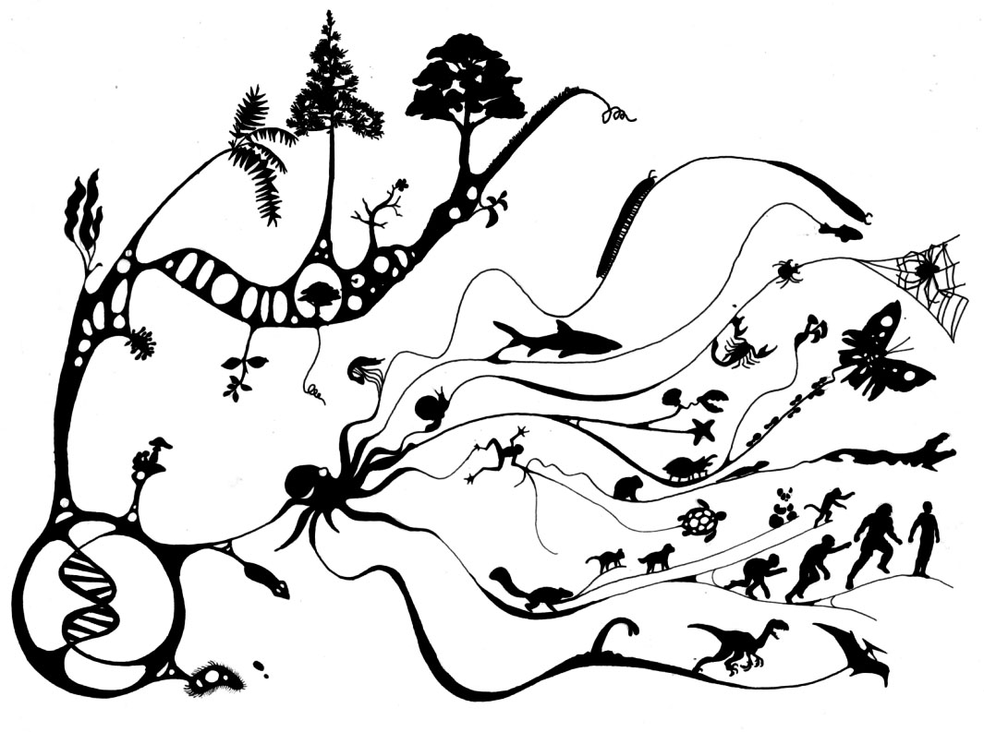
Evolution
Change in traits over time
Provides us a history or a way to explain the diversity of life on Earth

Slide 37
Cenozoic:
Age of Mammals
Mesozoic:
Age of Dinosaurs (reptiles)
Paleozoic:
Age of Marine organisms
Precambrian

Slide 38
Humans exist in the Holocene!

Slide 39
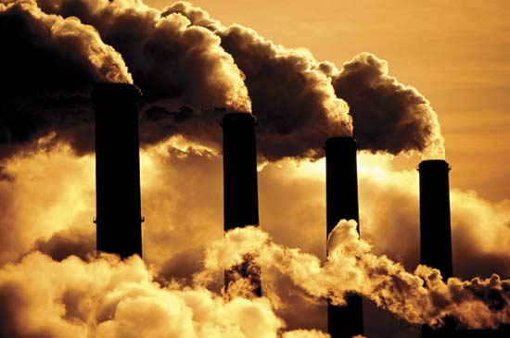
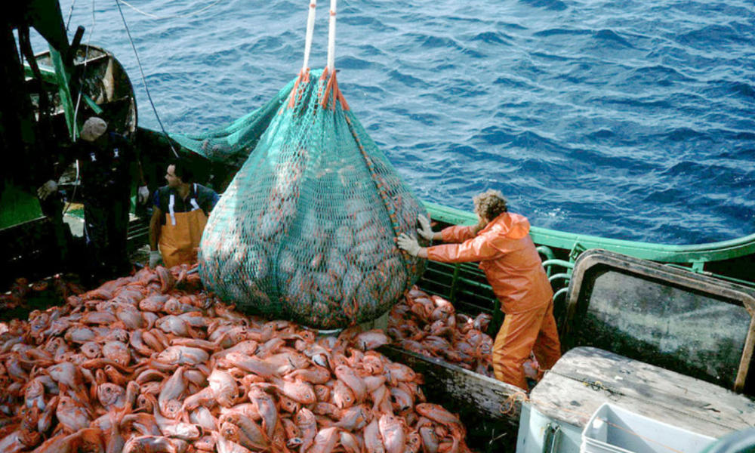
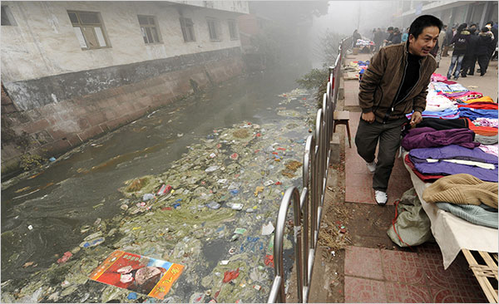
Holocene Extinction
Like all other extinctions, this is caused by environmental changes.
This extinction is unique because humans are causing this environmental change!

Slide 40
Humans are causing this extinction by
Overfishing the oceans and (overhunting on land),
polluting water (and land) all over the world
Overharvesting forests (decreases diversity and the ability for CO2 to be taken out of the atmosphere)
burning fossil fuels (thus causing global warming and sea level rise)

Slide 41
Overfishing Video
What is bi-catch?
What does the decrease in ocean predators tell us about the health of the ocean ecosystems?
What will happen as the ocean ecosystems collapse?
What personal choices are connected to ocean overfishing?
What did the 6th grade class do to help the issue of overfishing?

Slide 42
Ocean Acidification
What is ocean acidification?
What organisms will be affected most by ocean acidification? What will happen to them?
What is the source of Carbon Dioxide in the atmosphere that causes ocean acidification?
What will happen to the ocean food chain as ocean acidification?
What do humans need to stop doing to prevent ocean acidification?

Slide 43
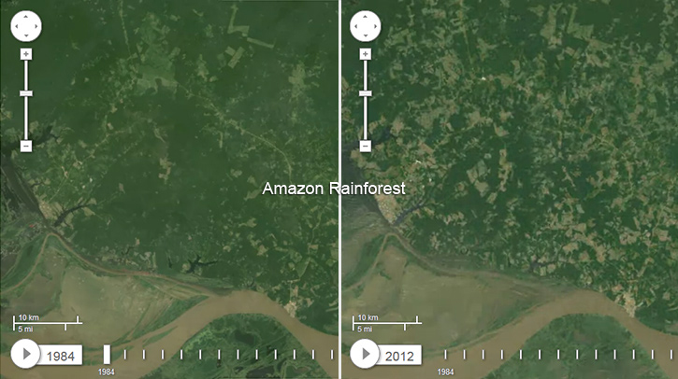
Overharvesting

Slide 44
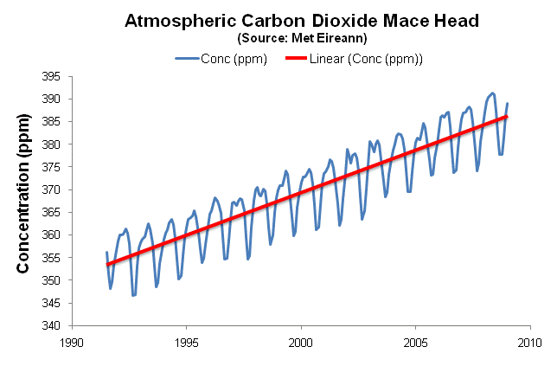
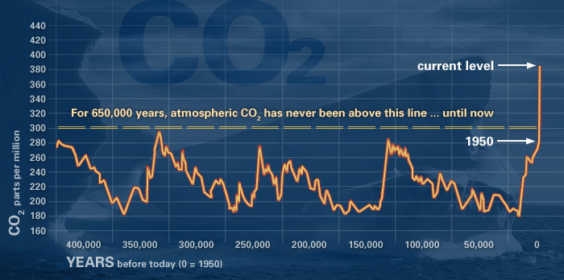

Slide 45
Chasing Ice
What event was filmed by the film makers?
What does this event tell us about global temperatures?
What will happen to sea levels as these huge ice sheets melt into the ocean?
What will the impacts be to ocean life (coral and non-moving ocean life) be?

Slide 46
Final Thoughts
After looking at some of the evidence for the 6th extinction…
Do you accept or reject the evidence for the 6th extinction?
What are the threats to the oceans?
What are the threats to land?
What can the human species do to prevent the 6th extinction from continuing?

Slide 49
Monica
Go to: http://humanorigins.si.edu/evidence/human-evolution-timeline-interactive
What are the 6 milestones of human evolution?
Explore 5 homonid species.
When did they live?
Where did they live?
What made them unique in the evolution of humans?
Go to: http://humanorigins.si.edu/evidence/human-family-tree
Describe the 4 hominid groups in the human family tree.

