Slide 1
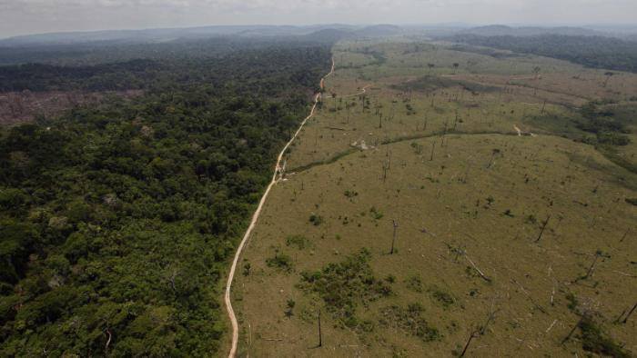
PTT 02MAY2016
Which ecosystem is more resilient (or more likely to endure change)?
Planner: Presentations Friday

Slide 2
Learning Goals
I can list and give an example for the deadly 5
I can read and obtain information about human health risks from Air Pollution

Slide 3
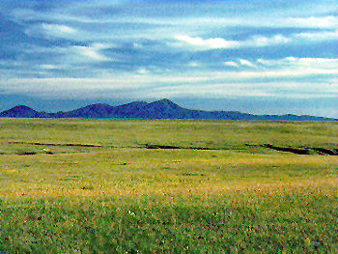
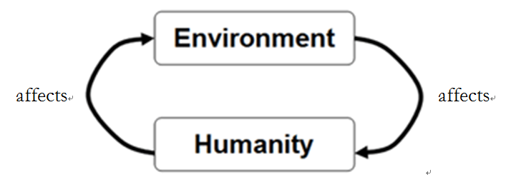

Slide 4
Biodiversity
Biodiversity: The number of species in a given area
Biodiversity is a measure of Ecosystem resiliency
More diversity > Less Diversity

Slide 5
Deadly 5
These 5 result in a decrease in biodiversity
Habitat Loss
Invasive Species
Pollution
Climate Change
Overharvesting

Slide 6
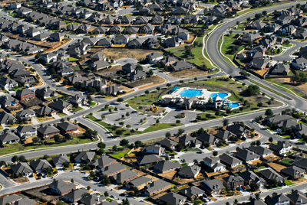
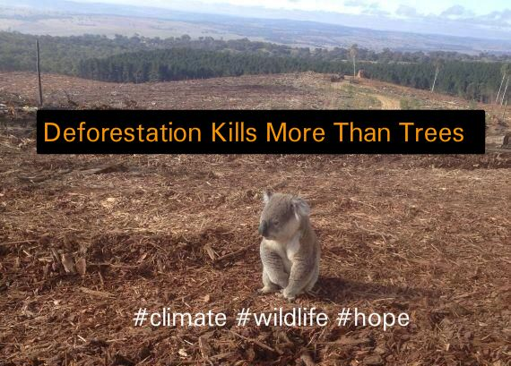
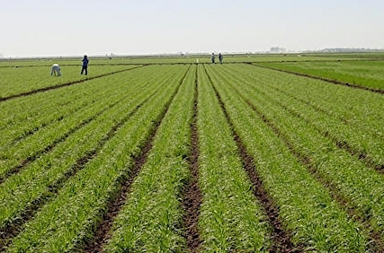
Deadly 5
Habitat Loss:
removal of the historical ecosystems

Slide 7
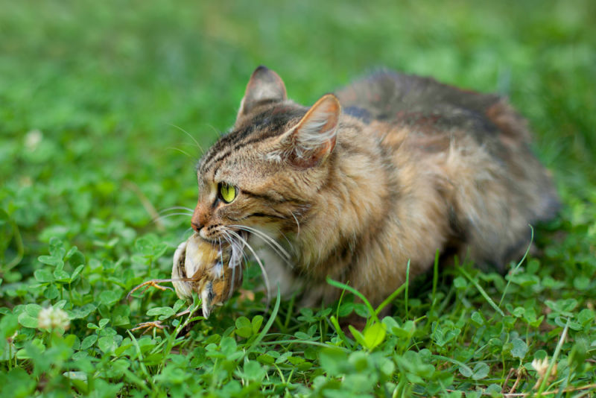
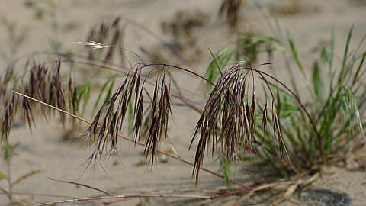
Deadly 5
Invasive Species:
Species that are not historically in the ecosystem.
Invasive species reproduce rapidly and often out compete

Slide 8
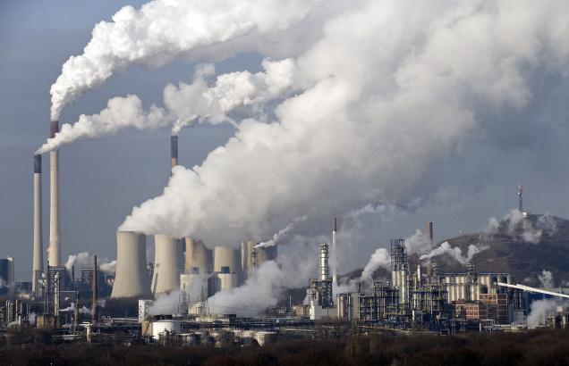
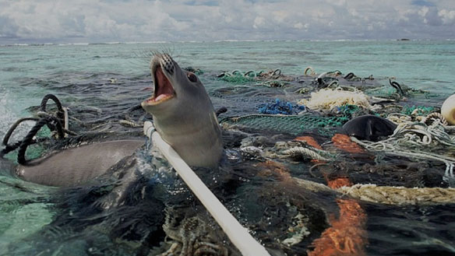
Deadly 5
Pollution: Air, Water, Noise, Light, Solid Waste, Human Waste
Humans are the only species that create waste that is UN-Usable to other species.

Slide 9
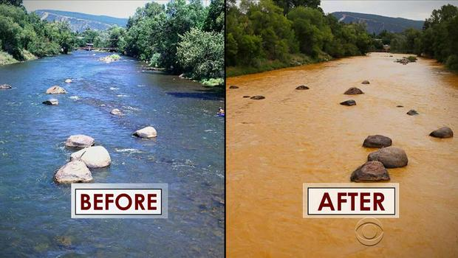
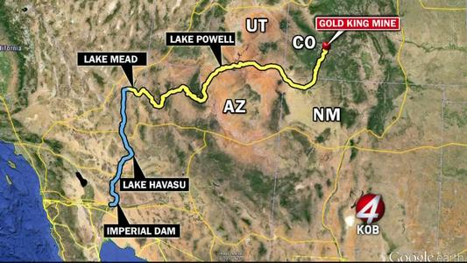

Slide 10
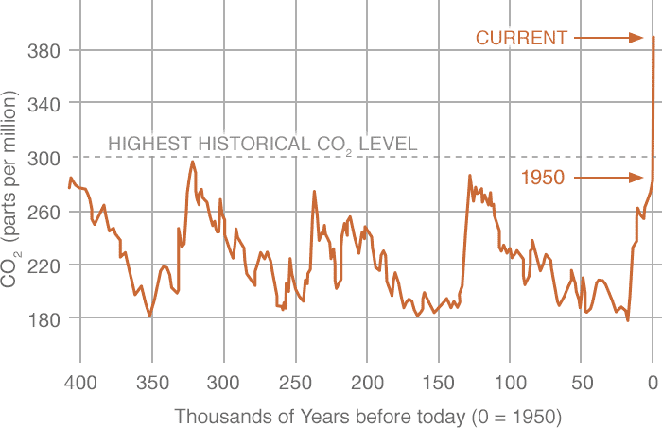
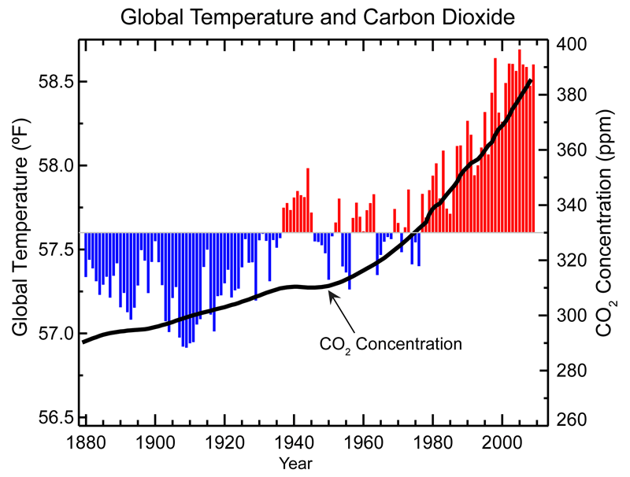
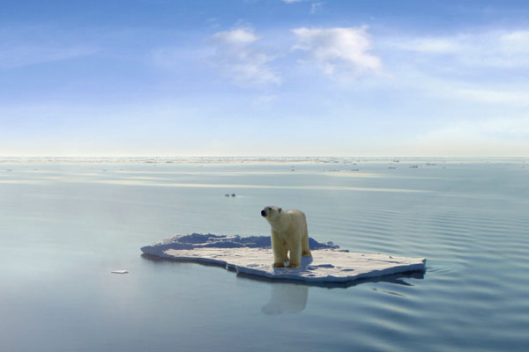
Deadly 5
Climate Change

Slide 11
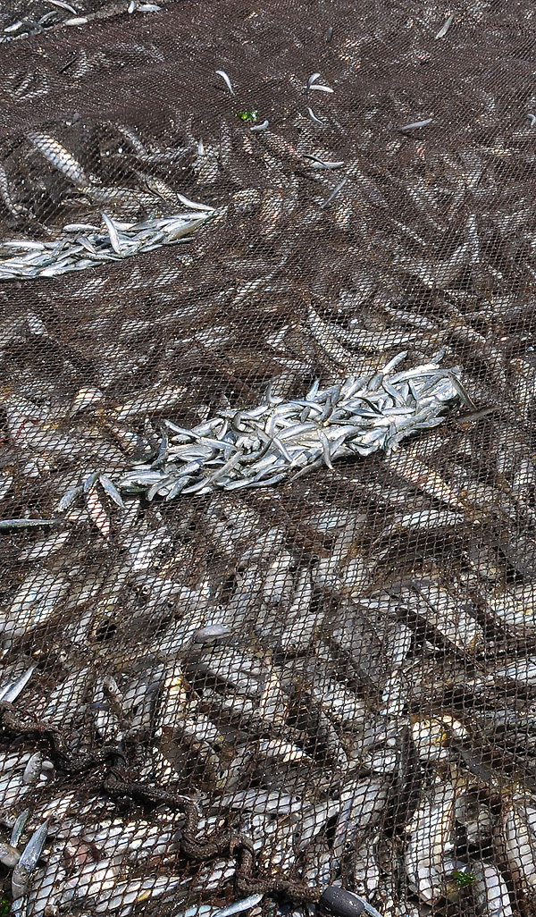
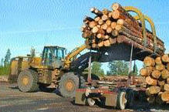
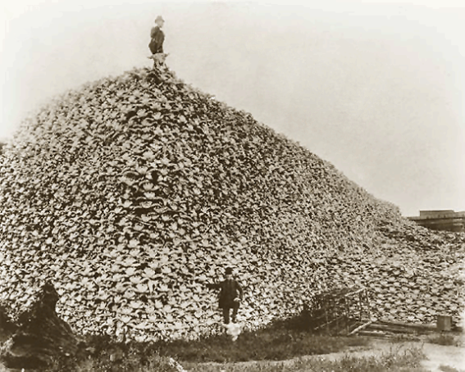
Deadly 5
Overharvesting: Taking more organisms than the population can replace.

Slide 12
Air Pollution
We are going to measure the pollution in Car Exhaust tomorrow
Today Read the article about Beijing with your table partner, SILENTLY first, then discuss.

Slide 13
TICKET OUT THE DOOR
List the Deadly 5
Give an example of a human health risk due to air pollution

Slide 15
PTT 03MAY2016
List and provide an example for the “Deadly 5”
How much do you ride in a car everyday?
Planners: Presentations Friday
Learning Goals:
I can calculate the pollution that is created when I ride in a car
I can measure the SO2, NOx, CO2 from Ms. Leigh’s car and use the data to respond to conclusion questions

Slide 16
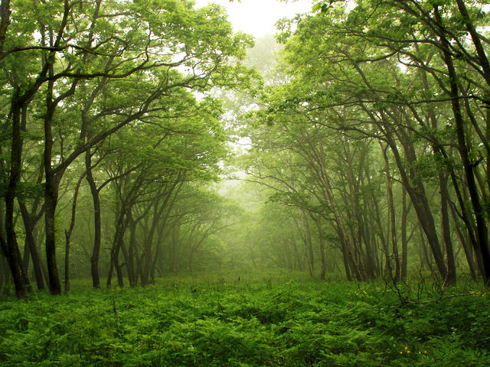
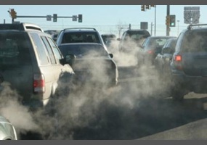

Slide 17
Air Pollution Sources
NATURAL
Volcanoes
Wildfires
Lightning
Decomposition
ANTHROPOGENIC
Transportation
Energy Production
Livestock
Industrial Processes

Slide 18
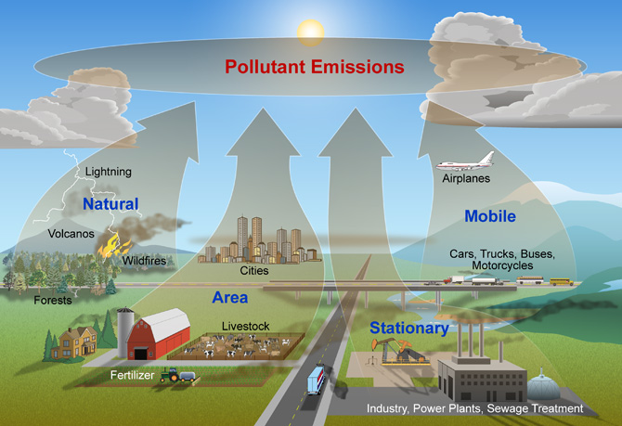

Slide 19
Air Pollution
Primary Pollutants:
Right out of the “tail pipe”
Secondary Pollutants:
Once it enters the atmosphere, the pollutant is chemically altered by the sun

Slide 20
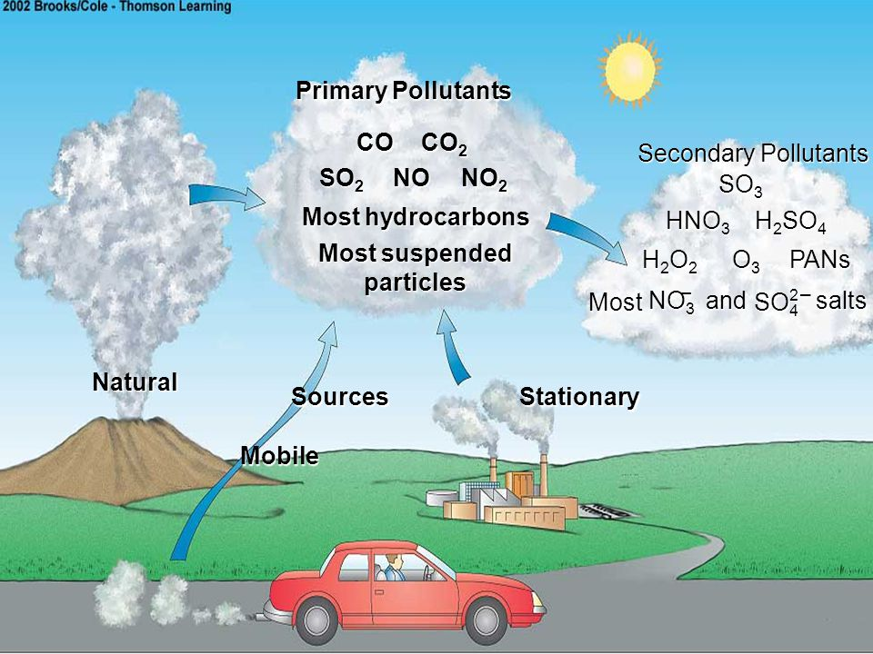

Slide 21
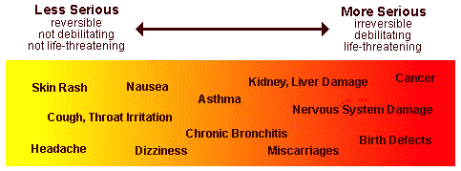
Effects to Animals

Slide 22
What is YOUR contribution?

Slide 23
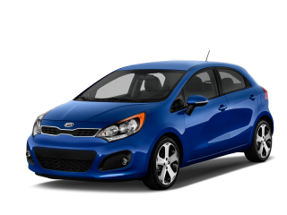
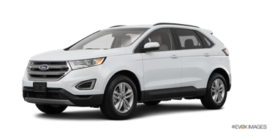
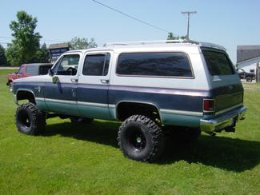
Miles Per Gallon (mpg)
Car: 26 mpg
SUV/Trucks: 17 mpg

Slide 25
PTT 04MAY2016
What questions have been sparked in your brain about Environmental Science so far?
(Write it on a post-it and put it on the board)
Planners: Presentations Friday
Learning Goals:
I can understand what the presentation requirements are.
I can use my time wisely in class to work on my team’s presentation

Slide 27
Presentations should have the following:
For your ecosystem make a list of: 5 plant species, 3 herbivores, 1 omnivore and, 1 predator.
Pick one of each and describe their adaptations to the ecosystem
What makes your ecosystem unique?
Which of the HIPCO effects your ecosystem the most? HOW? (pictures)
How can we ensure that the ecosystem survives into the future? What can we do? (examples)

Slide 29
PTT 05MAY2016
What do you need to do today to make sure your group presentation is finished?
Planners: Presentations TOMORROW
Learning Goals:
I can use my time wisely in class to work on my team’s presentation (I can practice!)
I can ensure that my group shared our presentation with Ms. Leigh

Slide 30
Presentations should have the following:
For your ecosystem make a list of: 5 plant species, 3 herbivores, 1 omnivore and, 1 predator.
Pick one of each and describe their adaptations to the ecosystem
What makes your ecosystem unique?
Which of the HIPCO effects your ecosystem the most? HOW? (pictures)
How can we ensure that the ecosystem survives into the future? What can we do? (examples)

Slide 32
PTT 06MAY2016
You have 5 minutes to prepare for your presentation.
Planners: Go Outside!
Learning Goals:
I can deliver an awesome presentation
I can grade my groups’ participation
I can finish the air pollution lab

