Slide 1
PTT 29FEB2016
You have 5 minutes to look over your notes one last time.
ELD only: use your notes during the quiz
For your Planners:
OAJ #20 Due Friday

Slide 3
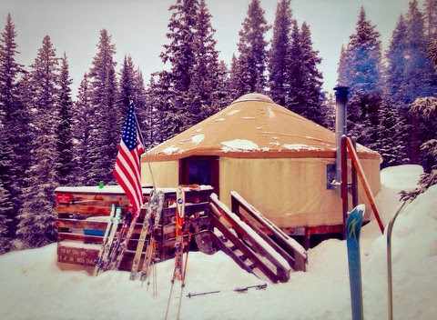
PTT 01MAR2016
What does OAJ stand for?
Where does that indicate you should be doing the weekly homework adventure?
For your planners:
OAJ #20 Due Friday

Slide 4
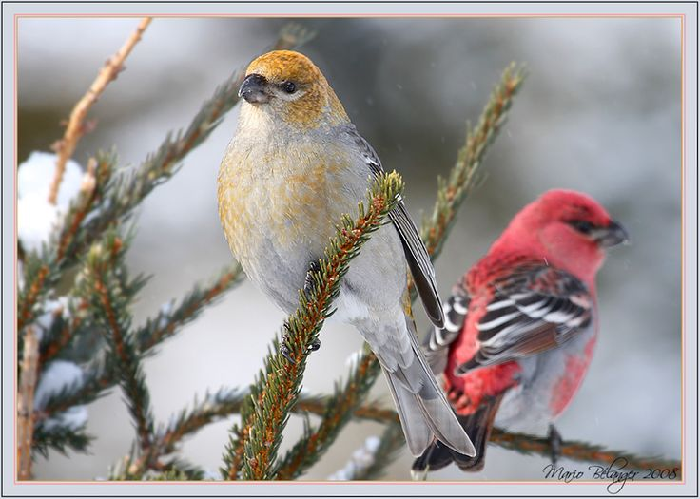
I skied 6 miles to a Yurt to celebrate my friend’s 30th Birthday. While sking I observed sea pine grosbeak. These are my favorite birds and I have never seen them in the winter before. They do not migrate, the birds are reclusive, so I have never seen them.
What surprised me is the birds were doing what I have always observed in the summer, just in the winter.
The experience is connected to Life Science through cells. I know that the Pine Grosbeak also goes through mitosis because it is a eukaryote.
I felt so content to be outside and away from the city. My phone didn’t work and it was so nice to see my friends.

Slide 5
Human Anatomy
How do the Cardiovascular, Muscular, Skeletal, and Respiratory work together to help Messi score a goal?

Slide 6
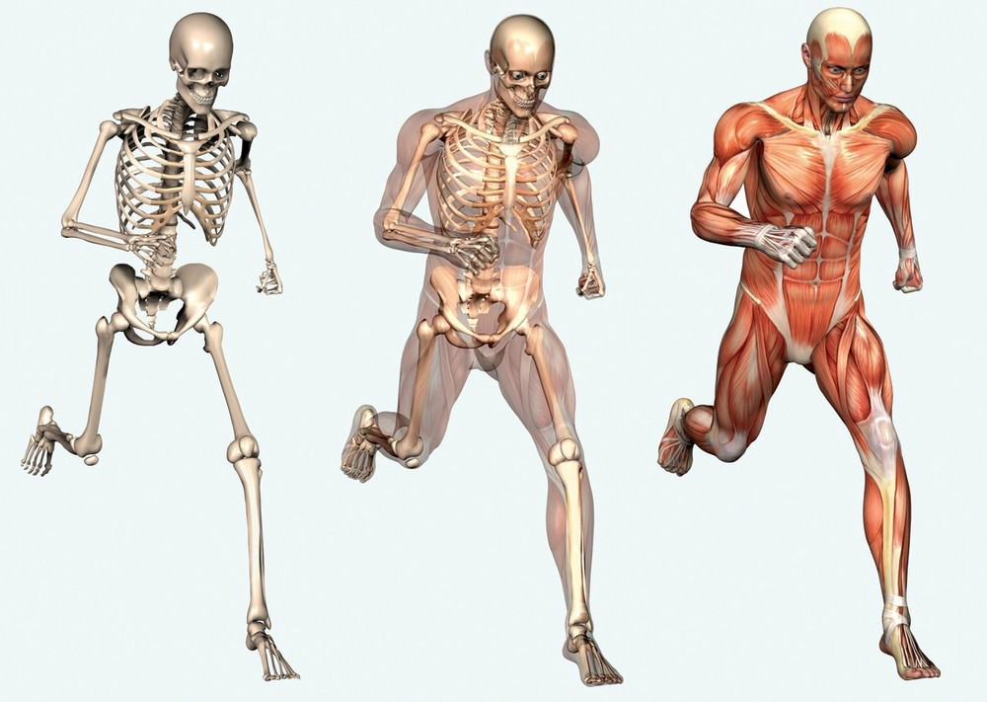
How do the skeletal and muscular system work together to produce movement?
NAME:____________________

Slide 7
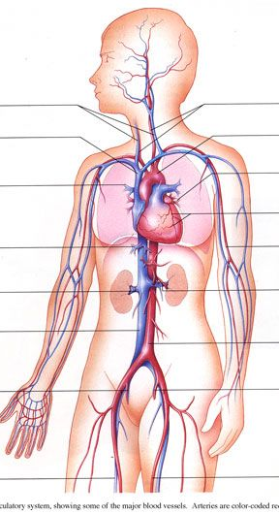
How do the cardiovascular and respiratory systems work together to oxygenate the muscles of the body to produce movement?
Respiratory Cardiovascular

Slide 8
Human Anatomy
How do the Cardiovascular, Muscular, Skeletal, and Respiratory work together to help Messi score a goal?

Slide 10
PTT 02MAR2016
What happens to Heart Rate when muscular activity is increased?
WHY does this happen?
For your planners: OAJ #20 Due Friday

Slide 11
How do the Cardiovascular, Muscular, Skeletal, and Respiratory work together to produce movement in animals?

Slide 12
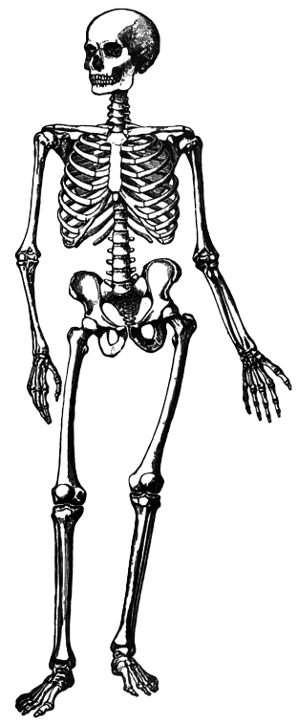
Skeletal System
Shape
Support
Movement
Protection
Storage

Slide 13
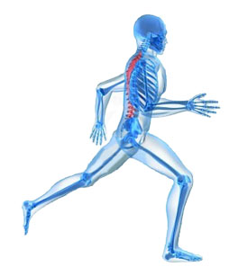
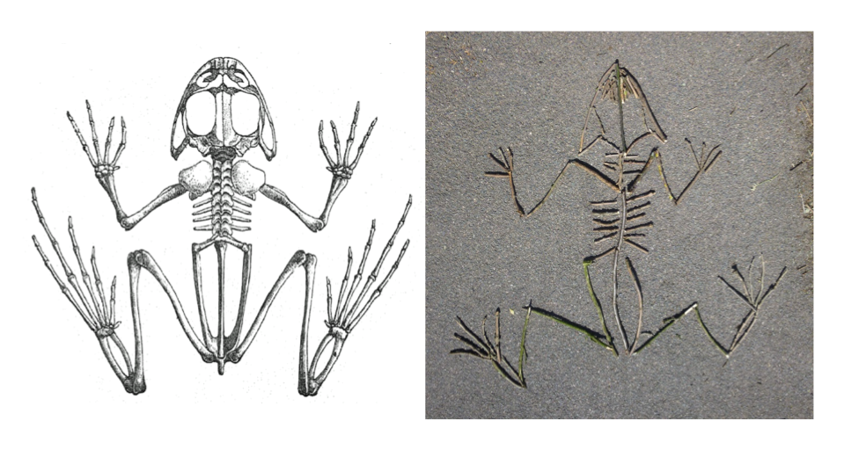
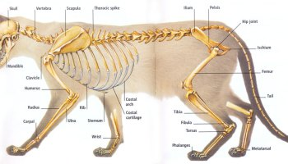
Skeletal System
Shape: Provides a shape that the body can be built around.
Support
Movement
Protection
Storage

Slide 14
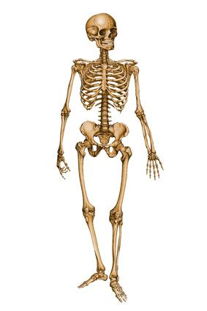
Skeletal System
Shape
Support: supports body, cradles organs
Movement
Protection
Storage

Slide 15
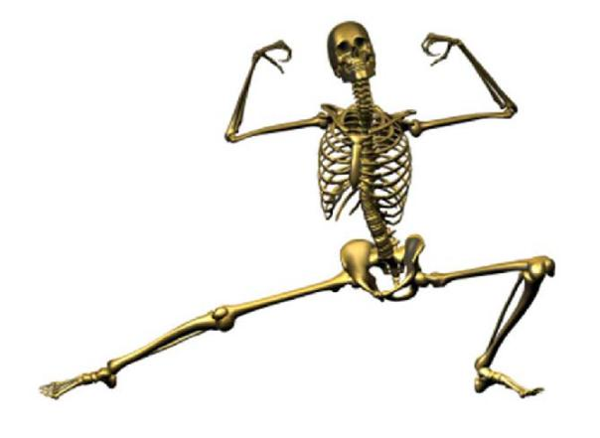
Skeletal System
Shape
Support
Movement: A Framework that the body and muscles can pivot from
Protection
Storage

Slide 16
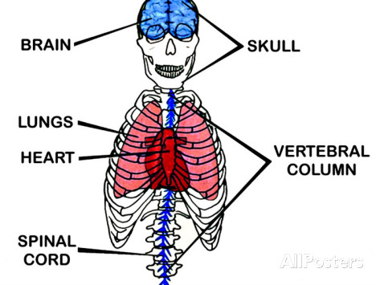
Skeletal System
Shape
Support
Movement
Protection: protects vital organs and soft tissues
Storage

Slide 17
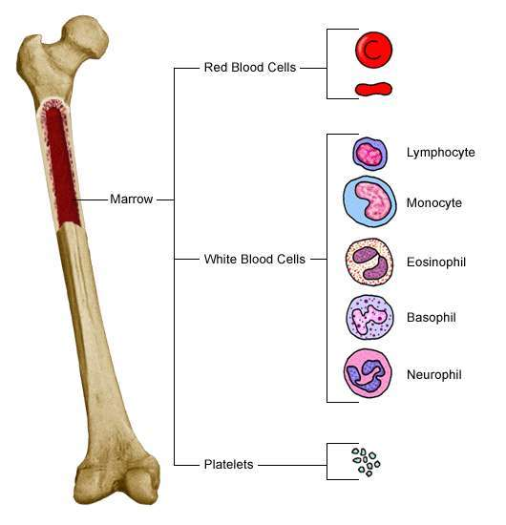
Skeletal System
Shape
Support
Movement
Protection
Storage: Produces and stores red and white blood cells

Slide 18
Build a Bone
Pick a joint
With your partner build a bone on either side of the joint
Once you have it constructed, label your skeleton diagram

Slide 20
PTT 03MAR2016
What are the 5 functions of the skeletal system?
For your Planners:
OAJ #20 Due tomorrow

Slide 21
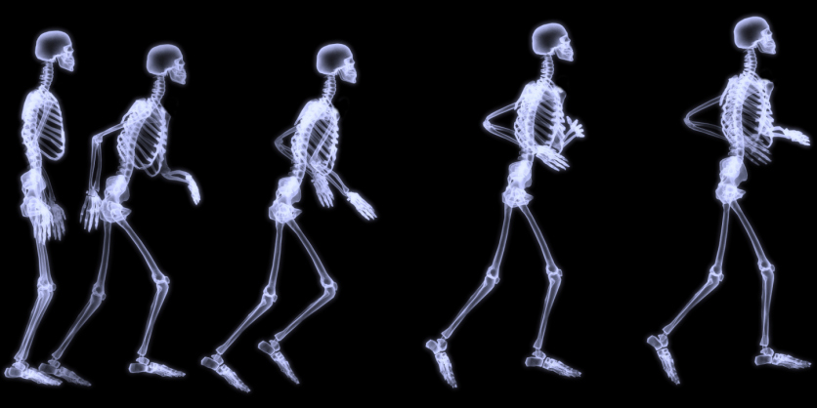
How do the Cardiovascular, Muscular, Skeletal, and Respiratory work together to produce movement in animals?

Slide 22
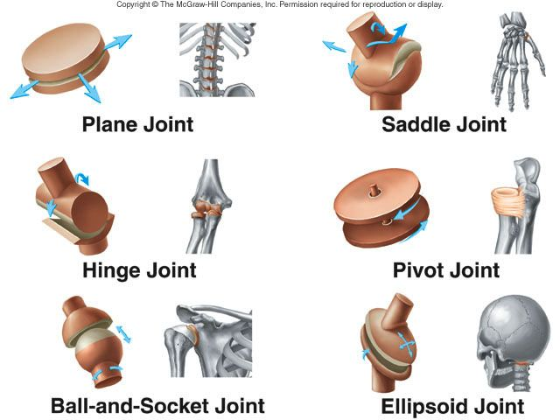

Slide 23
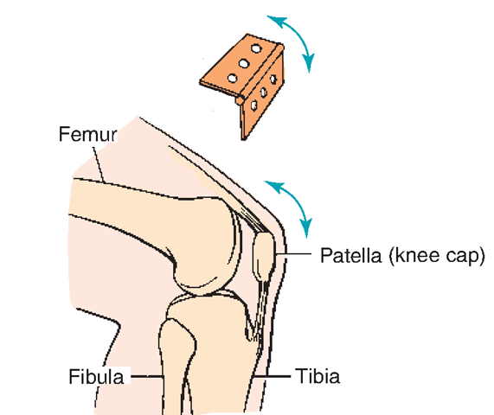
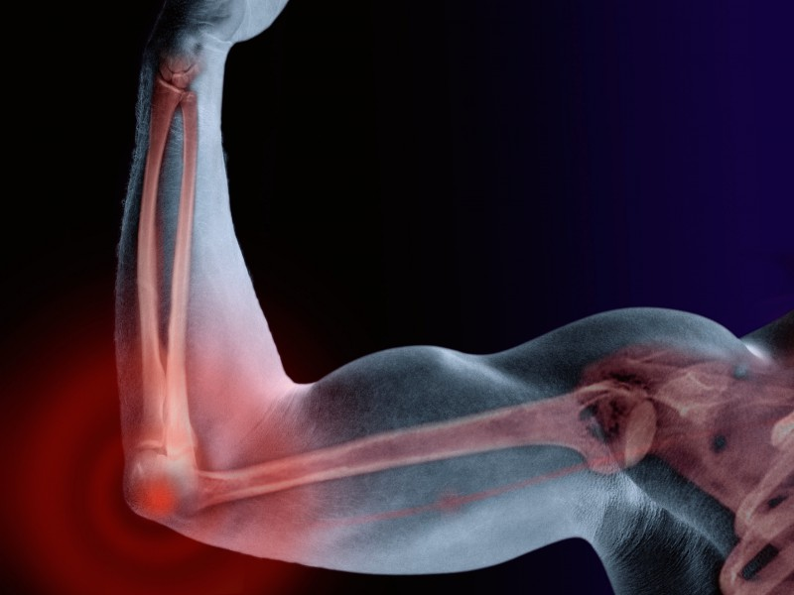
Hinge Joint
Elbow and Knee

Slide 24
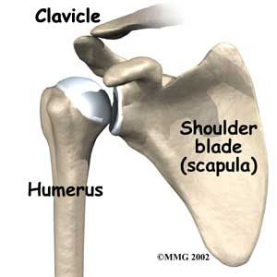
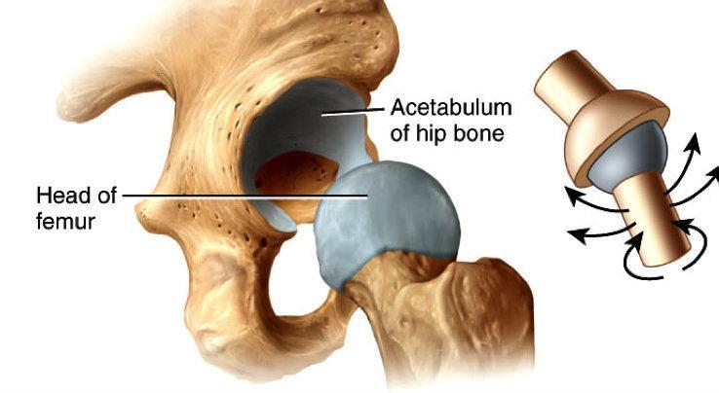
Ball and Socket Joint
Hip and Shoulder

Slide 25
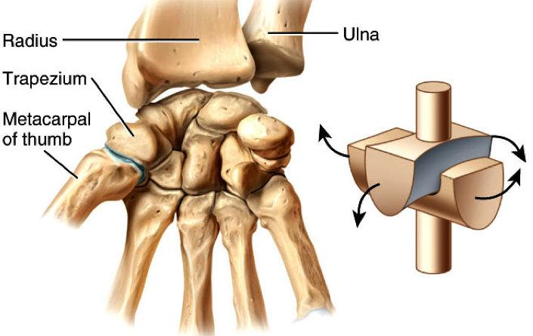
Saddle Joint
Wrist, Ankle, Thumb

Slide 26
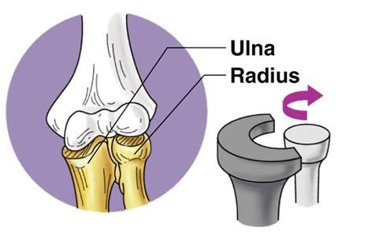
Pivot Joint
Forearm

Slide 27
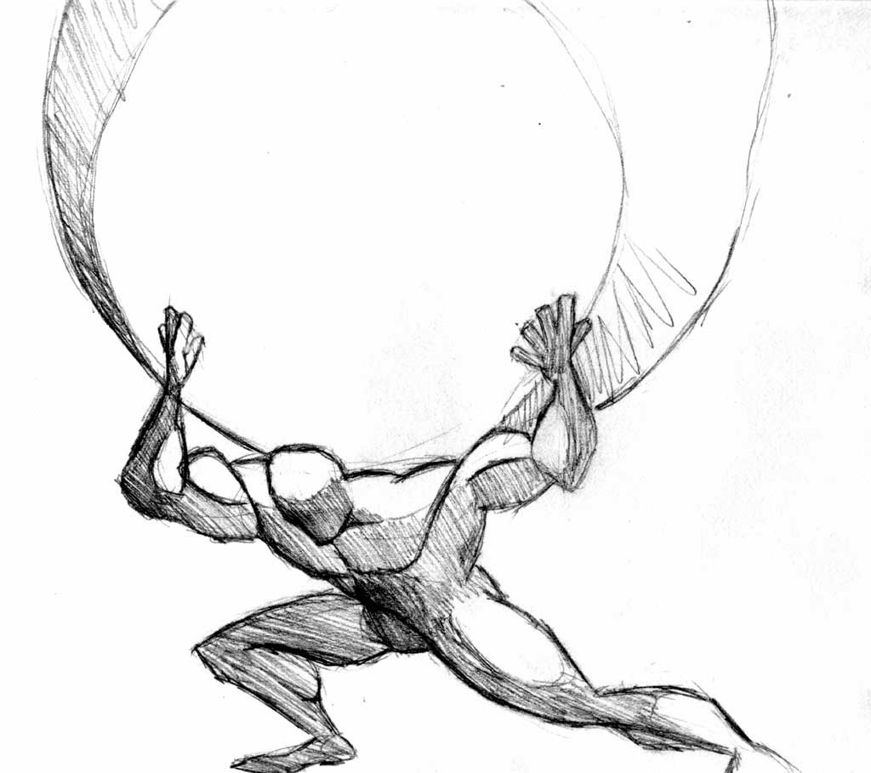
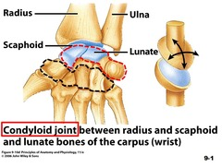
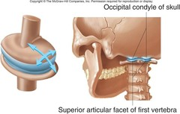
Ellipsoid Joint
Atlas and Wrist

Slide 28
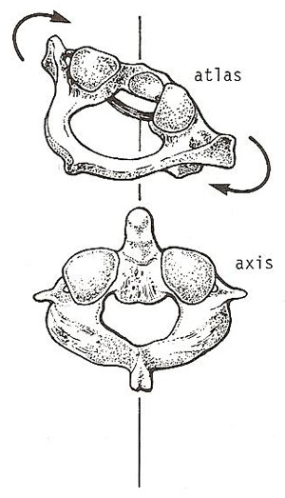
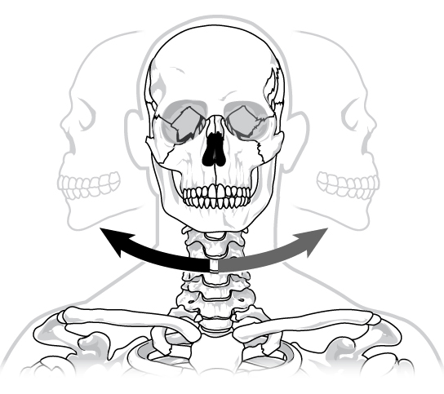
Plane Joint
Spinal Column

Slide 31
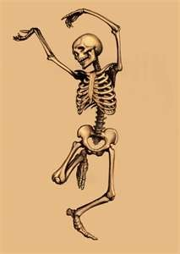
PTT 04MAR2016
Identify these joint types.
For your Planner:
Don’t Forget to turn in your OAJ #20
Enjoy the weekend!

Slide 32
How do the Cardiovascular, Muscular, Skeletal, and Respiratory work together to produce movement in animals?

Slide 34
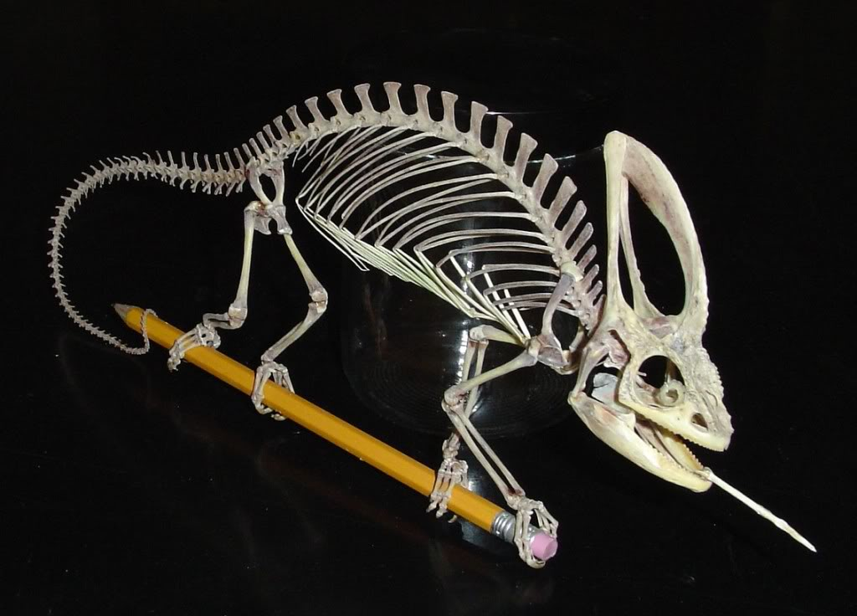
Identify these joints in this animal.

Slide 35
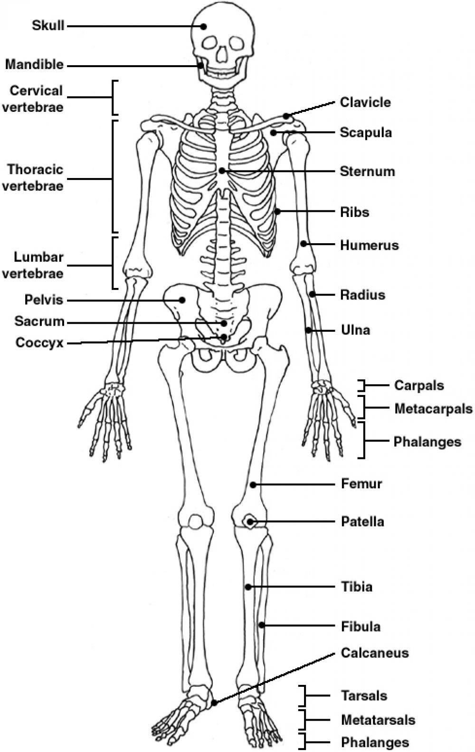
THE Skeleton

Slide 36
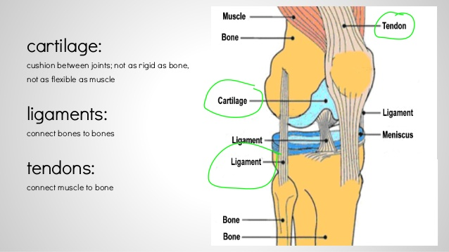
Knee Joint

Slide 37
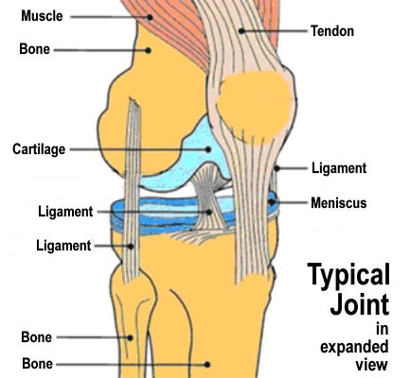

Slide 38
In your textbook
Page 484-489
TURN THIS IN at the end of class. Including the paragraph explanation of how the skeletal system allows movement in animals

