Slide 1
PTT 14MAR2016
How did you use your skeletal and muscular systems over the weekend?
Planners:
Human Anatomy Project Proposal Due Thursday

Slide 2
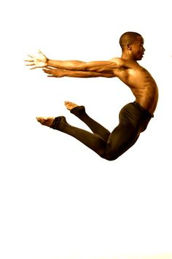
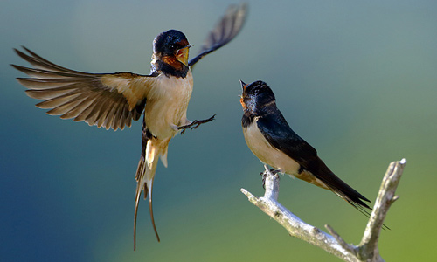
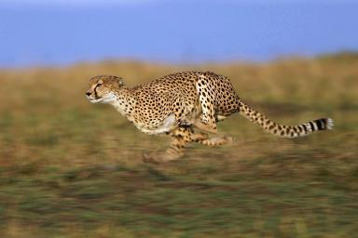
How do the Cardiovascular, Muscular, Skeletal, and Respiratory work together to produce movement in animals?

Slide 3
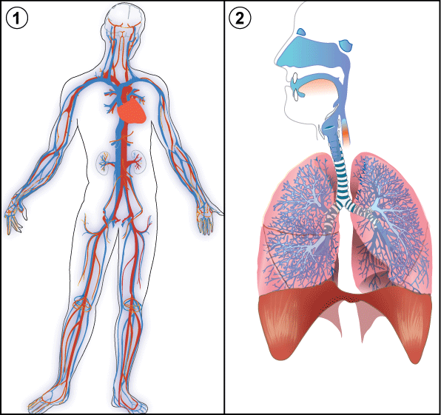
How do the Cardiovascular and Respiratory systems work together to keep the body oxygenated?

Slide 4
Know Want to Know Learned

Slide 5
Respiration
Breathing (inhaling and exhaling)
2. Gas exchange between the air and blood
3. Gas transport by the blood
4. Gas exchange between the blood and cells

Slide 6
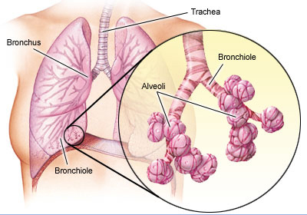
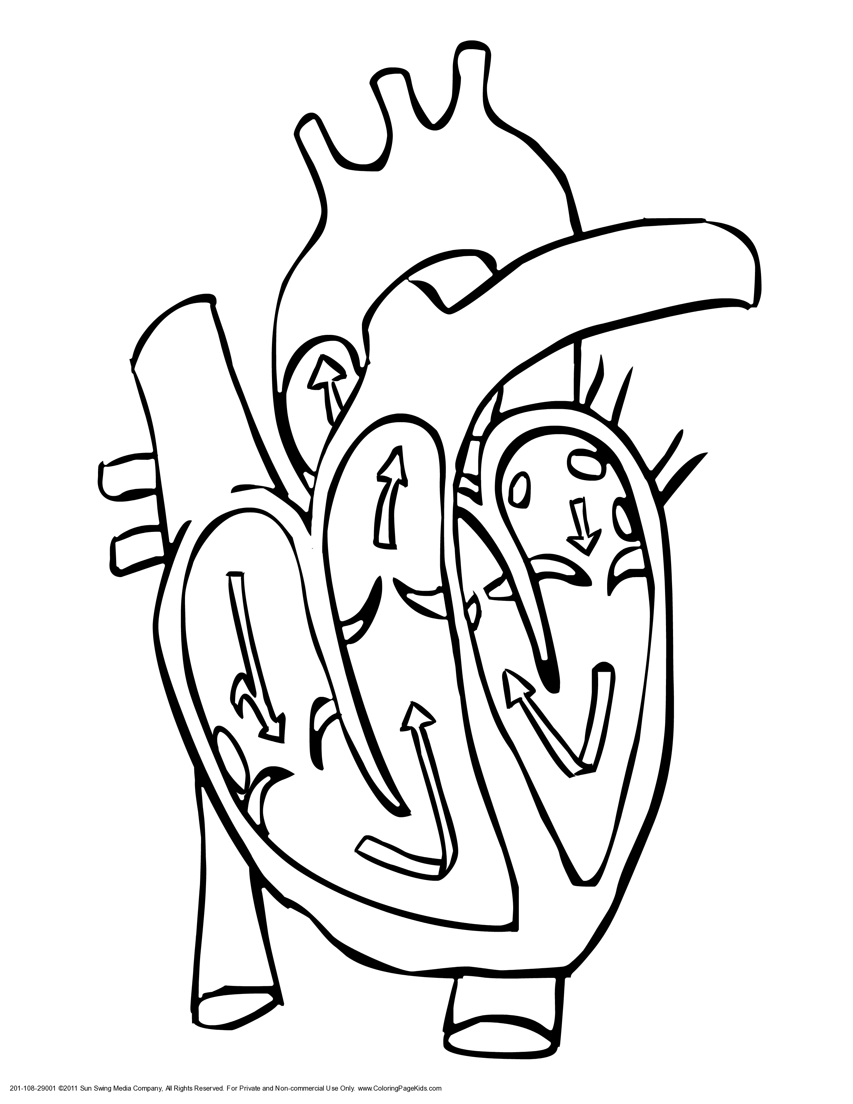
Label and Describe the Function

Slide 8
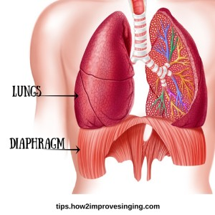
PTT 15MAR2016
What role does the diaphragm play in breathing in and out?
Planners:
Human Anatomy Experiment Proposal Due Thursday

Slide 9
How do the Cardiovascular and Respiratory systems work together to keep the body oxygenated?

Slide 10
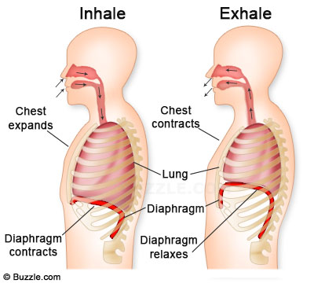

Slide 11
Respiration
Breathing (inhaling and exhaling)
2. Gas exchange between the air and blood
3. Gas transport by the blood
4. Gas exchange between the blood and cells

Slide 12
Label and Describe the Function

Slide 13
Respiration
Breathing (inhaling and exhaling)
The diaphragm flexes and contracts to fill the lungs with air. The diaphragm is a muscle that covers the base of the lungs. Air enters through the mouth and nose, travels down the trachea, into the bronchi.

Slide 14
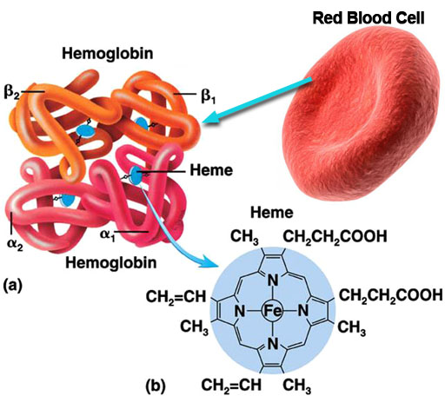
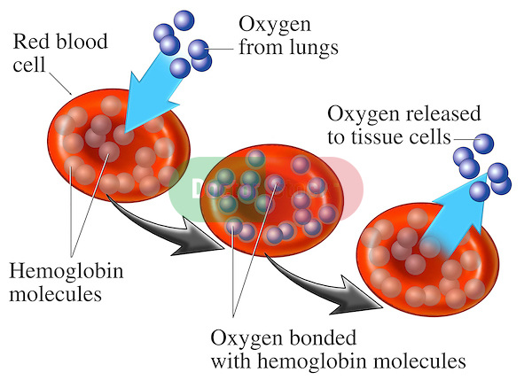
Respiration
Gas exchange between the air and blood
Blood cells are made of hemoglobin. The hemoglobin binds with the Oxygen molecules. The Oxygen diffuses across capillaries surrounding the alveoli.

Slide 16
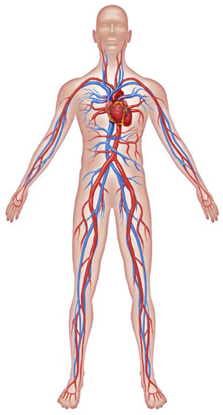
Respiration
Gas transport by the blood
Arteries and Veins carry blood around the body to provide oxygen to cells and carbon dioxide. All cells need oxygen! Again, the oxygen binds to the hemoglobin.
Arteries: Oxygen Rich
Vein: Oxygen Poor (Carbon Dioxide)

Slide 17
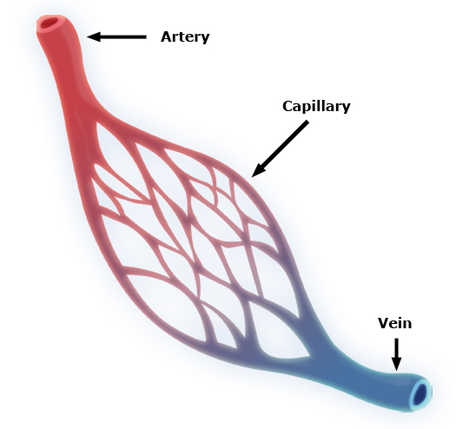
Respiration
4. Gas exchange between the blood and cells
Once the blood gets to the cells in the, muscles, and organs the oxygen diffuses to the cells that are relatively oxygen poor. This also happens through the capillaries. Carbon dioxide the attached to the blood cell that travels back to the heart and lungs to get rid of the carbon dioxide and pick up more oxygen.

Slide 18
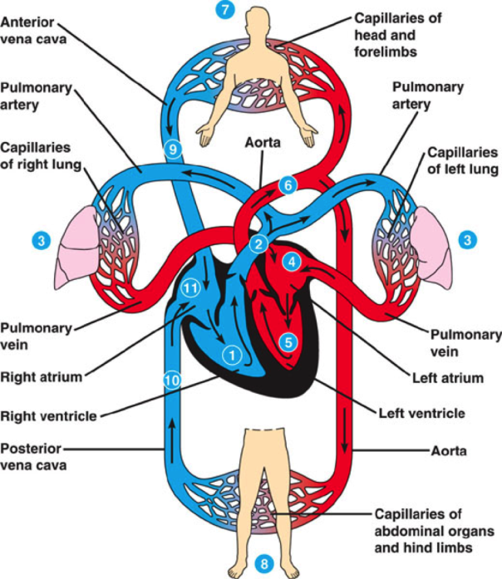

Slide 19
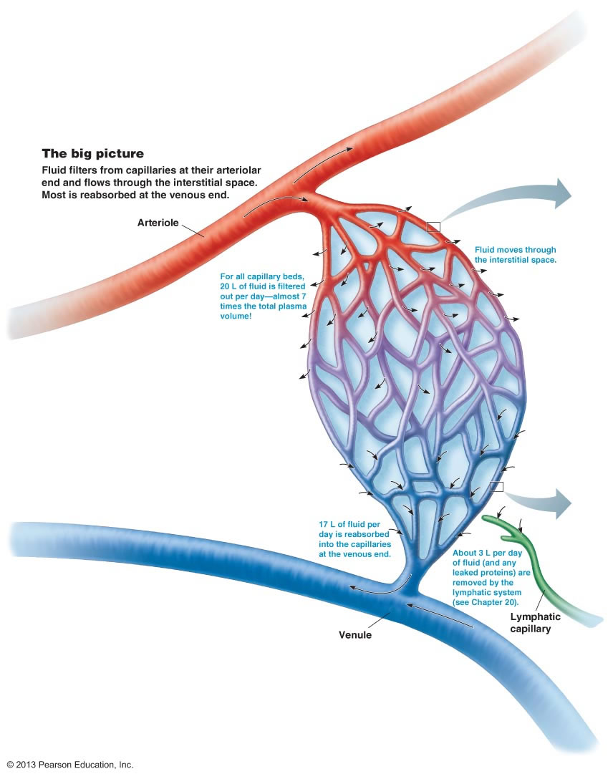

Slide 21
PTT 16MAR2016
What is a capillary?
What happens in the capillary?
Planners: Human Anatomy Experiment Proposal Due Thursday

Slide 22
Learning Goals
I can describe in detail the process of oxygenating cells and tissues of the brain or other organs.

Slide 24
How do the Cardiovascular and Respiratory systems work together to keep the body oxygenated?

Slide 25
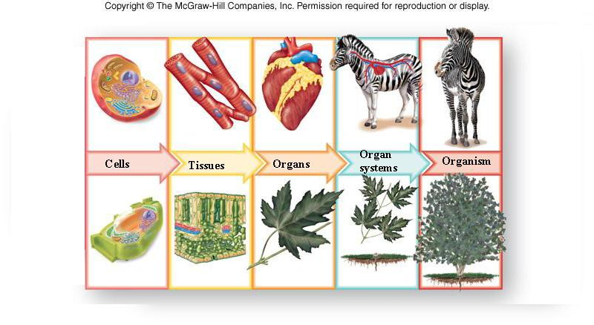

Slide 26
Circulation Role Play!

Slide 27
To Turn In…
Describe in detail the process of oxygenating cells and tissues of the brain or other organs. (there should be at least 8 steps)
List 2 things you learned in our circulation role play.
Ask two questions you still have about the respiratory or circulatory system.

Slide 29
PTT 17MAR2016
Where does gas exchange occur?
Where and Why is oxygen picked up and dropped off?
Where and Why is carbon dioxide get picked up and dropped off?
Turn in: Experiment Proposal

Slide 30
How do the Cardiovascular and Respiratory systems work together to keep the body oxygenated?

Slide 31
How do the Cardiovascular, Muscular, Skeletal, and Respiratory work together to produce movement in animals?

Slide 32
We have studied the skeletal, muscular, cardiovascular, and respiratory systems.
Today we will learn about the potential disease of these systems and how to prevent them.

Slide 33
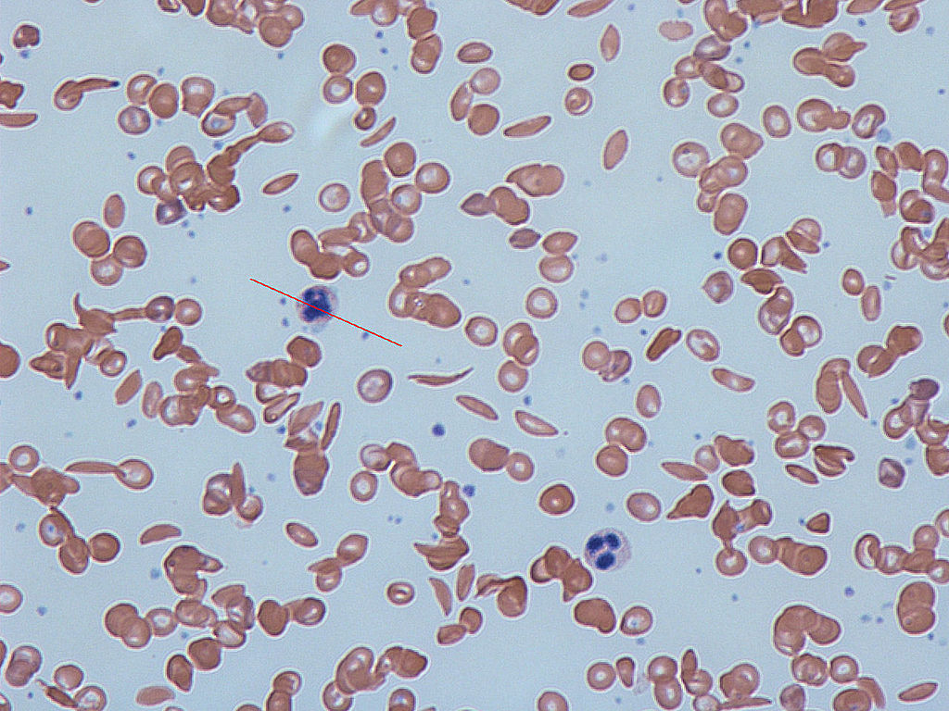
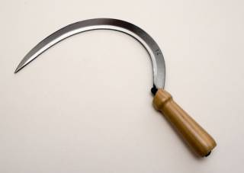
Sickle Cell Disease
A genetic trait that causes a mal-formed hemoglobin protein

Slide 34
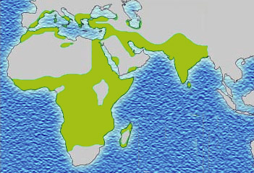
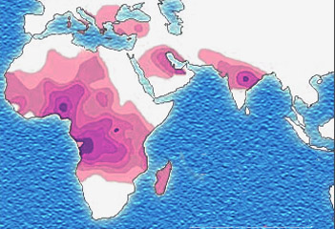
Human Evolution
Sickle Cell Disease Malaria Distribution
Distribution
When people with Sickle Cell disease contract Malaria, their symptoms are less severe

Slide 35
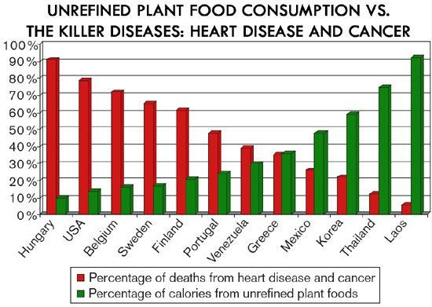

Slide 37
PTT 18MAR2016
Describe one disease of the human body that you learned about yesterday.
Knowing that we are all going to die of something, what are 3 things you can do to lessen your chance of dying of cancer or heart disease?
Planners: Human Anatomy Experiment

Slide 38
Learning Goals
I can explain in detail how the cardiovascular, respiratory, muscular, and skeletal systems work together to create movement in animals.
I can provide feedback to my peers about their Human Anatomy Experiment.
I can leave class with a clear idea of what my experiment will be on Monday

Slide 39
Unit Wrap Up
How do the Cardiovascular, Muscular, Skeletal, and Respiratory work together to produce movement in animals?

Slide 40
Learning Goals
I can provide feedback to my peers about their Human Anatomy Experiment.
3. I can leave class with a clear idea of what my experiment will be on Monday

Slide 41
Peer Feedback…
Check Pluses Gather on one side of the room
You will give feedback to two groups
By the end of class you should have feedback from 2 groups
Checks or Check minuses gather on the other
You are to work with your peers to design an experiment that is actually testable in class.
Re-submit your research plan with the new question.

