Slide 1
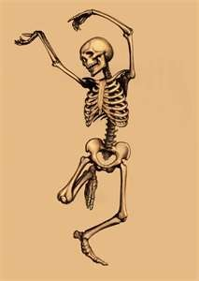
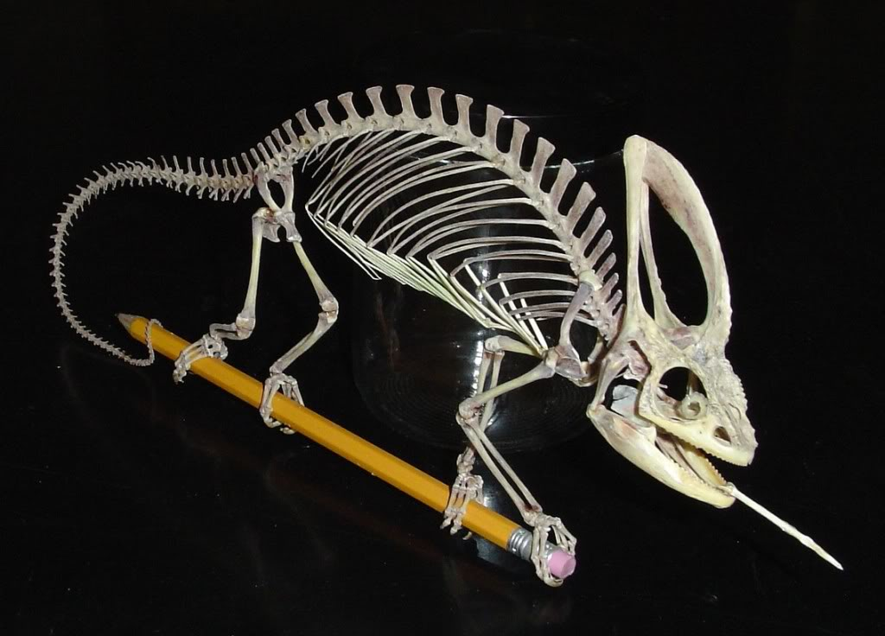
PTT 07MAR2016
What are the similarities between these two skeletal systems?
For your Planner: OAJ #21 - Friday

Slide 2
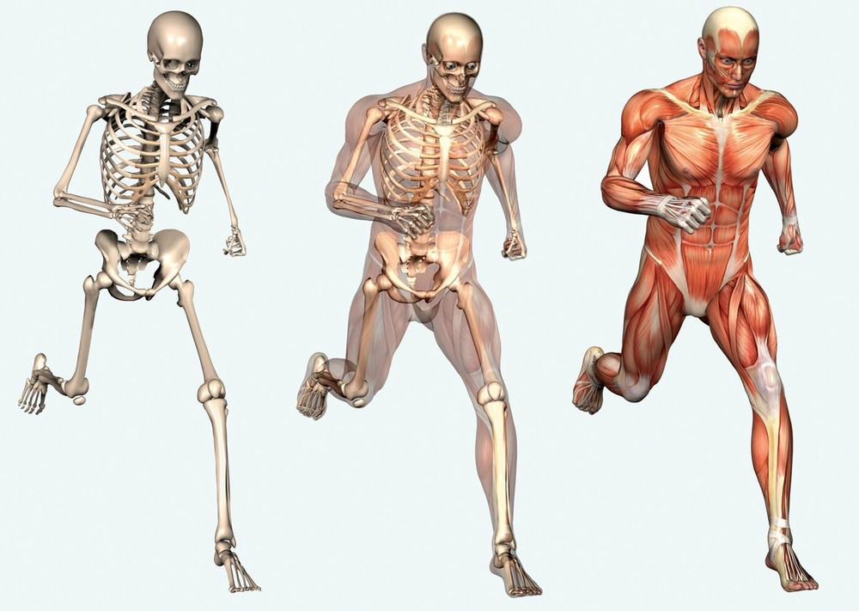
Skeletal and Muscular Systems
The systems work together to create movement.
Skeletal provides the frame and Muscles provide the movement

Slide 3
What is evolution?

Slide 4
What is evolution?
Change in traits over time.
The variation in skeletons is evidence for animal evolution

Slide 5
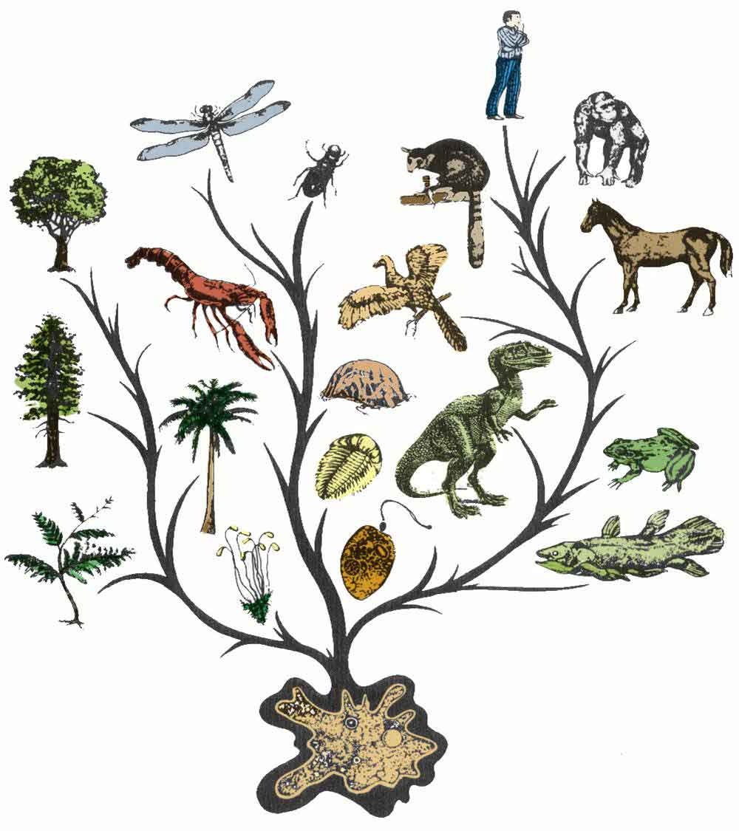

Slide 6
In your science notebooks…
Answer the questions at each table as you circulate around the room.

Slide 7
How are animal skeletons evidence for evolution?

Slide 8
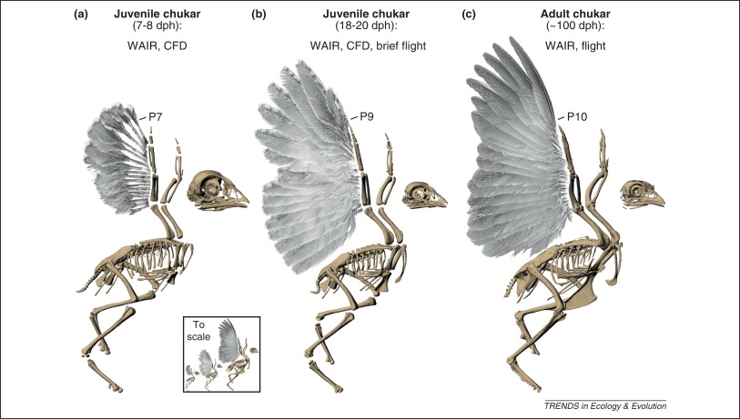
1. What do you observe about the number of bones in the Chukar as it ages?

Slide 9
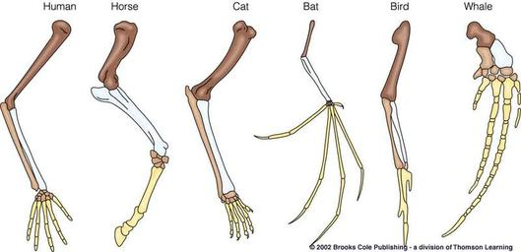
2. List 3 similarities AND 3 differences among these animal, front limbs.

Slide 10
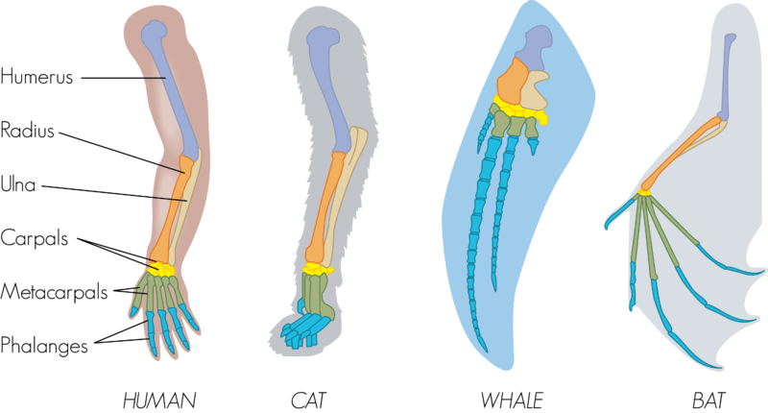
3. What do you observe about the arrangement of the front limbs of these animals?

Slide 11
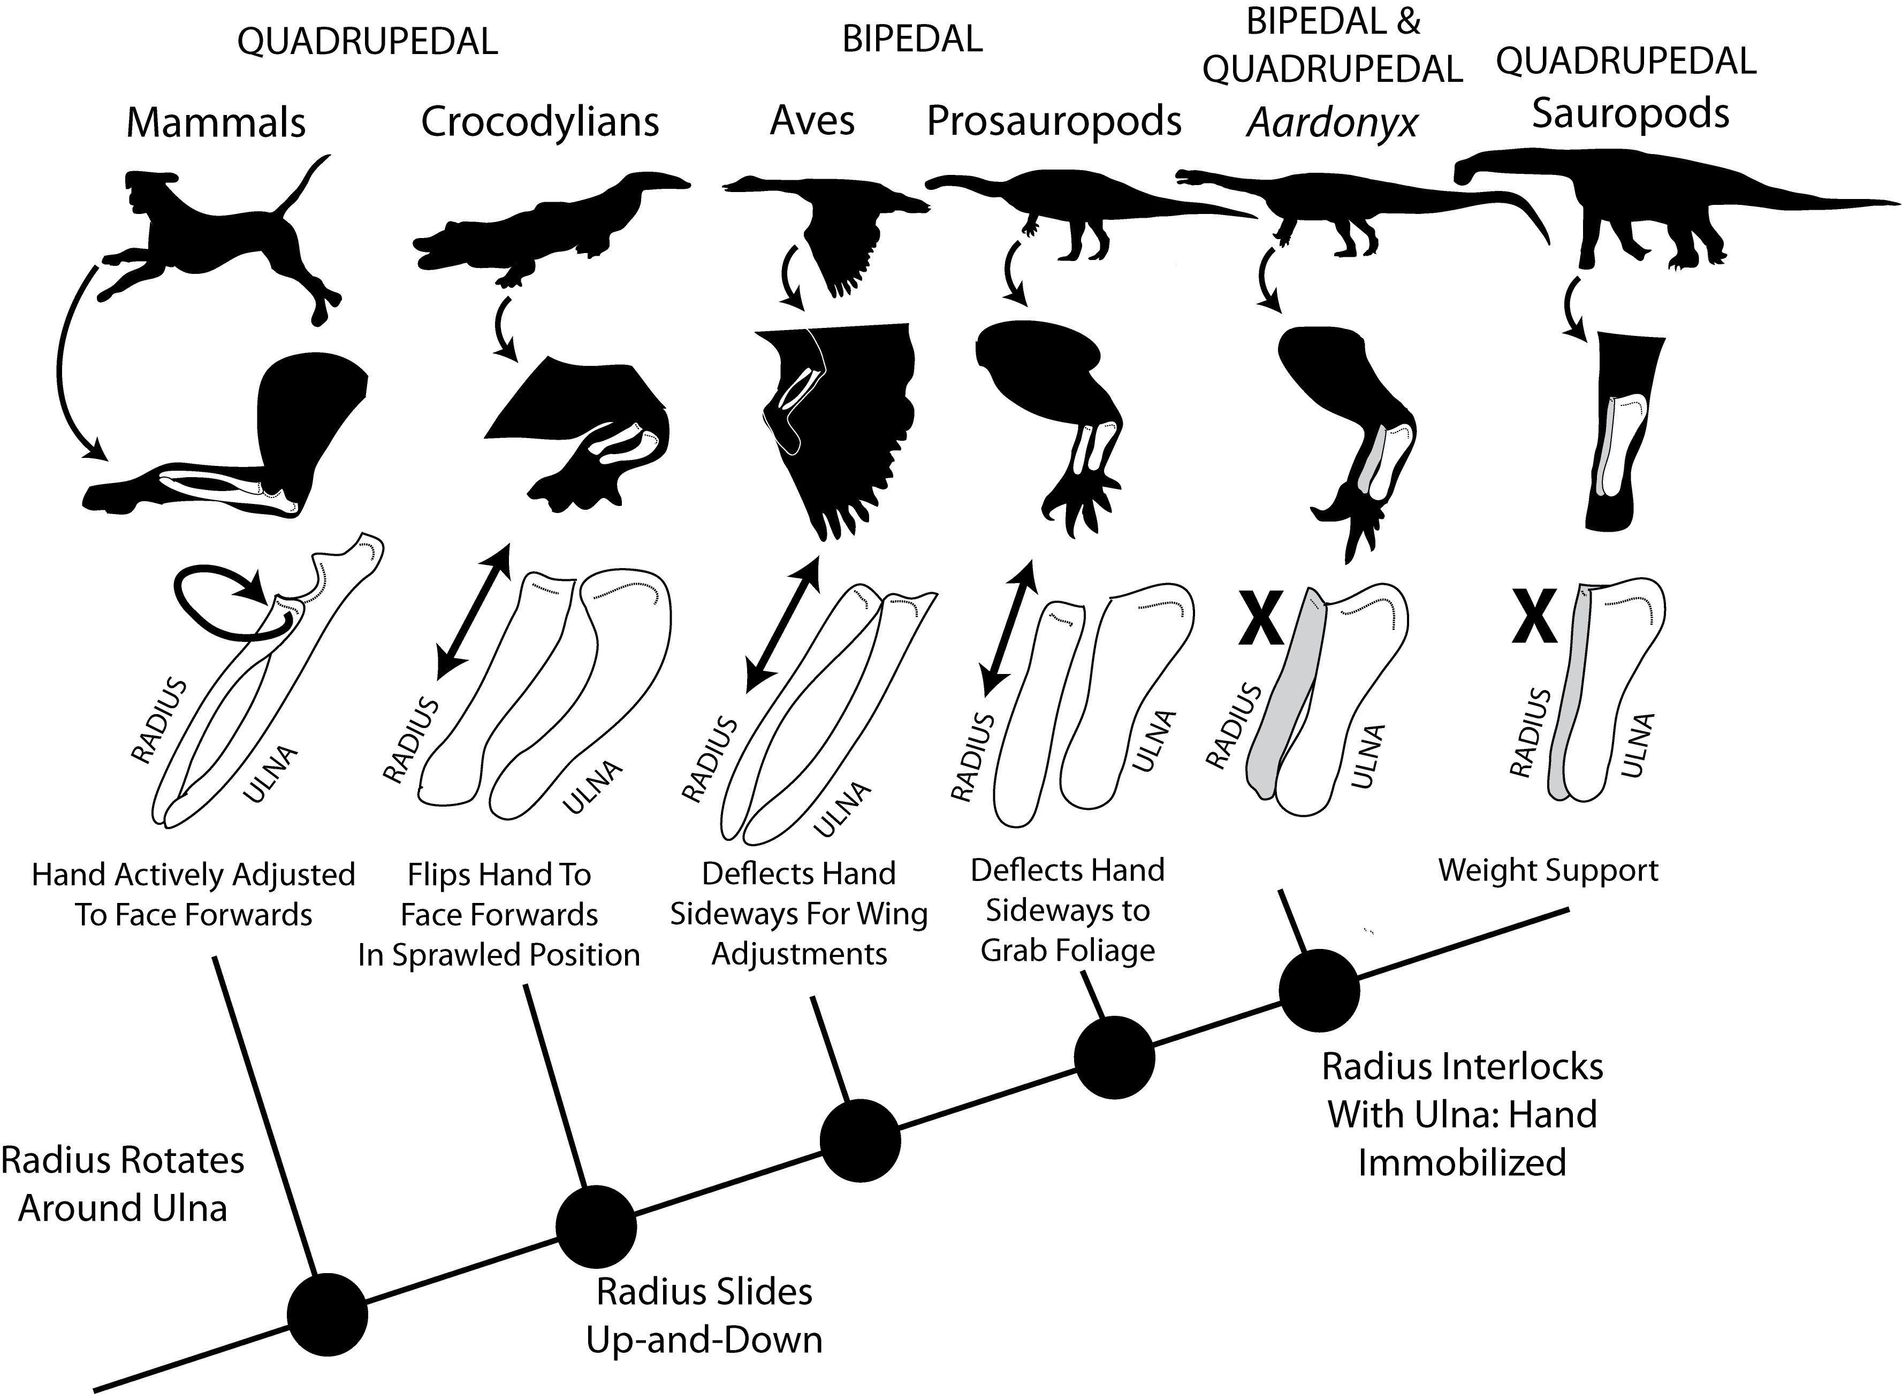
4. Explain how the evolution of the radius and ulna affect how the animals walk.

Slide 12
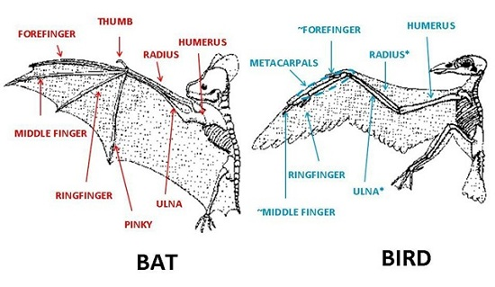
5. What are 3 similarities and 3 differences between bat and bird wings?

Slide 13
6. Hypothesize why these wings are slightly different but both allow the animals to fly. (Think: how are birds and bats different)

Slide 14
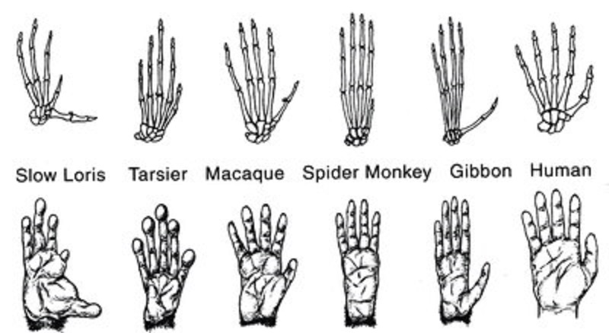
7. How does the arrangement of all these hands allow primates to grasp items? What bone in particular allows this movement?

Slide 15
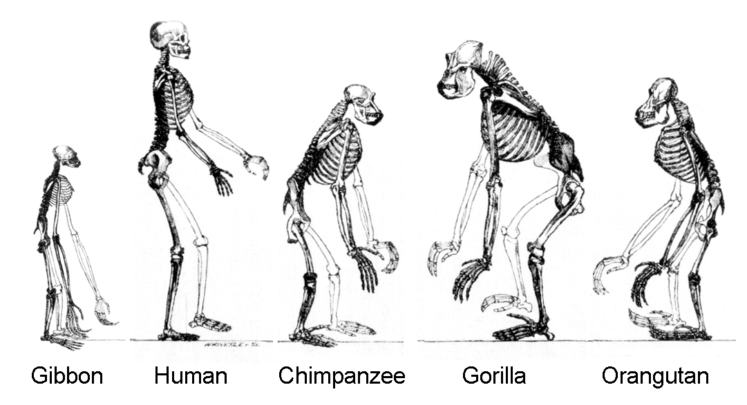
8. Explain how the location of the foramen magnum allows humans to stand and walk upright.

Slide 16
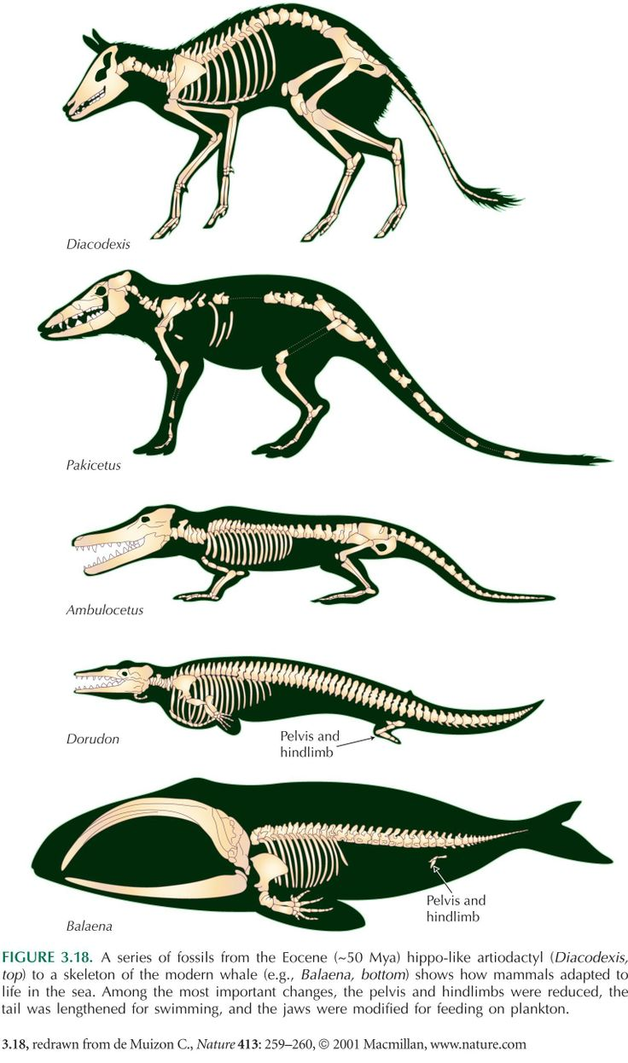
9. Explain how a boney fin could have evolved into a limb that can be used for walking or crawling.

Slide 17
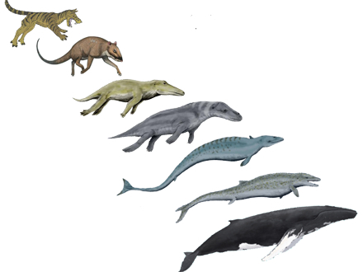
10. What trait to all of these animals have in common? What does this tell you about their relatedness?

Slide 19
PTT 08MAR2016
How are animal skeletons evidence for evolution?
Planners: OAJ #21 Due Friday

Slide 20
Skeletal and Muscular Systems
The systems work together to create movement.
Skeletal provides the frame and Muscles provide the movement

Slide 21
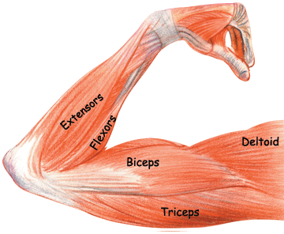
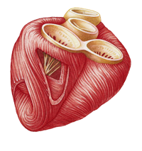
Muscles Control
Voluntary: Muscles that you can control or choose to move
Involuntary: muscles that you can NOT control consciously. Work all day and all night without notice

Slide 22
3 types of muscles
Skeletal: muscles that move bones
Smooth: found in organs, the digestive tract
Cardiac: only found in the heart

Slide 23
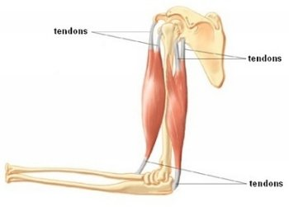
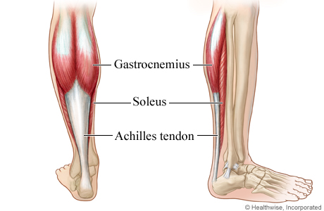
Tendons
Attach muscle to bone

Slide 24
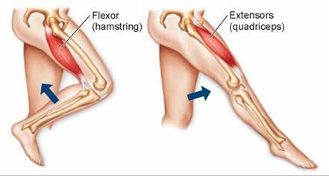
Muscles come in Pairs

Slide 25
Mini-Presentation
Name and demonstrate the muscle pair
Devise an exercise that moves the muscles group you are responsible for
You will share your muscles group and exercise with the class.

Slide 26
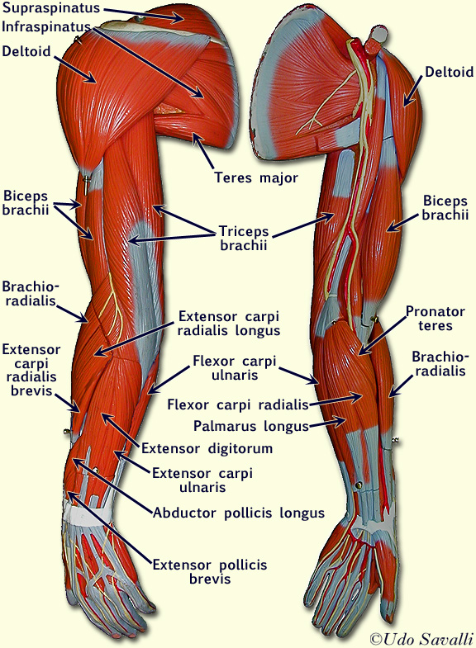
Bicep and Tricep

Slide 27
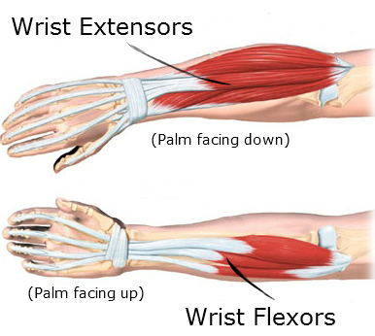
Extensor and Flexors forearm

Slide 28
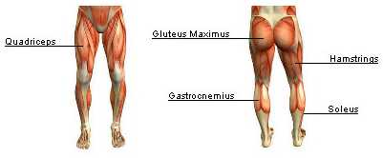
Quadriceps and Hamstrings

Slide 29
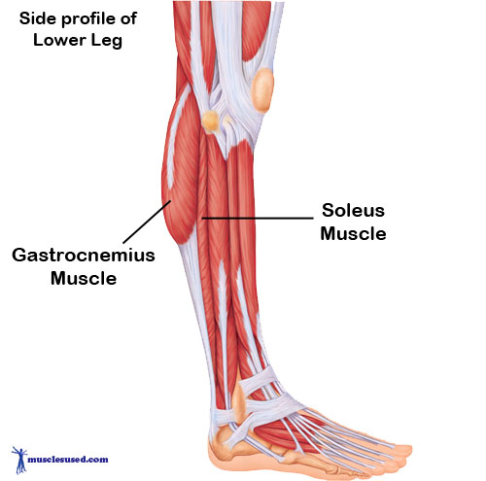
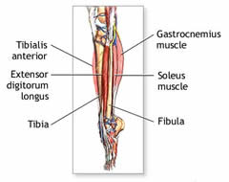
Gastrocnemius and Tibialis

Slide 30
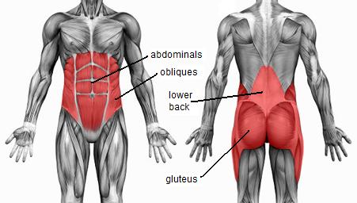
Abdominal and Back Muscles

Slide 31
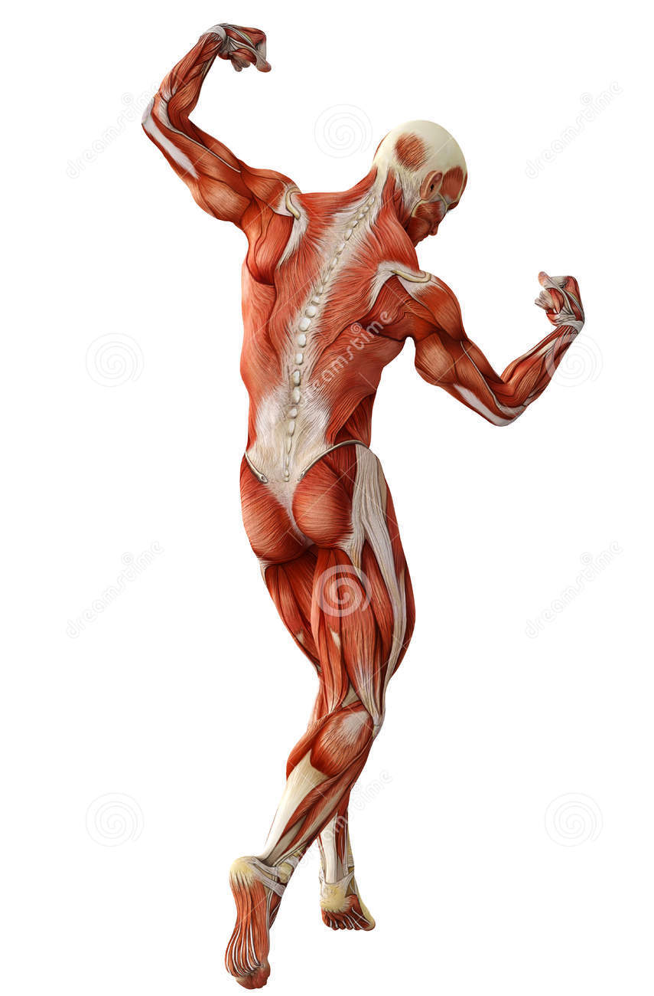
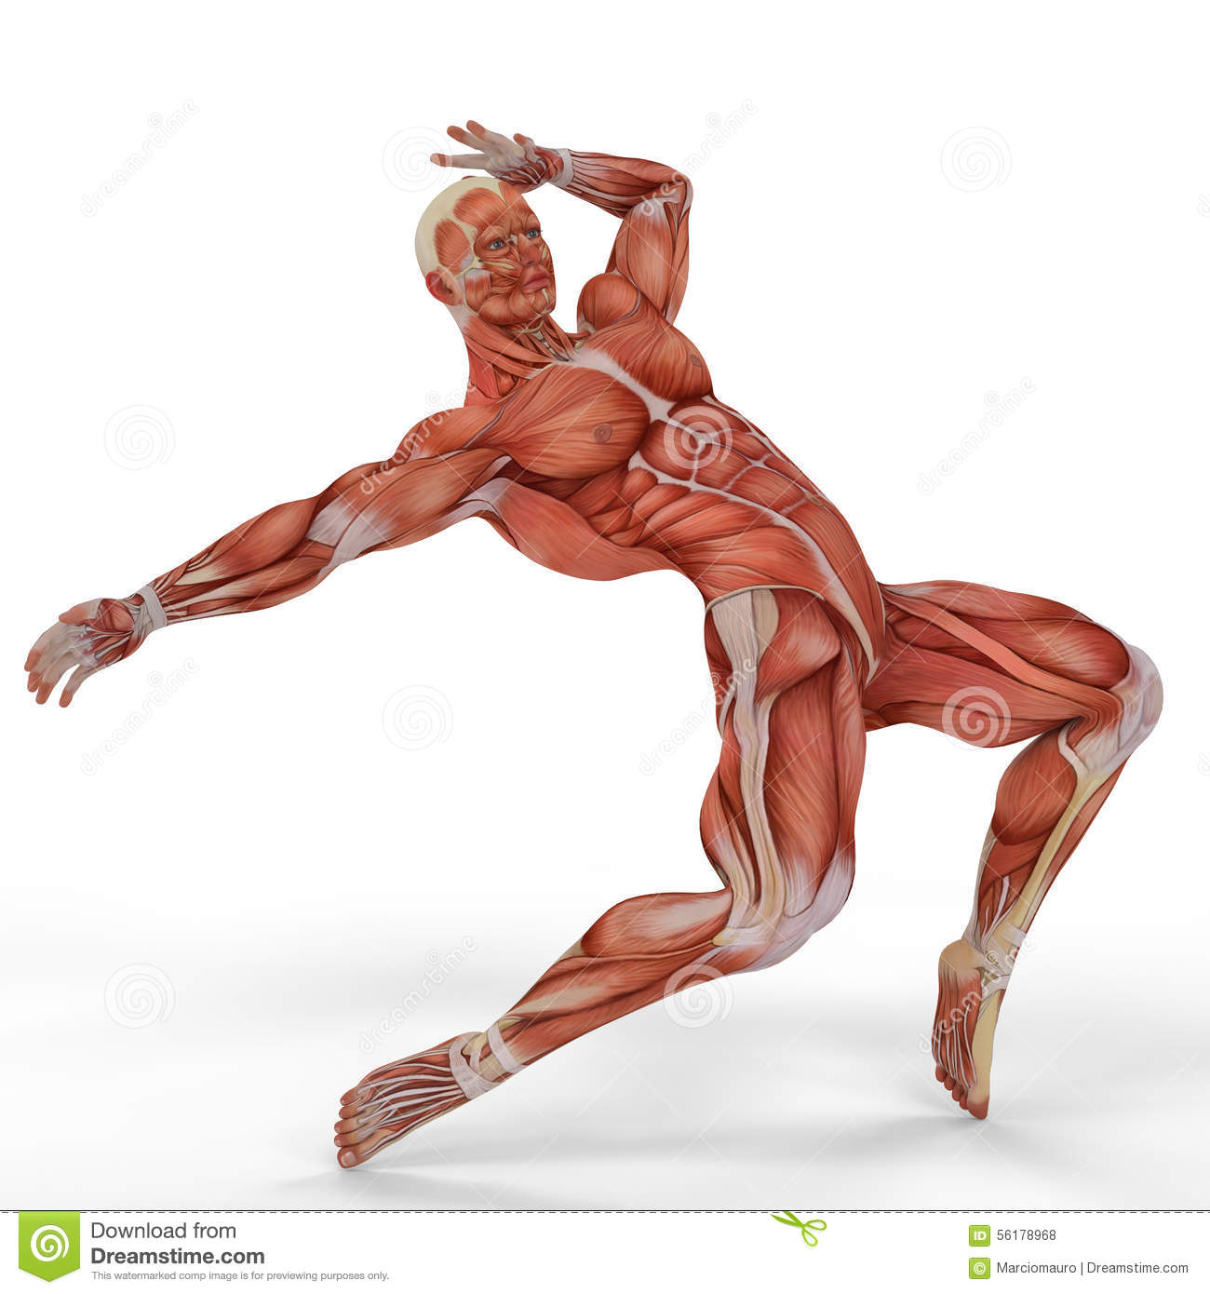
Label major muscle groups

Slide 32
What are the 3 types of muscle?
Why do muscle groups exist in pairs?

Slide 33
Label major muscle groups

Slide 34
Muscle Notes
Voluntary:
Involuntary:
Skeletal:
Smooth:
Cardiac:

Slide 36
PTT 09MAR2016
Compare and contrast voluntary and involuntary muscle movements.
Provide 2 examples of voluntary and involuntary muscles.
For your planner: OAJ #21 Due Friday

Slide 37
How do the skeletal and muscular systems work together to create movement?

Slide 39
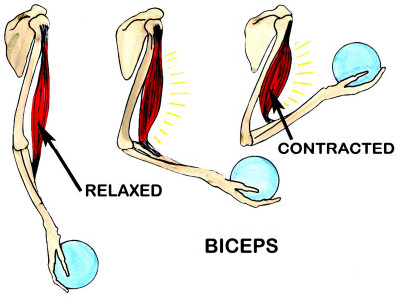
Muscle System
As muscles contract and relax, they move the bones in your body

Slide 40
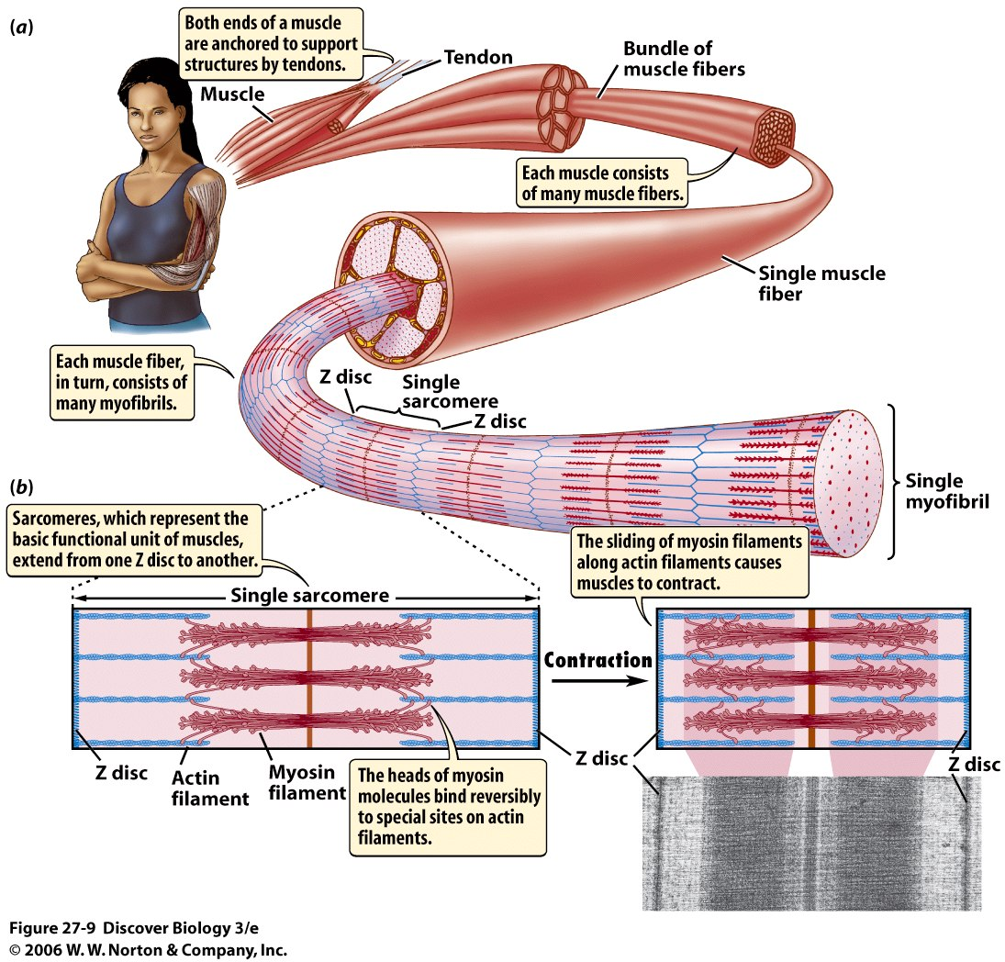

Slide 41
Movement uses energy and creates waste!
Oxygen + Glucose -> Carbon Dioxide + Water + Energy

Slide 42
Fatigue
Is a result of using up the energy, oxygen in the muscles. Lactic acid accumulates in the muscles
Your muscles get tired

Slide 43
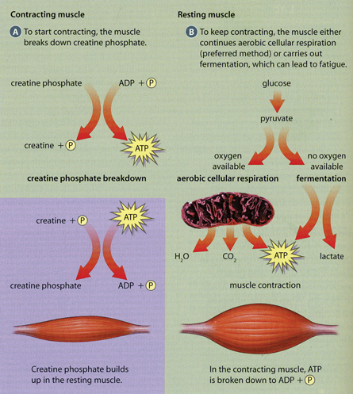
Lactic Acid Formation

Slide 44
Muscle Fatigue Lab
We will demonstrate muscle fatigue in our arms and hands
You will have time to complete this in class!

Slide 46
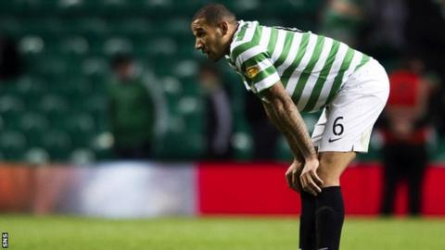
PTT 10MAR2016
Why do your muscles get tired?
Planner Check: OAJ #21 Due Tomorrow!

Slide 47
How do the skeletal and muscular systems work together to create movement?

Slide 48
Fatigue
Lactic Acid Formation

Slide 49
Fatigue Lab
Calf Lifts, last fatigue study
Answer the questions IN COMPLETE SENTENCES!
6. Compare and Contrast aerobic and anaerobic cellular respiration.
7. Explain how anaerobic cellular respiration can lead to fatigue in muscles.
8. How can you reduce fatigue in your muscles

Slide 52
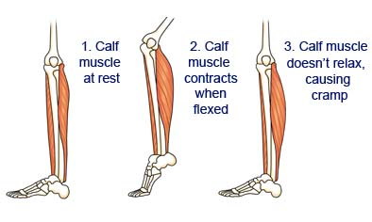
PTT 11MAR2016
How do muscles go from aerobic cellular respiration to anaerobic respiration? (In other words: explain the process of muscle fatigue)
Turn in your OAJ!

Slide 53
How do the skeletal and muscular systems work together to create movement?

Slide 54
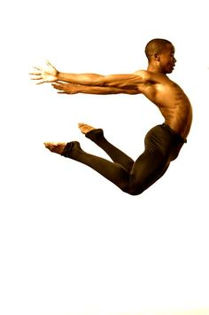
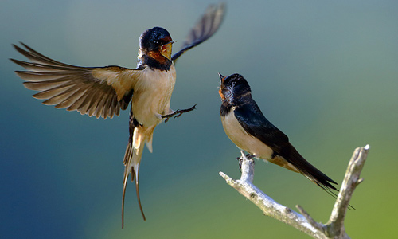
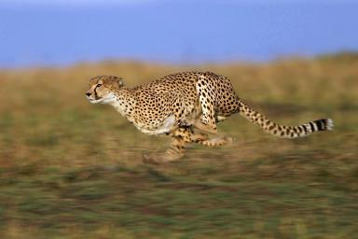
How do the Cardiovascular, Muscular, Skeletal, and Respiratory work together to produce movement in animals?

Slide 55
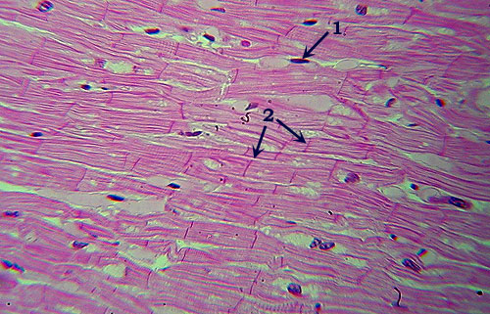
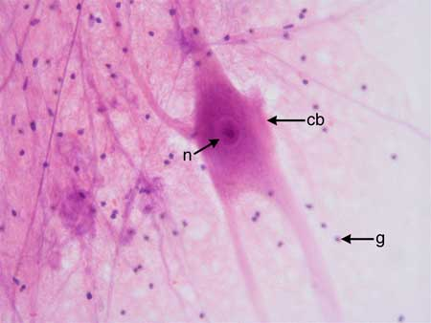
Tissue Slides!
Microscope expectations review
Observe and sketch the slides
Rotate when the buzzer sounds
Respond to questions on the back!
Turn it in!
(there have now been 3 opportunities to improve your grade this week!)

Slide 57
Name:____________
What did you observe in the following slides:
Skeletal Muscle
Smooth Muscle
Aorta
2. Which slide was the most interesting to you? Explain WHY.
3. Ask 3 questions about the tissues you observed today.
4. Explain how muscular system causes movement in animals. (at least 4 complete sentences!)

Slide 58
How do the skeletal and muscular systems work together to create movement?

