Slide 1
Fresh Water Biome
Bernadette W. & Fauzia M.

Slide 2
What is a Freshwater Ecosystem ?
It’s just like it’s name, any ecosystem where fresh water is present. A example of a freshwater biome is ponds, lakes, rivers, streams and sometimes wetlands. Obviously you can find this ecosystem anywhere so there is no actually location. The earth is 97% of water, so this is biome is pretty big. Chemical factors break down to pH levels of the environment, energy passed down in the food web.

Slide 3
Climate in Freshwater Ecosystem
As stated before this biome can be found in many locations, meaning it faces different seasons in those areas. During summer, it can ranges from 4C to 22C. As for winter is ranges from 0C to 4C.

Slide 4
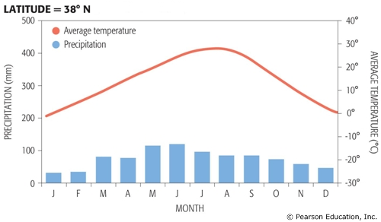
Visual Point
Keep in mind this is a average total of all the areas combined (Average Precipaatiton is 50-260inches a year)

Slide 5
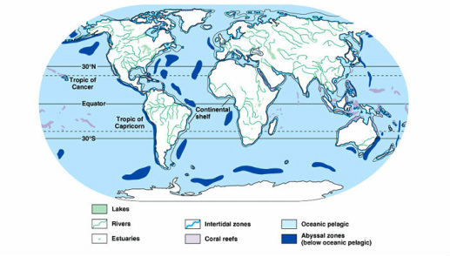
Visual Point

Slide 6
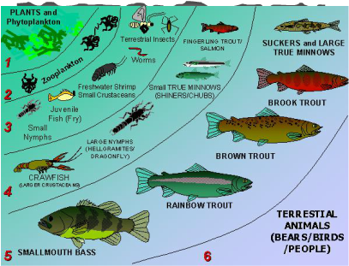
Visual Point

Slide 7
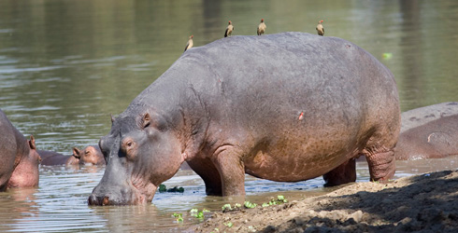
Hippopotamus
Scientific Name :
Hippopotamus Amphibius
Survival Strategy : Hippos live in Africa or hot areas. To have the ability to be able to live in the heat they sweat a liquid that looks like blood, the Liquid act as a sunscreen protector.

Slide 8
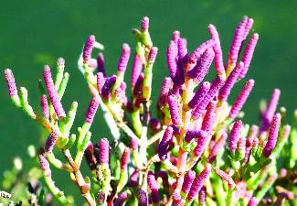
Pickleweed
Scientific Name :
Salicornia europeae
variety rubra
Survival Strategy :Salicornia is found all over the world as both annuals and perennials.It grows in salt watermarshes in the interior states of united states.

Slide 9
Environmental Damage
Freshwater ecosystem near town and cities can face threats from runoff and pollution. Agricultural fertilizers and pesticides can all end in rivers and streams, either falling directly or carried to the waterways by rain. Some toxic pollutants can wipe out an ecosystem entirely, they can also cause genetic mutations, altering the life cycle of fish and birth defects that can destroy a population over time.Draining of wetlands for development deplete habitats. Global warming may lead to devastating floods and droughts.

Slide 10
Solution
We can help by volunteering for a stream team and other community groups to monitor and restore freshwater biomes.Place laws on pollution and hunting of endangered species in the freshwater biome. Also filter out pollutants by using green roofs and rain gardens. Provide incentives for farming business to reduce the use of pesticides.

Slide 11
Sources
http://www.ehow.com/facts_7582091_average-rainfall-fresh-water-ecosystem.html
http://www.brainjet.com/random/2921/15-animals-with-crazy-survival-strategies#page=3
http://science.jrank.org/pages/897/Biome.html

