Slide 1
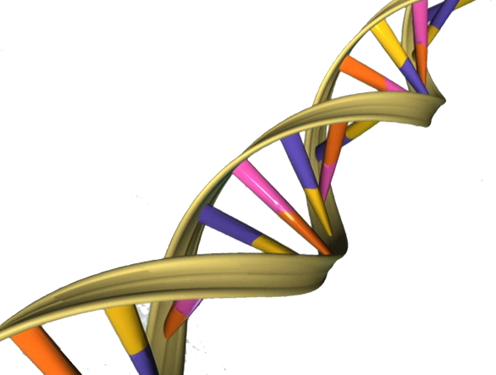
PTT 05FEB2016
Where is DNA stored in the cell?
What is DNA?

Slide 2
Turn in!
OAJ #16
“Fed-Up” Movie notes
Test Return and Review

Slide 3
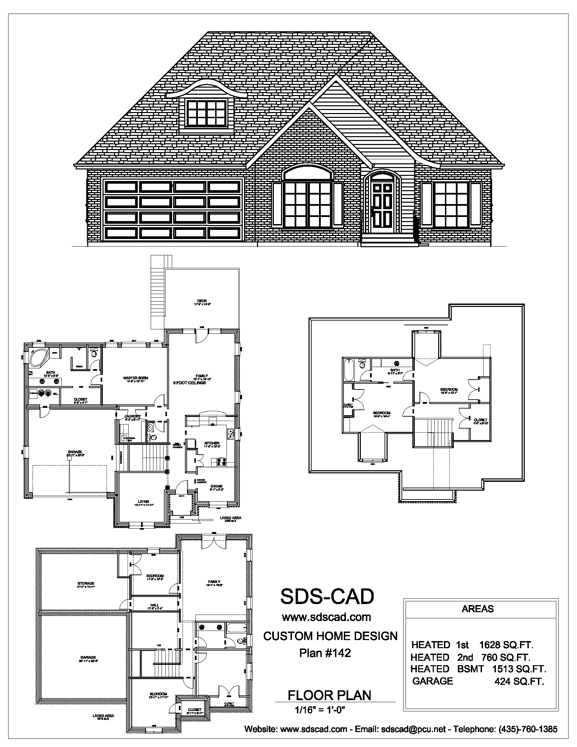
Mitosis (Cell Division)
How would you make a copy of this house?
What steps do you need to take?

Slide 4
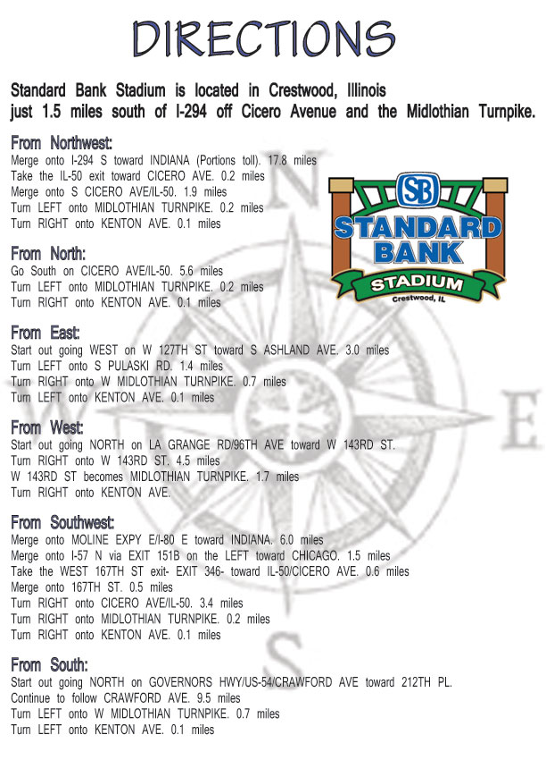
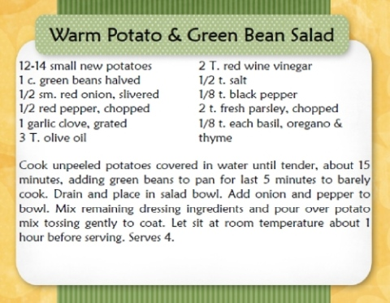
Directions can help us cook or to get to a specific location

Slide 5
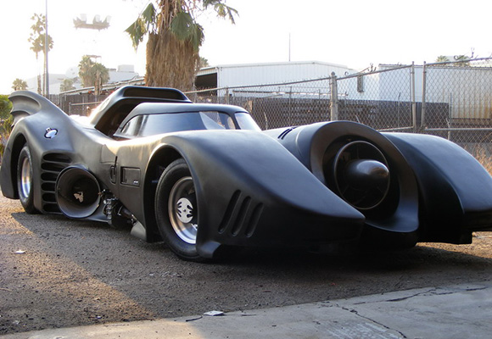
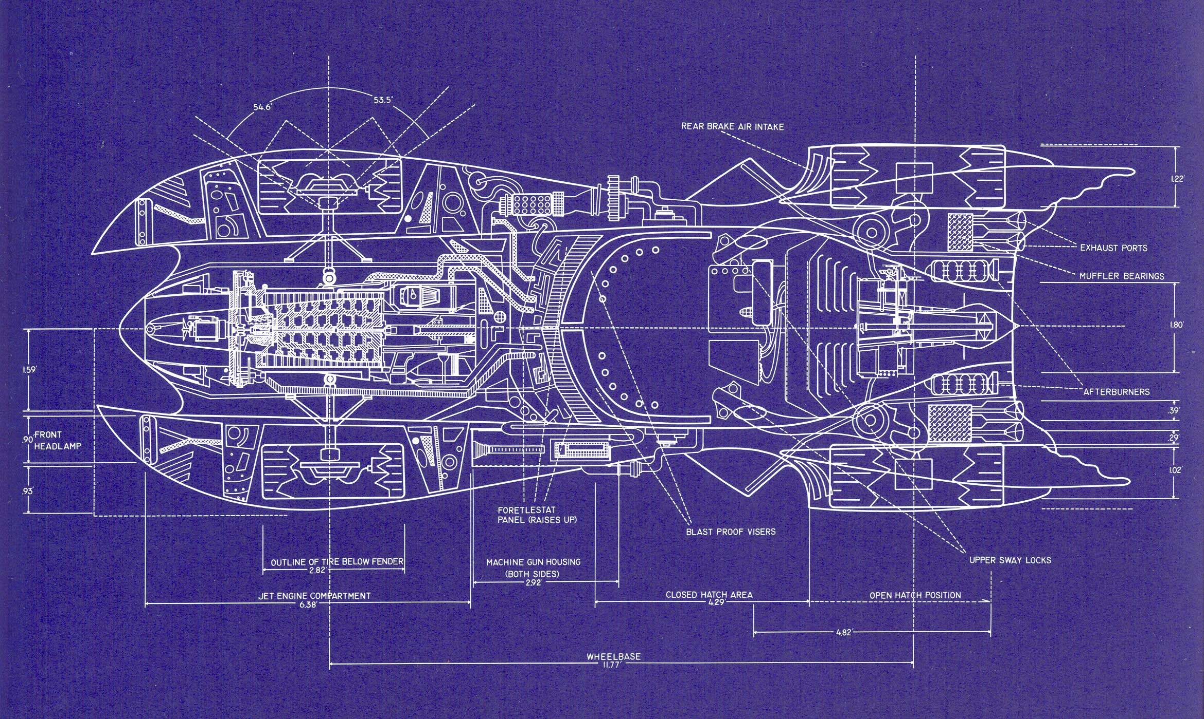
Blueprints help us build things

Slide 6
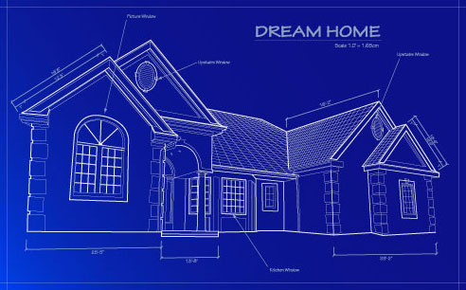

Slide 7
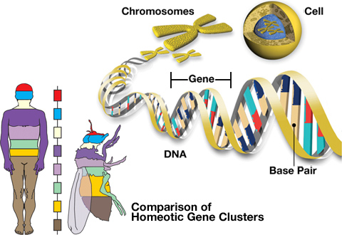
DNA is like a blueprint for a living thing.

Slide 8
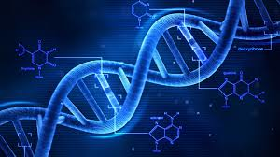
DNA stands for Deoxyribonucleic Acid
It can be found in the Nucleus and the Mitochondria

Slide 9
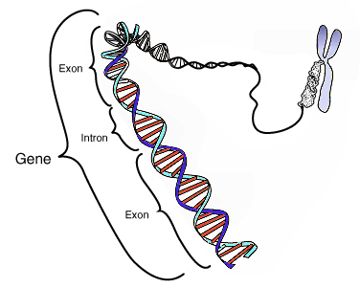
A gene is a section of DNA that codes for a certain trait

Slide 10
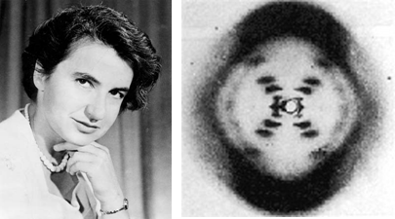
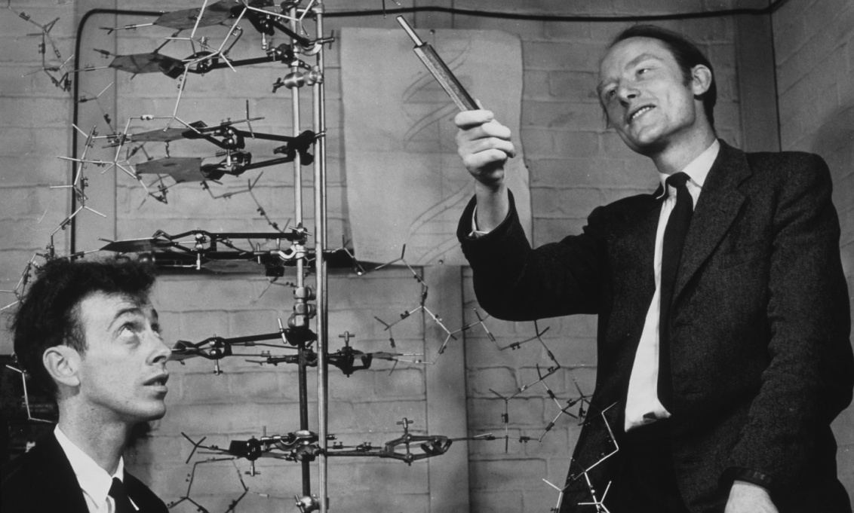
Who discovered DNA?
Watson and Crick
Rosalind Franklin

Slide 11
Double Helix
Sugar and Phosphates make up the sides
Nitrogen Bases Make up the middle

Slide 12
There are 4 simple nitrogen bases:
Thymine
Adenine
Guanine
Cytosine

Slide 13
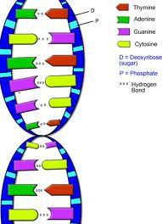
The four bases pair:
Thymine and Adenine
Guanine and Cytosine
They can only pair with their opposite

Slide 15
PTT 08FEB2016
ANSWER IN COMPLETE SENTENCES!
What is DNA? (write at least 3 sentences!)
What is a gene?

Slide 16
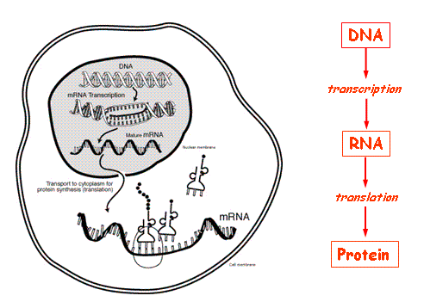
DNA makes rNA and rNA makes protein
This is because DNA is too big to be messages, so the cell communicates using proteins

Slide 17
DNA Stated Clearly

Slide 18
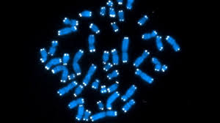
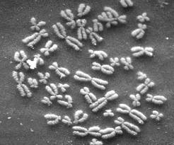
Chromosomes

Slide 19
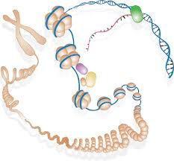
How is the DNA stored and then available for copy?

Slide 20
Genes Stated Clearly

Slide 21
DNA makes rNA and rNA makes protein
This is because DNA is too big to be messages, so the cell communicates using proteins

Slide 22
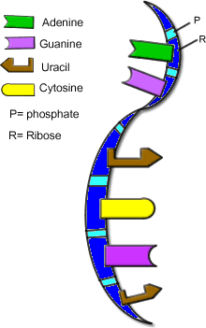
rNA
Ribo-nucleic Acid
Codes for proteins

Slide 23
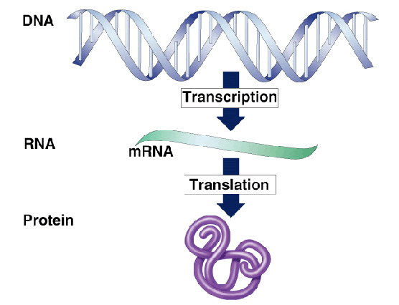

Slide 24
DNA, rNA, Protein video

Slide 26
PTT 09FEB2016
Identify this cellular structure.
How do cells send messages to other cells using the structures below?

Slide 28
Learning Goals
I can extract DNA from a strawberry
I can describe and analyze my results

Slide 29
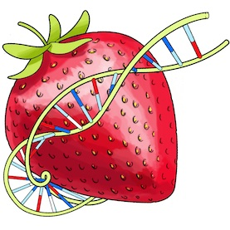
DNA Extraction Lab
We are using strawberries because they have a large number of chromosomes
14, 28, 42, 56, or 70 depending on the species

Slide 30
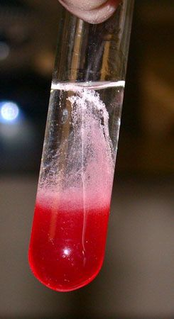
DNA Extraction Lab
Directions are on your tables.
Send one representative to get supplies while other team members read the directions completely
Follow the directions EXACTLY

Slide 32
PTT 10FEB2016
What did you observe in your test tube yesterday?
What is the DNA’s role in cell messages?

Slide 35
DNA contains genes
Genes code for traits OR message
Today we are going to study how DNA can determine traits in dogs

Slide 36
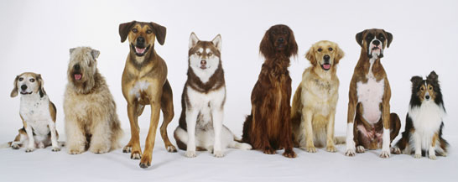
The DNA for dogs is very similar and this is why there are so many kinds of dogs

Slide 37
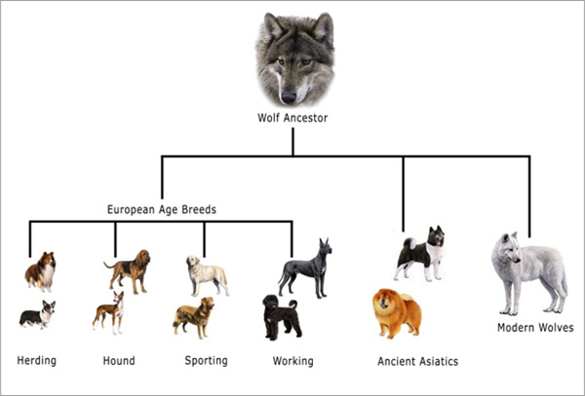
Dogs inherited their genes from wolves

Slide 38
Following the directions, YOU will build your own dog based on the genetic codes in your envelopes
MAKE SURE all your codes get back in the envelope at the end class.
Planner Check while you are working…

Slide 40
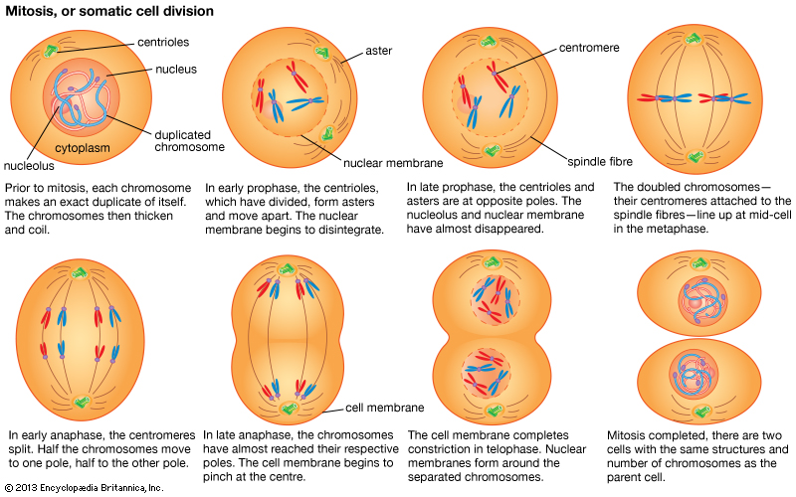
Mitosis

