Slide 1
PTT 22FEB2016
What is your opinion about using GMO technologies on Human Beings?
For your Planner:
Turn in assignments from last week
OAJ #19 Due Friday

Slide 2
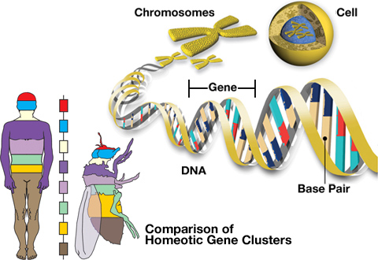
DNA is like a blueprint for a living thing.

Slide 3
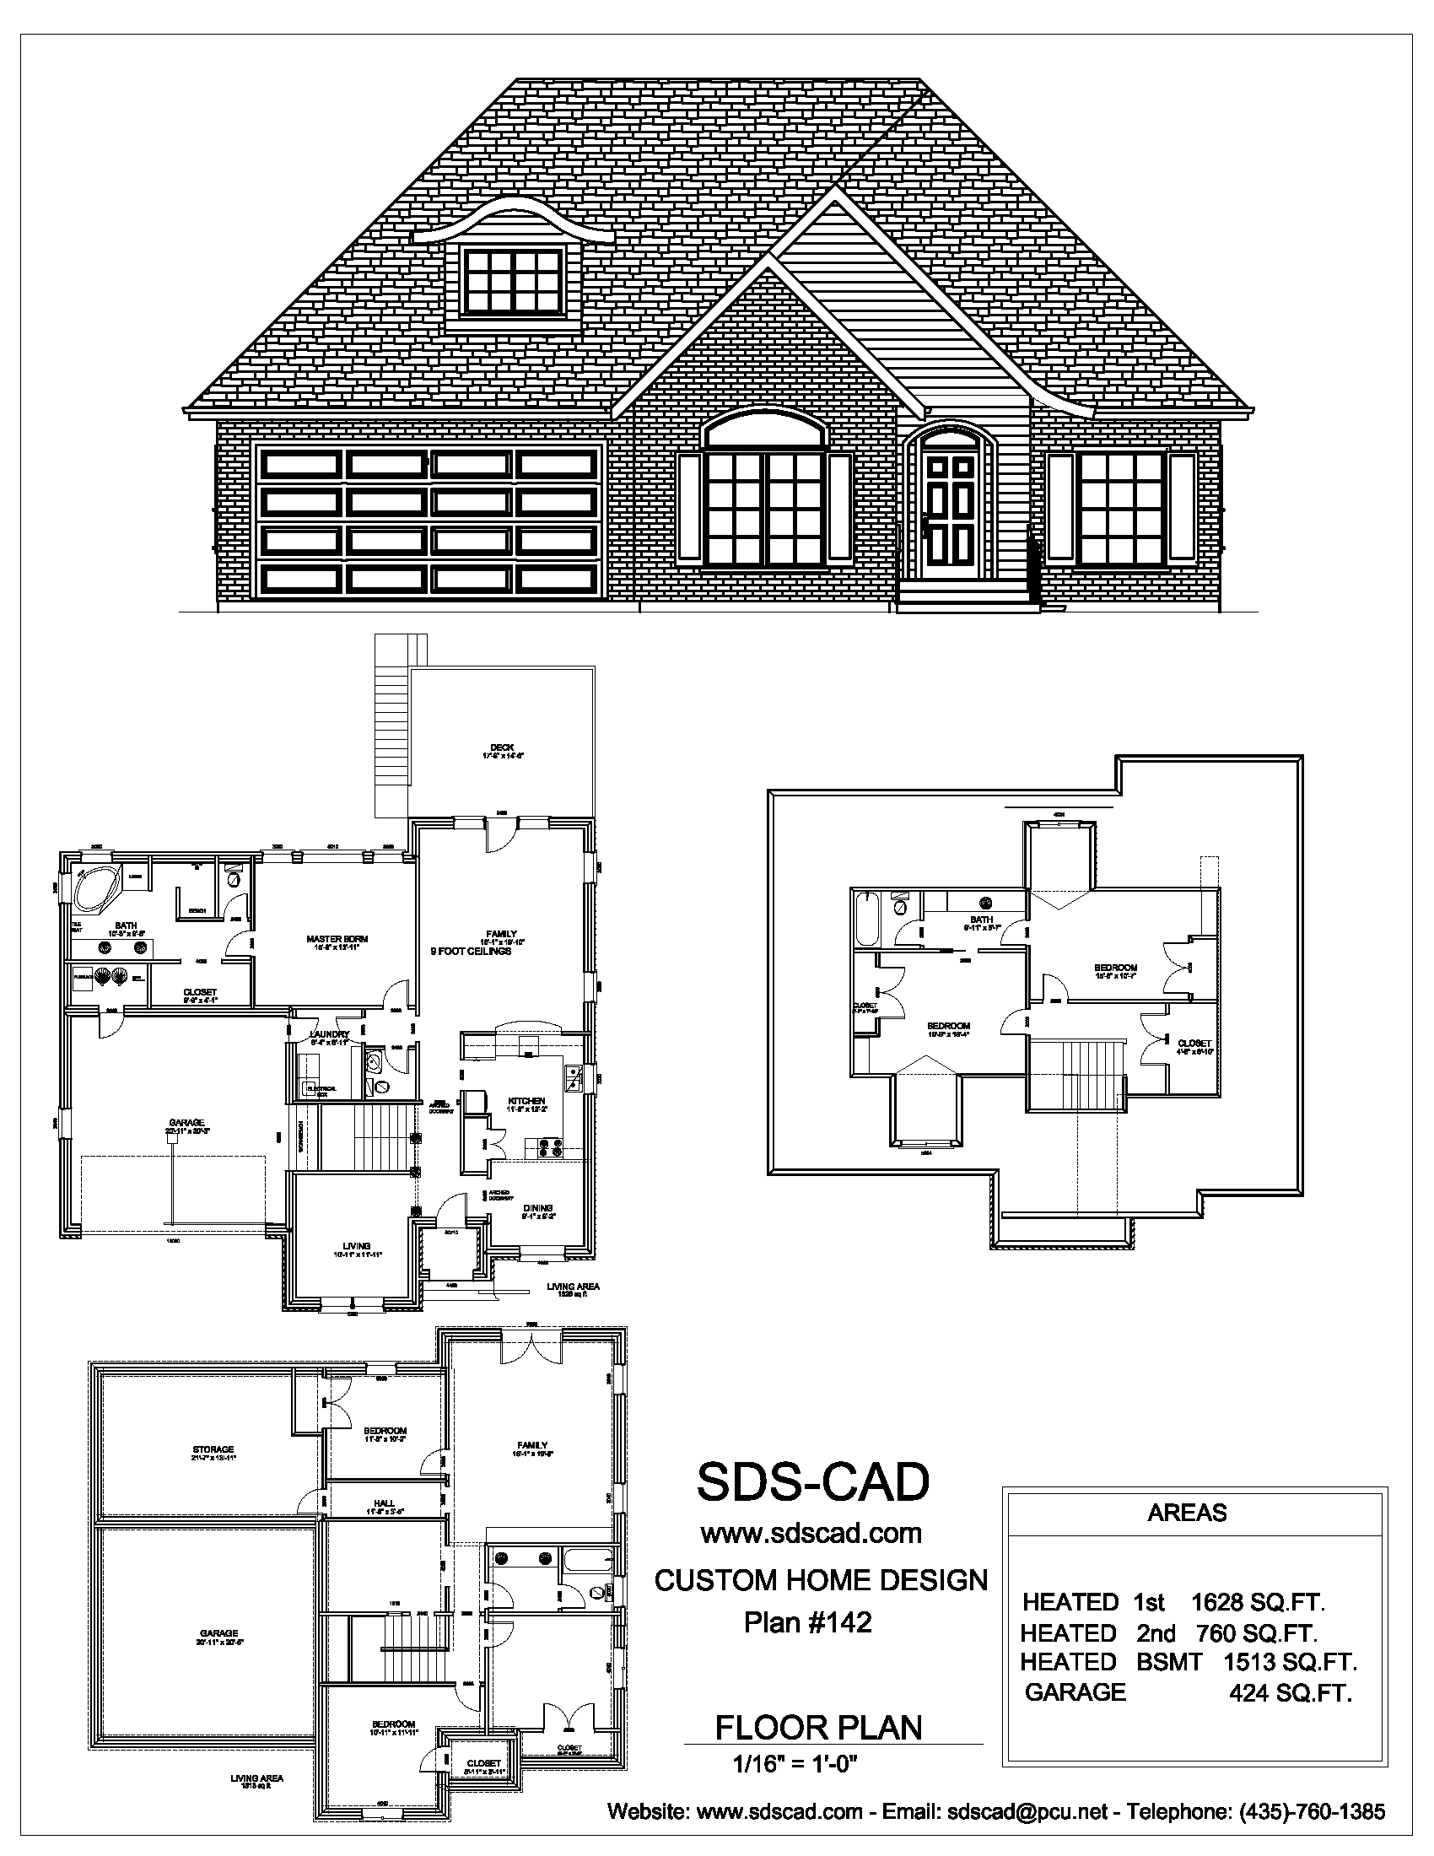
Mitosis (Cell Division)
How would you make a copy of this house?
What steps do you need to take?

Slide 4
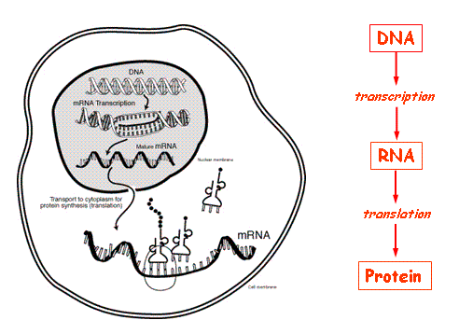

Slide 5
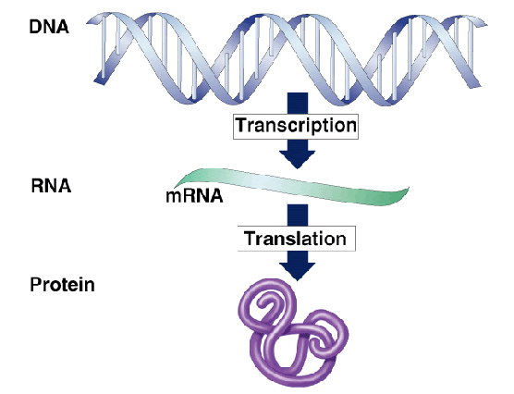

Slide 6
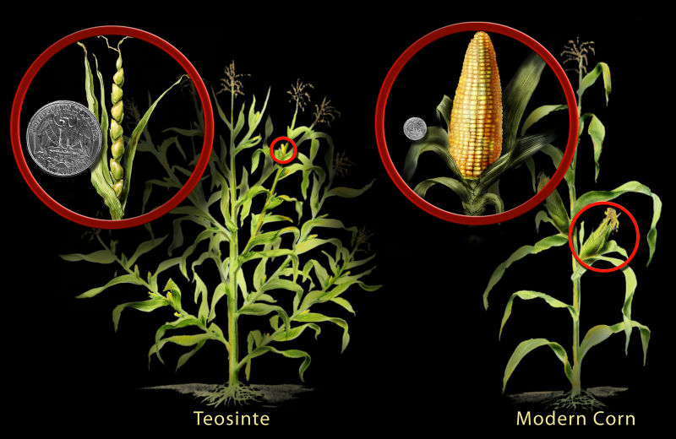
What are the 2 ways humans could manipulate traits in a plant?

Slide 7
Artificial Selection: Humans select traits
Genetic Modification: Humans change the genetic sequence

Slide 9
What if we could do this in humans?
What questions does this bring up in your mind?

Slide 10
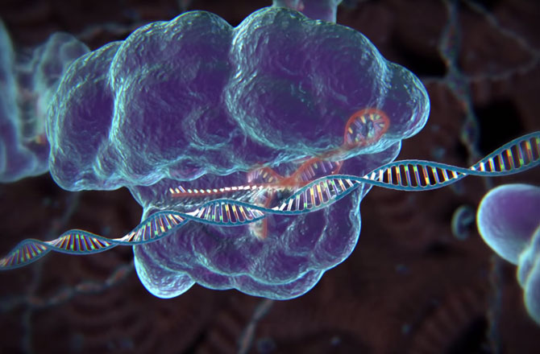
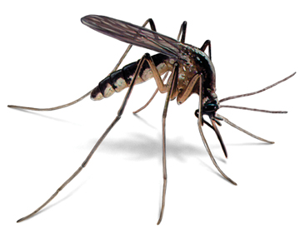
CRISPR Technologies
Allows precise gene editing
Already being used in mosquitoes

Slide 11
CRISPR Ted Talk

Slide 12
Ticket Out the Door
What are the 2 ways that humans can change the traits found in plants?
What is CRISPR technology?
Do YOU think we should apply CRISPR to humans?

Slide 14
PTT 24FEB2016
What is the end result of mitosis?
Why is naked DNA such a big deal?
For your planners:
OAJ#19 Due Friday
DNA Quiz Friday

Slide 15
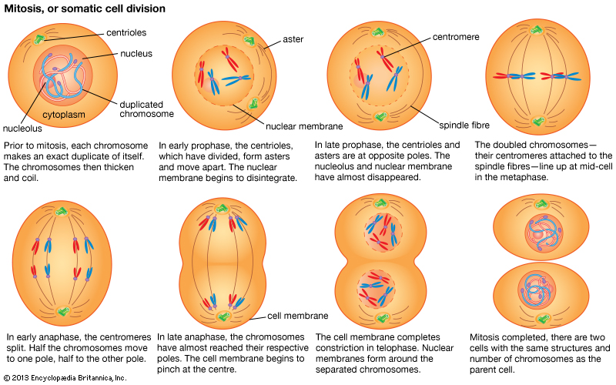
Mitosis

Slide 16
Learning Goals
I can deepen my knowledge of mitosis by reading a science textbook and responding to questions
I can sketch and label the phases of mitosis

Slide 18
PTT 25FEB2016
How many pairs of chromosomes do humans have?
In what phase does a cell spend most of it’s time?
For your Planners:
OAJ #19 Due Friday
DNA Quiz Monday

Slide 19
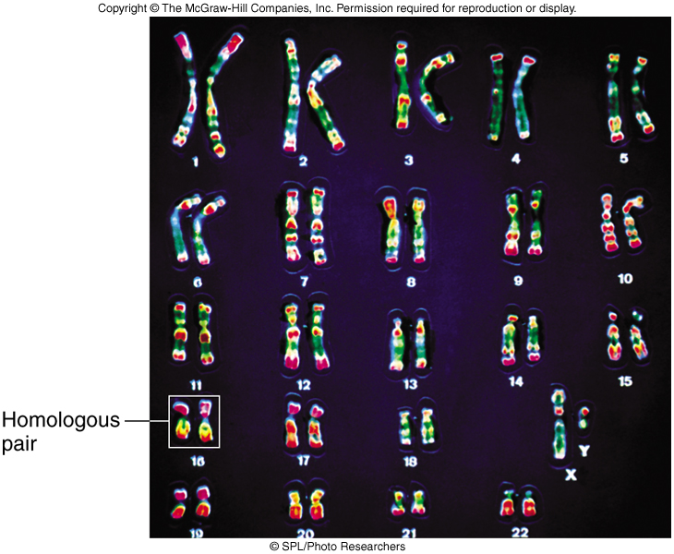
Human Chromosomes

Slide 20
You have about 10 minutes to finish the questions we started yesterday…

Slide 21
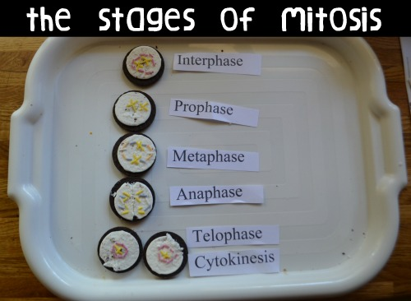

Slide 24
PTT 26FEB2016
Label the stages of Mitosis below:

Slide 25
For your Planner…
Study for DNA Quiz on Monday
Learning Goals:
I can explain how mutations can lead to cancer
I know the ways to reduce my risk of cancer

Slide 26
Earth Day t-shirts!
$10 – Pay at the Main office by March 2nd.
Wear the t-shirt to celebrate Earth Day, April, 22nd
All proceeds go towards raspberry bushes for the LSE Garden

Slide 27
CELL DIVISION VIDEO

Slide 28
What kinds of cancer have you heard of?

Slide 29
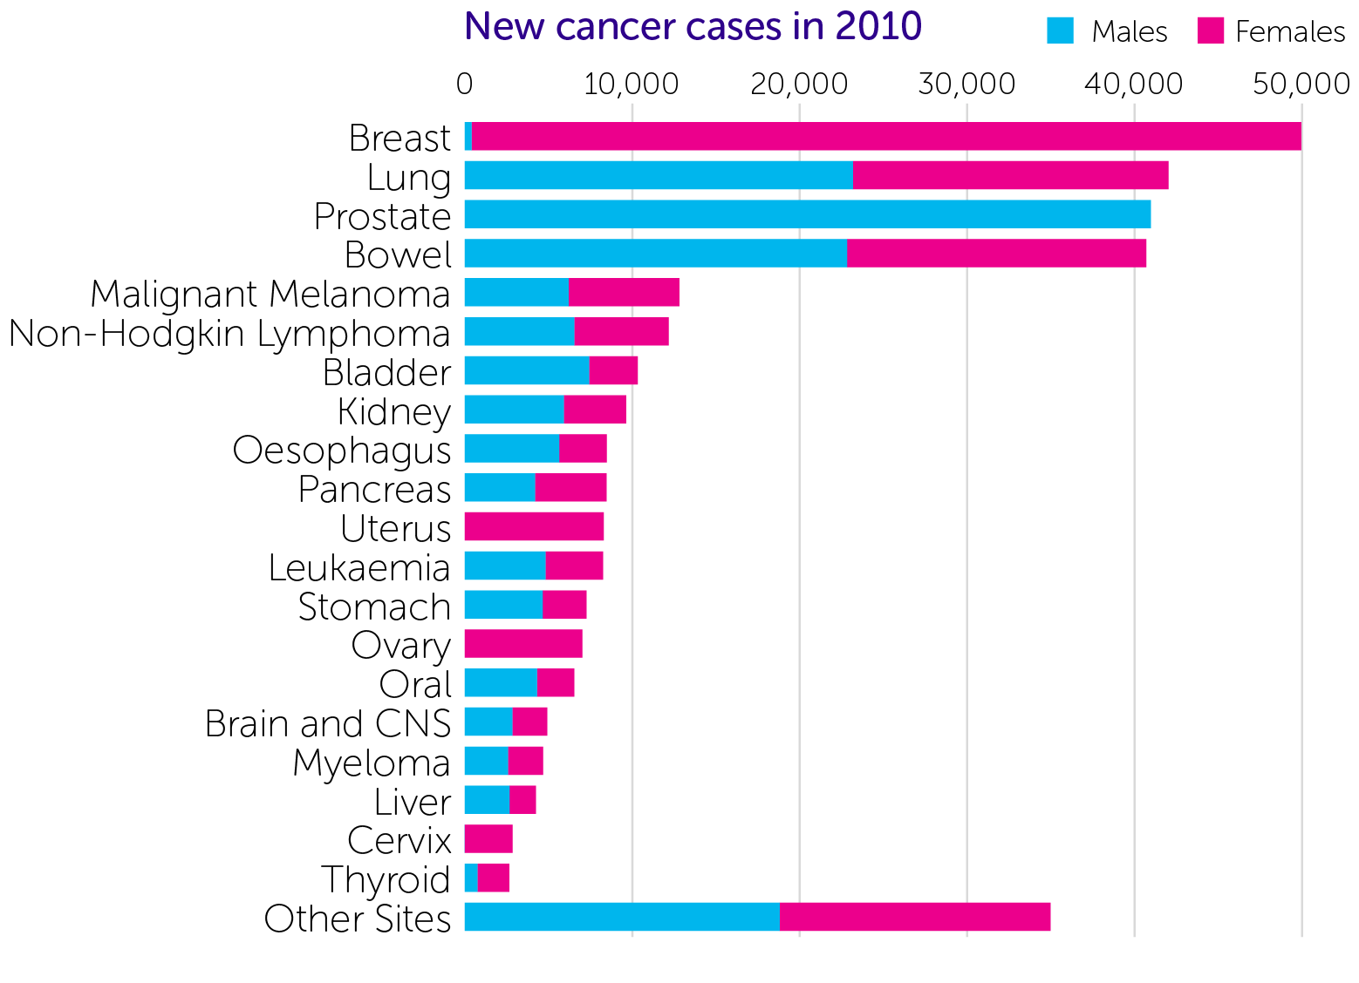
What kinds of cancer have you heard of?
*

Slide 30
Mutation
A mutation is a change in a DNA sequence.
Mutations can result from DNA copying mistakes made during cell division, exposure to ionizing radiation, exposure to chemicals called mutagens, or infection by viruses.

Slide 31
Cancer
Cells dividing out of control
Mitosis happens without stopping causing tumors
Tumors can be cancerous or not
Quick Video

Slide 32
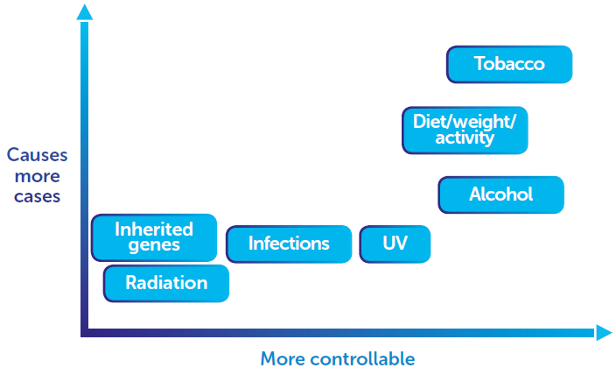
WHICH CAUSES OF CANCER CAN YOU CONTROL?

Slide 33
WHICH CAUSES OF CANCER CAN YOU CONTROL?
Sample
text

Slide 34
Speed Research
Does your item cause cancer?
How does it cause cancer?
How can you reduce the risk of cancer with that item?
Be prepared to share!

Slide 35
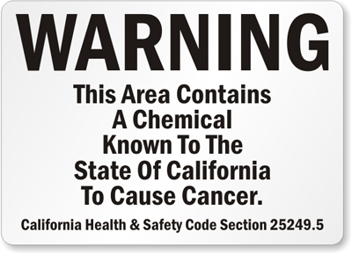
Ticket to take home
What are 3 ways to reduce your and your families risk of Cancer?

