Slide 1
Warm-Up 08DEC2014
How can the distribution of natural resources influence politics and economics?
What are the 3 rock types? How can you identify them in a sample?

Slide 2
Logistics
Warm-ups (Friday 12/11) Vocabulary (overdue, but I will take because I did not remind you AND it counts as a test grade)
Full Value Lab Report Due MONDAY 12/14
Soil Labs Due on (Thursday 12/10)
Ozone Check (Fri 12/11)
Klein Chapter 2 (Monday 12/14)
Celebration of Learning (Wednesday 12/16)

Slide 3
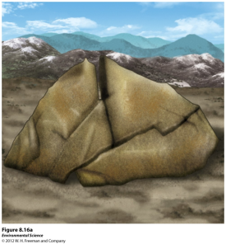
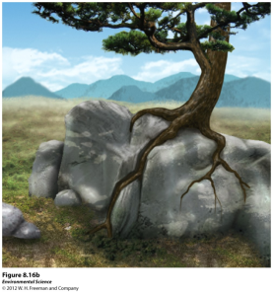
Weathering and Erosion
Weathering- when rocks are exposed to air, water, certain chemicals or biological agents that degrade the rock.
Physical weathering- the mechanical breakdown of rocks and minerals.

Slide 4
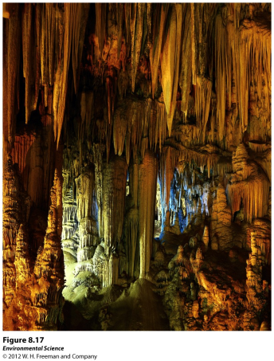
Weathering and Erosion
Chemical weathering- the breakdown of rocks and minerals by chemical reactions.

Slide 5
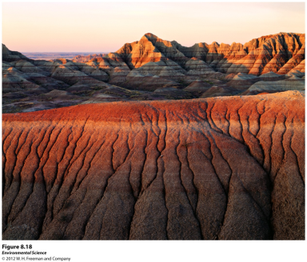
Erosion
Erosion- the physical removal of rock fragments from a landscape or ecosystem. Wind, water, ice transport and living organisms can erode materials.
Deposition- the accumulation or depositing of eroded material such as sediment, rock fragments or soil.

Slide 6
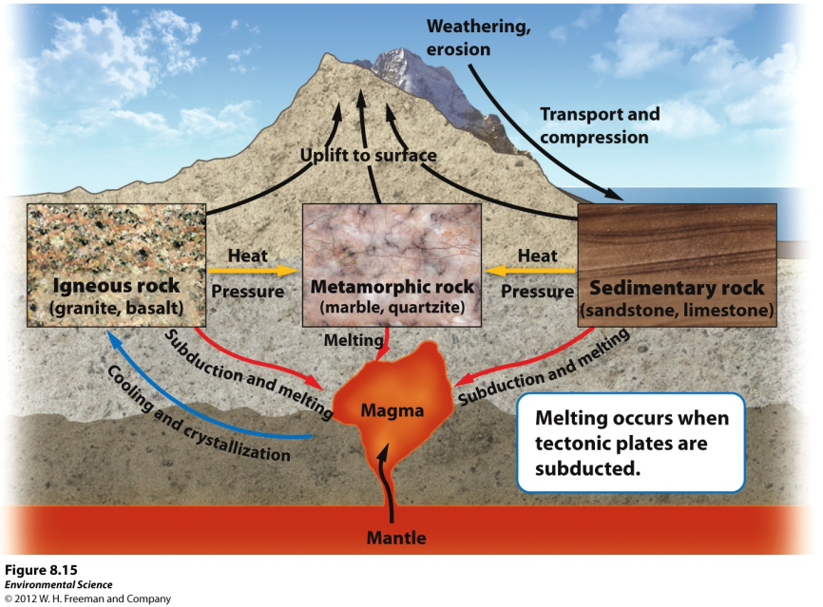

Slide 7
Earth’s resources are distributed unequally on the surface of the Earth
This is all due to the geologic make up of Earth
Soil is the link between the rock cycle and the biosphere

Slide 8
Soil
It is a mix of organic and geological components
Soil is important because it
Is a medium for plant growth
Serves as a filter for water
A habitat for living organisms
Serves as a filter for pollutants

Slide 9
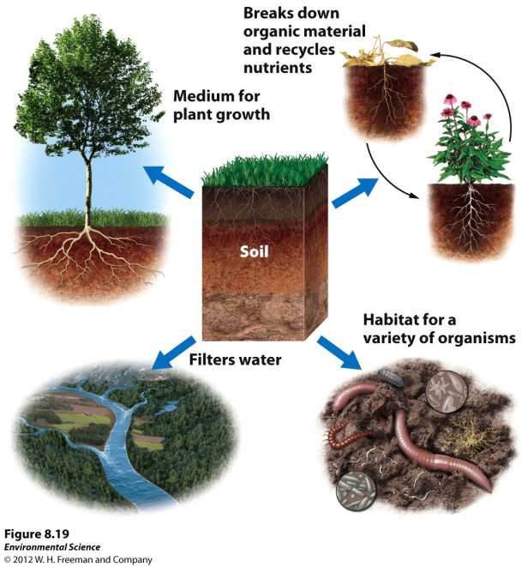

Slide 10
The Formation of Soil
Factors that determine the formation of soil:
Parent material- what the soil is made from influences soil formation
Climate- what type of climate influences soil formation
properties.

Slide 11
The Formation of Soil
Factors that determine the formation of soil:
Topography- the surface and slope can influence soil formation
Organisms- plants and animals can have an effect on soil formation
Time- the amount of time a soil has spent developing can determine soil properties.

Slide 12
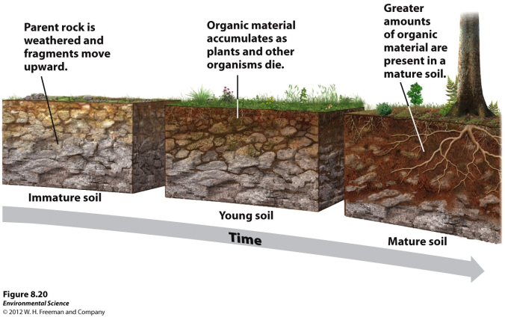
The Formation of Soil
Parent Material- the rock material from which soil is derived.

Slide 13
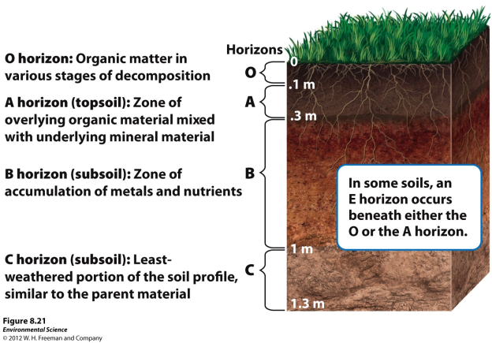
Soil Horizons
As soils form, they develop characteristics layers.

Slide 14
Soil Horizons
O horizon- (organic layer) composed of the leaves, needles, twigs and animal bodies on the surface.
A horizon- (topsoil) the zone of organic material and minerals mixed together.
B horizon- (subsoil) composed primarily of mineral material with very little organic matter
C horizon- (parent material) the least weathered horizon and is similar to the parent material.

Slide 15
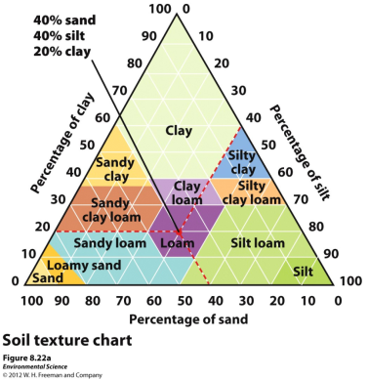
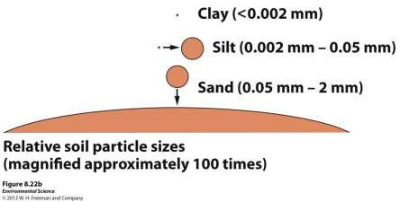
Physical Properties of Soil
Texture- the percentage of sand, silt and clay the soil contains.

Slide 16
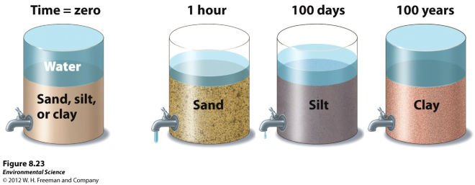
Physical Properties of Soil
Porosity- how quickly the soil drains (which depends on its texture)

Slide 17
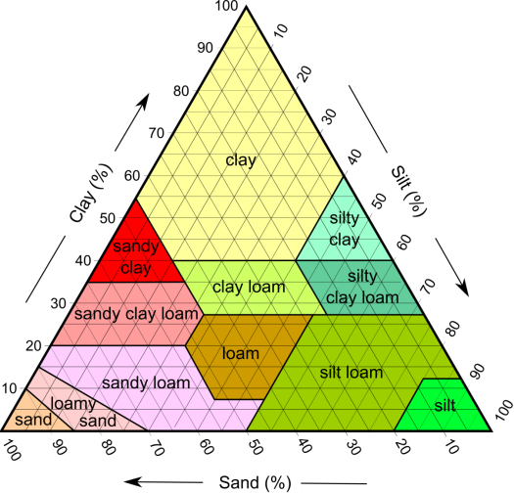
Soil Properties
You should include this experiment in your Soil analysis
You will have to start this tomorrow

Slide 19
Warm-Ups 08DEC2015
What is soil the intermediary between?
What are the 3 grain sizes that are possible in soils?
If you have Ertmer 7th period
bring your textbook or
Klein to class.

Slide 20
Logistics
Soil Labs Due on (Thursday 12/10) includes your project proposal…
Read NYT article by Thursday.
Ozone Check (Fri 12/11)
Warm-ups (Friday 12/11)
Klein Chapter 2 (Monday 12/14) You will be assigned your chapter on this day.
Full Value Lab Report Due MONDAY 12/14
Celebration of Learning (Wednesday 12/16)

Slide 21
News blast!

Slide 23
Chemical Properties of Soil
Cation exchange capacity- the ability of a soil to adsorb and release cations, positively charged mineral ions. (Think pollutants)
Soil bases- calcium, magnesium, potassium and sodium
Soil Acids- aluminum and hydrogen
Base saturation- the proportion of soil bases to soil acids

Slide 24
Soil Chemistry
I have the tools to assess soil pH, potash, phosphorus, and nitrogen
This should also be started tomorrow

Slide 25
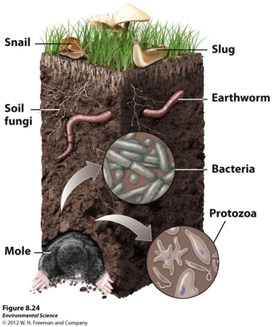
Biological Properties of Soil
Many organisms are found in the soil including fungi, bacteria, protozoans, rodents and earthworms.
25

Slide 26
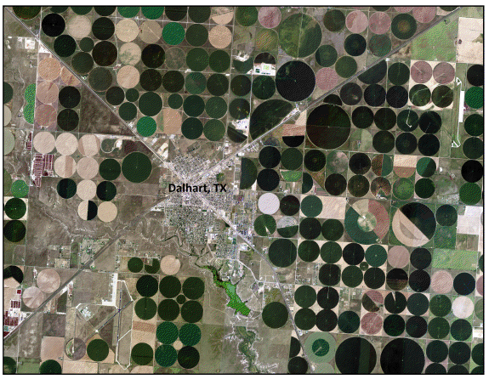
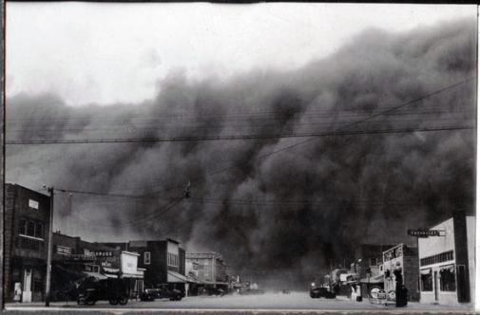
Soil Degradation and Erosion
Several environmental issues arise form poor management of soils and agricultural practice
At the root of the issue is converting native habitats to anthropogenic uses

