Slide 1
Warm-Up 30NOV2015
What are your initial thoughts about Klein’s book?
Anything surprise you? Are there conflicts with other readings this semester?
Not here Friday? Please pick up your questions…

Slide 2
Klein Discussions
This will start after Winter Beak:
You (and a partner) will be assigned a chapter to facilitate discussion for 30 minutes
You will be responsible for leading the discussion for said chapter
You must include topics from the book, class, and current events
Your team can do this in anyway you like as long as the main ideas are discussed and everyone actively participates

Slide 3
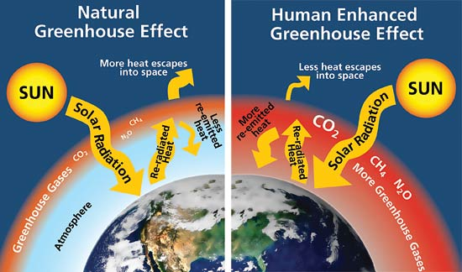

Slide 4
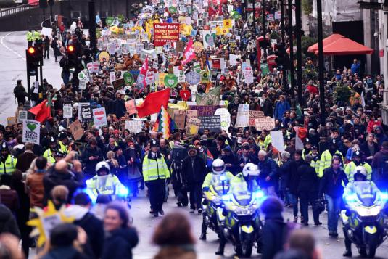
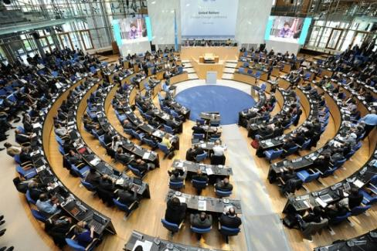

Slide 6
Warm-Up 01DEC2014
Rate your knowledge on a scale from 1-5 (5 being the expert) on the following topics:
Rock Cycle
Plate Tectonics
Soil formations
Soil Layers
Mining Practices

Slide 7
Logistics
Before Winter Break expect to complete the following:
OZONE CHECK tomorrow!
Cookie Mining (12/2)
Plate Tectonics Lab (due 12/4)
Klein Ch 1 Due Monday (12/7)
Soil types lab (due 12/11)
“Full Value” Lab Report for a Local Soil Analysis (due 12/14) this will include research and a complete write up.
Celebration of Learning in the week before break

Slide 8
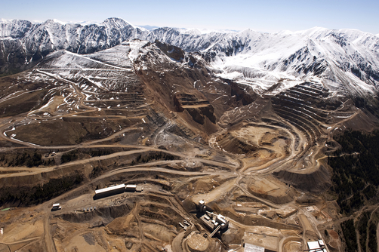
Current Events
Klein Part 1
Cookie Mining
We are modeling the economical and physical ways resources are extracted from the Earth
Think about the Climate Summit and other consequences of natural resource extraction (economical, social, and environmental)

Slide 10
Warm-Up 02DEC2015
Did you make money at your mine?
Why or why not?

Slide 11
Logistics
Before Winter Break expect to complete the following:
OZONE CHECK today!
Cookie Mining today
Read Chapter 8, ASK if you have questions!
Plate Tectonics Lab (due 12/4)
Klein Ch 1 Due Monday (12/7)
Soil types lab (due 12/11)
“Full Value” Lab Report for a Local Soil Analysis (due 12/14) this will include research and a complete write up.
Celebration of Learning in the week before break

Slide 12
Key Environmental Indicators
Biological Diversity
Food Production
Average global surface temperature, carbon dioxide concentrations in the atmosphere
Human Population
Resource depletion

Slide 13
Key Environmental Indicators
Biological Diversity
Food Production
Average global surface temperature, carbon dioxide concentrations in the atmosphere
Human Population
Resource depletion
-In order to understand depletion, we need to understand how it came to be

Slide 14
Natural resources are distributed unequally around the world.
This leads to political, economic, ethical, and philosophical conflict => Wars

Slide 15
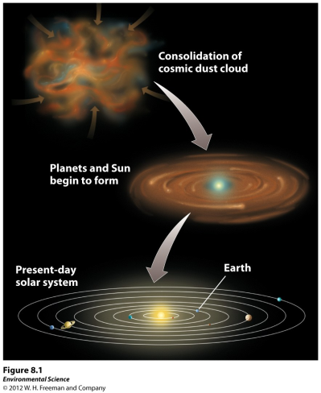
The Earth’s resources were determined when the planet formed.

Slide 16
The Earth’s Layers
Core- the innermost zone of the planet made of nickel and iron.
Mantle- above the core containing magma
Crust- the outermost layer of the planet.

Slide 17
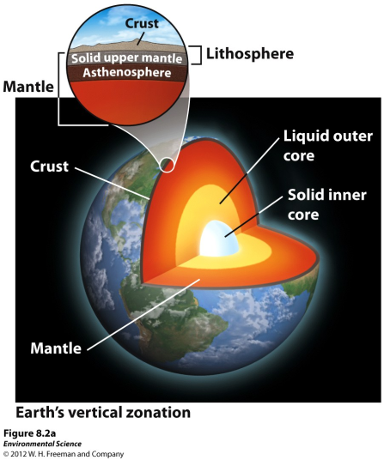
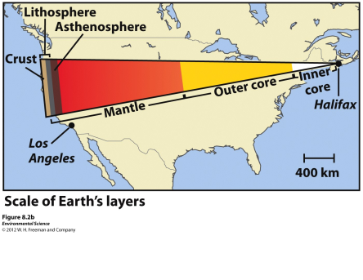

Slide 18
The Earth’s Layers
Asthenosphere- the outer part of the mantle, composed of semi-molten rock.
Lithosphere- the brittle outermost layer of the planet that is approximately 100 km thick.

Slide 19
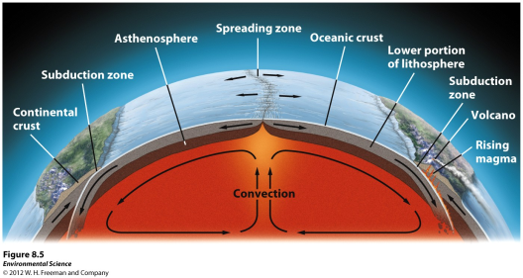
Convection and Hot Spots
The Earth is very hot at the center.
This heat causes plumes of hot magma to well upward from the mantle.
Hotspots- places where molten material from the mantle reach the lithosphere.

Slide 20
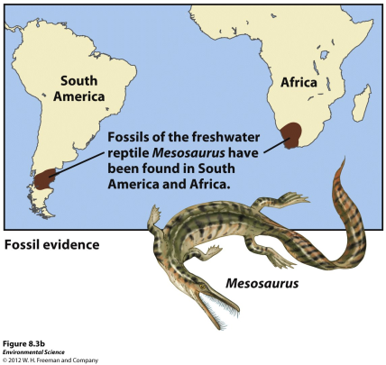
Theory of Plate Tectonics
Plate tectonics- the theory that states that Earth’s lithosphere is divided into plates, most of which are in constant motion.

Slide 21
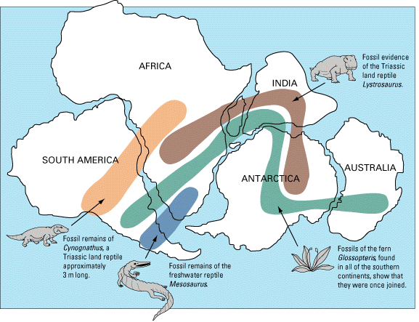

Slide 22
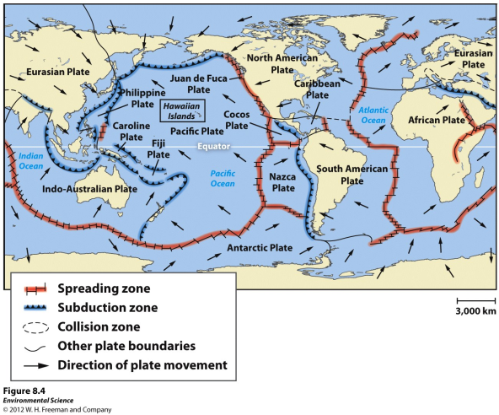
Tectonic Plates

Slide 23
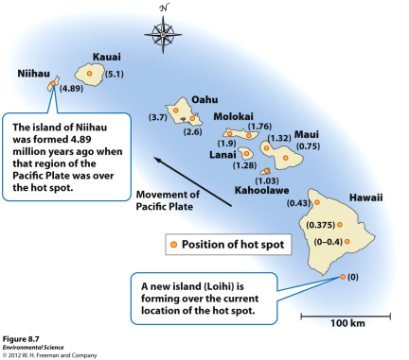
Consequences of Plate Movement
Volcanoes- as a plate moves over a hot spot, rising magma forms a volcano.

Slide 24
Types of Plate Contact
Divergent plate boundaries- when plates move apart from one another.
Convergent plate boundaries- when plates move toward one another and collide.
Transform fault boundaries- then plates move sideways past each other.

Slide 25
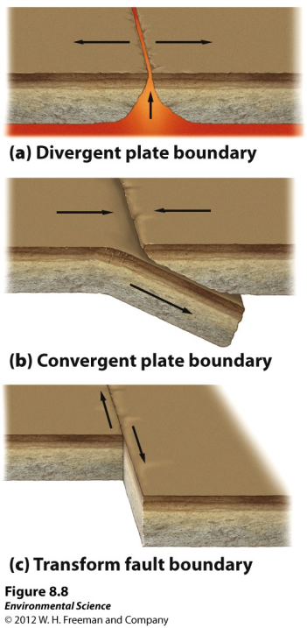

Slide 26
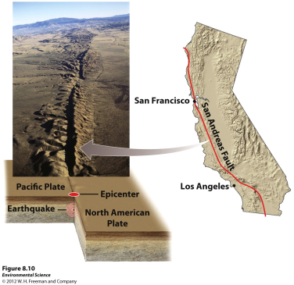
Faults and Earthquakes
Faults- a fracture in rock across which there is movement.
Earthquakes- occur when the rocks of the lithosphere rupture unexpectedly along a fault.

Slide 27
Faults and Earthquakes
Fault zone- large expanses of rock where movement has occurred.
Epicenter- the exact point on the surface of Earth directly above the location where the rock ruptures.
Richter scale- a measure of the largest ground movement that occurs during an earthquake. The scale increases by a factor of 10, so an earthquake of 7 is 10 times greater than an earthquake of 6.

Slide 29
Warm-Up 03DEC2015
What explanation do scientists provide for the following distribution of fossils on the surface of the Earth?
Theory of Plate Tectonics

Slide 31
Warm-Up 04DEC2015
Use only materials you have to create a model of each plate boundary
You may re-use the materials for the different models

Slide 32
Logistics
Before Winter Break expect to complete the following:
OZONE CHECK (yesterday!)
Read Chapter 8, ASK if you have questions!
Plate Tectonics Lab (Today!)
Klein Ch 1 Due Monday (12/7)
Soil types lab (due 12/10)
“Full Value” Lab Report for a Local Soil Analysis (due 12/14) this will include research and a complete write up.
Celebration of Learning in the week before break

Slide 33
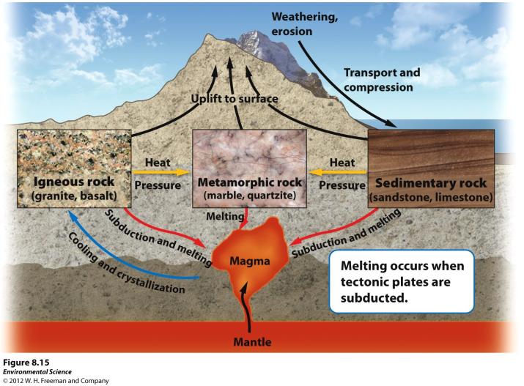
The Rock Cycle
Rock cycle- the constant formation and destruction of rock.

Slide 34
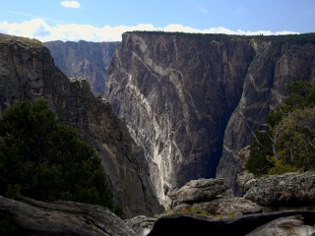
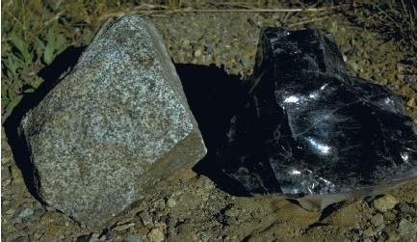
The Rock Cycle
Igneous rocks- rocks that form directly from magma.
Intrusive igneous- form from within Earth as magma cools.
Extrusive igneous- from when magma cools above Earth. (ex. A volcano that ejects magma out will form this)
.

Slide 35
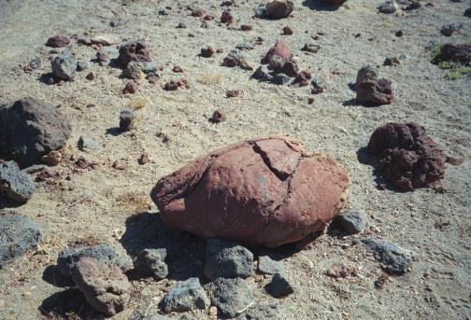
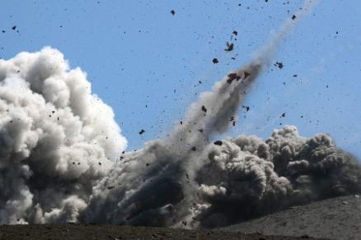
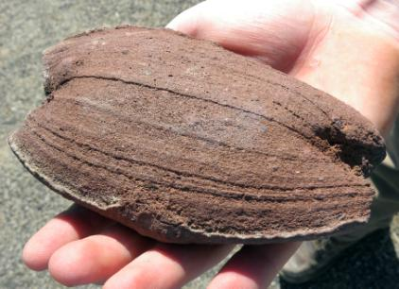
Volcanic Bombs
Igneous
EXtrusive

Slide 36
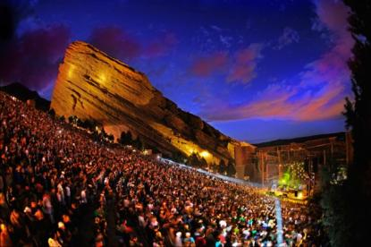
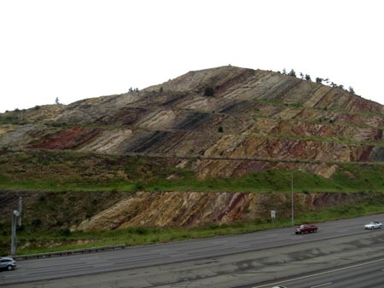
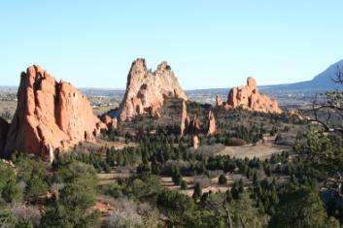
The Rock Cycle
Sedimentary rocks- form when sediment such as mud, sands, or gravels are compressed by overlying sediments.
.

Slide 37
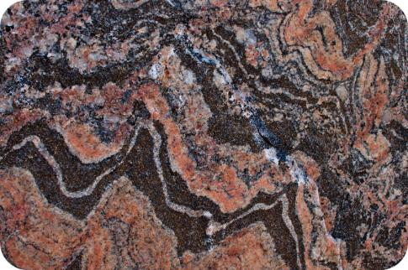
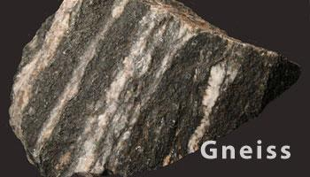
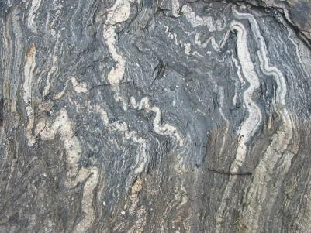
The Rock Cycle
Metamorphic rocks- form when sedimentary, igneous or other metamorphic rocks are subjected to high temperatures and pressures.

Slide 38
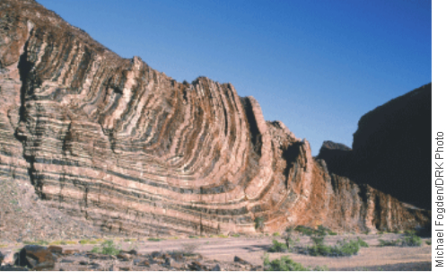
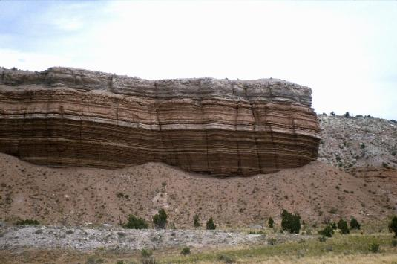
Law of Original Horizontality

Slide 39
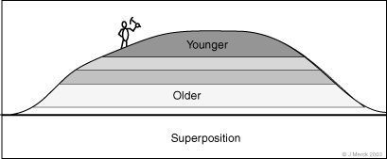
Law of Superposition

Slide 40
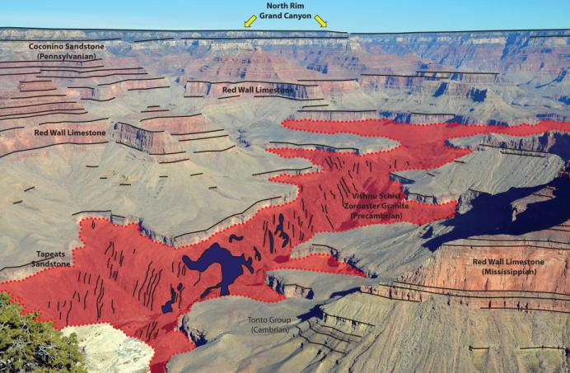

Slide 41
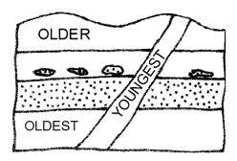
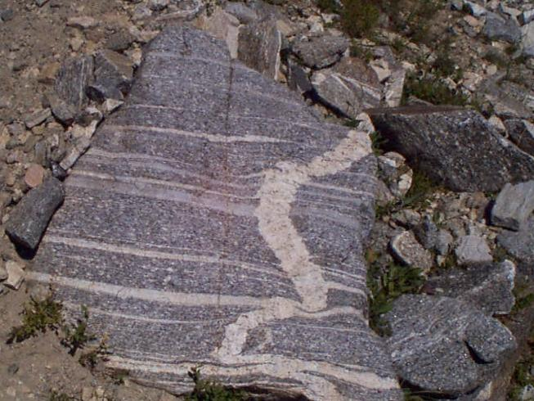
Cross-Cutting

