Slide 1
PTT 30NOV2015
What will we need to do to make the rest of the school year the best ever?
A school year where together we ALL learn, teach, feel safe, get along?

Slide 2
Classroom Norms!
We will work together to build a list of classroom expectations or norms…

Slide 3
Non-Negotiables
Students will listen to Ms. Leigh AND each other
In seats working on the PTT when the bell rings
Students will be respectful of study specimens and lab equipment
Students will be safe in the classroom, no horseplay, tag, etc.
No plagarism

Slide 5
Using your response from the PTT
Share with your table peeps
Share with the class
We will pick 5 and describe them with detail
These will become our agreed upon norms
We will all sign and will hold each other accountable

Slide 6
Choice
Behavior is a choice
Behavior (good or bad) has consequences
What are consequences for good or bad behavior?

Slide 8
PTT 01DEC2015
Make a list of 5 things you know about bacteria.

Slide 9
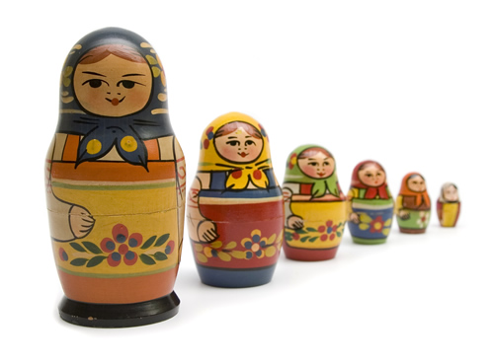
Levels of organization…
Put the items in front of you in order from smallest to largest

Slide 10
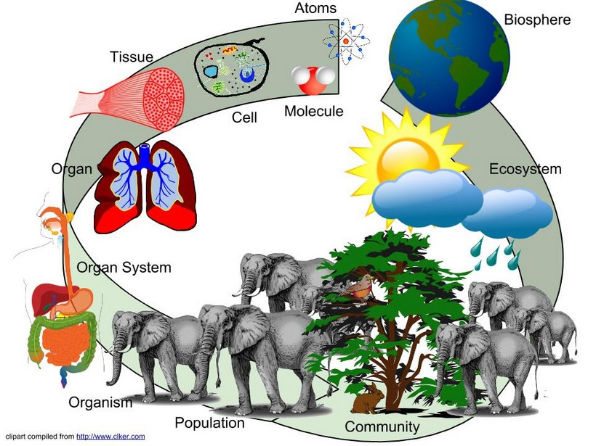
Levels of organization…

Slide 11
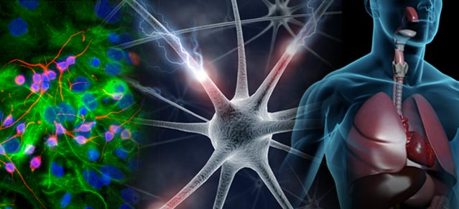
Cells make our tissues and organs
Cell function is a unifying principle in Life Science

Slide 12
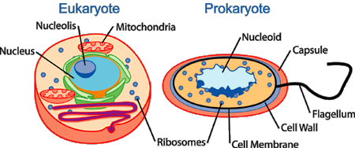
Cells are 2 types
Prokaryotes: NO membrane bound structures
Eukaryotes: Membrane bound structures

Slide 13
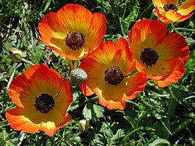
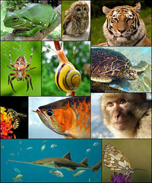
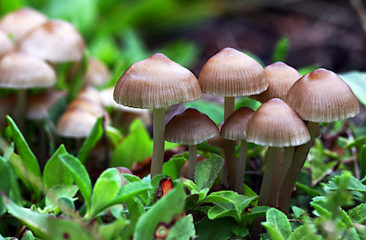
Eukaryotes

Slide 14
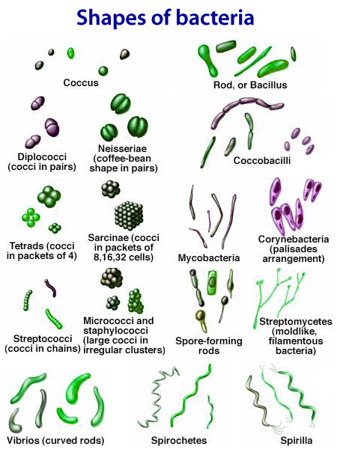
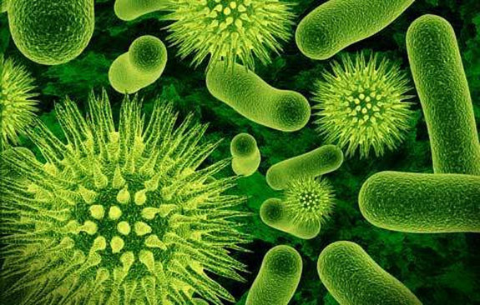
Prokaryotes
Beneficial Bacteria
Pathogens = sickness

Slide 15
Beneficial Bacteria: Digestive bacteria, bacteria in yogurt, cheese, MOST BACTERIA ARE BENEFICIAL
Pathogens: any bacteria that gets you sick. Streptococci for example gives you “strep”

Slide 17
PTT 02DEC2015
What are the 2 cell types?
Why are they different? Why are they similar?
Gecko sitter wanted for Winter Break

Slide 19
Both have:
Ribosomes
Genetic Material

Slide 20
Prokaryotes
Eukaryotes
0.2 – 2 u in size (small)
Nucleoid
NO membrane bound organelles
Divide by Binary Fission
Single Chromosome
Complex Cell Wall
Can have Flagella or “hair”
10-100 u in size (big)
Nucleus
Membrane bound organelles
Divide by Mitosis
Multiple Chromosomes
Simple Cell Wall (plants only)
No flagella

Slide 21
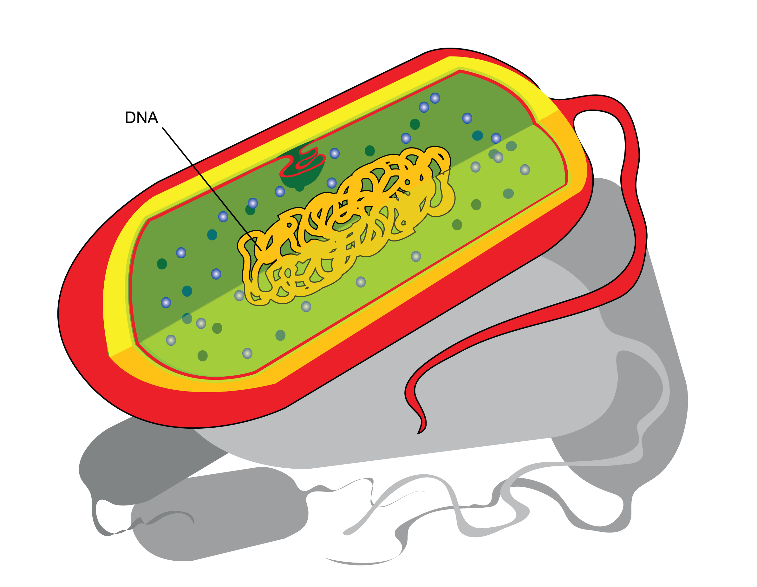
Prokaryote

Slide 22
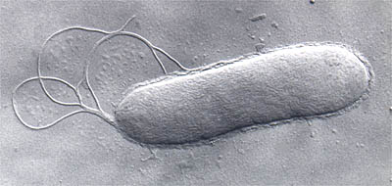
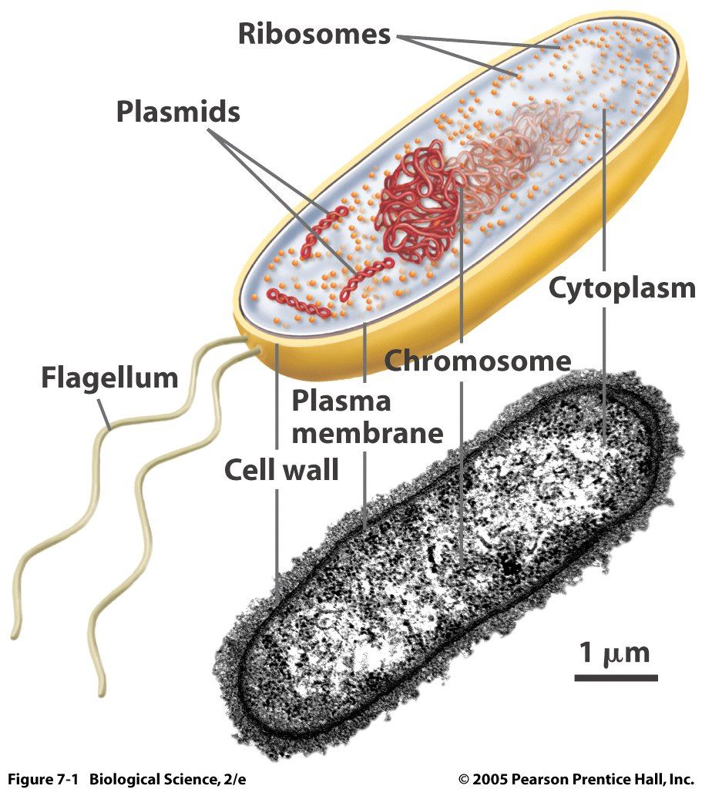
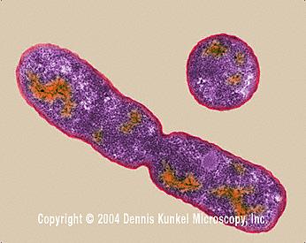
Prokaryotes

Slide 23
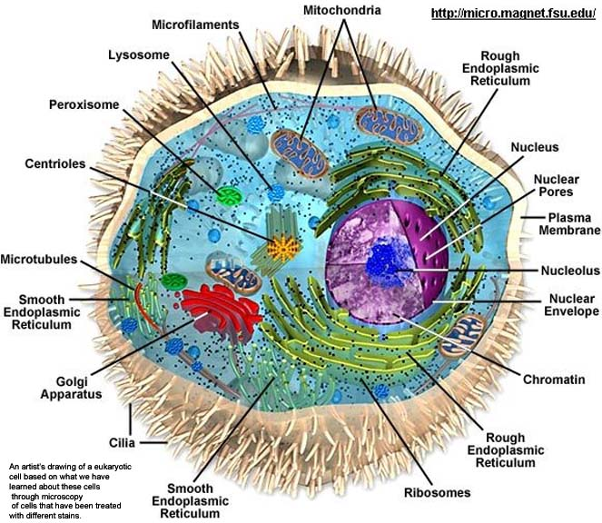
Eukaryote

Slide 24
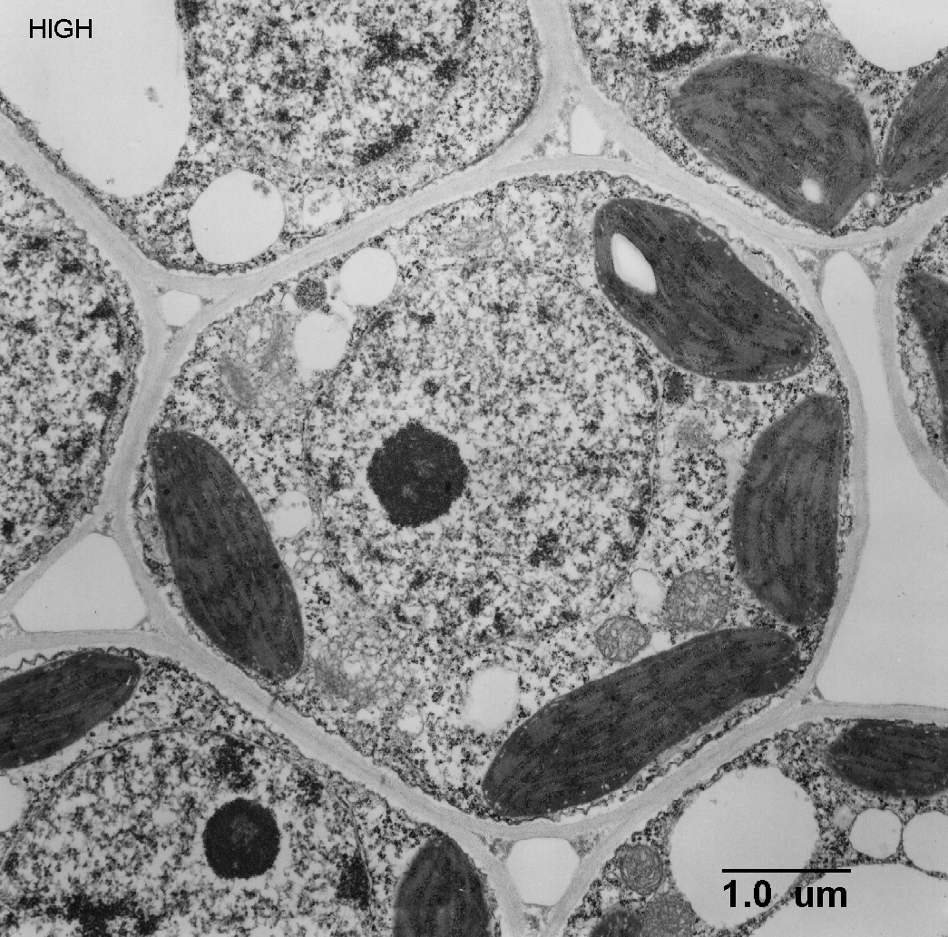
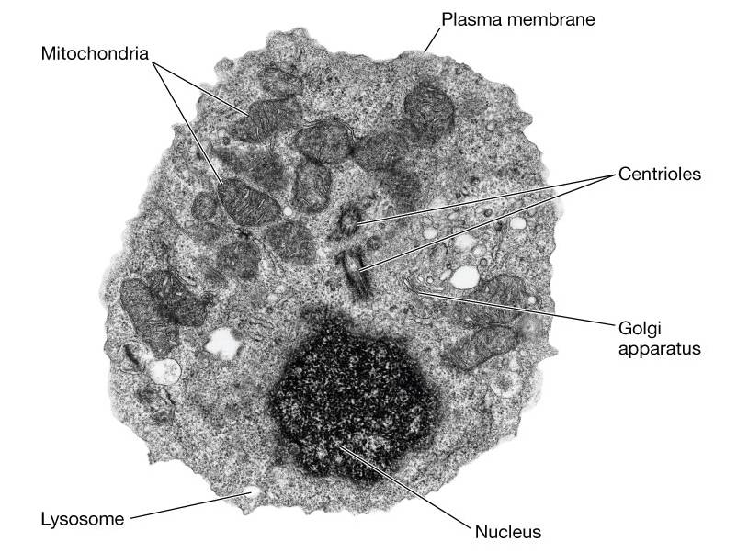
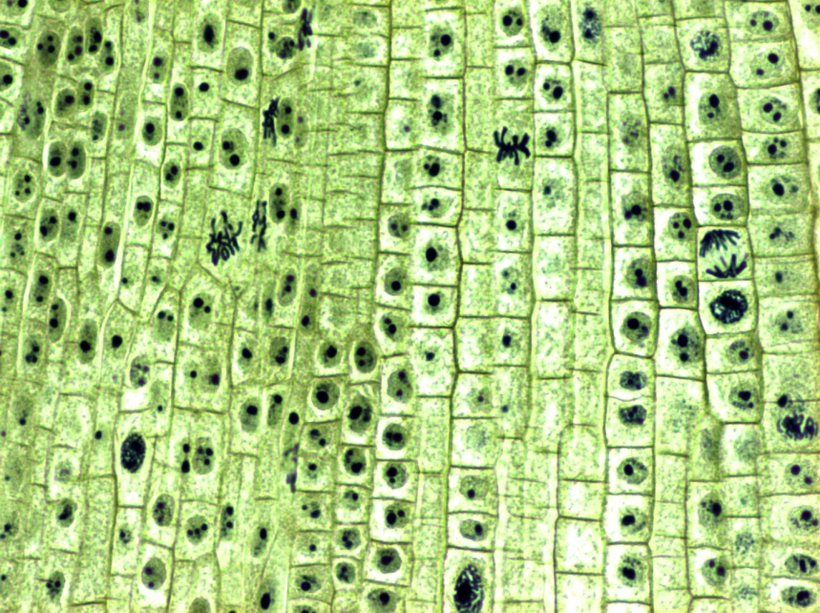
Eukaryotes

Slide 25
Video

Slide 26
TICKET OUT THE DOOR
B
A
Name the Cell Type for A and B.
EXPLAIN how you know your answer.

Slide 28
PTT 03DEC2015
How can you tell that this is a prokaryote?
2. How can you tell that this is a eukaryote?

Slide 29
Cell Theory
Developed over time as technology of microscopes developed
Technology influences scientific discoveries

Slide 30
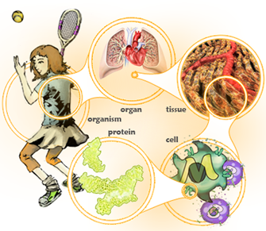
CELL THEORY
All living things are made up of cells
Cells are the basic unit of structure and function in living things
All cells are produced by other cells

Slide 31
Group Presentations
What was their contribution to cell theory?
How did they make their scientific discovery?
What did they contribute to microscope technology?
Anything else you think is interesting and important…

Slide 32
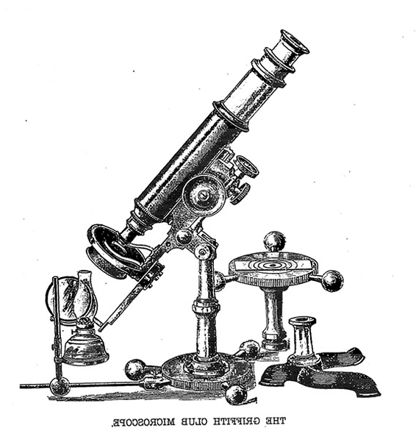
First Microscope
Robert Hooke (1660)
Anton van Leeuwenhoek (1683)
Matthias Schleiden & Theodor Schwann (1839)
Rudolf Virchow (1855)

Slide 33
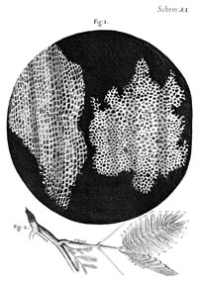
First Microscope
Robert Hooke (1660)
Anton van Leeuwenhoek (1683)
Matthias Schleiden & Theodor Schwann (1839)
Rudolf Virchow (1855)

Slide 34
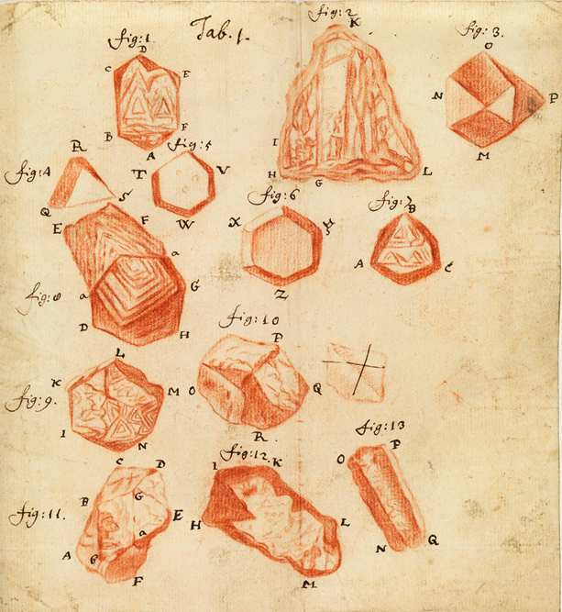
First Microscope
Robert Hooke (1660)
Anton van Leeuwenhoek (1683)
Matthias Schleiden & Theodor Schwann (1839)
Rudolf Virchow (1855)

Slide 35
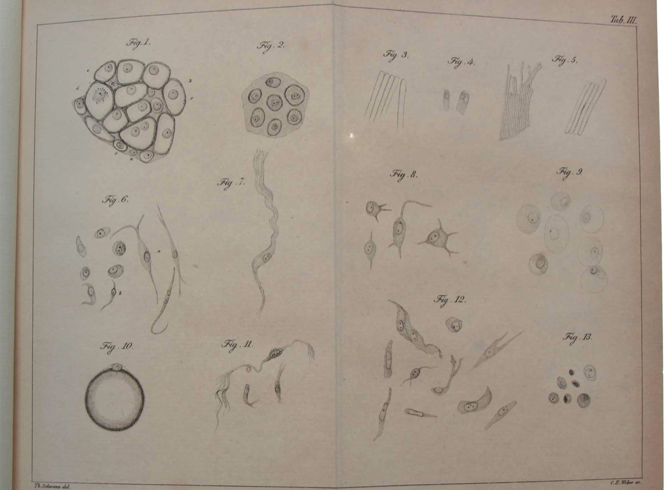
First Microscope
Robert Hooke (1660)
Anton van Leeuwenhoek (1683)
Matthias Schleiden & Theodor Schwann Rudolf Virchow (1855)

Slide 36
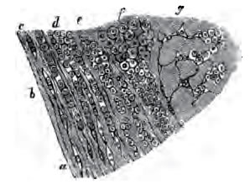
First Microscope
Robert Hooke (1660)
Anton van Leeuwenhoek (1683)
Matthias Schleiden & Theodor Schwann (1839)
Rudolf Virchow (1855)

Slide 37
CELL THEORY
All living things are made up of cells
Cells are the basic unit of structure and function in living things
All cells are produced by other cells

Slide 38
Prokaryotes
Eukaryotes
Small
Nucleoid
NO membrane bound organelles (M.B.O.)
Binary Fission
1 Chromosome
Complex Cell Wall
Hairy
Big
Nucleus
Membrane bound organelles (M.B.O.)
Divide by Mitosis
1+ Chromosomes
Simple Cell Wall
Not Hairy

Slide 40
PTT 04DEC2015
List 2 of the 3 parts of the cell theory.
Turn in your OAJs #11
The Gecko needs a babysitter for Winter Break
Tutoring invitations MUST come back with a parent signature (10 possible BTS for attending and returning invitation)

Slide 41
CELL THEORY
All living things are made up of cells
Cells are the basic unit of structure and function in living things
All cells are produced by other cells

Slide 42
Microscopes
Carry with 2 hands!
Be aware when switching magnification
Fine vs. Coarse adjusting
High vs. Low light

Slide 43
In your lab notebook
Sketch each prokaryote you observe and LABEL THE PARTS!

Slide 45
PTT 07NOV2014
What are some good and bad parts about bacteria?
What was the coolest part about using the microscopes?

Slide 46
Prokaryotes are both good and not good for humans on Earth

Slide 47
Prokaryote Sketch this in your Science Notebook

Slide 48
Label your sketch

Slide 49
Bacteria is more than a pathogen
Read your section and summarize it in your notebook
Be prepared to share your summary with the class

Slide 50
Why do people take antibiotics?

Slide 51
How bacteria survive antibiotics
Read the article and answer the following:
What can some bacteria do in response to antibiotics?
How are scientists trying to make the antibiotics better at killing bacteria?
Make a list of the words you did not understand.

