Slide 1
Warm-up 28SEP2015
What are the 2 factors that define climate?
Logistics:
Presentations this week!
Tomorrow: Rainforest, Savana, Subtropical Desert
Individual Biome Paper is due on Friday (turn in early for 5 bonus points and feedback)
10 Vocabulary due Friday

Slide 2
Climate Factors
TEMPERATURE
Latitude (distance from the equator)
Altitude (elevation above sea level)
Distance from the ocean
PRECIPITATION
Prevailing Winds (most common wind direction)
Topography (proximity to the mountains: windward or leeward side of the mountains)

Slide 3
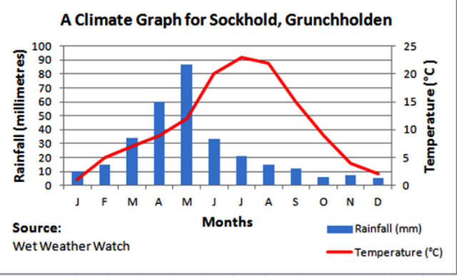
Climates are demonstrated by climatograms
Temperature and Precipitation each have their own axis

Slide 4
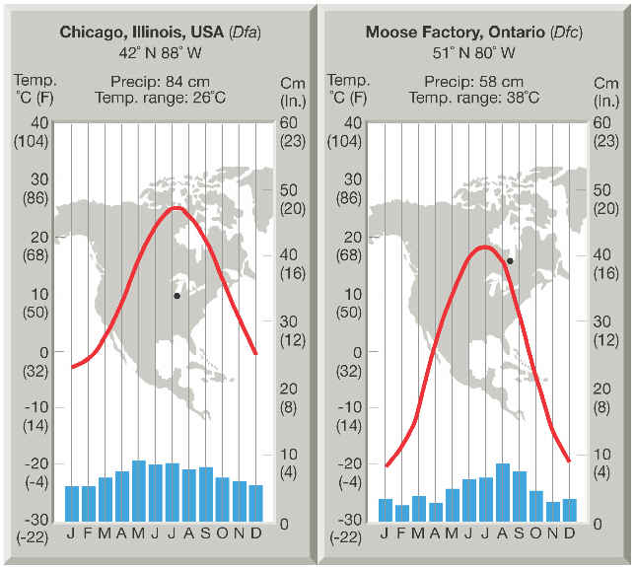

Slide 5
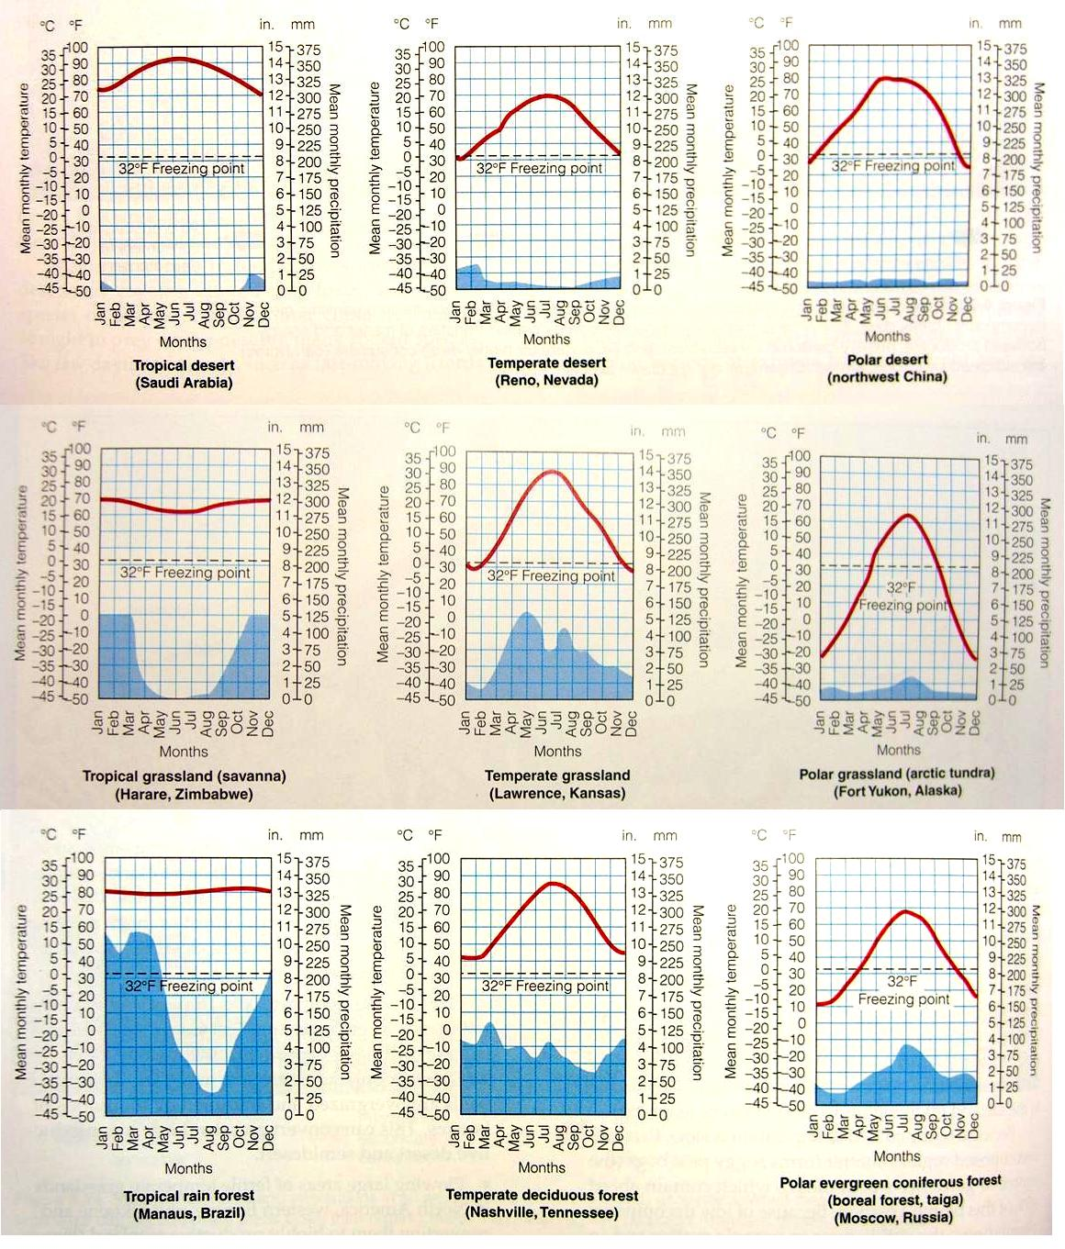

Slide 6
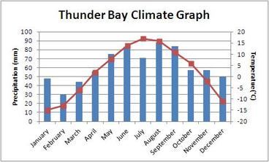
Building a Climatogram
One axis for temperature and one for precipitation

