Slide 1
Warm-Up 15SEP2015
What makes the Haber-Bosch process so important?
What are the other 2 ways to create “fixed “ nitrogen?
Logistics: 10 vocab, celebration, and owl pellet lab is ALL due on Friday (FRQ for chapter 2/3 Monday)
Ozone analysis is TODAY!

Slide 2
ENERGY FLOWS! (through ecosystems)
Open system
MATTER CYCLES! (in the biosphere)
Closed system

Slide 3
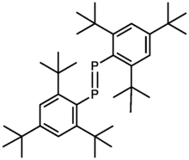
The Phosphorus Cycle
A major part of DNA and ATP (in all living things)
Is a limiting element in ecosystems
Often used in fertilizer
NO GASEOUS PHASE!!

Slide 4
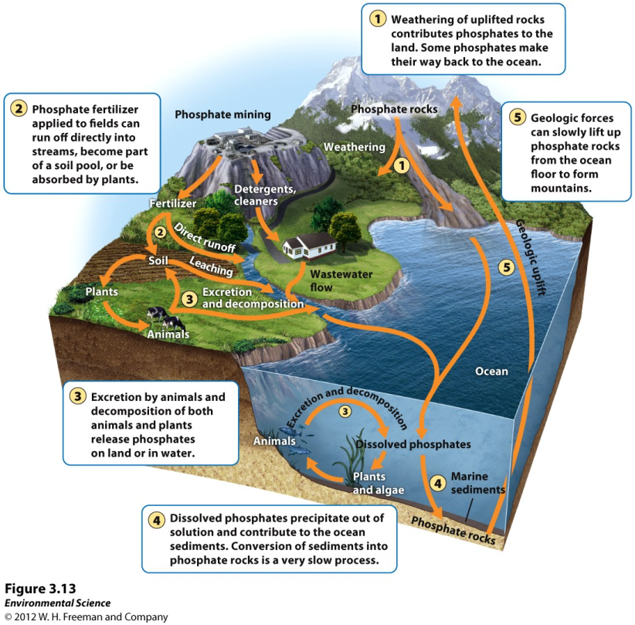
The Phosphorus Cycle

Slide 5
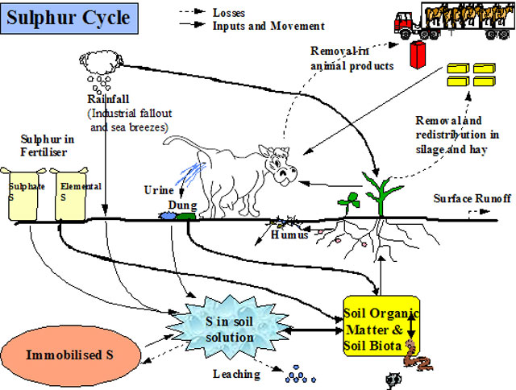
Calcium, Magnesium, Potassium, and Sulfur Cycle

Slide 6
Calcium, Magnesium, Potassium, and Sulfur Cycle
All are essential for life processes
All have no GASEOUS phase, but can be deposited by dustl

Slide 7
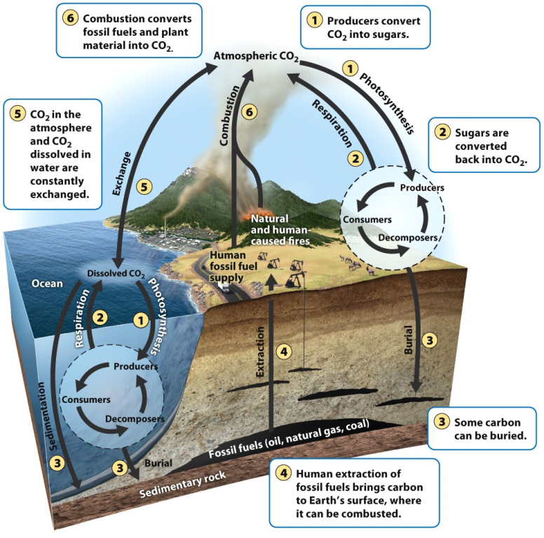
The Carbon Cycle

Slide 8
The Carbon Cycle
Photosysnthesis
Respiration
Exchange
Sedimentation
Burial
Extraction
Combustion
Pre-industrial times, the carbon cycle was balanced.

Slide 9
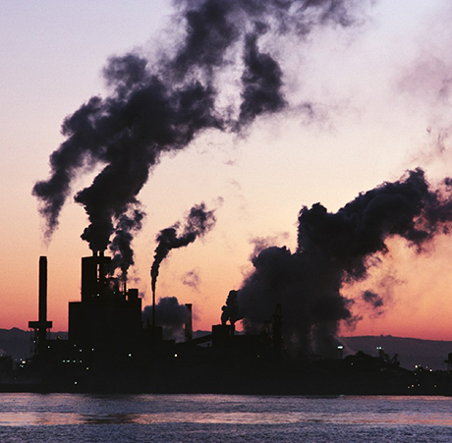
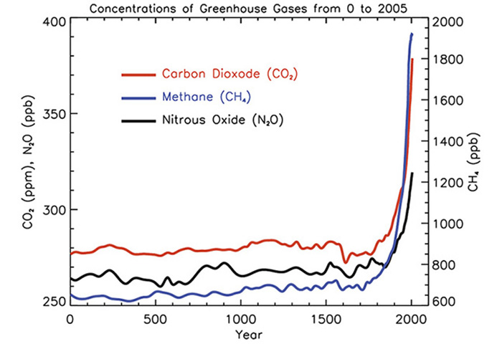

Slide 10
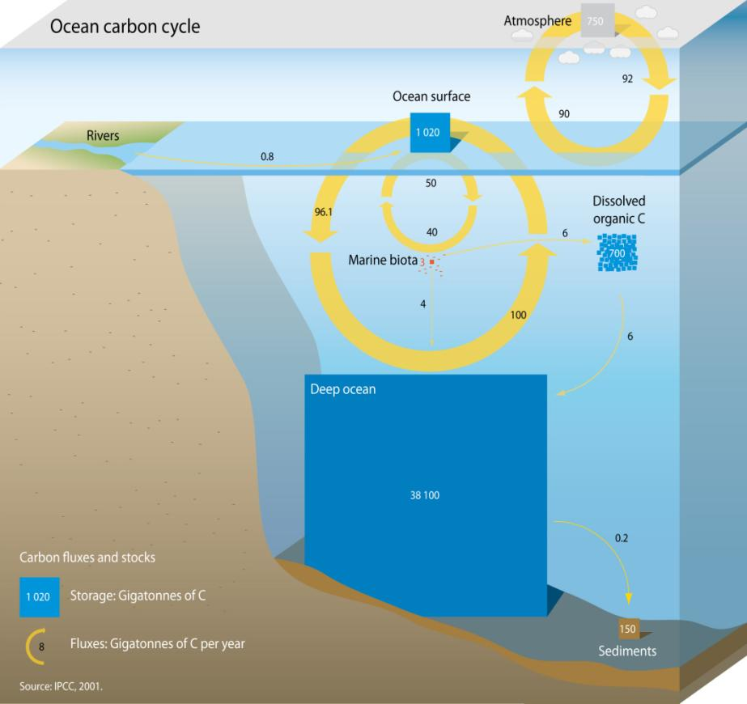
CaCO3

Slide 11
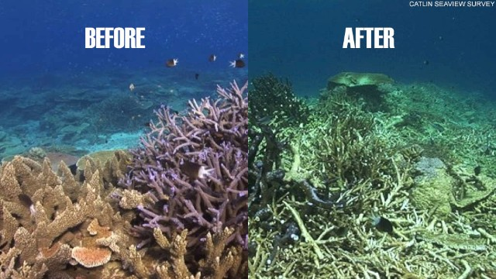

Slide 12
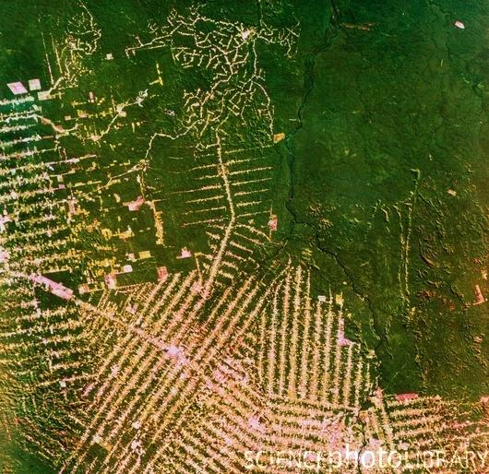
Human Altering of Carbon Cycle
Combustion
Deforestation

Slide 13
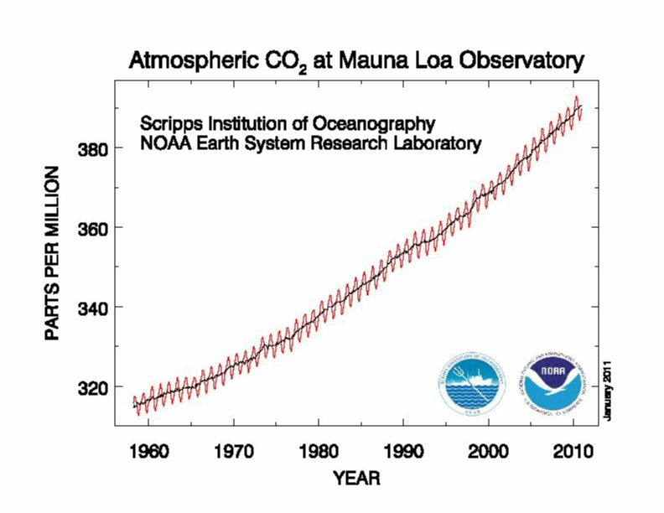

Slide 14
Things to do today…
Ozone Lab for September (write in the same data table from last time-KEEP IT ALL YEAR!)
Owl Pellet Lab 2.0 (there are multiple parts be sure to read ALL the directions)
10 Vocabulary
Tuesday is afterschool APES time ☺

Slide 15
Warm-Up 16SEP2015
What are 2 ways human alter the Carbon cycle?
How are the phosphorous and nitrogen cycle similar? Different?

Slide 16
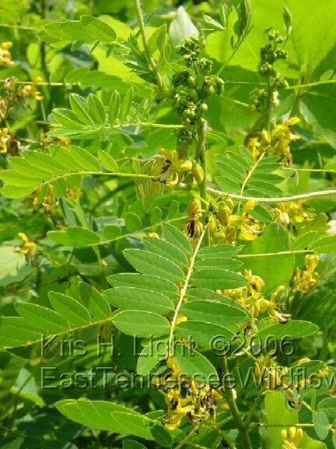
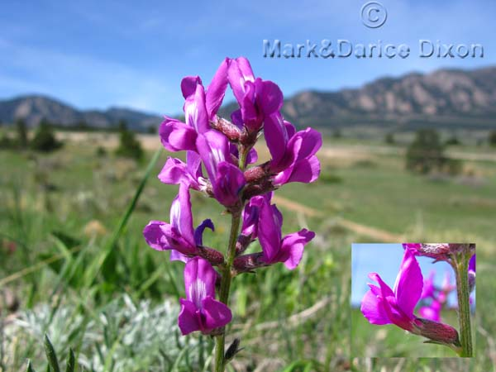

Slide 17
DISTURBANCE = CREATION (in ecology)
Disturbance- An event caused by physical, chemical or biological agents that results in changes in population size or community composition.

Slide 18
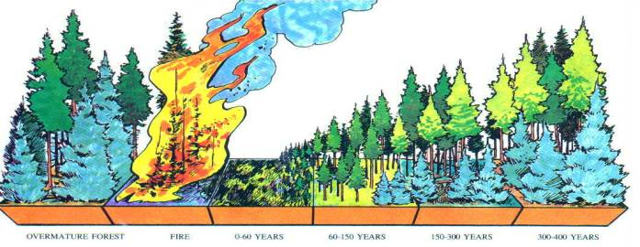
Disturbances
Earthquakes, Fires, Tsunamis, Logging, Etc.

Slide 19
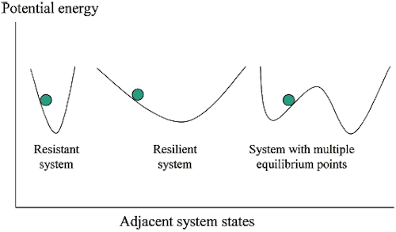
Resistance versus Resilience
Resistance- A measure of how much a disturbance can affect its flows of energy and matter.
Resilience- The rate at which an ecosystem returns to its original state after a disturbance.
.

Slide 20
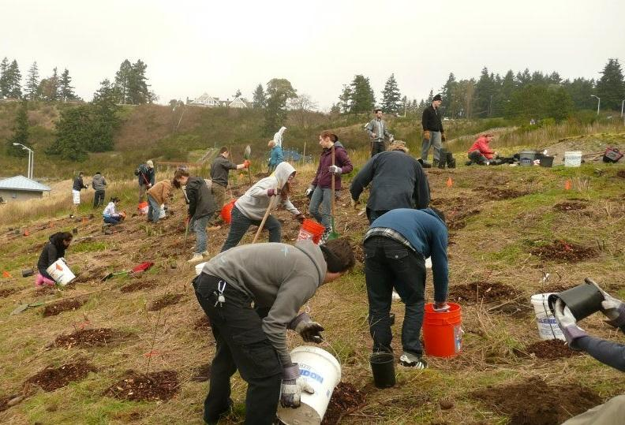
Restoration Ecology
Restoration ecology- A new scientific discipline that is interested in restoring damaged ecosystems.

Slide 21
The Intermediate Disturbance Hypothesis
The intermediate disturbance hypothesis- states that ecosystems experiencing intermediate levels of disturbance are more diverse than those with high or low disturbance levels.

Slide 22
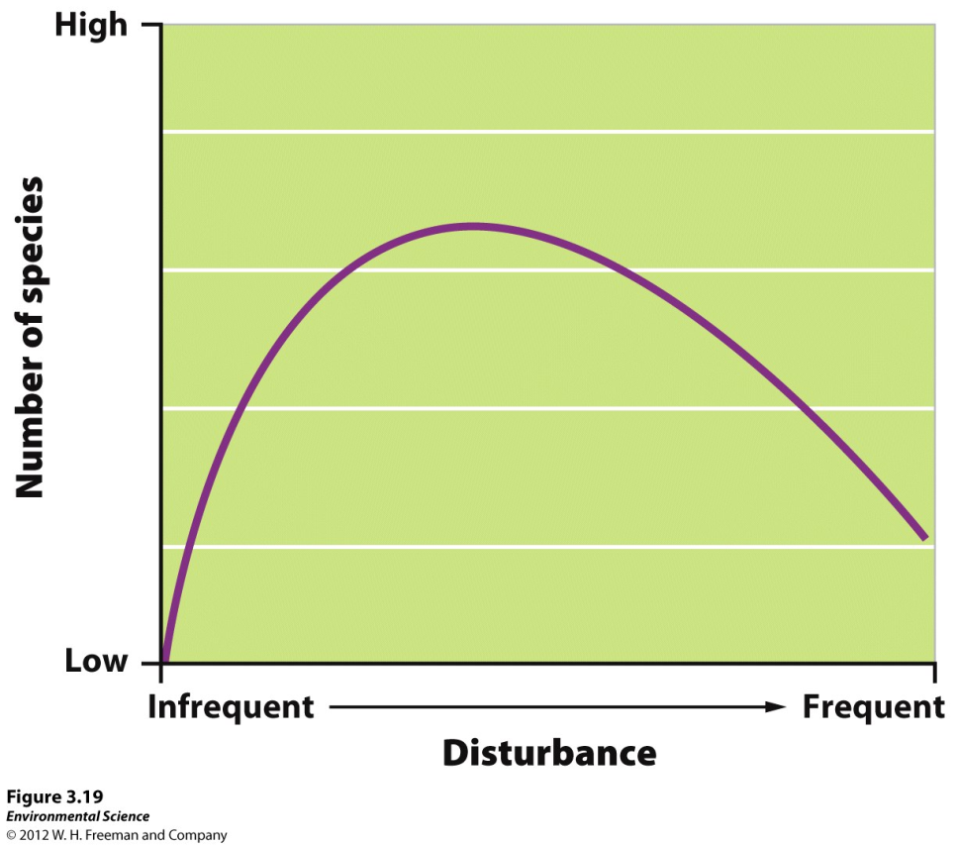

Slide 23
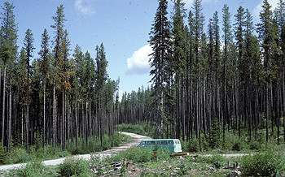
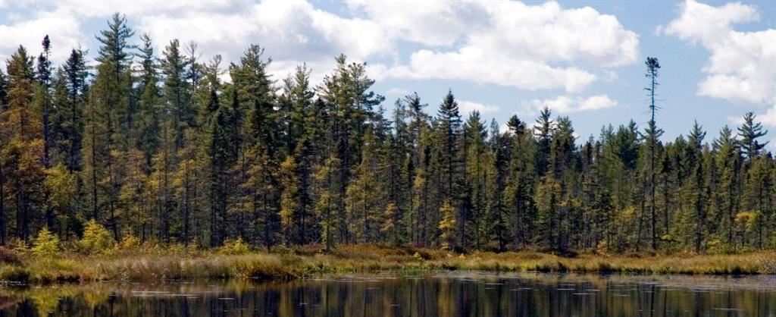
Lodgepole Pine vs Spruce Fir
LP burns 20-80 years
SF burns 200-300 years

Slide 24
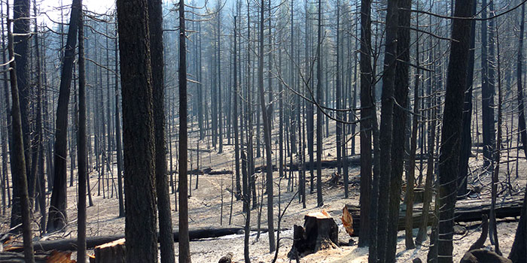
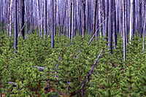

Slide 25
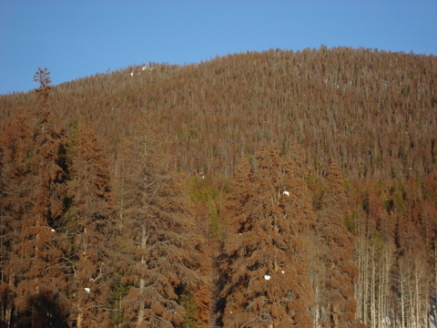
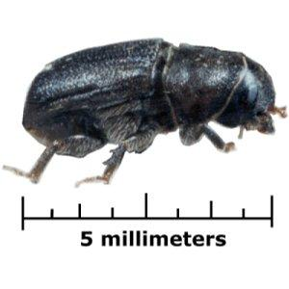

Slide 26
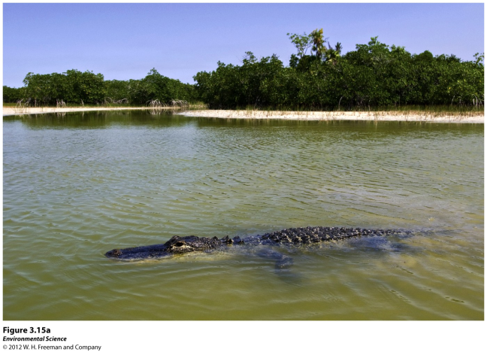
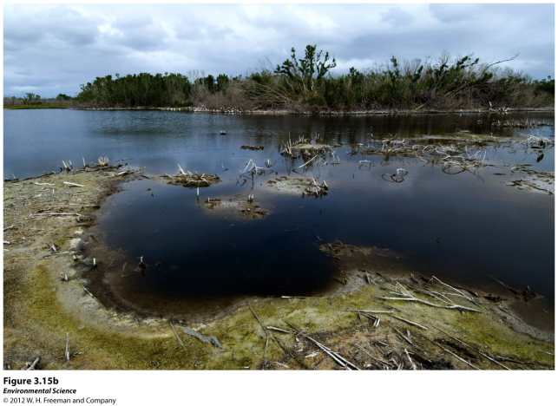
Pre and post Katrina

Slide 27
Watershed Studies
Watershed- All of the land in a given landscape that drains into a particular stream, river, lake or wetland.
ALL the biotic and abiotic things that effect the watershed/landscape

Slide 28
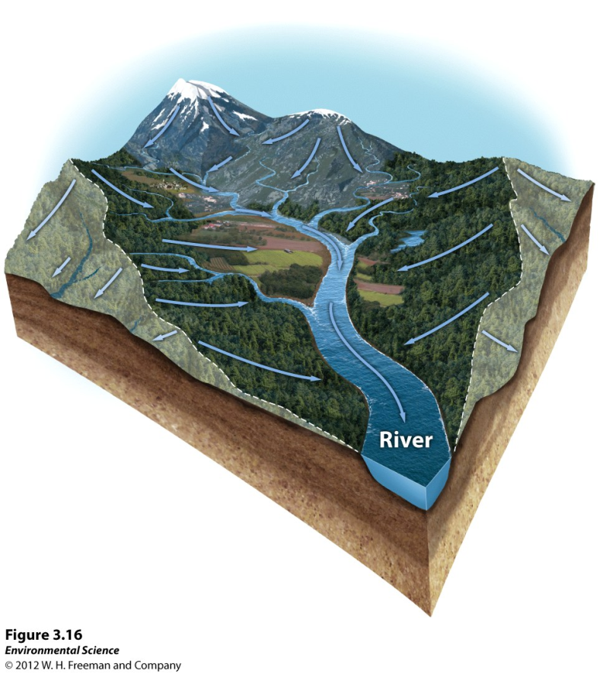
Logging
Mining
Human Development
Drought
Recreation
Etc.

Slide 29
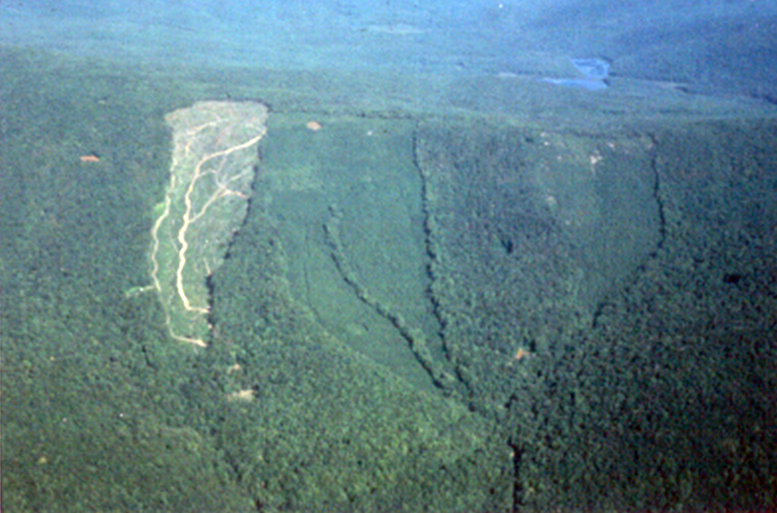
Hubbard Brook Experimental Forest

Slide 30
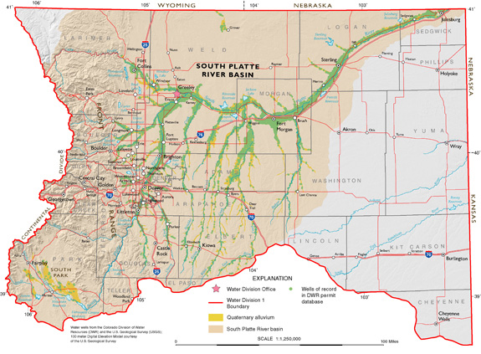

Slide 31
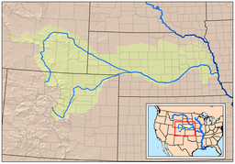

Slide 32
Ecosystems Provide Valuable Services
Services are connected to our economic system, through goods and services
Services are our food
Changes to the Ecosystem has ecological consequences, social consequences, and economical consequences

Slide 33
Instrumental Values of Ecosystems
Provisions- Goods that humans can use directly.
Regulating services- The service provided by natural systems that helps regulate environmental conditions.
Support systems- The support services that natural ecosystems provide such as pollination, natural filters and pest control.

Slide 34
Instrumental Values of Ecosystems
Resilience- Resilience of an ecosystem ensures that it will continue to provide benefits to humans. This greatly depends on species diversity.
Cultural services- Ecosystems provide cultural or aesthetic benefits to many people.

Slide 35
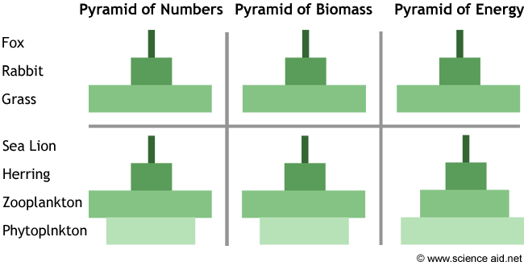
Owl Pellet Lab
Complete sentences!!
Separate sheet of paper
Pre-Lab (“extra credit”)

Slide 36
Things to do today…
Ozone Lab for September (write in the same data table from last time-KEEP IT ALL YEAR!)
Owl Pellet Lab 2.0 (there are multiple parts be sure to read ALL the directions)
10 Vocabulary

Slide 38
Warm-Up 17SEP2015
What is the intermediate disturbance hypothesis?

Slide 39
The Intermediate Disturbance Hypothesis
The intermediate disturbance hypothesis- states that ecosystems experiencing intermediate levels of disturbance are more diverse than those with high or low disturbance levels.

Slide 40
Things to do today…
Ozone Lab for September (write in the same data table from last time-KEEP IT ALL YEAR!)
Owl Pellet Lab 2.0 (there are multiple parts be sure to read ALL the directions)
10 Vocabulary
MISSING ASSIGNMENTS!
Study for the “celebration of learning”

