Slide 1
Warm-Up 31AUG2015
What are the properties of water that make it able to support the conditions of life?
Logistics:
Return tests (re-takes ONLY)
Please read Chapter 1
10 Vocabulary is due Friday (all are posted on the CoolSiS
FRQ Today in the last 25 minutes of class

Slide 2
Earth is a single interconnected system AKA: EVERYTHING IS CONNECTED

Slide 3
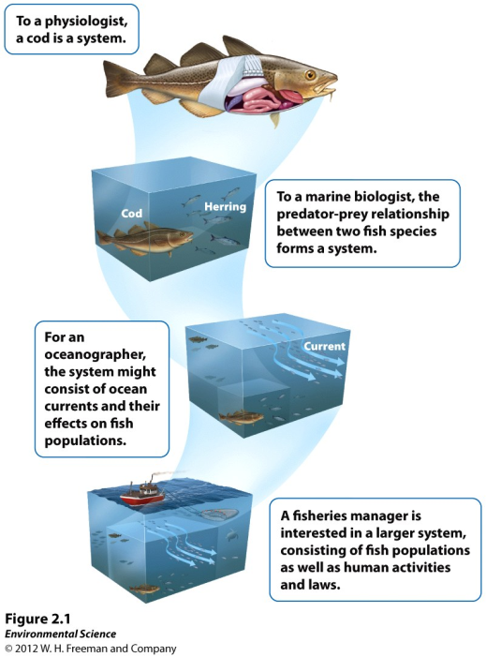

Slide 4
All environmental systems consist of matter

Slide 5
Matter- anything that occupies space and has mass.
Mass- a measure of the amount of matter an object contains.
Weight- the force that results from the action of gravity on mass.

Slide 7
Warm-Up 01SEP2015
Compare and contrast mass and weight.

Slide 8
Matter- anything that occupies space and has mass.
Mass- a measure of the amount of matter an object contains.
Weight- the force that results from the action of gravity on mass.

Slide 10
Abiotic + biotic = Ecosystem!

Slide 11
Atoms and Molecules
Atom- the smallest particle that can contain the chemical properties of an element.
Element- a substance composed of atoms that cannot be broken down into smaller, simpler components. Elements can be solid, liquid or gas.

Slide 12
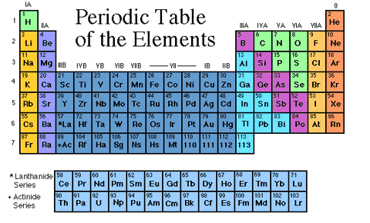
Periodic Table- lists all the elements currently known.
Molecules- particles containing more than one atom.
Compounds- molecules that contain more than one element.

Slide 13
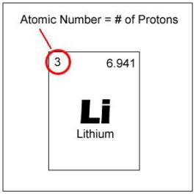
Atoms and Molecules
Atomic Number- the number of protons in the nucleus of a particular element.
Mass Number- the total number of protons and neutrons in an element.

Slide 14
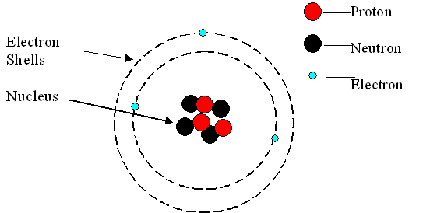

Slide 15
Isotopes- atoms of the same element that have different numbers of neutrons, and therefore different atomic masses.

Slide 16
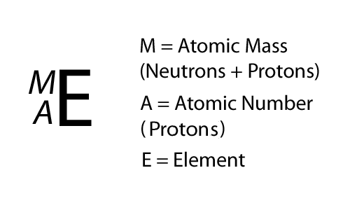
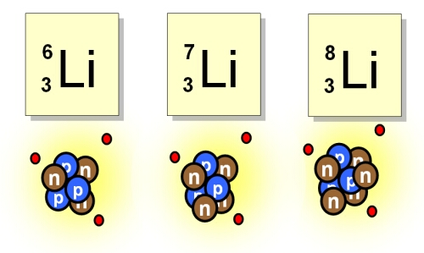

Slide 17
Radioactivity
Radioactive decay- the spontaneous release of material from the nucleus of an unstable isotope.
Radioactive decay changes the radioactive element into a different element. i.e. Uranium-235 decays to form Thorium-231.
Uranium is called the parent and thorium the daughter.

Slide 18
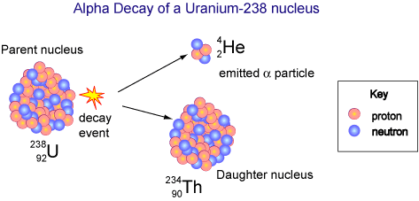

Slide 19
Radioactivity
Half-life- the time it takes for one-half of the original radioactive parent atoms to decay.
Some elements that undergo radioactive decay emit harmful radiation.
Knowledge of the half-life allows scientists to determine the length of time that a radioactive element may be dangerous.

Slide 20
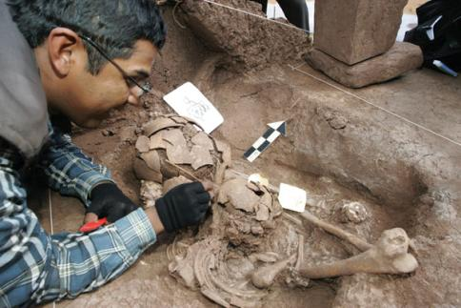
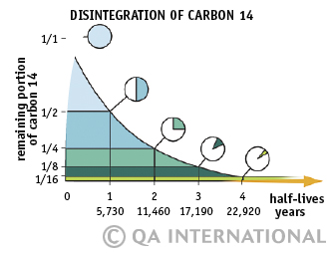

Slide 21
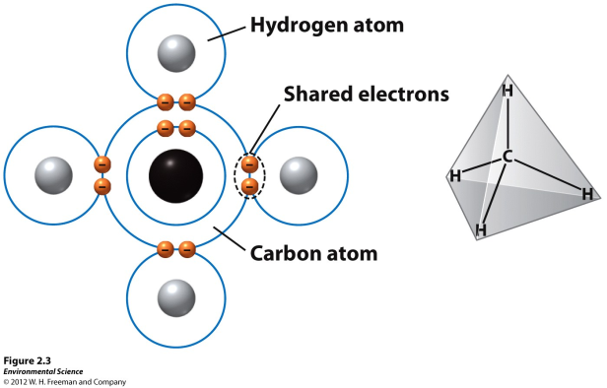
Chemical bonds
Covalent bonds- elements that form compounds by sharing electrons. (methane)

Slide 22
Chemical bonds
Ionic bonds- elements that form compounds by transferring electrons from one element to another.
When this transfer happens, one atom becomes electron deficient (positively charged) and one atom becomes electron rich (negatively charged)

Slide 23
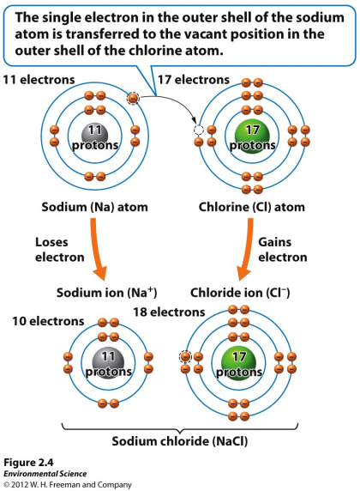
Chemical bonds

Slide 24
Chemical bonds
Hydrogen bonds- a weak chemical bond that forms when hydrogen atoms that are covalently bonded to one atom are attracted to another atom on another molecule.
Water is known as a polar molecule, one side is more positive and the other side is more negative.

Slide 25
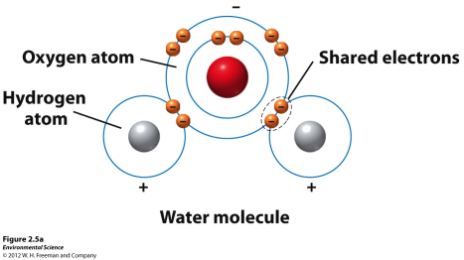
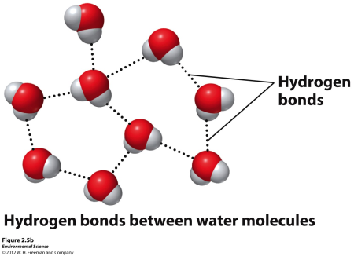
Chemical bonds

Slide 26
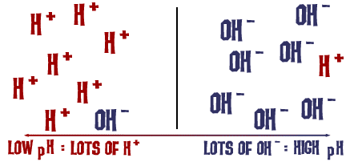
acids, bases, and pH
Acid- a substance that contributes hydrogen ions to a solution.
Base- a substance that contributes hydroxide ions to a solution.

Slide 27
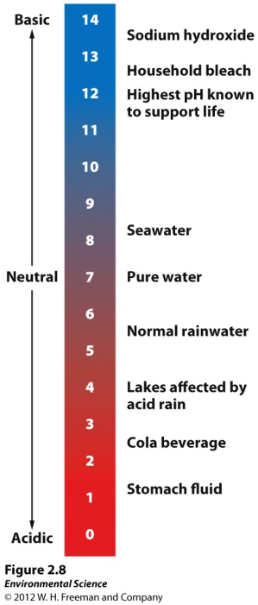

Slide 28
acids, bases, and pH
pH- a way to indicate the strength of acids and bases.
The pH scales ranges from 0 - 14.
A pH value of 7 is neutral
A pH above 7 is basic
A pH below 7 is acidic

Slide 29
pH Mini-Lab
Measure the pH of all the items.
Record your data on a separate sheet of paper.
Bring one of your acidic solutions to a neutral pH.
Provide directions on how you did this
Turn this in!

Slide 30
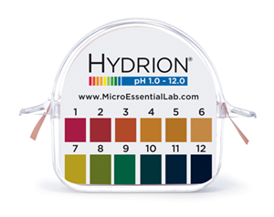

Slide 32
Warm-Up 02SEP2015
Name and describe the 3 types of chemical bonds.
Logistics: Please be reading chapter 2
Tomorrow we will complete a “popcorn relay” be ready to go outside
10 Vocabulary words are due Friday

Slide 33
Properties of water
Surface tension- the result from the cohesion of water molecules at the surface of a body of water.
Capillary action- when adhesion of water molecules to a surface is stronger than cohesion between the molecules.

Slide 34
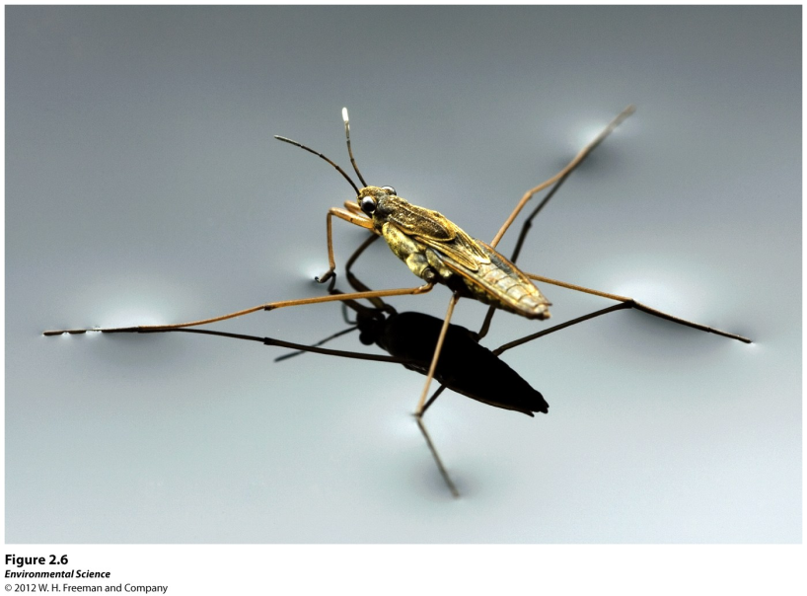

Slide 35
Properties of water
Boiling and freezing- at Earth’s surface, water boils at 100 degrees celsius and freezes at 0 degrees celsius.
Water as a solvent- many substances dissolve well in water because their polar molecules bond easily with other polar molecules. (UNIVERSAL SOLVENT)

Slide 36
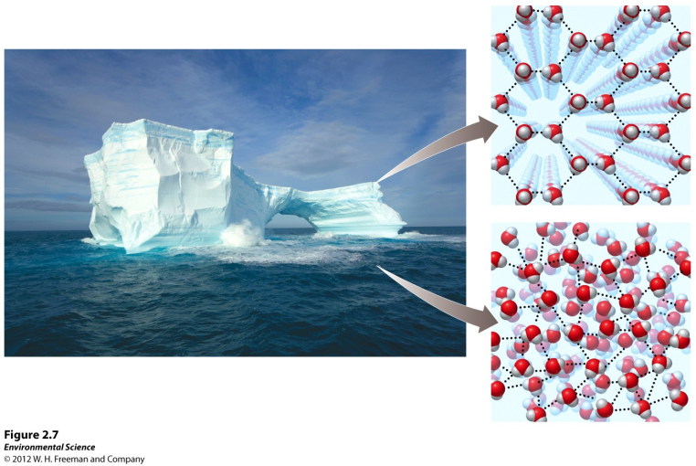
Properties of water

Slide 37
acids, bases, and pH

Slide 38
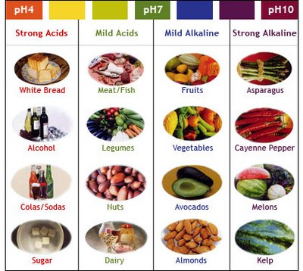

Slide 39
Chemical reactions and the conservation of matter
Chemical reaction- occurs when atoms separate from the molecules they are a part of or recombine with other molecules.
Law of conservation of matter- matter cannot be created or destroyed; it can only change form.

Slide 40
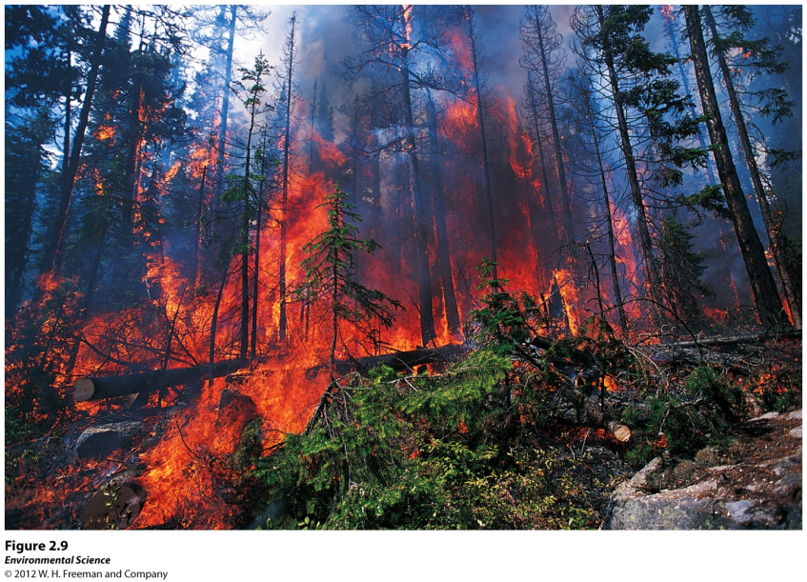

Slide 41
Biological molecules and cells
Inorganic compounds- compounds that do not contain carbon or do contain carbon, but only carbon bound to elements other than hydrogen.
ex. NH3, NaCL, H2O, and CO2
Organic compounds- compounds that have carbon-carbon and carbon-hydrogen bonds.

Slide 42
Biological molecules and cells
Carbohydrates- compounds composed of carbon, hydrogen,and oxygen atoms. Ex. C6H12O6
Proteins- made up of long chains of nitrogen-containing organic molecules called amino acids.

Slide 43
Nucleic Acids- organic compounds found in all living cells.
DNA
RNA
Lipids- smaller biological molecules that do not mix with water. Ex. fats, waxes and steroids.

Slide 45
Biological molecules and cells
Cells- the smallest structural and functional component of organisms.
single cells- Ex. bacteria and some algae
multicellular- Ex. bring shrimp

Slide 46
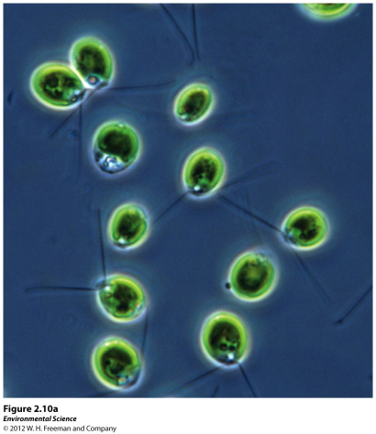
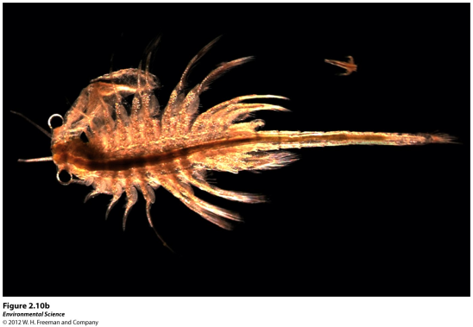

Slide 47
What are the 3 types of chemical bonds?
What are the unique properties of water? In what ways do those properties make life possible on Earth?
What are the 4 types of biological molecules?

