Slide 1
Warm-Up 19AUG2015
Be ready to present your environmental indicator (3 minutes max)
Logistics:
Turn in AP Summer Assignment
Due tomorrow: 10 vocabulary words
Presentations are next week.

Slide 2
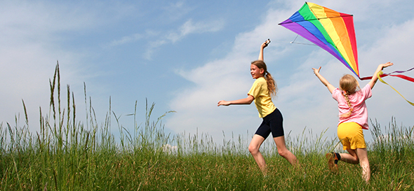
Five global Environmental Indicators
Biological Diversity
Food Production
Average surface temperature and CO2 concentrations
Human Population
Resource Depletion

Slide 3
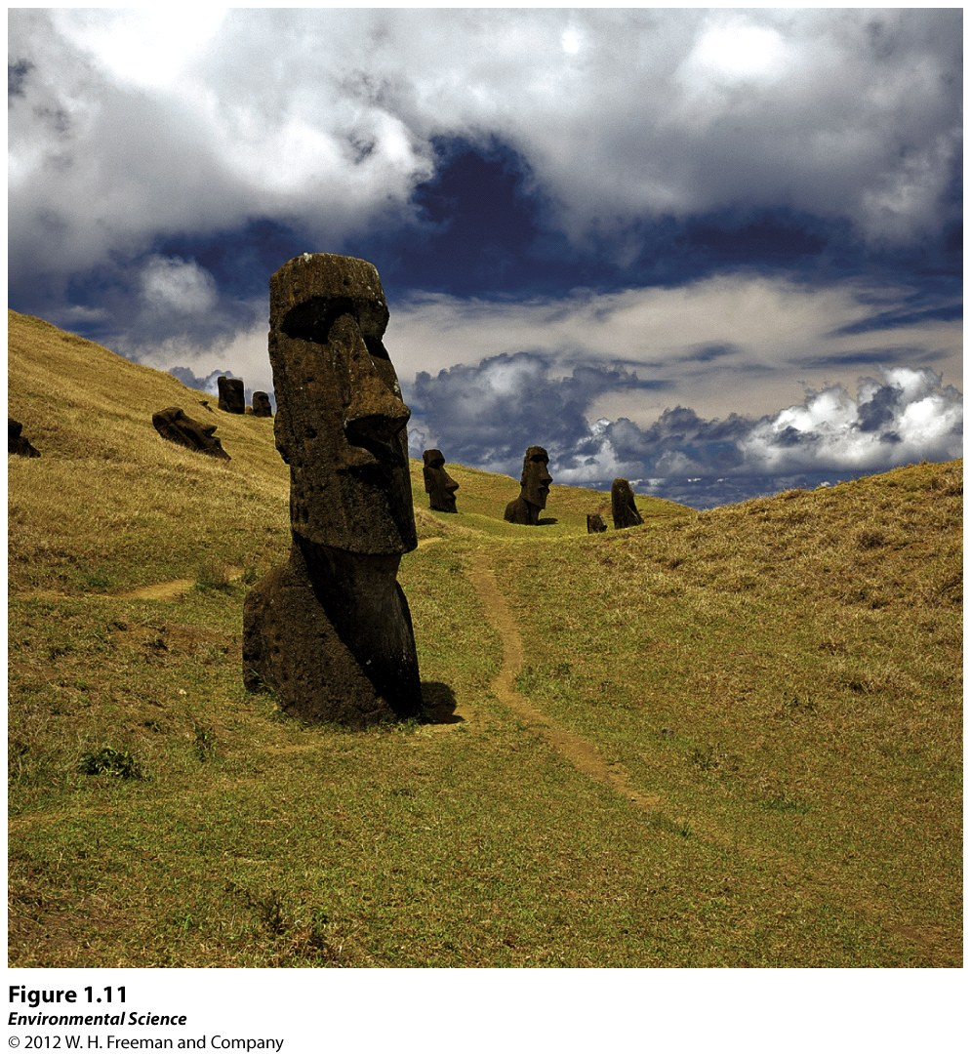

Slide 4
Human Well-Being Depends on Sustainable Practices
Sustainable Development- development that balances current human well-being and economic advancement with resource management for the benefit of future generations.

Slide 5
Human Well-Being Depends on Sustainable Practices
In order to live sustainably:
Environmental systems must not be damaged beyond their ability to recover.
Renewable resources must not be depleted faster than they can regenerate.
Nonrenewable resources must be used sparingly.

Slide 6
Defining Human Needs
People in developed nations might say that they "need" electricity.
People in the developing world have never heard of this modern convenience.
Basic human needs- air, water, food and shelter.
Biophilia

Slide 7
The Ecological Footprint
A measure of how much a person consumes, expressed in area of land.

Slide 8
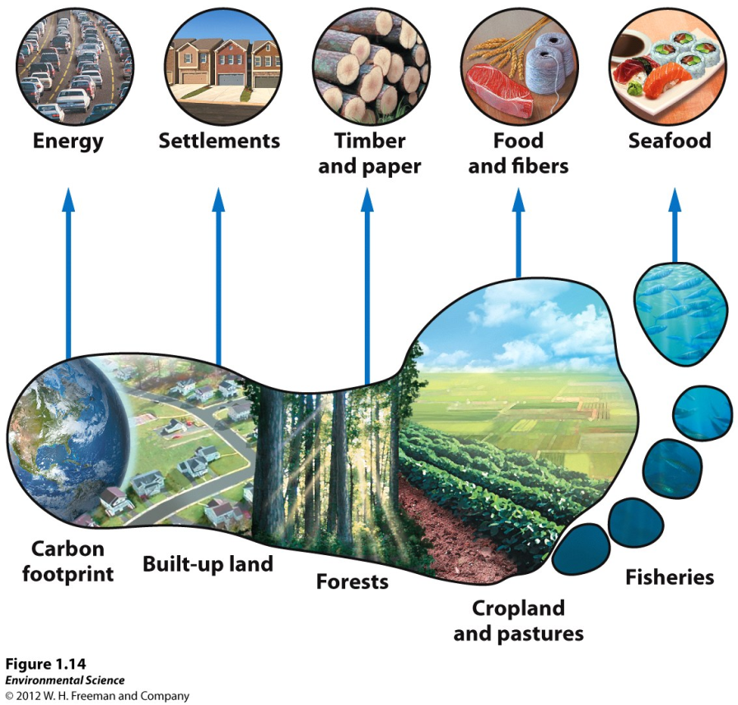

Slide 9
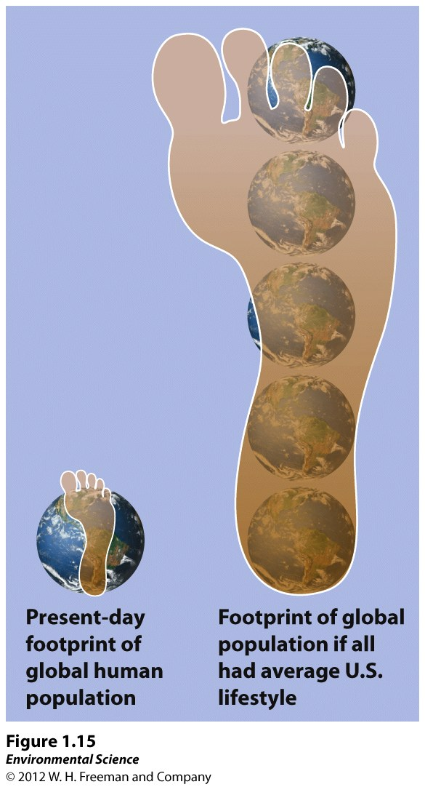

Slide 10
What is meant by basic human needs?
What does it mean to live sustainably?
What can an ecological footprint tell us?
Why is it important to calculate?

Slide 11
Science is a Process AND Science is a verb!

Slide 12
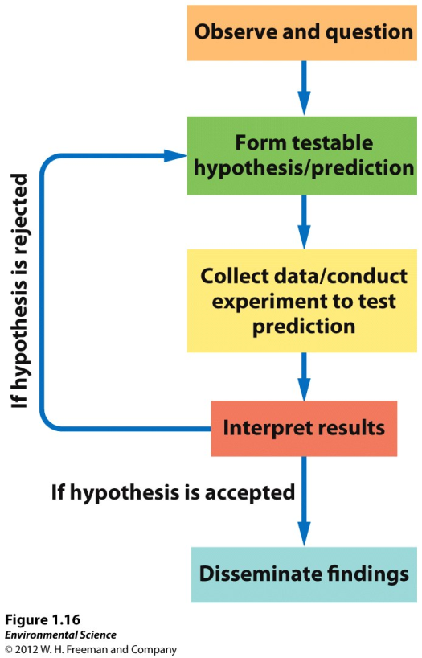
The Scientific Method
Observations and questions
Hypothesis
Collecting data
Interpreting results
Disseminating findings

Slide 13
Observations and Questions
Observing and questioning is the first step of the scientific process.

Slide 14
Hypothesis
An educated guess that can be proved or disproved through controlled experimentation.
A null hypothesis is a statement that can be proved wrong.

Slide 15
Collecting Data
Replication- repeating the measurement many times
Sample size- the number of times the measurement is repeated.
Accuracy- how close a measured value is to the actual or true value.
Precision- how close to one another the repeated measurements are.
Uncertainty- how much the measure differs from the true value.

Slide 16
Interpreting Results
Once results have been obtained, analysis of the data begins. This process involves two types of reasoning, inductive and deductive.
Inductive reasoning- the process of making general statements from specific facts or examples.
Deductive reasoning- the process of applying a general statement to specific facts or situations.

Slide 17
Disseminating Findings
Scientists present papers at conferences and publish the results of their investigations. This allows other scientists to repeat the original experiment and verify or challenge the results.

Slide 18
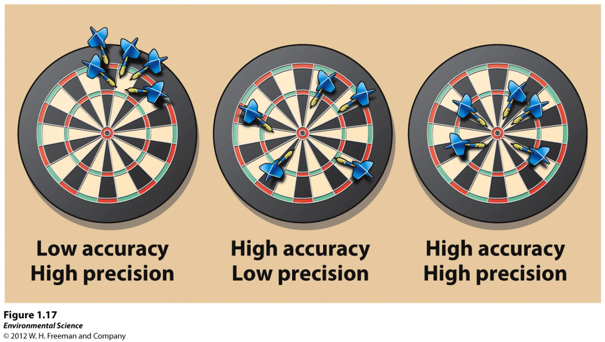

Slide 19
Theory- a hypothesis that has been repeatedly tested and confirmed by multiple groups of researchers and is widely accepted.
Natural law- When a theory has been tested multiple times and there are no known exceptions. Ex. Law of gravity and laws of thermodynamics.

Slide 20
Controlled Experiments and Natural Experiments
Controlled experiment- an experiment conducted in the controlled conditions of a laboratory.

Slide 21
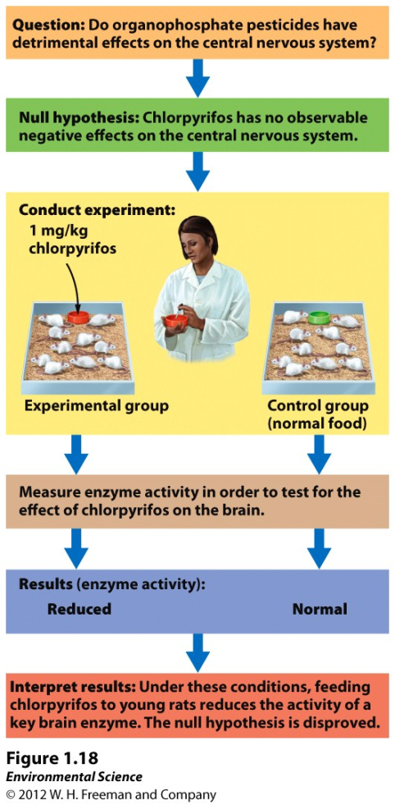

Slide 22
Controlled Experiments and Natural Experiments
Natural experiments- when a natural event, such as a volcano, acts as an experimental treatment in an ecosystem.

Slide 23
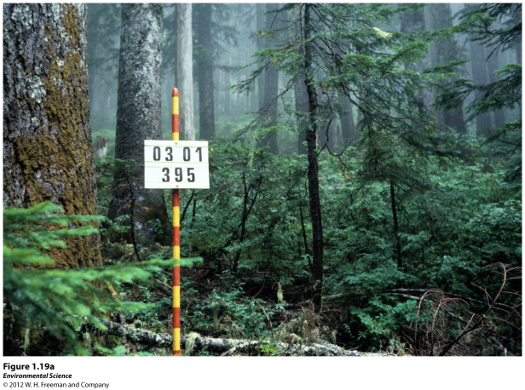
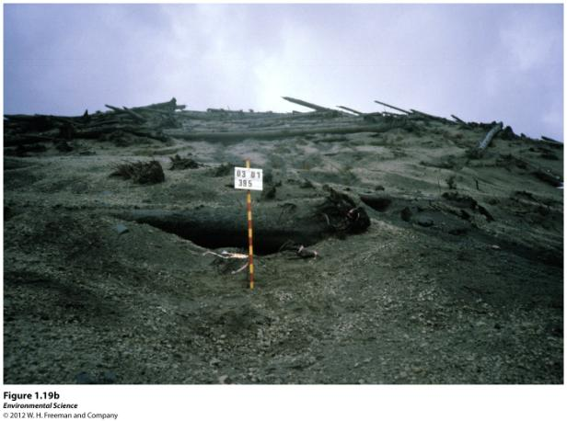
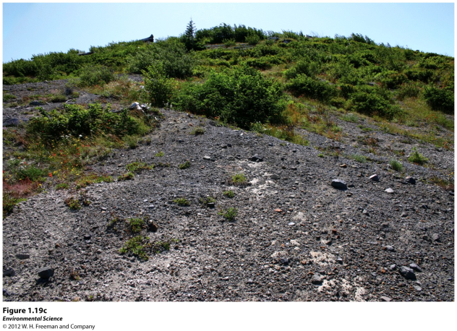

Slide 24
Experimental Science Presents Unique Challenges
There is no "control" planet to compare the Earth with.
It is difficult to decide what is better or worse for the environment than something else.
Environmental science has so many interacting parts, it is not easy to apply one system to another.
Human well-being is a concern because people that are unable to meet their basic needs are less likely to be interested in saving the environment.

