Slide 1
ARCTIC TUNDRA
By: Amanda Labadie & Ethan Hunley

Slide 2
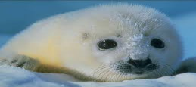
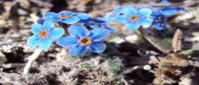
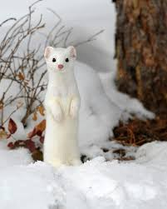
Arctic Tundra
Description:
The Arctic Tundra is a biome with a very cold climate that has very little vegetation, various animals, very short growing seasons, poor nutrients, and very little precipitation.
Physical Factors:
Very cold
No trees, but has small vegetation like grasses, shrubs, mosses, heaths, and lichens
Has an approximate 4 month growing season
Has very little precipitation
Chemical Factors:
Due to cold temperatures, chemical reactions occur very slowly
Causes plants and animals to decompose slowly
Slow decomposition causes an accumulation of organic matter over time and results in lack of nutrients in the soil

Slide 3
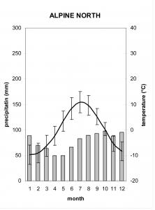
Monthly Precipitation
Monthly Temperature
For each month, the arctic tundra doesn’t ever get a whole lot a precipitation. The least amount of precipitation is seen in the summer and the precipitation increases only slightly in the winter. The average amount of precipitation received is approximately 15-25 cm.
For each month, the monthly temperatures don’t really fluctuate that much. As shown on the graph, the higher temperatures are seen in the summer and decreases dramatically in the winter due to the latitude it is at which is 60-70 degrees North.. The average temperature ranges from -20 to 20 degrees F.

Slide 4
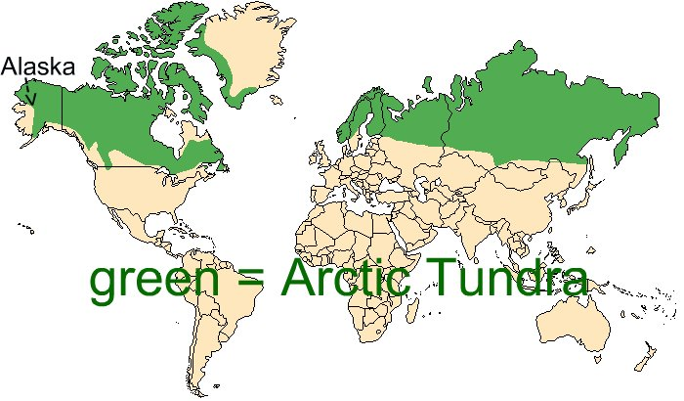
ARCTIC TUNDRA MAP

Slide 5
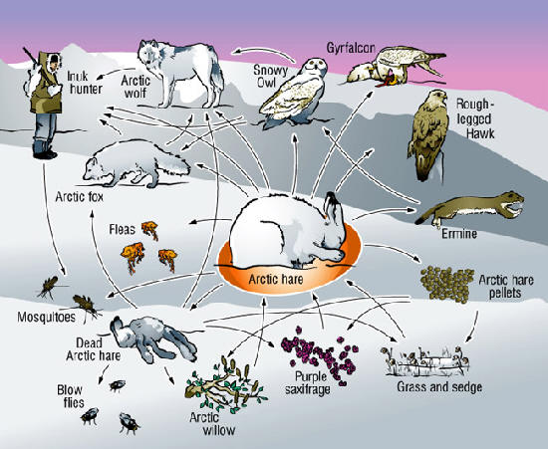
ARCTIC TUNDRA FOOD WEB

Slide 6
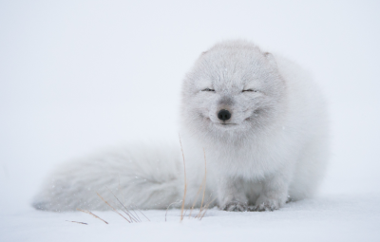
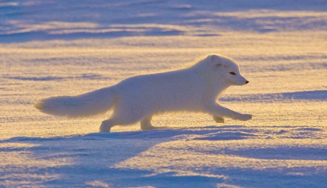
Arctic Fox
Vulpes Lagopus
Survival Techniques:
The Arctic fox has adapted to the cold because of it’s small body. It often lays or sits in a ball to minimize surface area. This saves body heat. The thick fur on it’s paws allow it to walk on the snow and ice. It loves to eat Lemmings, but will eat whatever it can get its paws on.

Slide 7
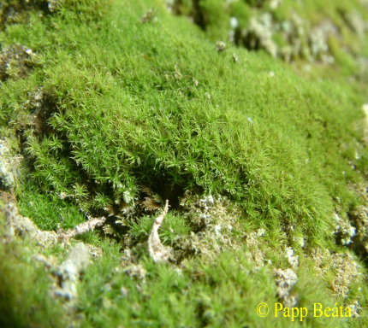
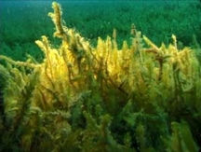
Calliergon Giganteum
One of the most common plants in the Arctic Tundra is the Arctic Moss. The Calliergon Giganteum grows in the Arctic Tundra. Its survival strategies involve being able to survive both underwater and on land. On land it sticks so close to the ground that it can survive the strong, dry winds. When it’s not growing, it stores various nutrients in its leaves.

Slide 8
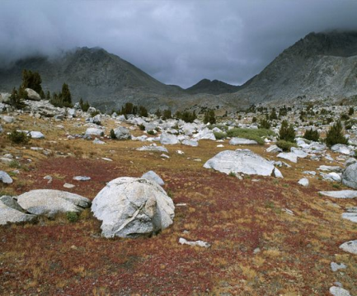
Environmental Threats
Global warming melts the permafrost which changes the landscape and animal diversity
Ozone depletion which causes stronger UV rays which drastically changes the landscape
Air pollution contaminates the vegetation which most of the animals need to survive
Extraction of oils, gases, and minerals
Addition of pipelines and roads disturb the environment
Oil spills (due to the people continually trying to extract them)
Buildings and roads increase heat and pressure which melts the permafrost
Invasive species

Slide 9
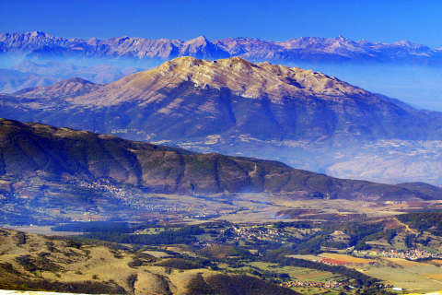
Protection Solutions
Minimize human-made global warming
Create specific areas of protection like national parks
Limit human construction
Limit tourism
Arctic National Wildlife Refuge
Set by Eisenhower
Helps protect the wildlife and wildernesses
Clean Air Act
Helps minimize human-made pollution to help protect the environment
General Mining Act
Minimizes the extraction of oils, gases, and minerals
National Park Organic Service Act
Sets aside and protects specific areas from human development and damage
Endangered Species Act
Protects the species whose populations have declined to the brink of extinction or have forever become extinct

Slide 10
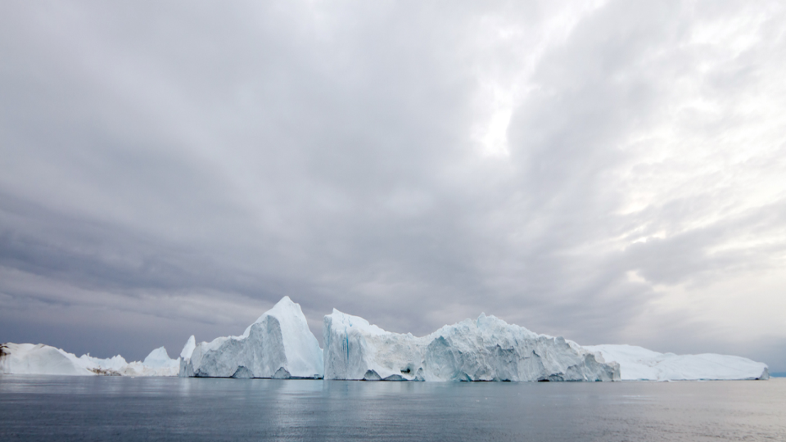
BIBLIOGRAPHY
Thomas, Robert, and Margaret Orr. “The Tundra Biome.” The Tundra Biome. University of California Museum of Paleontology, 2004. Web. 26 Sept. 2015.
Friedland, Andrew J., Rick Relyea, and David Courard-Hauri. Environmental Science for AP*. New York: W. H. Freeman, 2012. Print.
A., Sam. "Tundra Climate." Tundra Climate. N.p., 2000. Web. 29 Sept. 2015.
"Basic Facts About Arctic Foxes." Defenders of Wildlife. Defenders of Wildlife, 19 Mar. 2012. Web. 29 Sept.
"Tundra Threats, Tundra Species - National Geographic." National Geographic. National Geographic, 2015. Web. 30 Sept. 2015.
"Basic Facts About Arctic Foxes." Defenders of Wildlife. Defenders of Wildlife, 19 Mar. 2012. Web. 29 Sept. 2015.
"Arctic Tundra Biome." Arctic Tundra Biome. N.p., n.d. Web. 30 Sept. 2015.
"AIP Simulation Circuit [Archive] - Toyota Tundra Forums : Tundra Solutions Forum." AIP Simulation Circuit [Archive] - Toyota Tundra Forums : Tundra Solutions Forum. N.p., 2015. Web. 30 Sept. 2015.

