Slide 1
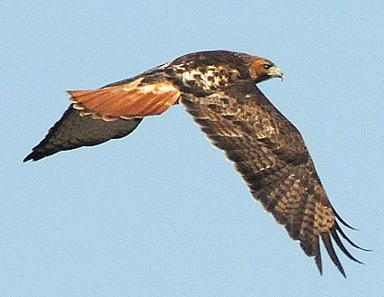
PTT 04APR2016
What did you do OUTSIDE over Spring Break?
Any interesting spring observations?
Turn in: Take Home Test and Permission Slip
For your Planners: Wildlife Refuge Writing Friday

Slide 2
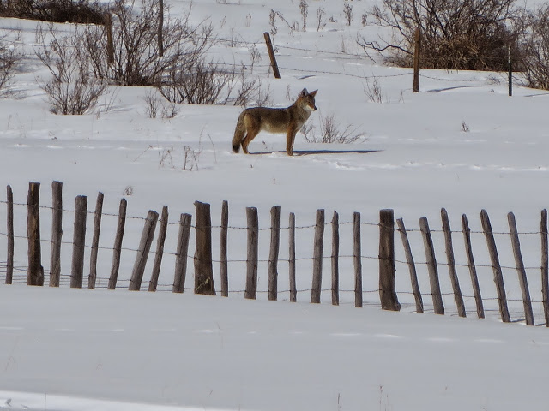
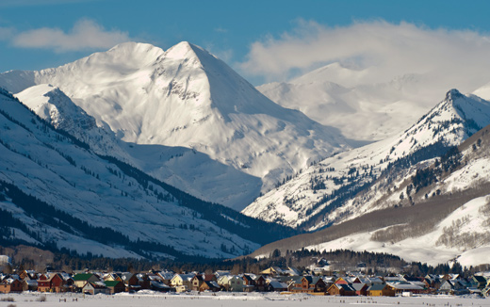
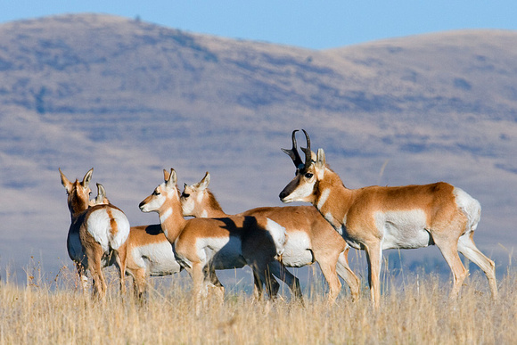
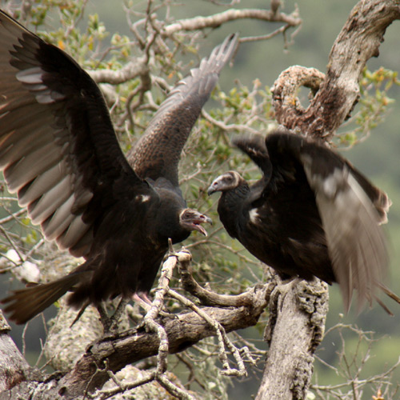

Slide 3
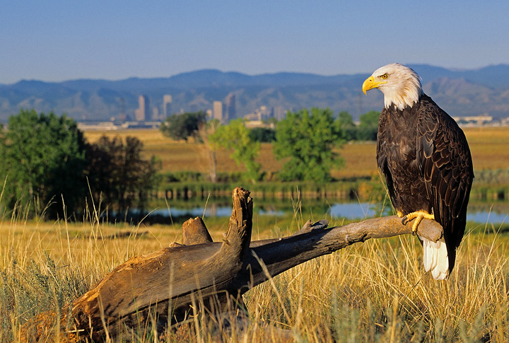
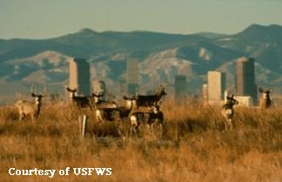
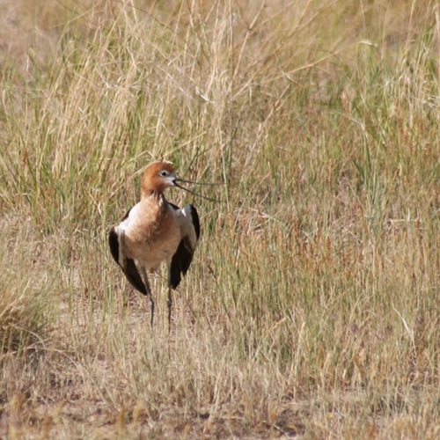
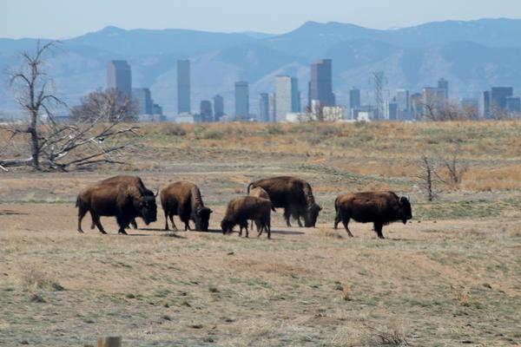
Rocky Mountain National Wildlife Refuge

Slide 5
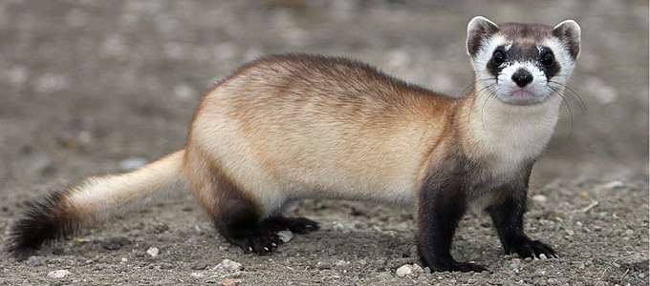
PTT 05APR2016
What are you most excited to see on the field trip?
For your Planner: Wildlife Refuge Assignment Due MONDAY.

Slide 6
Wildlife Refuge Assignment
2 Species Descriptions (1 Native, and 1 Invasive Species)
Latin Name, Common Name
Picture
Habitat
Life History
Range Map
Interesting Facts
1 Descriptive Writing

Slide 7
Native vs Invasive Species
Native Species: species that lives in its historical range, typically where it has lived for thousands if not millions of years.
Invasive Species: species that spreads rapidly across large areas.

Slide 8
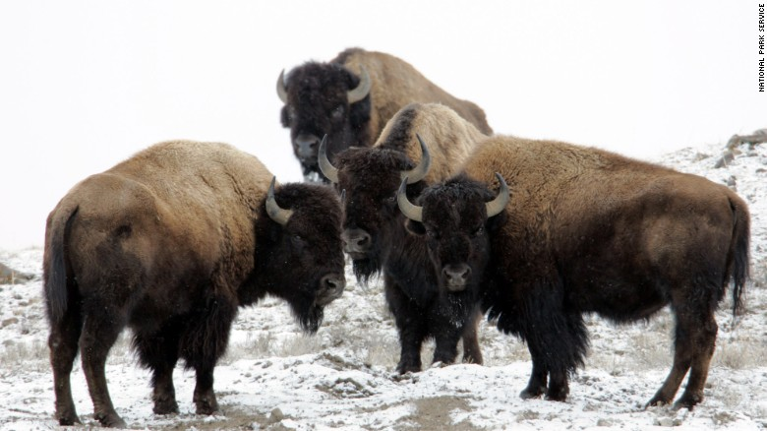
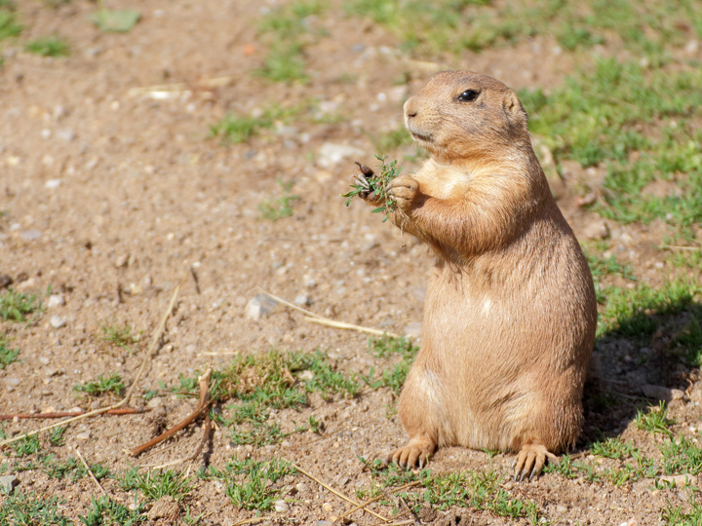
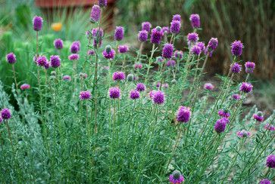
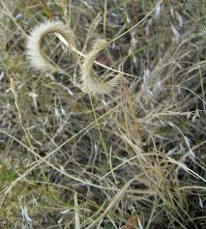
Native vs Invasive Species
Native Species: species that lives in its historical range, typically where it has lived for thousands if not millions of years.

Slide 9
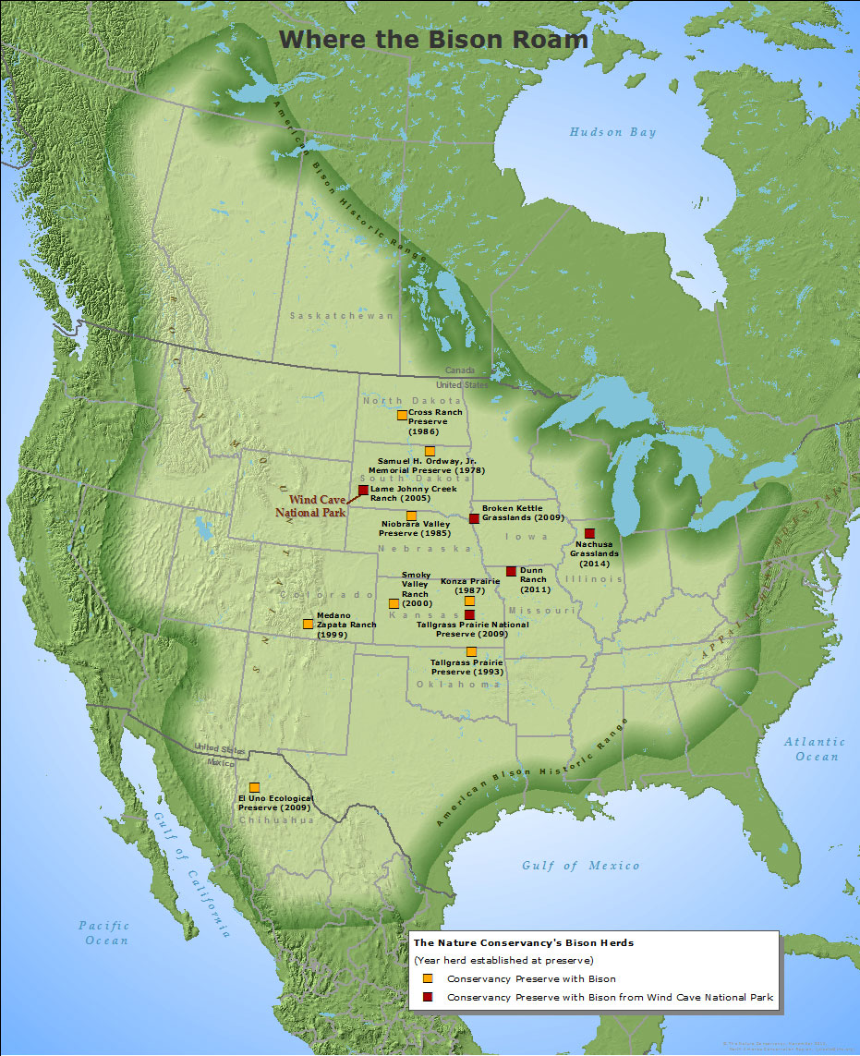
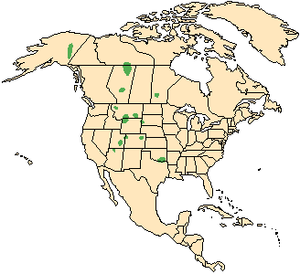
Bison Range Maps

Slide 10
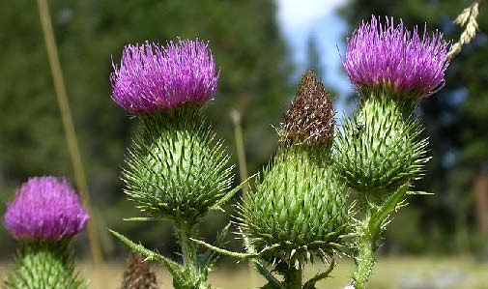
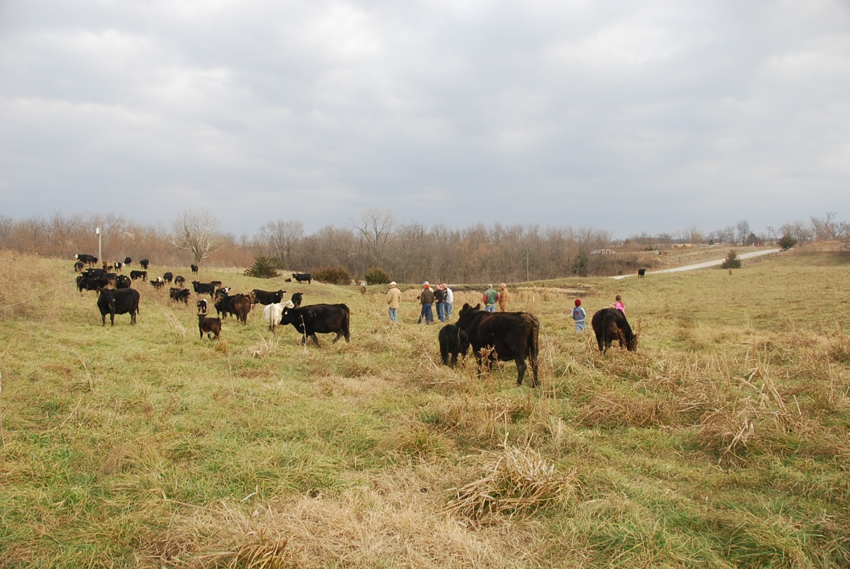
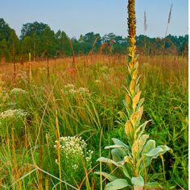
Native vs Invasive Species
Invasive Species: species that spreads rapidly across large areas.

Slide 11
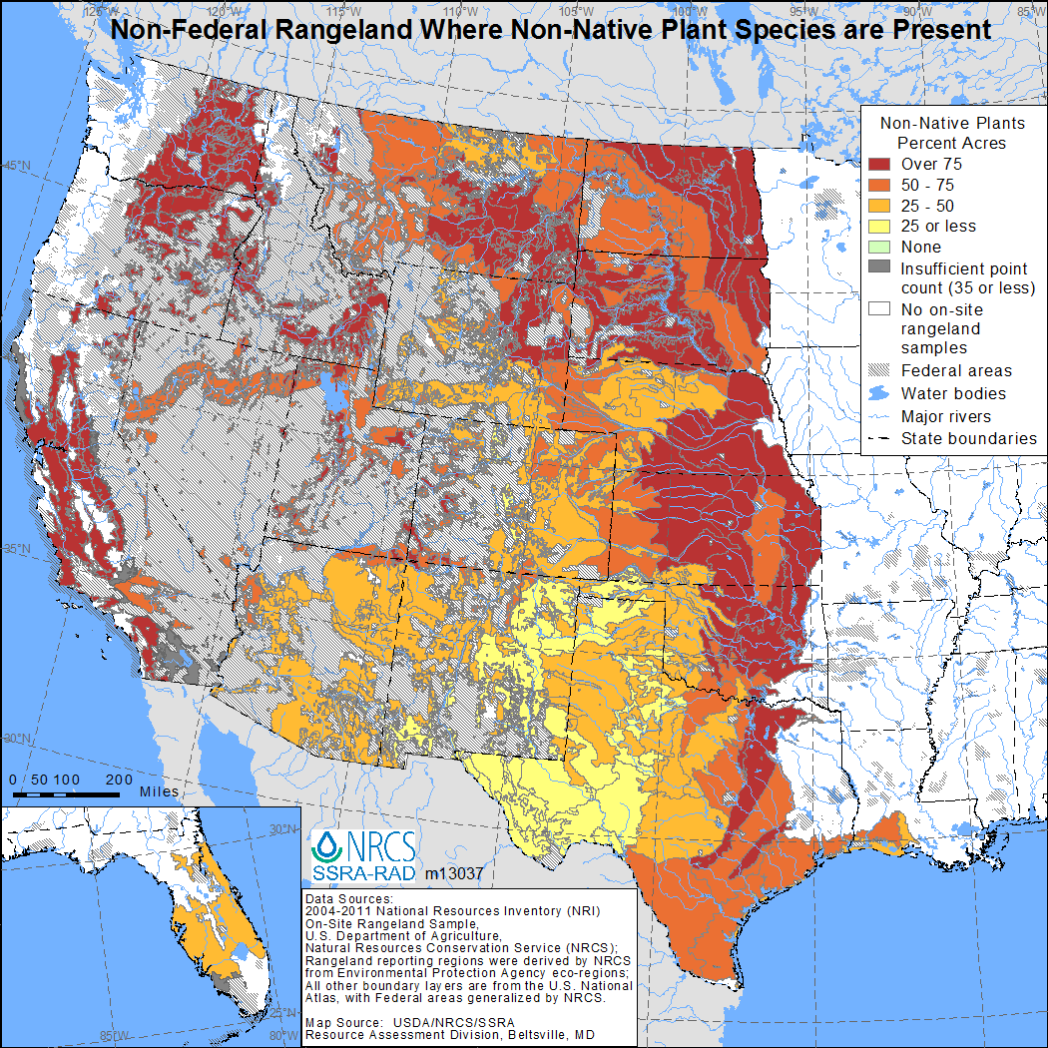
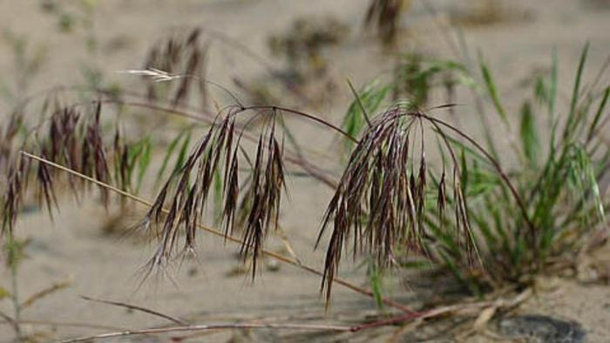
Cheatgrass

Slide 12
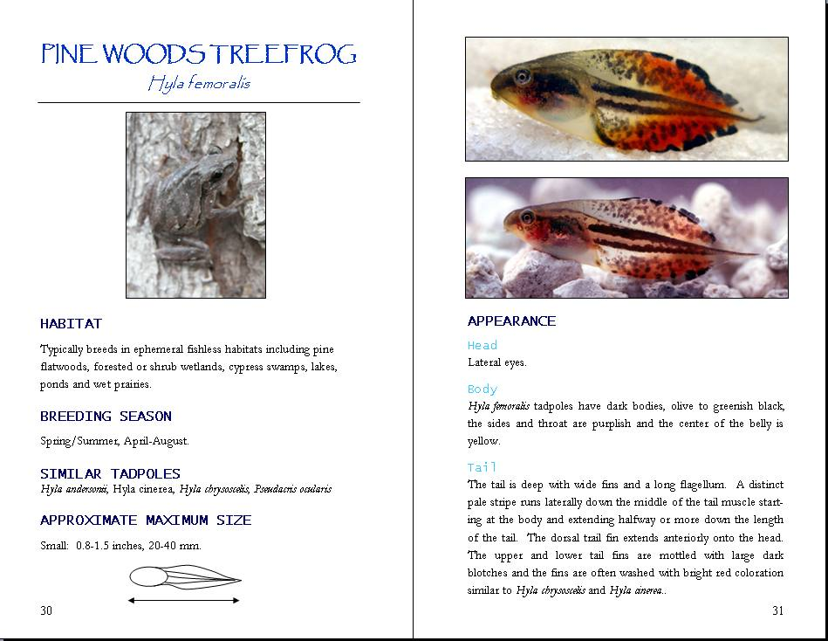
Species Descriptions

Slide 13
While we are outside
Sketch IN DETAIL both a cheat grass plant
When we come back inside you will write the rest of the species description

Slide 15
PTT 06APR2016
Compare and Contrast Native and Invasive Species.
For your Planner: Wildlife Refuge Assignment Due MONDAY.

Slide 16
Bromus techtorum Cheatgrass
Latin Name, Common Name
Picture
Habitat
Life History
Range Map
Interesting Facts

Slide 18
PTT 08APR2016
List 2 things you learned yesterday.
What was your favorite part of the Wildlife Refuge?
Planners:
Wildlife Refuge Assignment due MONDAY

Slide 19
Wildlife Refuge Assignment
2 Species Descriptions (1 Native, and 1 Invasive Species)
Latin Name, Common Name
Picture
Habitat
Life History
Range Map
Interesting Facts
1 Descriptive Writing

