Slide 1
PTT 18APR2016
How does a message travel from the brain to the arm?
How is the message communicated between the chain of neurons?
Planners: OAJ #24 Due Friday
Learning Goals:
I can read collaboratively to understand the causes and treatments of brain damage.

Slide 2
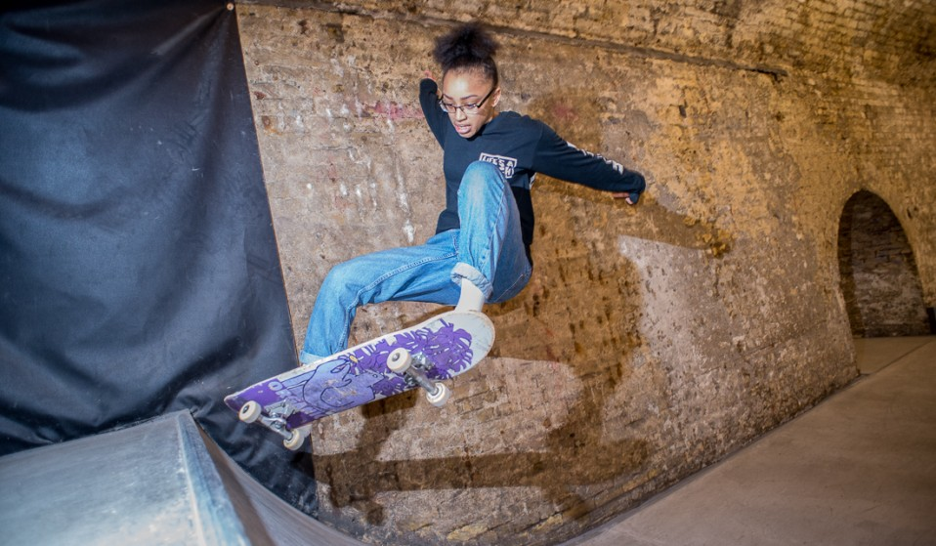
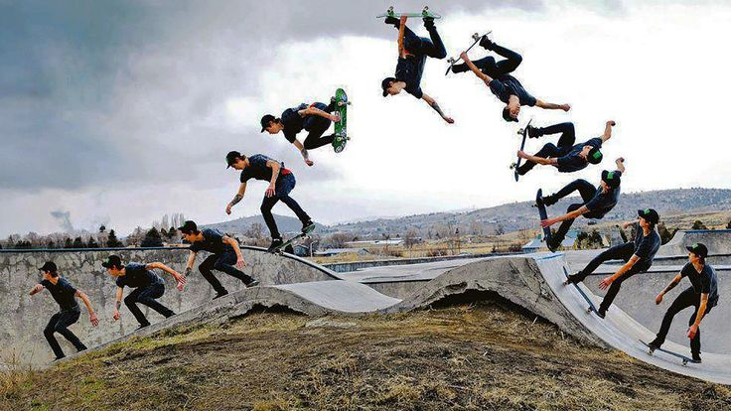
Explain what happened in the nervous system of the skateboarder in the accident
We studied the nervous system cells and how the cells communicate in a normally functioning nervous system

Slide 3
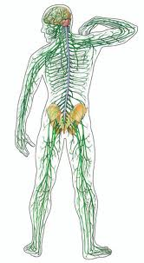
Nervous System
To respond to stimuli, maintain homeostasis, and store memories
Nerve Cells
Sensory neurons, Inter neurons, Motor neurons
Brain
Central Nervous System
Peripheral Nervous System
Somatic and Autonomic

Slide 4
Collaborative Reading!!
Clunks: words you don’t understand
Gist: The main idea
Respond to the prompts on your paper for Part 1 and Part 3.
Part 2 is simply a list of Brain Damage Causes and potential Results. Read Part 2, There is no questions for it.

Slide 6
PTT 19APR2016
How can you get a brain injury?
What are the symptoms?
How can you prevent brain injuries?
Planner: OAJ #24 Due Friday
Learning Goal:
I can explain the difference between short term and long term memories.
I can apply memory techniques to remember more things in the boxes.

Slide 8
Nervous System
To respond to stimuli, maintain homeostasis, and store memories
Nerve Cells
Sensory neurons, Inter neurons, Motor neurons
Brain
Central Nervous System
Peripheral Nervous System
Somatic and Autonomic

Slide 9
Memory
Process of encoding, storing, and recalling information.

Slide 10
Memory
Encoding: making sense of incoming information

Slide 11
Memory
Encoding: making sense of incoming information
Storing: creating a record in the short or long term memory

Slide 12
Memory
Encoding: making sense of incoming information
Storing: creating a record in the short or long term memory
Recalling: calling back the information in response to a cue or for use in a process

Slide 13
Short Term Memory
Very recent memories
What you had for breakfast
A book you recently read
Things you observed on the walk to school
Demonstration.

Slide 14
Long Term Memory
Memories that are long lasting
An event in your past
A cultural event
Memories that last for months to years
We are going to practice techniques to push information from your short term memory into your long term memory.

Slide 15
Memory Techniques
Visualization:.
Chaining:
Give the information a context
Chunk the information
Phrase the information

Slide 16
Ticket out the door
Explain the difference between short term and long term memories.
PROVIDE AN EXAMPLE of how you will use the memory boosting techniques to remember information for an upcoming test.

Slide 18
Memory
Encoding: making sense of incoming information
Storing: creating a record in the short or long term memory
Recalling: calling back the information in response to a cue or for use in a process
Short term Memory Long Term Memory
Recent Memories Longer lived Memories

Slide 19
Memory
Encoding:
Storing:
Recalling:
Short term Memory Long Term Memory

Slide 20
Ticket out the door
Explain the difference between short term and long term memories.
PROVIDE AN EXAMPLE of how you will use the memory boosting techniques to remember information for an upcoming test.

Slide 22
PTT 20APR2016
Compare and contrast short and long term memory.
What are 2 strategies you learned yesterday to increase memory?
Planners: OAJ #24 Due Friday, 7B Turn in your Progress Reports – It is a Test Grade
Learning Goals:
I can interpret Brain Injury Data
I can develop a research question, hypothesis, and method to test my question

Slide 23
Nervous System
To respond to stimuli, maintain homeostasis, and store memories
Nerve Cells
Sensory neurons, Inter neurons, Motor neurons
Brain
Central Nervous System
Peripheral Nervous System
Somatic and Autonomic

Slide 24
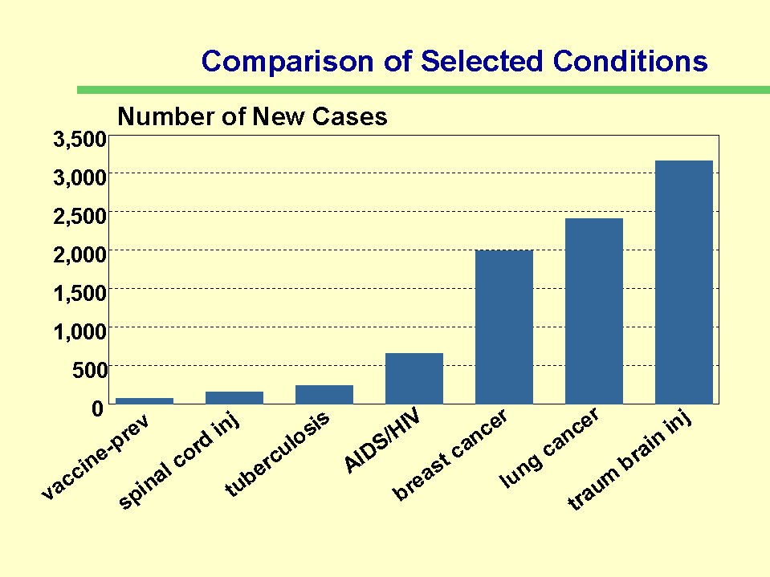
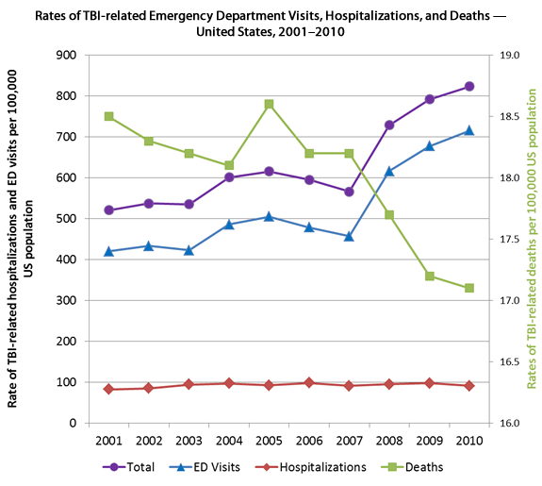
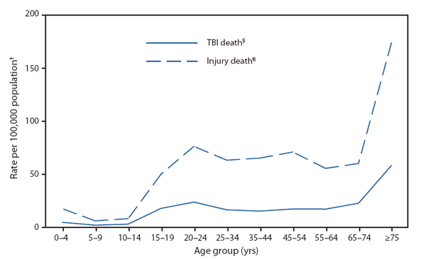

Slide 25
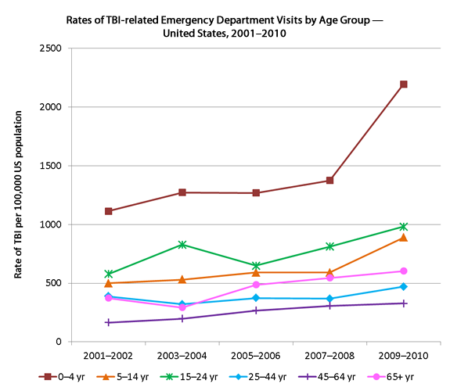
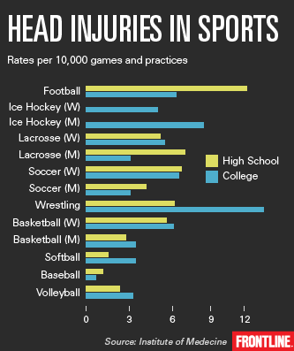
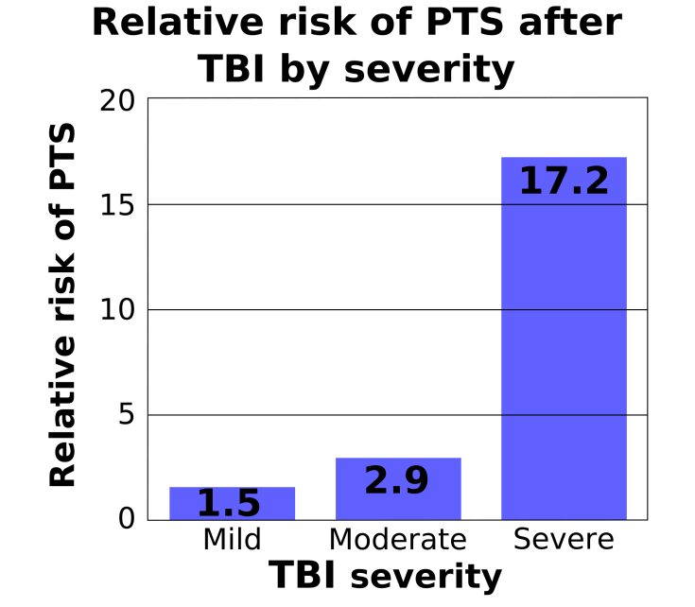

Slide 27
PTT 21APR2016
What does your body do to prevent getting sick?
Planners: OAJ#24 Due Friday
Learning Goals:
I can explain the first and second lines of defense against pathogens
I can prepare an informative presentation about part of the immune response

Slide 28
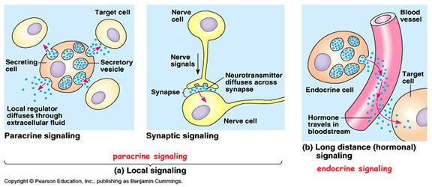
Cell Communication Review

Slide 29
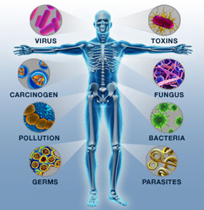
Immune System
A group of defenses against pathogens
Pathogens can:
Cause harm
Cause disease
Cause illness

Slide 30
Two Lines of Defense
First Line
External: skin, respiratory, digestion, and circulatory system
Internal: Mucus, cilia, white blood cells, and inflammation (swelling)
Second Line (Immunity)
Antibody fights antigens
Active Immunity
Vaccination (passive Immunity)

Slide 31
Your Group Presentation
Internal First Line
Inflammation
Specific Immunity
Active Immunity
Vaccination
You must include a visual demonstration!
Page 652 to 655 and your notes are good resources

Slide 33
PTT
What are the first and second lines of defense of the immune system?
Turn In: OAJ #24
Learning Goals:
I can apply my peers’ feedback to create a informative and interesting presentation.

Slide 34
Your Group Presentation
Internal First Line
Inflammation
Specific Immunity
Active Immunity
Vaccination
You must include a visual demonstration!
Page 652 to 655 and your notes are good resources

