Slide 1
Warm-Up 05AUG2015
On the note card in front of you write the following information:
Your Name and Grade Group
A contact person that Ms. Leigh can call in case of emergency or complements
Draw, sketch, or write your favorite animal (can be real or imaginary)

Slide 3
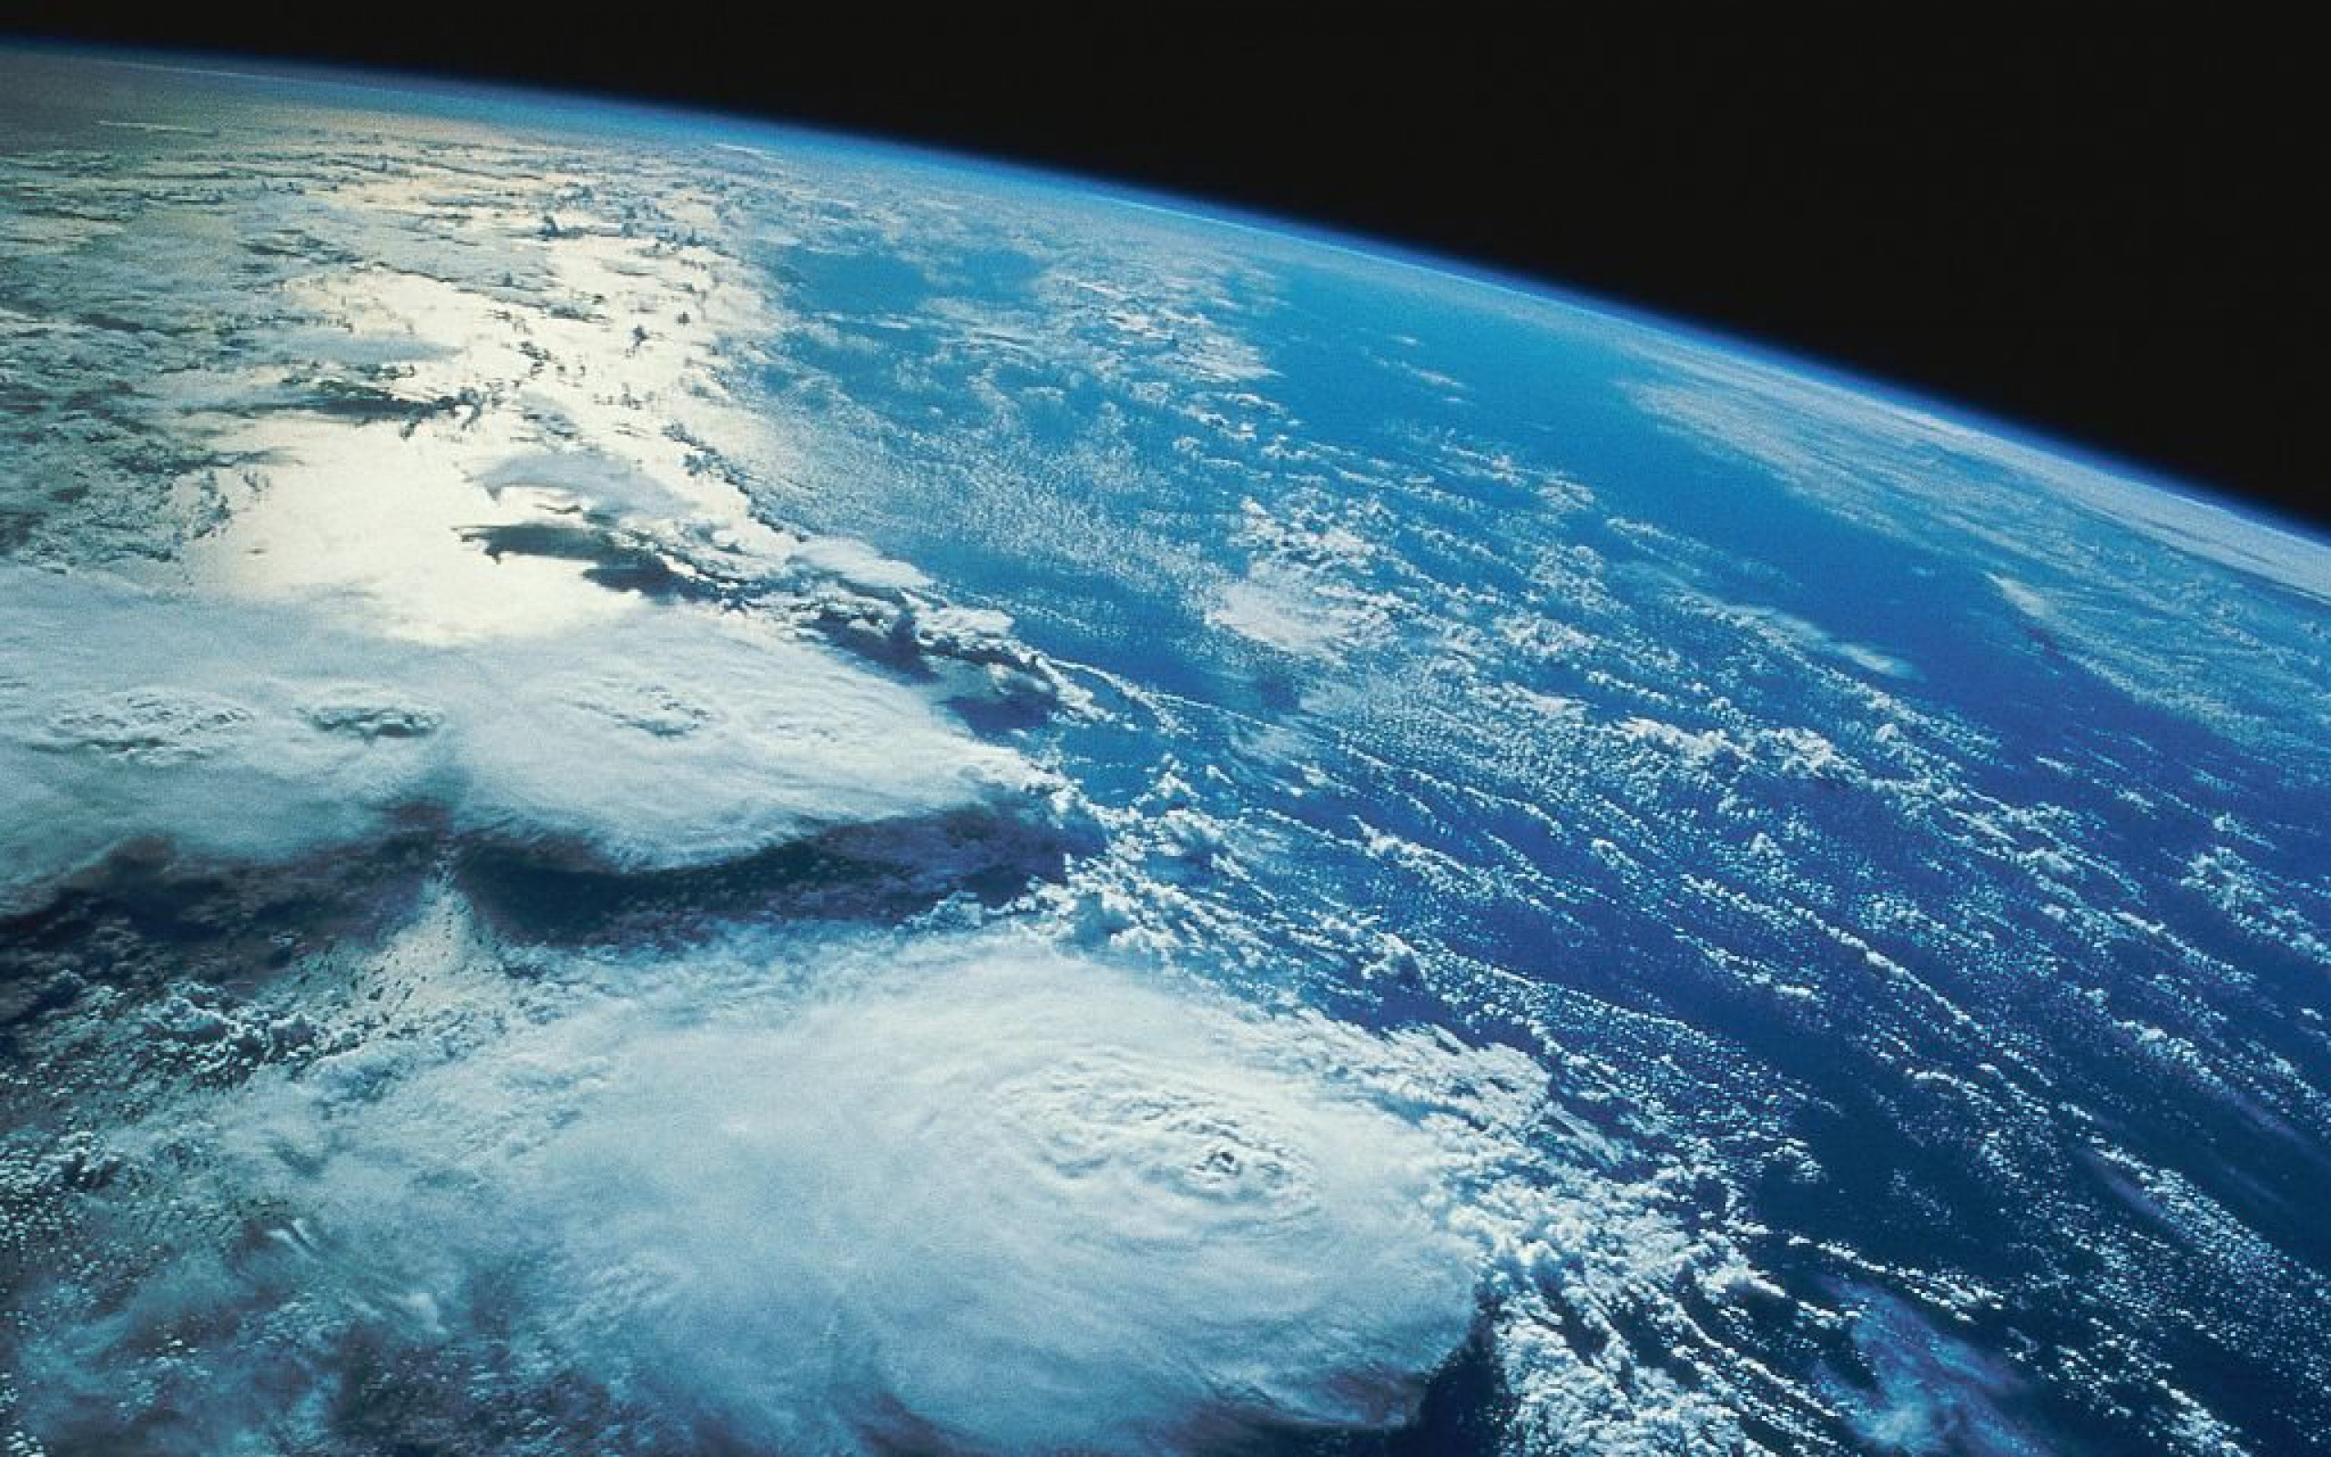
Everything is Connected!

Slide 4
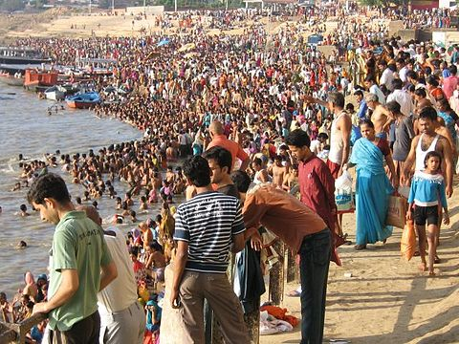
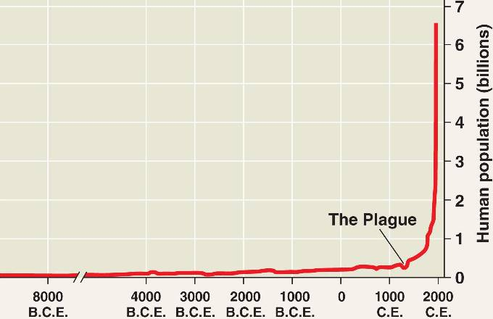

Slide 5
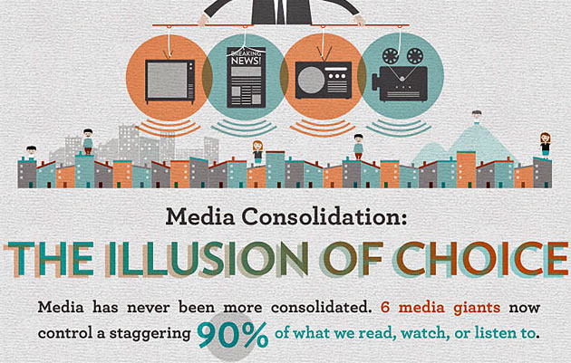

Slide 6
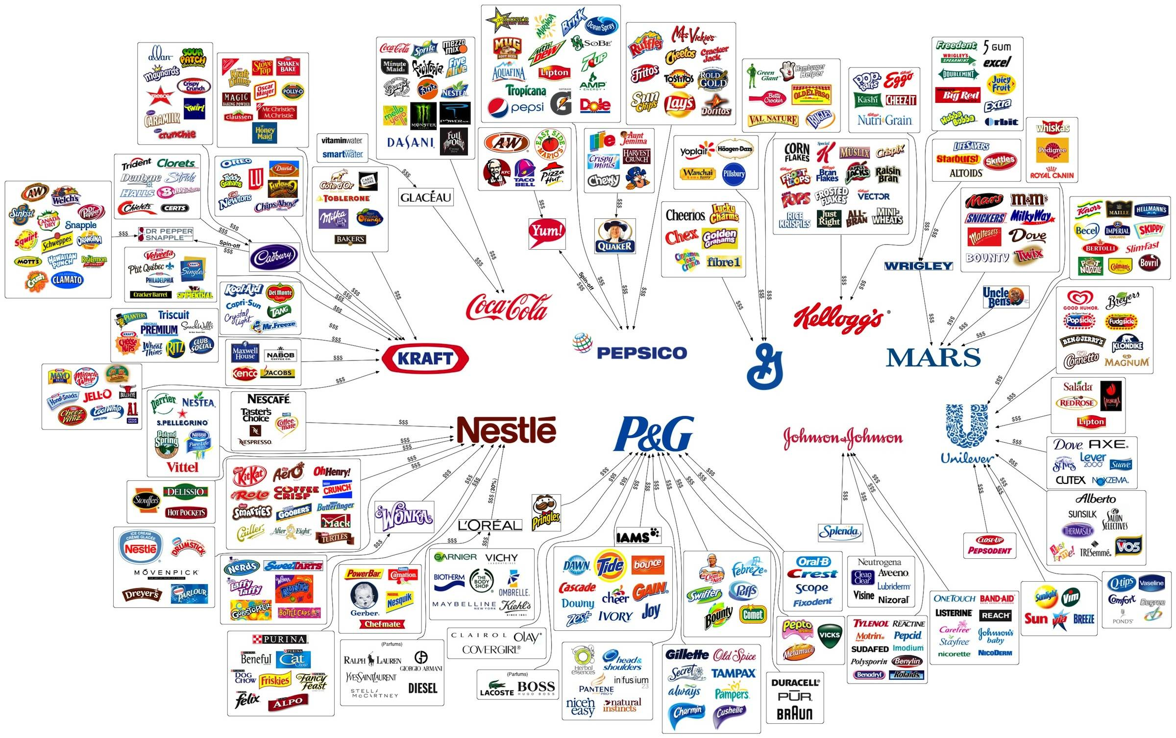

Slide 7
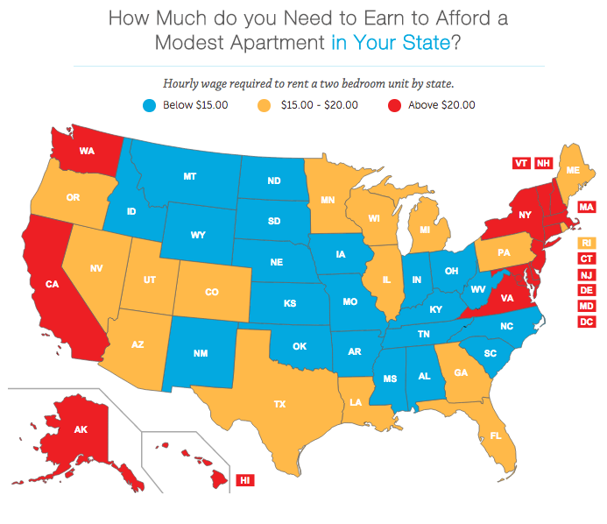

Slide 8
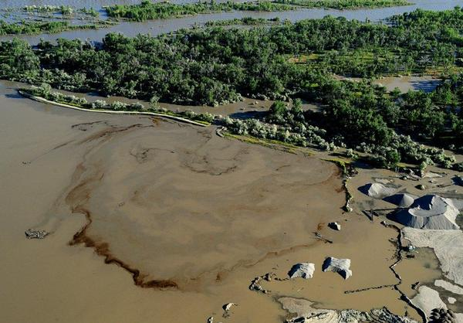
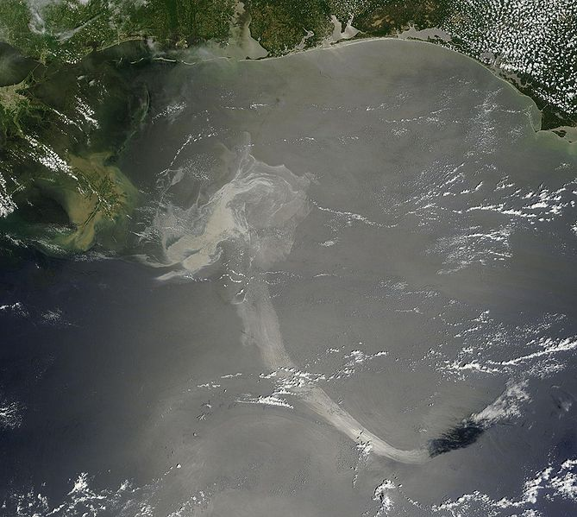

Slide 9
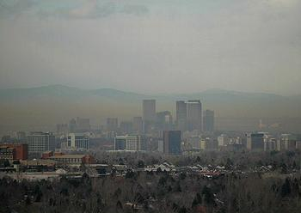
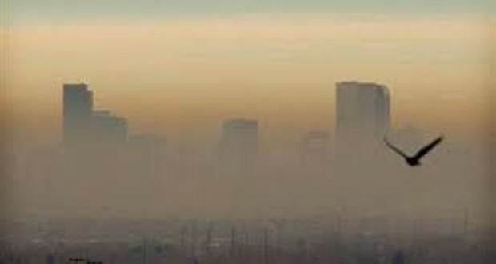

Slide 10
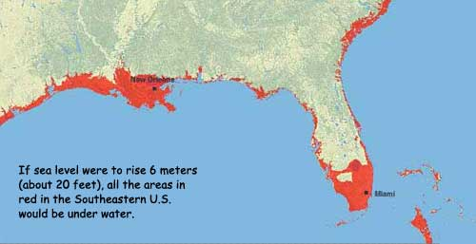
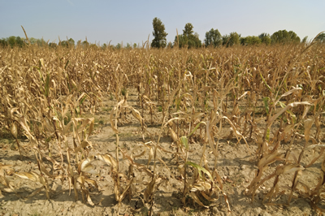

Slide 11
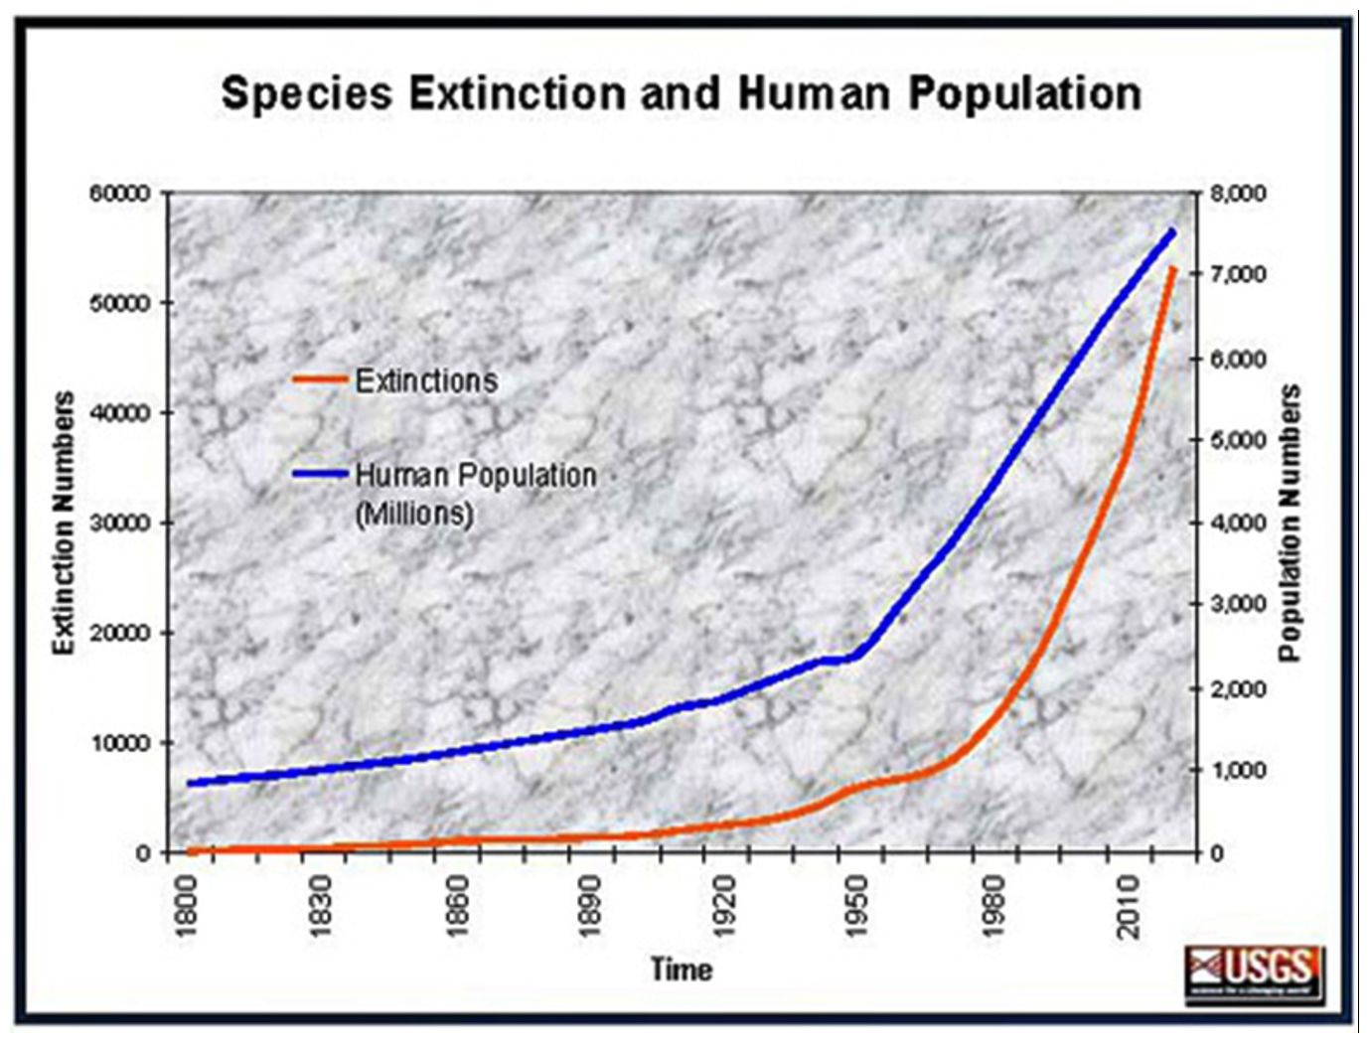

Slide 12
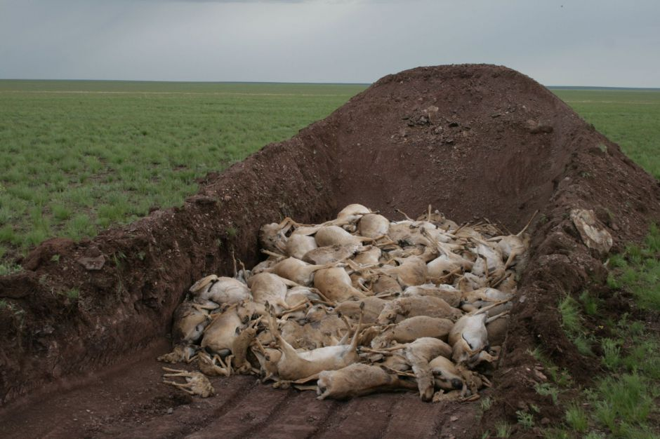
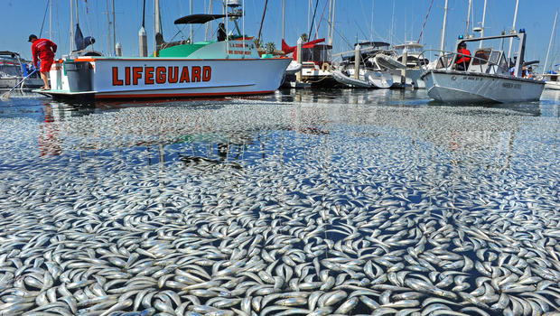
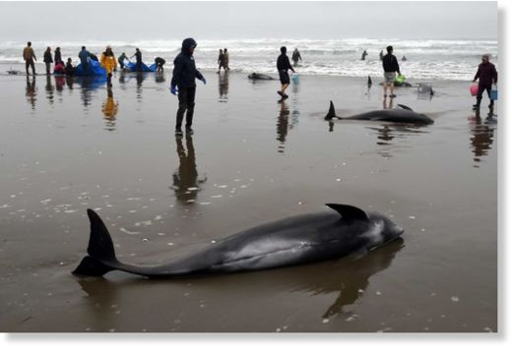

Slide 13
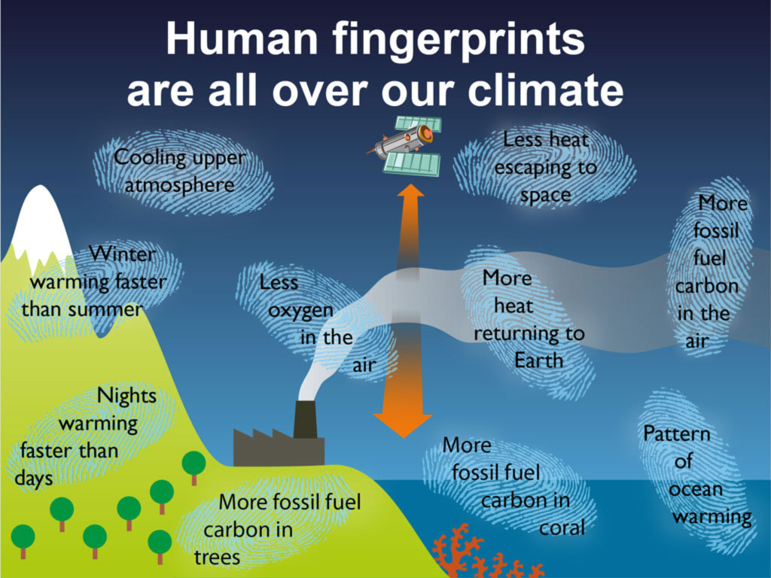

Slide 14
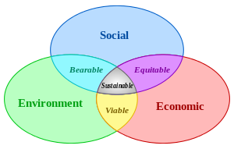
Sustainable Solutions

Slide 16
Warm-Up 05AUG2015
Climate change is the biggest issue to effect the human species.
List all the things you know about climate change?
What time frame are we looking at to see the impact of climate change on our daily lives?

Slide 17
Logistics
Warm-ups are worth 10 points, every 2 weeks
Please read the Economics reading in it’s entirety by Wednesday (8/12) next week
Please complete the summer assignment (over the summer…)
You will be getting more assignments – Get Ready

Slide 18
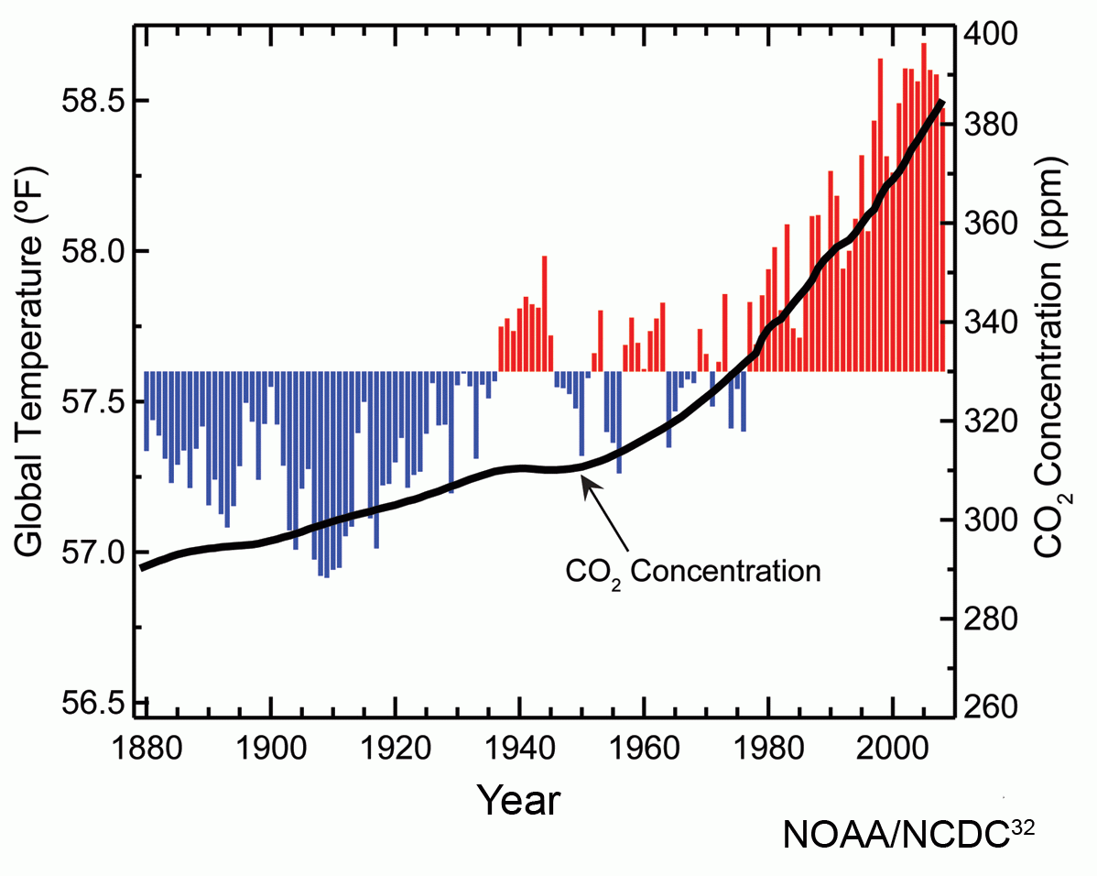

Slide 20
Warm-Up 06AUG2015
What values influence your behavior?
OR
What values do you demonstrate when you make certain choices?
Examples?
Agenda:
“Food for thought” discussion
The Lorax
Time to work on the Lorax Questions

Slide 21
Logistics
If I was to have the WiFi password could you do research on your phones?
Schedule of due dates posted outside the door.
National Pass Rates

Slide 22
Food for thought…
Do your values align with your parents?

Slide 23
Food for thought…
What values exist in our economic system?
HOW do you know this?

Slide 24
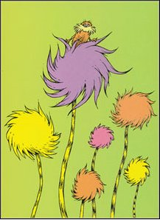
What does it mean to act within an ethical code?

Slide 25
What happens when the ethical code conflicts with the “accepted norms” for behavior?

Slide 26
While we watch the Lorax, think ponder what the characters are valuing and how their behavior reflects that.
Who (or what values/concepts) in real life might the characters represent?

Slide 28
Warm-Up 07AUG2015
Who did the lorax and the once-ler represent?
What did the truffula tree repesent?

Slide 29
Economics ⬄ Ecology
Economic systems are rooted in AND limited by ecological systems
Biotic + Abiotic = Ecologic System

Slide 30
Economic System in a picture… (Capitalism)
Goods and
Services
Social Values
(laws)
Natural Resources

Slide 31
Economic System
social institution through which goods are produced, distributed and consumed to satisfy people’s needs and wants, EFFICIENTLY

Slide 32
Economic System in a picture…
Goods and
Services
Social Values
(laws)
Natural Resources

Slide 33
Types of capital
Natural capital: earth’s natural processes
Human capital: people’s physical and mental talents
Manufactured: machinery, equipment, factories

Slide 34
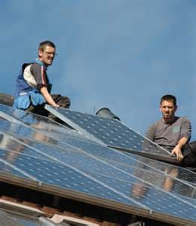
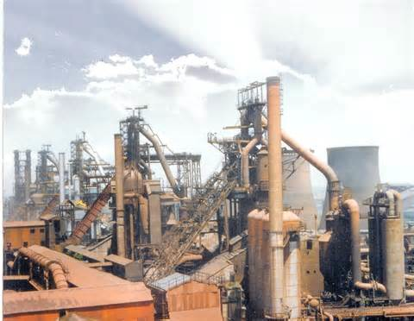
Think natural + human capital + manufactured capital = tradable goods and services

Slide 35
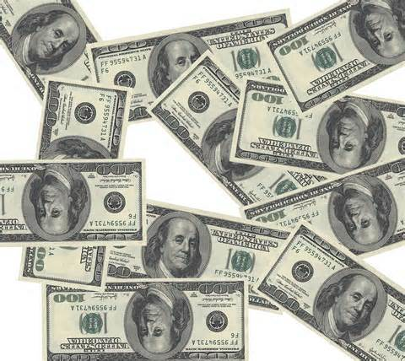
Think natural + human capital + manufactured = tradable goods and services

Slide 36
Economic system in a picture…
Social Values
(laws, trade systems, regulations)
Goods and
Services
Natural Resources

Slide 37
“Free Market” economy
interaction of DEMAND and SUPPLY and PRICE
economists believe that an economic system based on private ownership without government interference is the best way to solve problems
In this system companies that produce goods and services are driven by consumer choice.

Slide 38
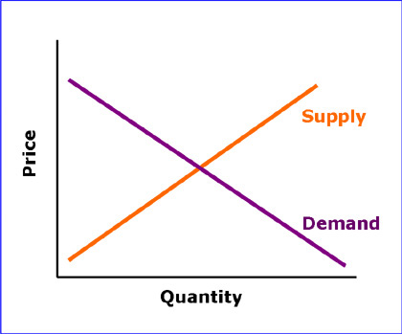
Supply and demand curves intersect at market price equilibrium point

Slide 40
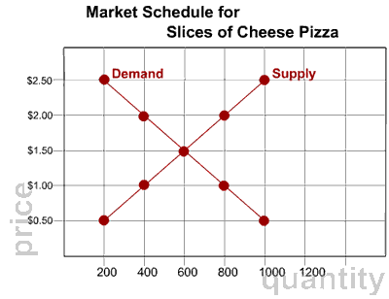

Slide 41
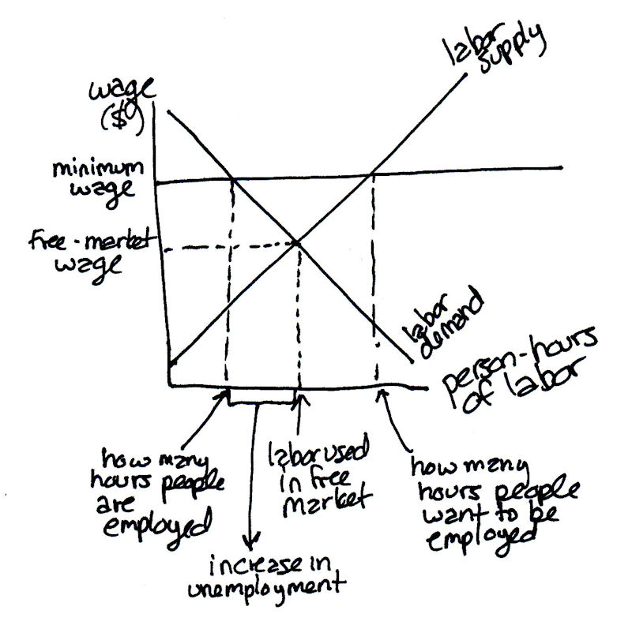

Slide 42
Economic system in a picture…
Social Values
(laws, trade systems, regulations)
Goods and
Services
Natural Resources

Slide 43
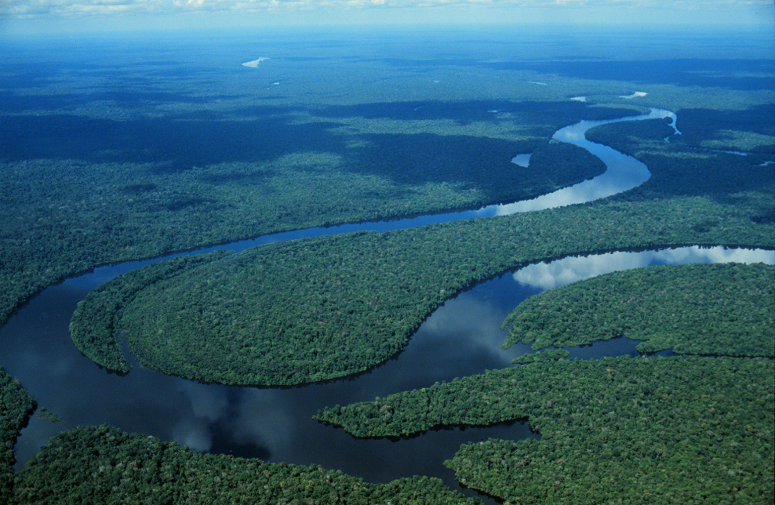
How many ways can this have “value”?

Slide 44
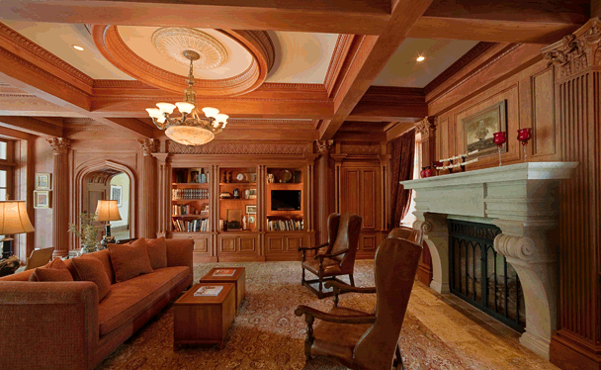
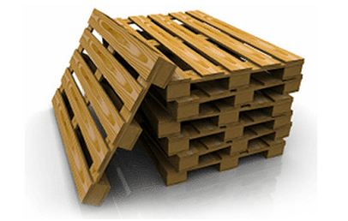

Slide 45
High throughput economics
Continued increase of flow of materials and resources is needed to continue economic growth
Waste ends up in planetary sinks (air, soil, water, organisms)
Draw on board (pg 634)

Slide 46
The worth of anything (natural, human, and manufactured goods) is based solely on its ability to be traded on a market.
Open-access resources, like air, the ocean, forests, freshwater, are available to all are not traded on the market.
These have NO value in any state of existence (good or bad) therefore there is no incentive besides government regulation to promote good behavior = MARKET FAILURE

Slide 47
Governments intervene to correct market failures…………
national security
education
economic safety net
civil and property rights
worker health
protect natural capital
manage public land resources

Slide 48
Neoclassical Economics
Marshall and Friedman (Chicago school of Economics)
Assume that growth is unlimited and that growth is essential to maintain a growing economy
Natural capital can be replaced with substitutes
Issues with these assumptions?

Slide 50
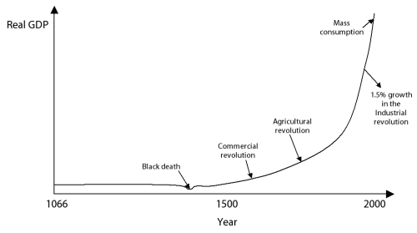
“Biggering, biggering, and biggering” (economic growth is unlimited)

Slide 51
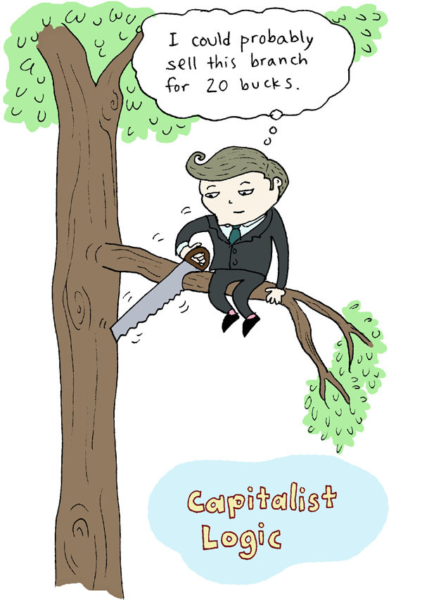

Slide 52
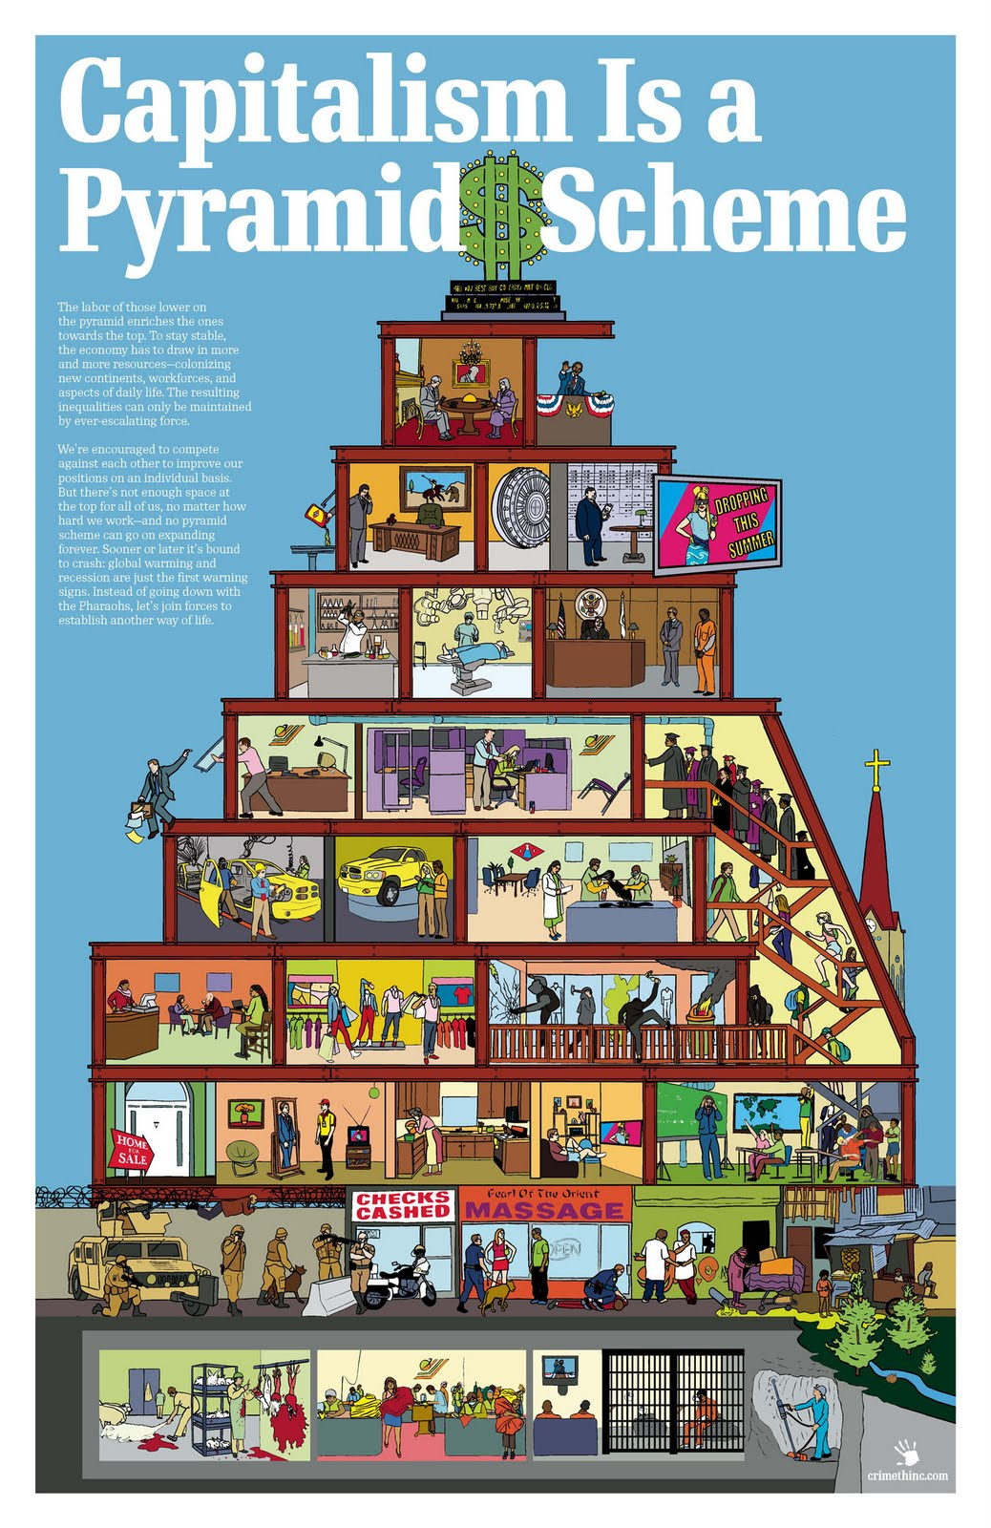
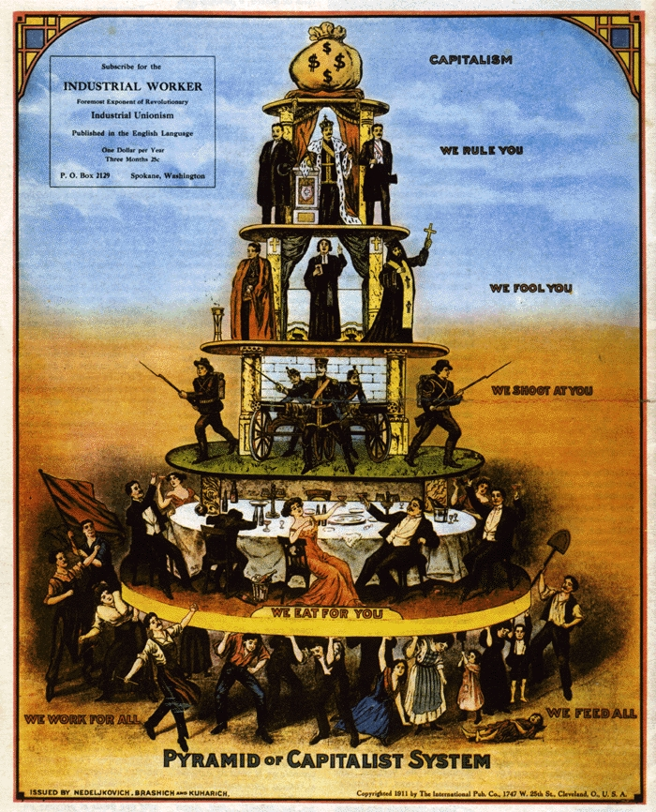

Slide 54
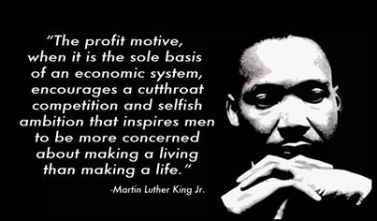
What does Dr. MLK Jr. mean?

Slide 55
Ecological economists
Herman Daly and Robert Costanza
resources limited, no waste
encourage environmentally beneficial and sustainable forms of economic development
harmful environmental and health effects of production of goods should be included in price (full cost pricing
Issues with these assumptions?

Slide 56
Non – use value of natural resources/ ecological services
Existence value
Aesthetic value
Bequest or opinion value

Slide 57
Strategies to fulfill goals…
Monitor economic and environmental health /enforce laws

Slide 58
Cost Benefit analysis
use uniform standards
clearly state all assumptions used
include estimates of ecological services
estimate long-term/short benefits and costs
summarize range of estimated costs and benefits

Slide 59
Strategies to fulfill goals…
Eco-labeling and certification
Phase in subsidies/tax breaks for environmentally beneficial goals
Tax shifting (pollution and waste
Instead of income taxes)

Slide 60
Full-Cost Pricing
Market Price/ Direct Price does not include the Indirect or External costs of harm to environment or human health (hidden cost)
Ex. failure to include climate change in the prices of fossil fuels

Slide 61
Reduction of poverty
GRAMEEN banks in Bangla Desh

